Slide 1


Personalized Health and Fitness Recommendation System

Slide 2

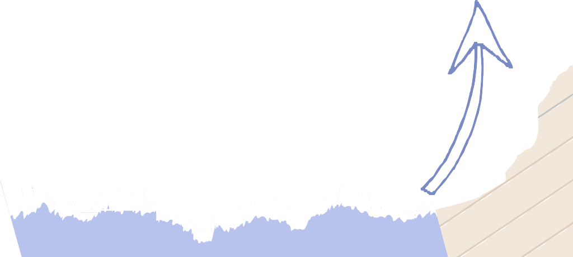
Introduction
Problem Statement:
A lot of people struggle with making personalized health and fitness plans that fits their goals, physical attributes, or health conditions.
Objective:
This project tries to build a machine learning-based recommendation system to make exercise and diet plans more personal.
Solution Overview:
Used Random Forest models to predict exercises and diets based on user inputs.
Deploy the system in a web application for real- time recommendations.

Slide 3
Workflow Overview
s
Data collection
Data Preprocessing
Model Training
Data Cleaning
Model Evaluation
Web Deployment

Slide 4
Data Collection
Source: The dataset was taken from Kaggle, which is one of the leading platforms for datasets and machine learning projects.
Dataset Focus: Contains information about gym and diet recommendations according to an individual’s BMI
Key Attributes: Includes Demographic data, health metrics and personalized fitness and diet plans.
Purpose: Collected to help users create a personalized diet and fitness plans.

Slide 5
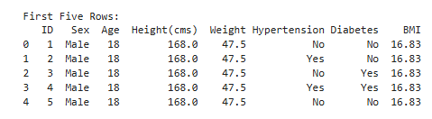
Data Preprocessing
In the preprocessing stage, ID column was removed because it didn’t hold any meaningful relevance to the predictions.
Key columns include:
Sex: Gender of the individual (e.g., Male/Female).
Age: Age of the individual in years.
Height (cms): Height of the individual in centimeters.
Weight: Weight in kilograms.
Hypertension and Diabetes: Indicate if the individual has these conditions.
BMI: Calculated Body Mass Index.

Slide 6
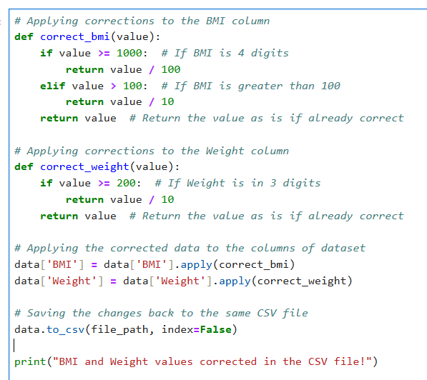
Data Cleaning
Issue Identification: Detected outliners in the dataset where BMI values were in 4 digits and weight values were in 3 digits indicating unrealistic data.
Corrections: Utilized Python function to scale correctly the values of BMI and Weight.
Output: Saved the cleaned dataset to same file for better analysis and model training

Slide 7
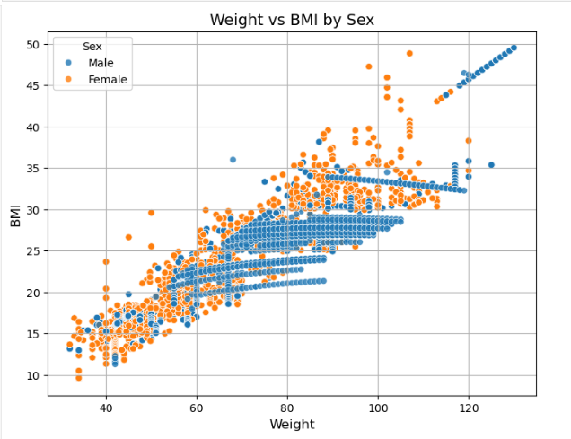
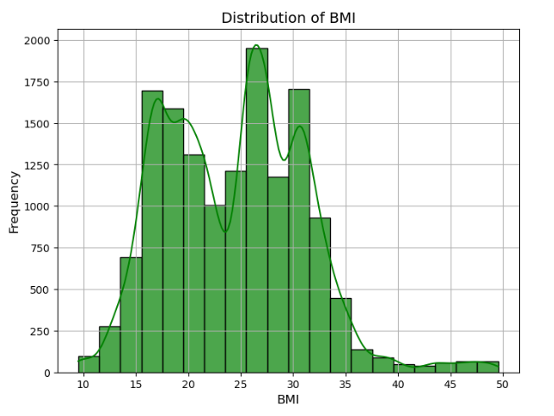
Visualizing Data

Slide 8
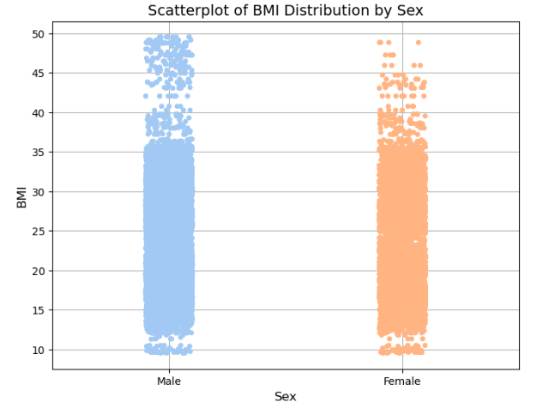
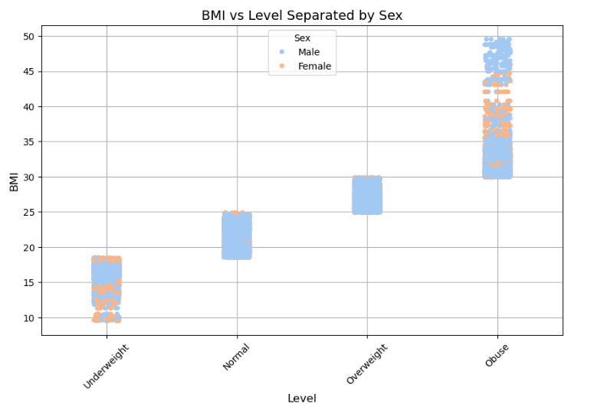
Visualizing Data

Slide 9
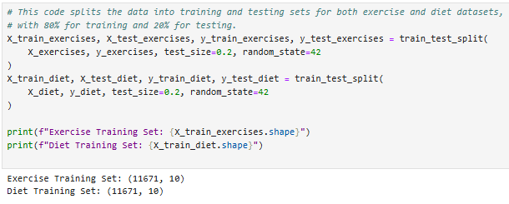
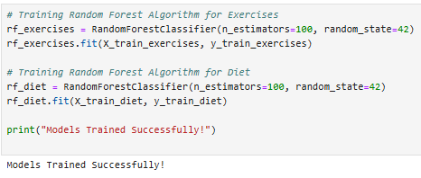
Model Training
Algorithm used: Used Random Forest Algorithm to train two models for exercises and diet recommendation each.
Training Process: Split the data into training and test sets and trained the models using user data features.
Model Deployment: Successfully trained and saved the models for real-time prediction in the web application.

Slide 10
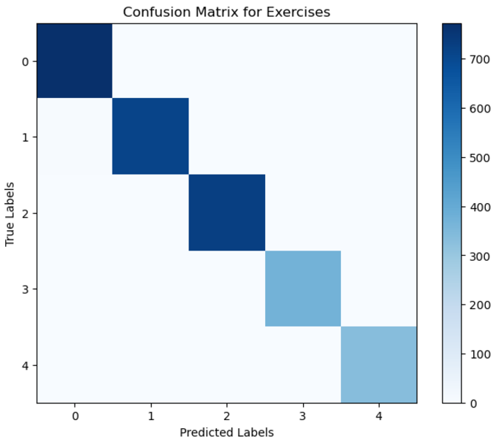
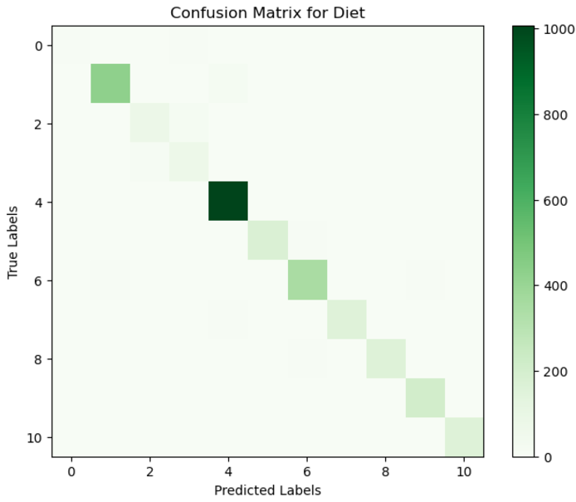
Model Training
Confusion Matrix of both the models

Slide 11
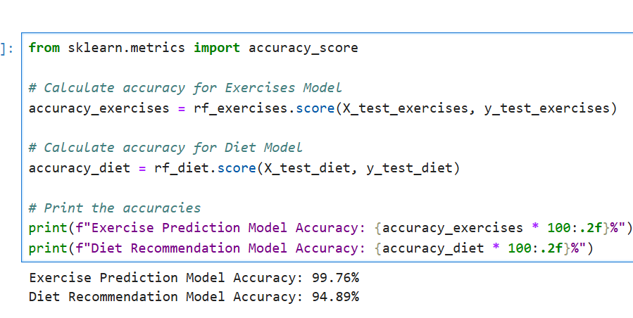
Model Evaluation
Accuracy Calculation: Evaluated the performance of exercise and diet models by calculating their accuracy on test datasets.
Models Accuracy: Achieved a high accuracy rate which shows effective exercise and diet recommendations.
Metric Significance: Accuracy provides an overview of the model’s effectiveness in predicting correct labels.

Slide 12
Web Deployment
Website Functionality: Developed a user-friendly web application where users can input personal health parameters.
Prediction Output: Upon that user input, a new web page renders with the personalized predictions for exercise and diet plans.
User Experience: Designed for simplicity and accessibility, ensuring seamless interaction for users seeking fitness and diet advise.

Slide 13
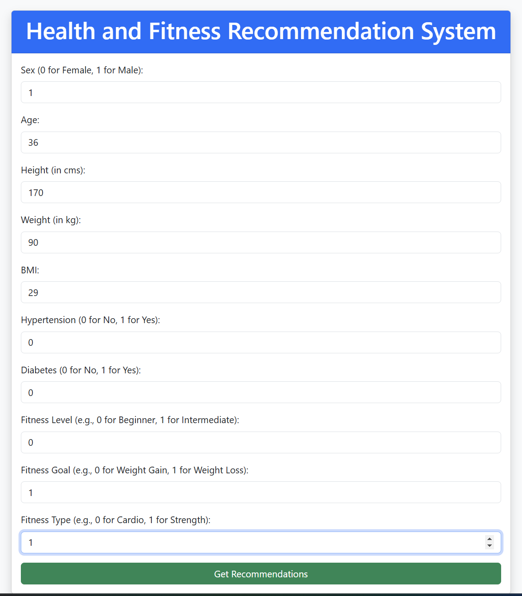
Web Deployment
Personal Health Data Input for Personalized Recommendations

Slide 14
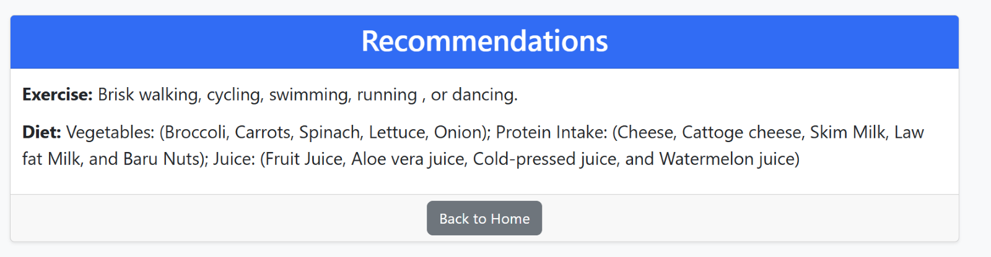
Web Deployment
User Input-Driven Fitness and Diet Recommendations

Slide 15

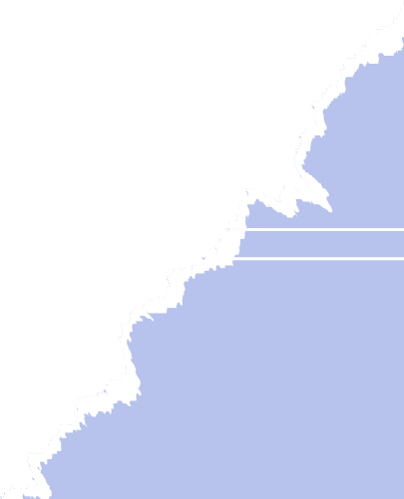
Thanks!
Do you have any questions?

