Slide 1
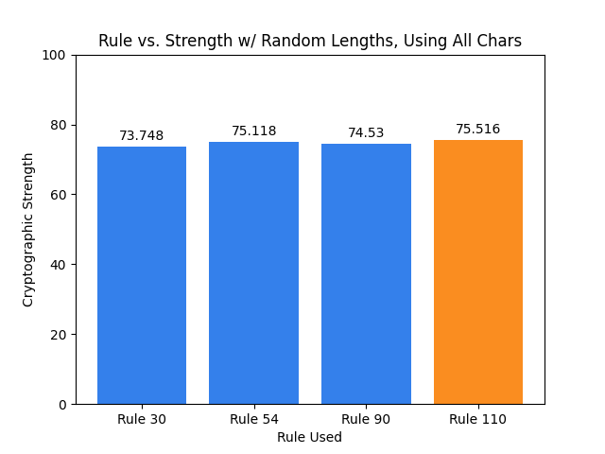
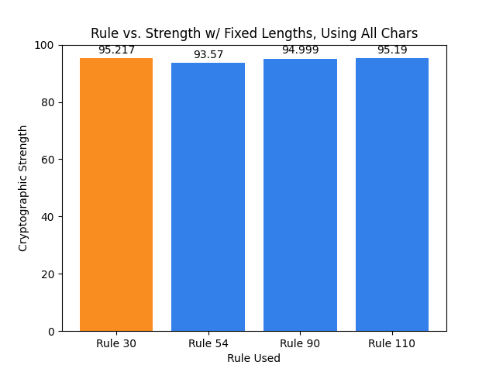
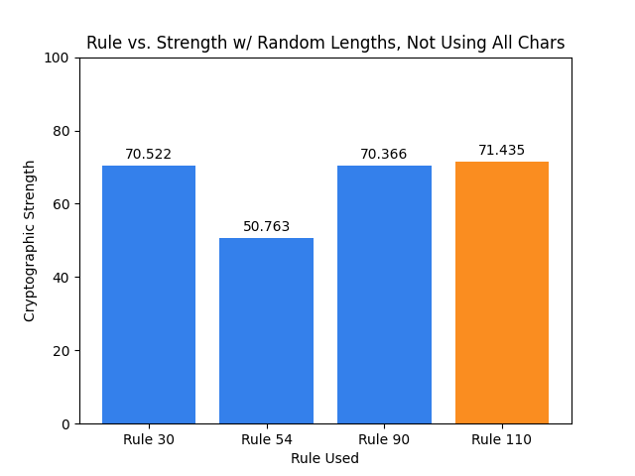
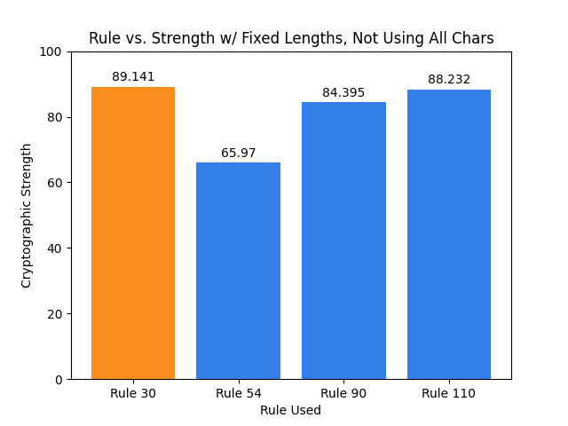
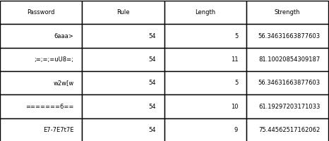
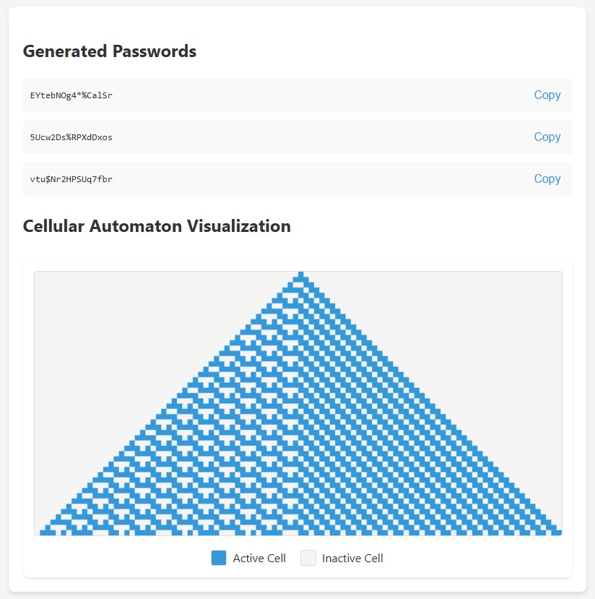
Cellular Automata & Password Generation
By: Brian Merino, Bhumir Patel, David T. Wilkey
Problem Statement / Motivation
Can cellular automata be successfully used to generate secure passwords?
How does the CA rule effect the strength of the generated password?
Experiment Methodology
Given a cellular automata, obtain an integer from chunks of bits in the automata.
Use this integer to pick a character from the pool of possible characters.
Repeat the process to build a password of the desired length.
Evaluate strength and compare performance across different well-known rules.
Rules Used
Rule 30: Highly chaotic and pseudo-random
Rule 54: Localized order with some complexity
Rule 90: Complex symmetry and fractal patterns
Rule 110: Very complex, yet structured interactions
Results
A wide variety of passwords were produced ranging from very weak to very strong.
Top performers were Rule 30 and Rule 110.
With using all characters
Without using all characters
Dataset Example
Visualization Example (Rule 110)
Conclusion
Cellular automata with a high degree of chaos and/or complexity reliably produce the strongest passwords.
Ensuring adequate length and a diverse character set significantly improves password strength across all rules tested.
Consider use case limitations due to potentially reproducible results.

Slide 2
Title of Project
Student Name(s)

