Slide 1
BHUMISVARA K
2021503704
CT Dept. MIT, Anna University
TNSDC-Gen AI Project

Slide 2
PROJECT TITLE
WINE QUALITY
PREDICTION

Slide 3


AGENDA
Data collection, preprocessing, and feature engineering
Model selection, training, and evaluation
Interpretation of results
Deployment and integration
Future considerations for improvement and scalability
3/21/2024 Annual Review

Slide 4

PROBLEM STATEMENT
Objective: Develop a predictive model to assess the quality of wines based on chemical and sensory features.
Dataset: Contains information on properties such as acidity, sugar content, pH level, aroma, and taste.
Goal: Build a reliable model for predicting wine quality scores.
Applications: Aid winemakers, distributors, and consumers in decision-making regarding production, selection, and consumption of wines.
Scope: Model should handle both red and white wines.
Key Metrics: Accuracy and generalizability are crucial for practical application within the wine industry.

Slide 5

PROJECT OVERVIEW
Data Collection and Preparation:
Gather customer data including demographics, transaction history, and interactions.
Clean and preprocess the data for training the Artificial Neural Network (ANN).
Exploratory Data Analysis (EDA):
Analyze the data to uncover patterns and relationships in customer wine selection.
Explore correlations between variables to understand their impact on wine preferences.

Slide 6
PROJECT OVERVIEW
Model Selection and Training:
Create or transform features to enhance predictive power.
Choose a machine learning model suitable for wine prediction.
Train the selected model using prepared data to predict customer wine preferences.
Results and Deployment:
Evaluate the model's performance using metrics such as accuracy.
Deploy the trained model for real-time predictions.
Implement targeted retention strategies based on model predictions to enhance customer engagement.
Conclusion and Future Work:
Summarize project findings and key insights.
Discuss potential areas for future research and improvement of the ANN model.
Explore additional features or data sources to further enhance model accuracy and effectiveness.

Slide 7

WHO ARE THE END USERS?
Marketing Teams
Customer Service Teams
Product Development Teams
Management and Executives
Sales Teams
3/21/2024 Annual Review

Slide 8

MY SOLUTION AND ITS VALUE PROPOSITION
SOLUTION:
Develop a machine learning model using artificial neural networks (ANNs) to predict customer wine quality based on customer data.
Utilize Python programming language with libraries such as TensorFlow or PyTorch for ANN implementation.
Use Colab Notebook for interactive development and documentation of the project.

Slide 9
MY SOLUTION AND ITS VALUE PROPOSITION
VALUE PROPOSITION:
Develop a machine learning model for assessing wine quality based on chemical and sensory features.
Impact: Empowers winemakers, distributors, and consumers with insights for production optimization, inventory management, and informed purchasing decisions.
Benefits: Leveraging advanced algorithms to enhance efficiency, profitability, and customer satisfaction throughout the wine industry value chain.

Slide 10

THE WOW IN MY SOLUTION
The "WOW" factor in my solution lies in its ability to revolutionize how businesses approach marketing and customer engagement. By harnessing the power of artificial neural networks, your solution offers:
Comprehensive Approach: Your project takes a comprehensive approach to customer wine prediction, combining survival analysis techniques, machine learning models, and explainable AI techniques to provide a deep understanding of customer behavior and churn.
Practical Application: By deploying the model as a Flask web app, you have made the insights and predictions easily accessible and actionable for businesses, allowing them to implement targeted retention strategies.
3/21/2024 Annual Review

Slide 11
THE WOW IN MY SOLUTION
Insightful Visualizations: The use of visualizations such as the Kaplan-Meier curve, log-rank test plots, and Shap values in the Flask app enhances the user experience and facilitates better decision-making.
Focus on Lifetime Value: Calculating the expected lifetime value of customers adds a valuable dimension to the analysis, helping businesses prioritize their retention efforts based on the potential value of each customer.
Business Impact: The ultimate "wow" factor lies in the potential business impact of your solution, which can lead to significant cost savings through reduced churn rates and increased customer retention and loyalty.
3/21/2024 Annual Review

Slide 12
MODELLING
Logistic Regression: A simple yet effective model for binary classification, where the output is the probability of a customer churning.
Decision Trees: These models use a tree-like graph of decisions and their possible consequences. They are easy to interpret and can handle both numerical and categorical data.
Random Forest: A type of ensemble learning method that combines multiple decision trees to improve prediction accuracy and reduce overfitting.

Slide 13
MODELLING
Gradient Boosting Machines (GBM): Another ensemble method that builds models sequentially, each new model correcting errors made by the previous ones.
Support Vector Machines (SVM): A supervised learning model that analyzes data for classification and regression analysis.
Neural Networks: Deep learning models that can learn complex patterns in data. They are particularly useful for large datasets with many features.
Survival Analysis: This technique is used to predict the time until an event (such as customer churn) occurs, taking into account censoring and other factors.

Slide 14


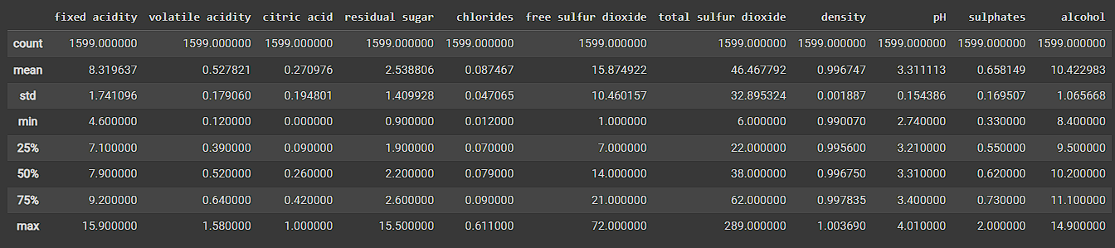
RESULTS
# Predicting Test Set
Descriptive Statistics for Wine Features

Slide 15
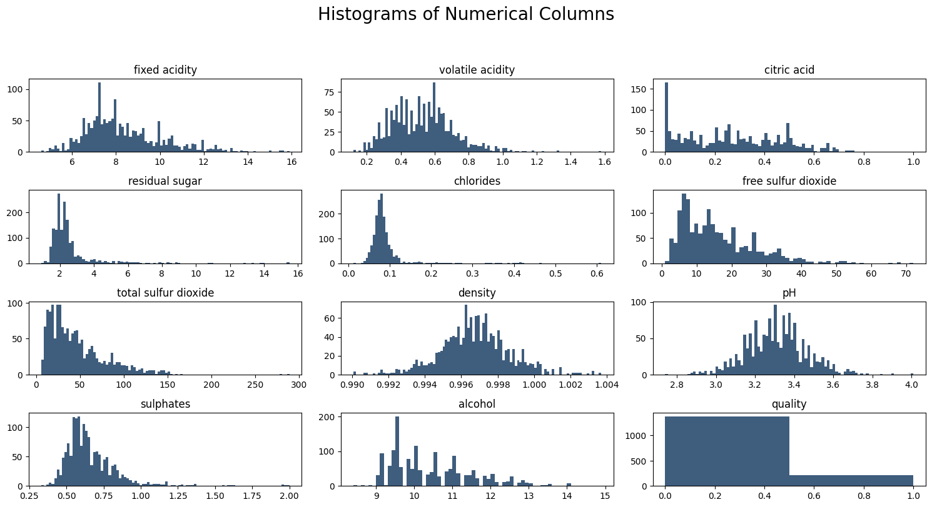
GRAPHS

Slide 16
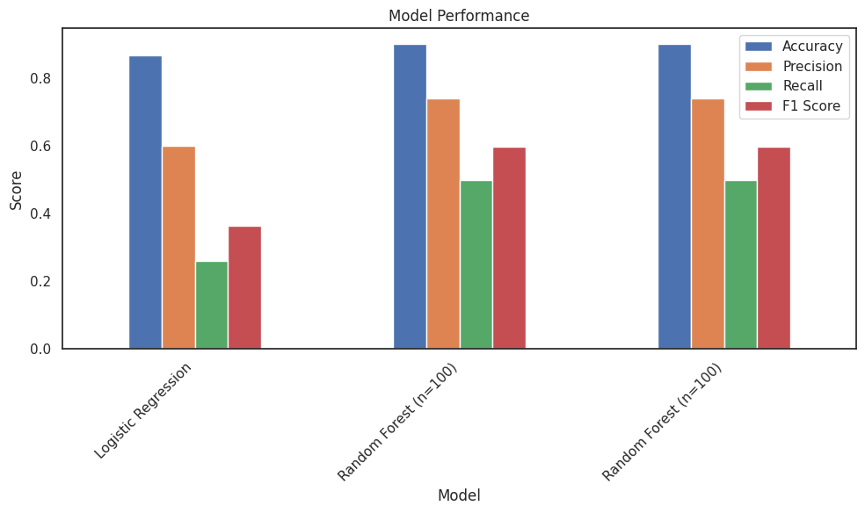
GRAPHS
Demo Link
https://colab.research.google.com/drive/1SS_Ia793D0hzYXXtFS3qHwYZ6MrcwAzR?usp=sharing

