Slide 1
Gramener Case Study
Balaji Ramaswamy
Bhumit Trivedi
Mohandas Amarnathan
Raunak Mukhia

Slide 2
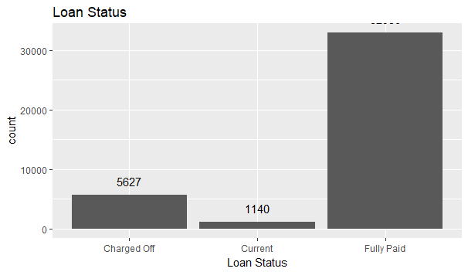
Metadata Summary: Variables considered in analysis
Categorical variables | Numerical Variable
Term | Loan Amount
Grade and Sub Grade | Funded Loan Amount
Employee Title | Interest Rate
Employee Length | Instalment
Home Ownership | Annual Income
Verification Status | DTI
Purpose
Addr State
Delinq_2yr
Inq_last_6_months
mths_since_last_record
Categorical variables
pub_rec
pub_rec_bankruptcies
Off the total loans about 14% loans have defaulted

Slide 3
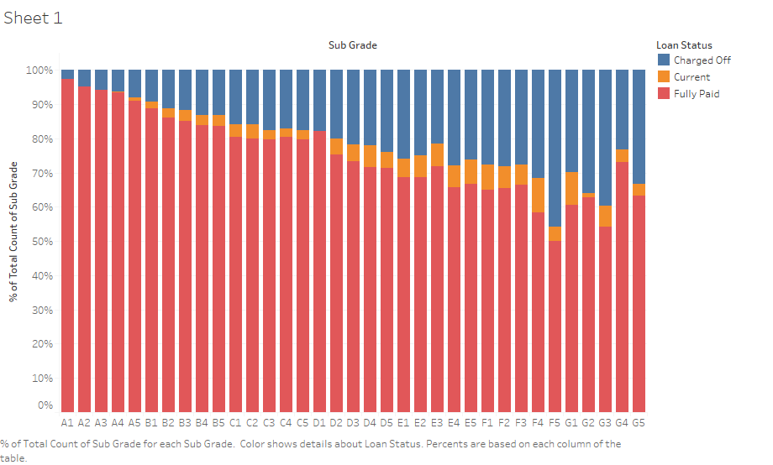
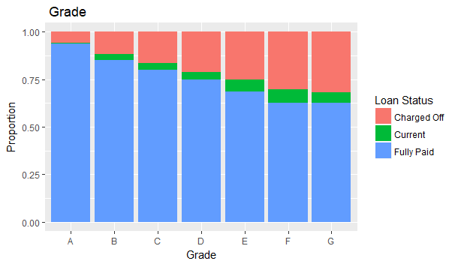
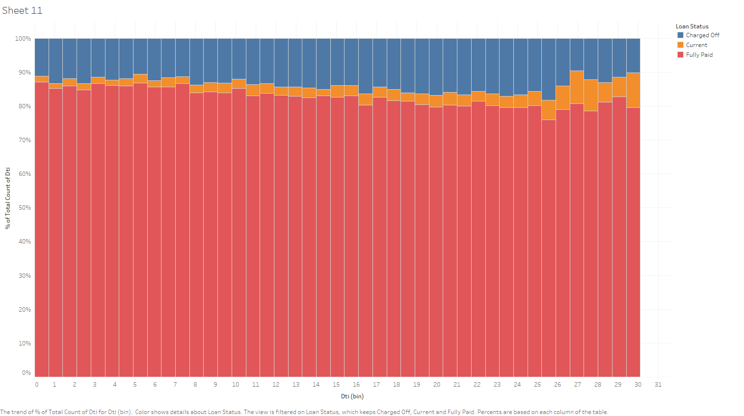
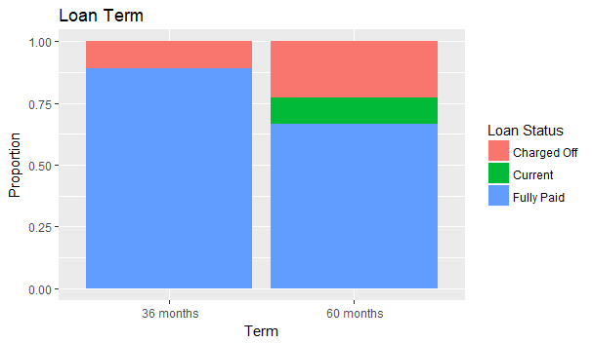
Drivers based on Univariate Analysis
Grade and sub grade are a driver
Loans disbursed for 60 months also act as a driver
DTI is also a driver with a slight increase in defaulters with higher DTI. For DTI higher than 25 the number of samples are less, so the upward trend can be ignored

Slide 4
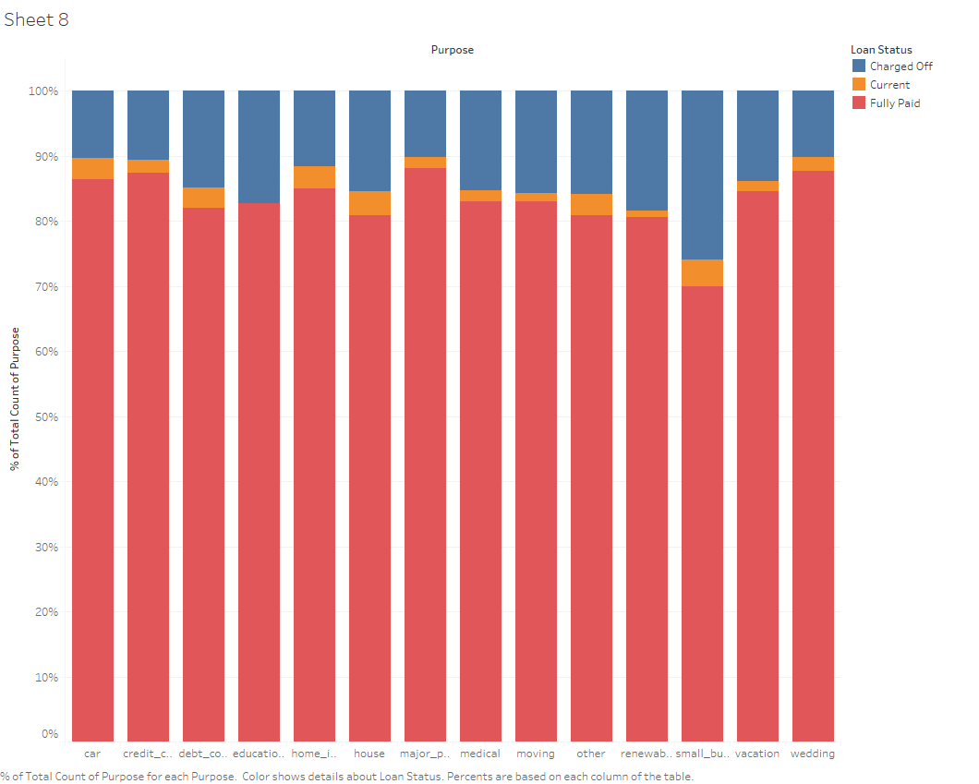
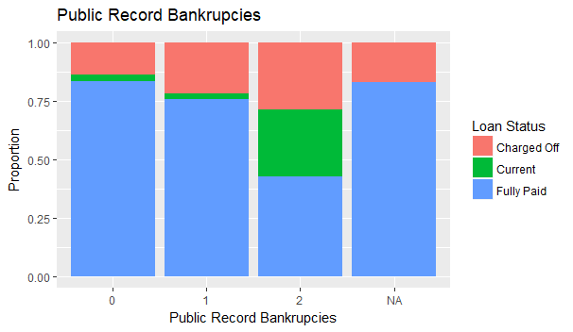
Drivers based on Univariate Analysis
Slightly higher rate of defaulters when the purpose of the loan is small business
Higher rate of defaulters with higher number of public record bankruptcies

Slide 5
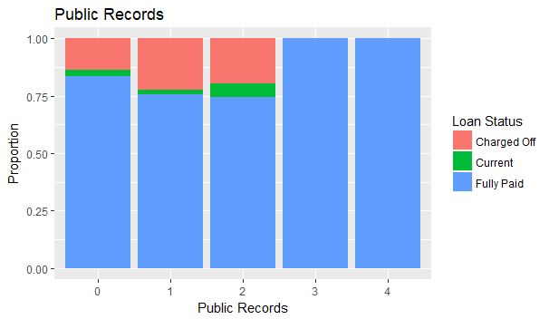
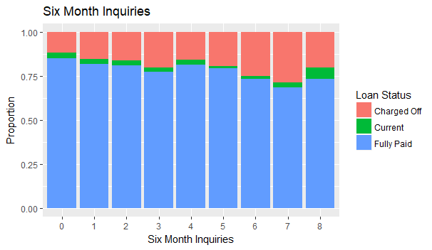
Drivers based on Univariate Analysis
With higher value of public derogatory records, the density of default loans are increases. For number of derogatory records greater than 3 and 4, the number of samples are very less to be considered.
Higher density of defaulters for non-zero number of inquiries

Slide 6
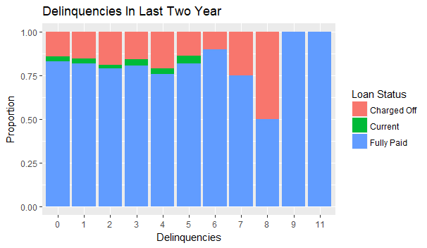
Drivers based on Univariate Analysis
Higher density of defaulters for non-zero number of delinquencies.
For number of delinquencies records greater than 1 the samples are very less to be considered.

Slide 7
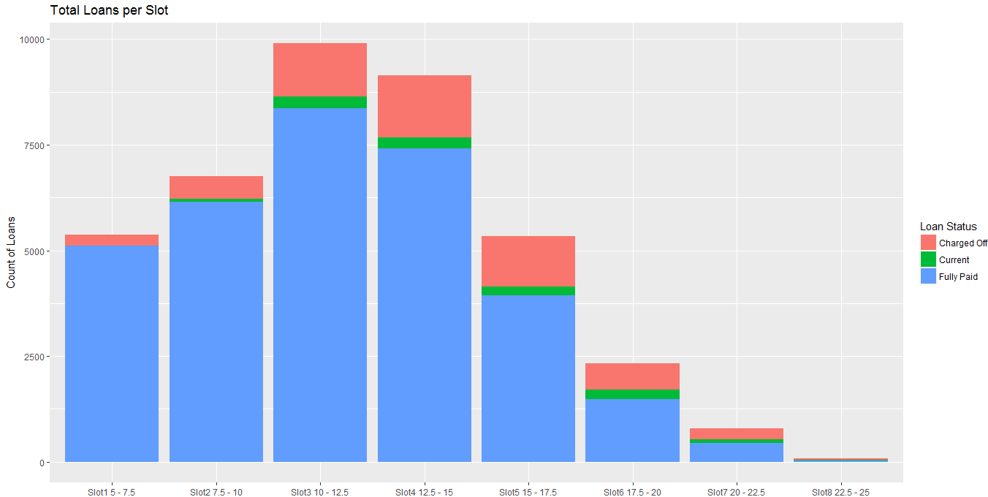
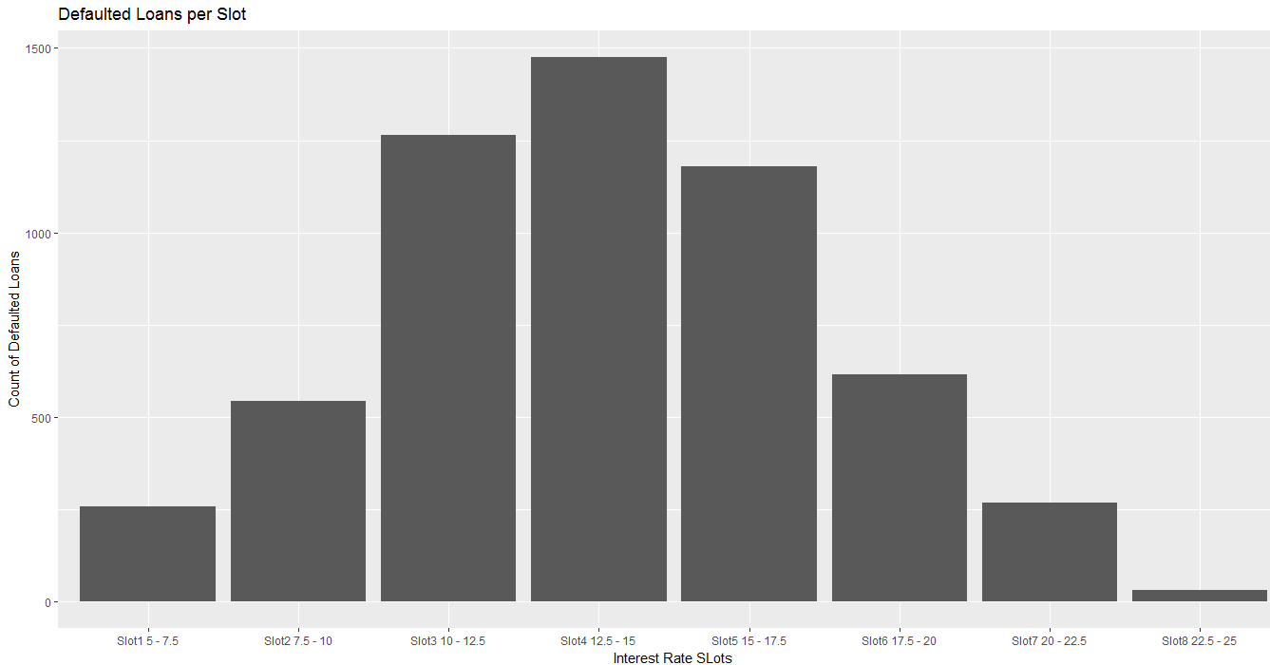
Derived Metric based analysis. Derived Interest Rate Slots.
In Graph of Left we can see Majority of loans are given at 10 – 15 % rate of interest. In Graph on right it shows that Slot of 12 –15 % has the Highest defaulting loans.

Slide 8
Segmented Univariate and Bivariate Analysis
Variable 1 | Variable 2 | Density of default loans | Conclusion
No filters | No filters | 0.14*
Home ownership is mortgage | Grade B or C or D or E or F | 0.16 | Higher probability of default
Home ownership is mortgage | None | 0.13
Funded value greater than 25K | DTI greater than 20 | 0.20 | Higher probability of default
Funded value greater than 25K | Employment term less than 1 year | 0.22 | Higher probability of default
Annual income greater than 350K | Income not verified | 0.14
* Denotes density in population

Slide 9
Conclusion:
<Add concluding points here>
* Denotes density in population

