Slide 1
Market Basket Analysis
By:-
Bhupal Patil
Laxmi Khot

Slide 2
1
System Requirement Specification
1)Hardware requirements:
Laptop or PC
Minimum 4GB RAM
Minimum 2Ghz processor
Minimum 10GB Hard-disk
2)Software requirements:
Jupyter Notebook
OS –Windows 8 or more

Slide 3
2
System Design Diagrams
1)Data Flow Diagram
2)Use Case Diagram
3)Activity Diagram

Slide 4
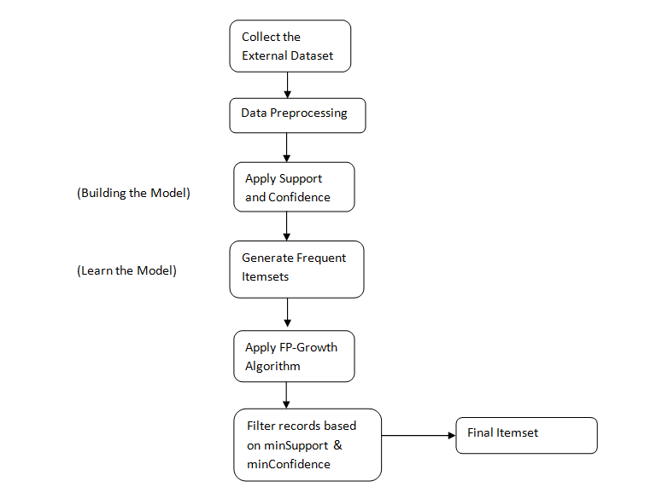
1)Data Flow Diagram

Slide 5
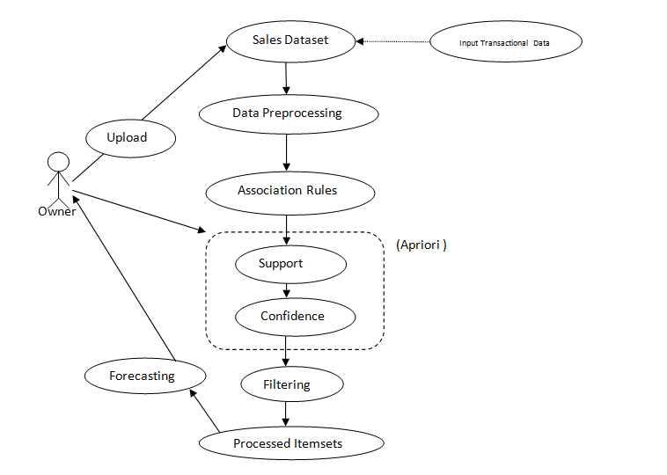
2)Use Case Diagram

Slide 6
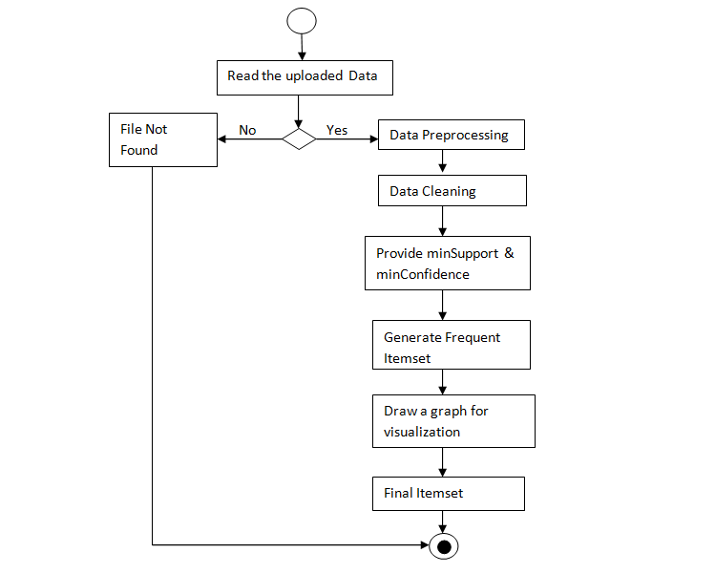
3)Activity Diagram

Slide 7
Thank You

