Slide 1
VEHICLE THEFT DETECTION AND CONTROL
Pruthviraja bhupal

Slide 2
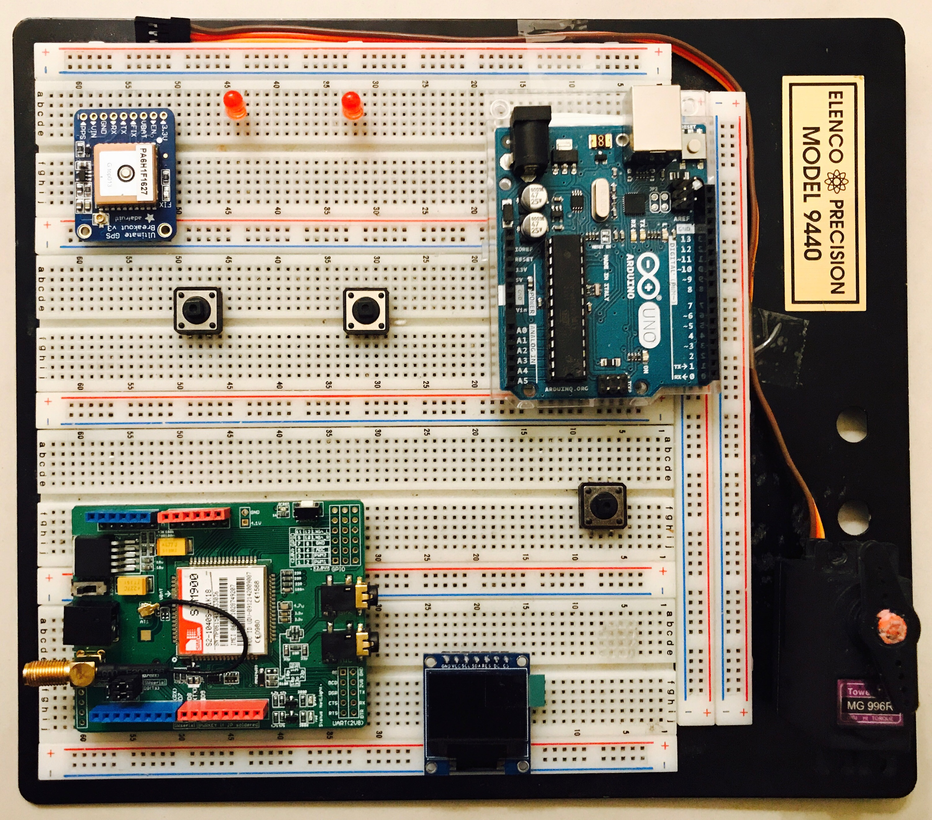
INDICATORS
GPS MODULE
ARDUINO
THEFT BUTTON
DRIVE BUTTON
EMERGENCY
GSM MODULE
SERVO MOTOR
OLED DISPLAY

Slide 3
Components
Arduino Microcontroller
GSM Module
GPS Module
Motor
OLED Display

Slide 4
Abstrsact
The project consists of two modes a)Drive Mode b)Theft Mode
When the Drive Mode is switched ON, the automobile is in its regular operation and is switched OFF when the ignition is turned OFF
The Automobile is switched to Theft Mode when the automobile is parked.
If the Drive Mode is turned ON in this mode then a message is sent to the owner of the automobile indicating that the vehicle is accessed by someone else.
If the owner resends a message with 'STOP' then the vehicle stops and a message to the owner is again sent back with the GPS co-ordinates.

