Slide 1

Process Mining Virtual Internship
by
B.SWAROOPA
Roll No. 214G1A32B1
Department of Computer Science and Engineering (Data Science)
Srinivasa Ramanujan Institute of Technology
(Affiliated to JNTUA & Approved by AICTE) (Accredited by NAAC with ‘A’ Grade & Accredited by NBA (EEE, ECE & CSE)
Rotarypuram Village, B K Samudram Mandal, Ananthapuramu – 515701.
2023 - 2024

Slide 2
Contents
Course Objective
Introduction
Technology
Applications
Modules
Real Time applications
Learning outcomes
GitHub Link
Queries

Slide 3
Course Objective
The main objective of Process Mining applies data science to discover, validate and improve workflows. By combining data mining and process analytics, organizations can mine log data from their information systems to understand the performance of their processes, revealing bottlenecks and other areas of improvement.
Process mining is the technology at the heart of the Celonis Execution Management System (or EMS), enabling enterprises to fully understand how their core business processes run and find the hidden value opportunities, before taking intelligent, automated action to improve performance.
Another objective of process mining are setting objectives, data gathering and preparation, applying data mining algorithms, and evaluating results.

Slide 4
Introduction
Process:
A process is very simply a series of linked actions or steps taken to achieve a particular end. It is a series of actions taken from start to finish to complete an activity. In process mining, this set of actions can be individual steps or tasks that define a business operation's start and end points. Processes can be one-time, recurring, or periodic, depending on the nature of the workflow.
Process Mining:
Process Mining is the combination of two disciplines: Data Science and Business Process Management. Process Mining essentially uses Data Science techniques, such as Big Data and AI, to address Process Science problems such as process improvement and automation.Process Mining achieves this union by taking the digital footprints that are created in IT systems and using them to reconstruct and visualize process flows.

Slide 5
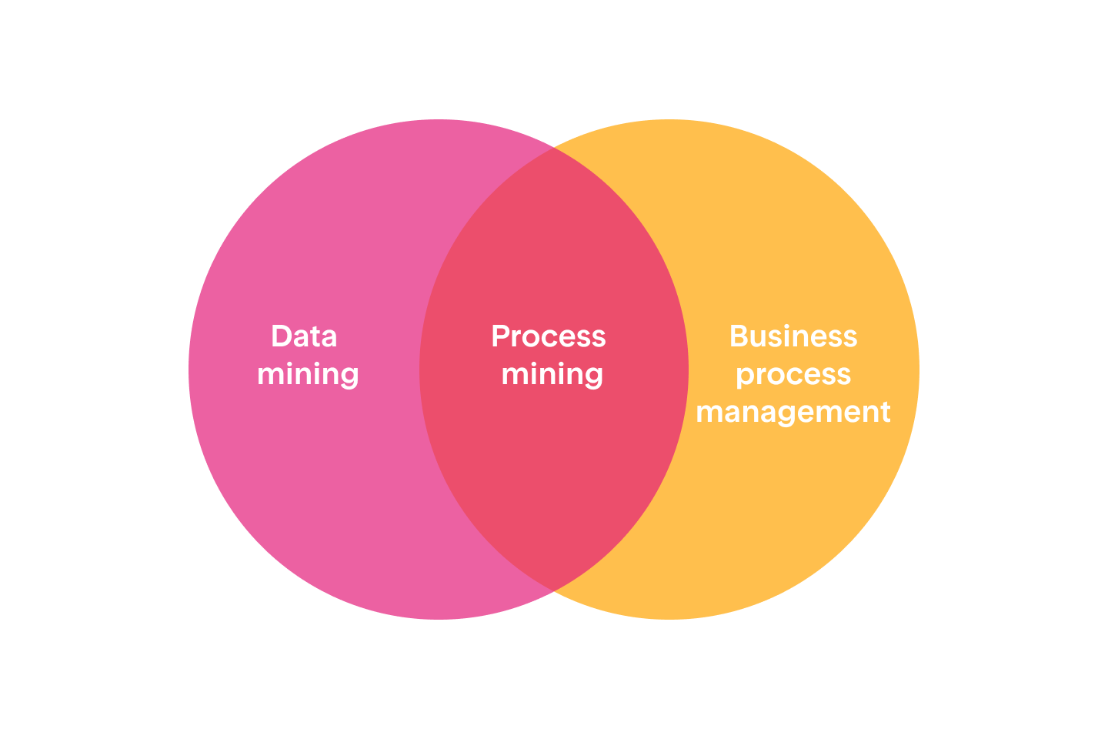
Intro..
Process Mining Importance:
Process mining helps businesses reduce these costs by quantifying the inefficiencies in their operational models, allowing leaders to make objective decisions about resource allocation. The discovery of these bottlenecks can not only reduce costs and expedite process improvement.
Process mining includes:
Automated process discovery (extracting process models from an event log)
Conformance checking (monitoring deviations by comparing model and log)
Social network/organizational mining
Automated construction of simulation models
Model extension
Model repair
Case prediction
History-based recommendations

Slide 6
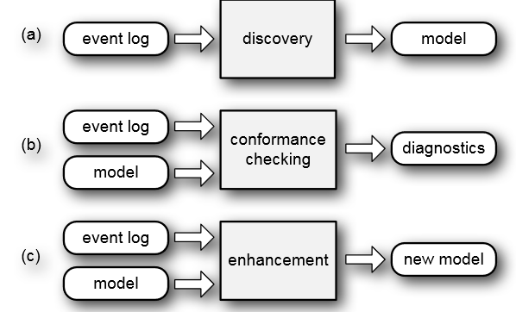
Technology
Process mining techniques or technologies benefit companies of any size and workflow. Process mining solutions can focus on various elements like the flow of a process, the organizational or time management with data mining and machine learning integration.
There are three main classes of process mining techniques:
Process Discovery
Conformance Check
Analysis and Enhancement

Slide 7
Technology
1. Process Discovery :
Process discovery uses event log data to create a process model without outside influence.This type of process mining is the most widely adopted.During discovery, process mining software traces the entire business workflow from end to end and provides an ideal blueprint to its users.
2. Conformance Check:
This method systematically evaluates the current process flow and compares event logs with the reference or target models. Conformance check assists in discovering and correcting any inefficiencies that might occur in the execution of the ongoing processes by measuring their performance against the ideal performance requirements.
3. Analysis and Enhancement :
This type of process mining has also been referred to as extension, organizational mining, or performance mining. In this class of process mining, additional information is used to improve an existing process model. For example, the output of conformance checking can assist in identifying bottlenecks within a process model, allowing managers to optimize an existing process.

Slide 8
Applications
Applications of process mining involve using process mining techniques to analyze and improve processes as they occur, providing insights and interventions in real-time. Here are some examples of real-time applications of process mining:
Emergency Response Management: During emergency situations or crisis events, real-time process mining can help organizations manage response processes effectively by identifying bottlenecks, allocating resources, and adapting to changing conditions.
Manufacturing Process Control: Real-time process mining can monitor manufacturing processes, identify deviations from optimal conditions, and trigger adjustments to maintain quality and efficiency.
Dynamic Resource Allocation: In scenarios where resources need to be allocated dynamically, such as in manufacturing or service industries, real-time process mining can help optimize resource allocation based on the current state of the process and demand.

Slide 9
Applications
Financial Services : Finance teams gather the information needed to gain a clear view of key performance indicators (KPIs). Examples include revenue generated, net income, payroll costs, etc. Data analytics allows finance teams to scrutinize and comprehend vital metrics, and detect fraud in revenue turnover.
Fraud Prevention: In financial transactions, real-time process mining can detect unusual patterns or behaviours that might indicate fraudulent activities. Immediate alerts can be triggered for further investigation.
Operational Monitoring and Alerts: Process mining can be used to monitor ongoing processes in real-time and generate alerts when deviations or anomalies are detected. This allows organizations to take immediate action to address issues and maintain process efficiency.

Slide 10
Modules
Process Mining Fundamentals
Tables and charts in Analysis
Process Query Language (PQL)
PQL Joins
Data Integration
Get data into the EMS

Slide 11
Process Mining Fundamentals :
Process mining is an analytical discipline for discovering, monitoring, and improving processes as they are Process Mining works by extracting knowledge from event logs (also called digital footprints) readily available in today’s information systems, to visualize business processes and their every variation as they run. The Celonis Execution Management System (EMS) extends process mining by executing on insights automatically and orchestrating your existing technologies.
When interacting with the dynamic visual representation one can take an exploratory approach or a confirmatory approach.
Exploratory Approach : An exploratory approach is one where you simply explore the data and see what value opportunities jump out at you. You’re diving into the data without specific expectations and with an open mind. Analysis tools such as the Process Explorer, the Variant Explorer.
Confirmatory Approach : With the confirmatory approach, you’re examining the data to see if it confirms or denies a hypothesis. Using your Celonis Analysis, specifically by filtering on attributes you can find out whether the data confirms or denies that these perceived pain points exist and have a significant impact.

Slide 12
Process Mining Fundamentals :
Process Explorer : The Process Explorer is another analysis tool to use when taking an exploratory approach. It is especially useful for quickly revealing activities beyond the most common ones. It also allows you to narrow your focus on a single activity, for example an undesired activity, to see which activities cases typically come from and which activities they are going to.
Analysis Charts :A dimension is a category of attributes; for example, the dimension "customer name" is a category for individual customer names. Other examples of dimensions, depending on the nature of the process, can include vendor name, sales organization, region, and material group.Key Performance Indicators (KPIs) are used to calculate and add aggregated values, for example, case count, order value, invoice value, throughput time, and automation rate.

Slide 13
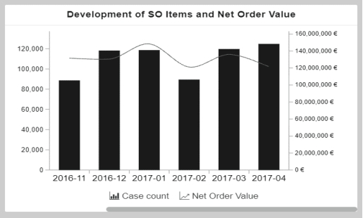
Process Mining Fundamentals :
This chart shows the development of sales order items (KPI) and the corresponding net order value (KPI) over a period of time (dimension). The x-axis displays the dimension, the creation date of sales order, grouped by months. The two y-axes display the KPIs: The columns display the number of sales order items (case count) and the line displays the net order value.This OLAP table is currently displaying three KPIs for all the sales organizations.The first column displays the dimension, Sales Organization. The other three columns show KPIs: number of sales orders, average cycle time, and order value.

Slide 14
Tables & Charts in Analysis
Analysis : An Analysis helps to identify execution gaps in your business processes. It lets you create a custom visualization of your as-is process and analyze the underlying data.An Analysis can be linked to a Data Model or a Knowledge Model. A Knowledge Model lets you define KPIs in one place, from which they can be referenced by other Celonis EMS assets. You can import KPIs to an Analysis from a linked Knowledge Model and use them in addition to local KPIs that you create in the Analysis.
Anytime you add a table or chart to the analysis, you'll need to select the dimension(s) and KPI(s) to display.
Dimensions : Dimensions are used to determine which attributes from the analysis are displayed; for example, vendor name, customer name, date, region, or document type. Dimensions represent the columns of the data tables (for example, Dimension = Customer name, Attribute = Acme Bread Company).
KPIs : KPIs, or Key Performance Indicators, are used to calculate and add aggregated values; for example, case count, order value, invoice value, throughput time, or automation rate. KPIs are functions that consolidate a set of values belonging to a single occurrence inside a dimension into one single value.

Slide 15
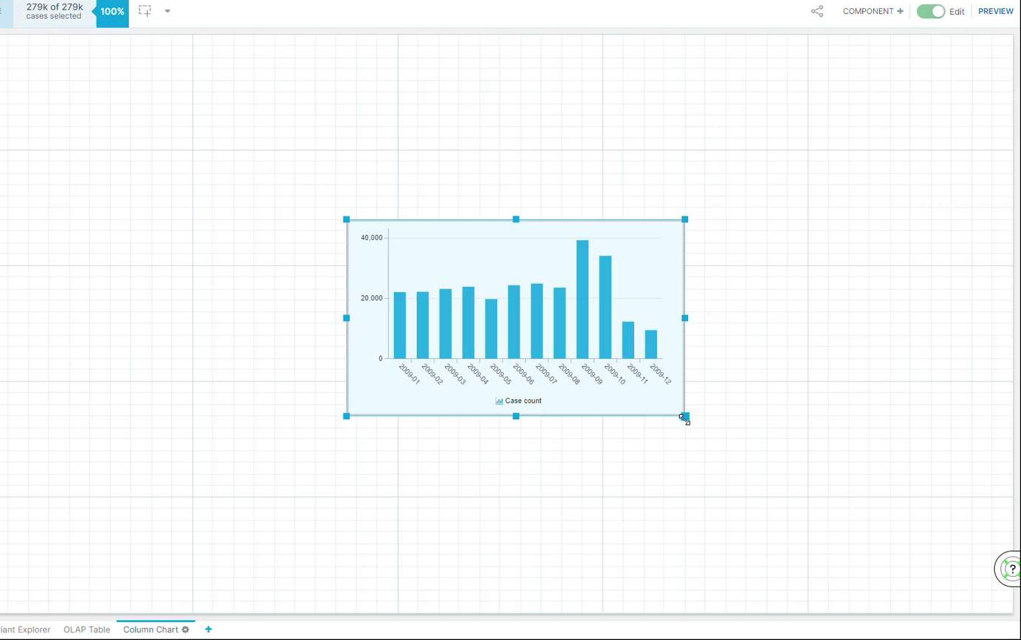
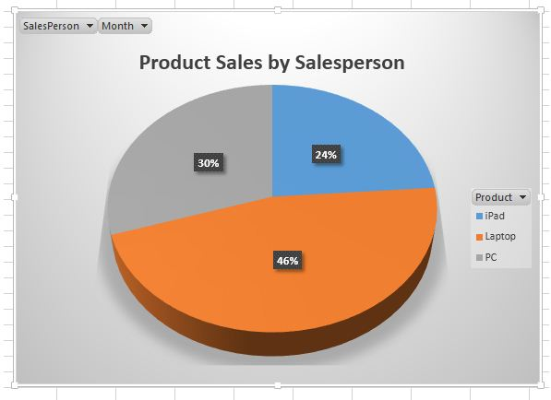
Tables & Charts in Analysis
we'll configure a column chart with the creation date
of purchase orders as a dimension and case count as
KPI. You'll get to know the date functions available.
PIE Chart : The principle of creating table and chart
componentsin Celonis is always the same. Although, you’ll
need to select only one KPI to display in a Pie Chart.
Each piece of the pie (each row) represents one attribute from the
dimension, Material Group. In this case, it would be really
difficult to select beyond the first handful of rows.
We need to limit the pieces of pie (rows) displayed.

Slide 16
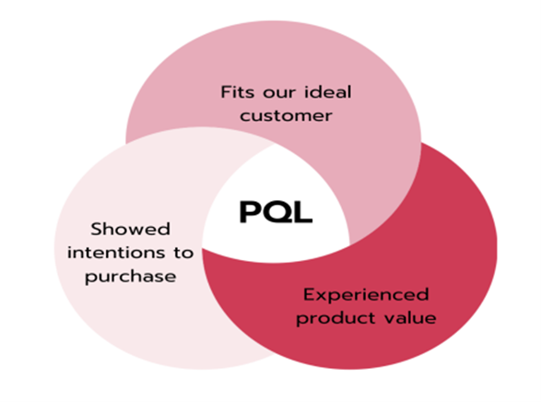
Process Query Language
It is essential for Process Mining users to formalize their process questions as executable queries. It translates process-related business questions into queries and executes them on a custom-built query engine, the Celonis PQL Engine.
For this purpose, we present the Celonis Process Query Language (Celonis PQL), which is:
a domain-specific language
tailored towards a particular process data model
designed for business users.

Slide 17
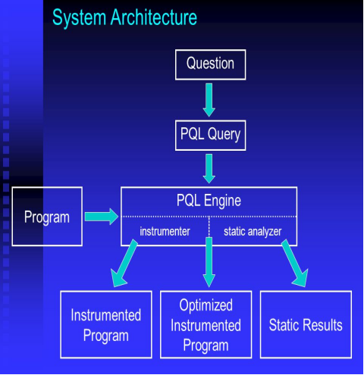
PQL
System Architecture : All Celonis applications use this language to query data from a data model. PQL enables the user to translate process-related business questions into queries, which are then executed by a custom-built query engine. PQL covers a broad set of operators, ranging from process-specific functions to aggregations and mathematical operators. Its syntax is inspired by SQL, but specialized for process-related queries.
Question
PQL Query
Celonis PQL Engine
Results

Slide 18
PQL
PQL Queries : PQL can be written in a lot of different applications. You can apply it in Analyses,
Knowledge Models, Action Flows and so on. But when it comes to writing queries, you shouldn’t be
worried about visualization or design. The design of the PQL language follows seven principles:
Compactness: PQL queries should allow capturing intents in short, succinct programs that avoid ungrounded code redundancy.
Decidability: PQL queries should be solvable by algorithms on a wide range of inputs.
Efficiency: PQL queries should require reasonable and attainable amounts of computational resources.
Expressiveness: PQL queries should allow describing many ideas.
Intuitiveness: PQL queries should be easy-to-read and easy to comprehend.
Portability: PQL queries should be independent of execution environments and data formats.
Usefulness: PQL queries should allow fulfilling many practical tasks.

Slide 19
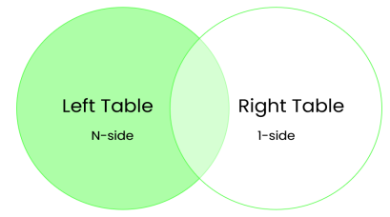
PQL Joins
The tables in a Data Model are connected via specific relationships to associate rows of one table with rows of another table. This is done using a foreign key. In general, these relationships can be classified as:
One-to-many or 1:N
One-to-one or 1:1
Many-to-many or N:M
Depending on the number of rows of one table that can be matched with a row of another table. In Celonis Data Models only one-to-many (1:N) relationships are supported. Every asset in Celonis has an underlying Data Model with multiple tables and 1:N relationships. The joins between those tables are left-outer joins, where the N-side is on the left.

Slide 20
Data Integration
Data Integration (formerly known as Event Collection), you’re responsible for bringing in clean, real-time process data into the EMS. In other words, you build the data pipeline. Process Data is a set of connected activities with timestamps following one specific case, or object. Every activity is an "event" and your task is to collect these events and organize them in the right order.

Slide 21
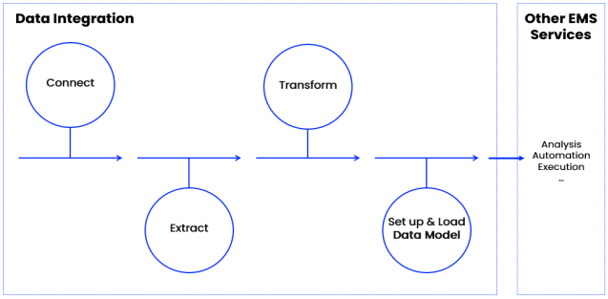
Data Integration
Get Data Into The EMS : It helps you connect to source systems, extract the relevant data, transform it to your needs, and load it into a polished Data Model. You can think of the Data Model as the fuel to all other work in your EMS. Once it’s ready, your team picks it up and can get started on analyzing it and acting on it.This process mainly involves 5 steps:
Process connect
Extract data
Transform data
Data Model
Execution Management System

Slide 22
Real Time Applications
IT & software: IT professionals benefit from sorting out disorganized engineering processes by gaining clarity and managing the complexity of ERP migrations and implementation. They can also monitor systems in real-time to ensure everything is running smoothly.
Education: Educational process mining (EPM) allows administrators to analyze and visualize students’ learning behavior by applying specialized algorithms. The student activity logs provide insights into tracking and monitoring their academic performance.
Healthcare: The healthcare industry has a surplus of data, from health records to appointment booking procedures. Professionals can reconstruct this data digitally with process mining software for seamless integration.
Retail : Used to analyze and interpret customer data. All this data can reveal actionable information about customer behavior through trends and associations. The data collected can then be used to optimize pricing, gain new customers, and increase loyalty.

Slide 23
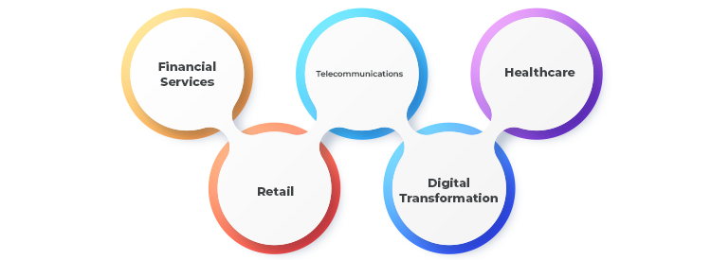
Real Time Applications
Telecommunication : Process mining helps telecommunication companies identify anomalies and predict fraudulent activities by monitoring user behavior and operational workflow.

Slide 24
Learning Outcomes
Get a better understanding of Process Mining Fundamentals.
Understanding about the Tables & Charts in analysis.
To analyse about the PQL Queries.
Get an idea of different Types of Joins in PQL.
Better understanding of Data Integration.
To know the different applications of Process Mining.

Slide 25
Any Queries?

Slide 26
Thank You!!!

