Slide 1

Assets
of
Loksabha
Candidates
Presented by:
V Pravas, B Nithin

Slide 2
Introduction to the Problem statement
  The Statement: How did declared assets change for candidates who contested in 2014, 2019 and 2024, winners against losers?
  Team Slice: Maharashtra, Tamil Nadu, Uttar Pradesh, Bihar
The Sources (and why we used them for):
  My-Neta affidavit summaries: The Assets, Liabilities, Outcome, etc.
  Open-City Lok Sabha Election Dataset: The Vote Counts, Vote Share, Party, etc.
  TCPD (https://github.com/tcpd/ppi): Normalisation of Party names.
*only the candidates who contested the Lok Sabha elections in the chosen states across the 2014, 2019, and 2024 cycles were chosen
All files aare saved in .csv format because the datasets are not that large and csv format is human-readable, hence easy inspect

Slide 3
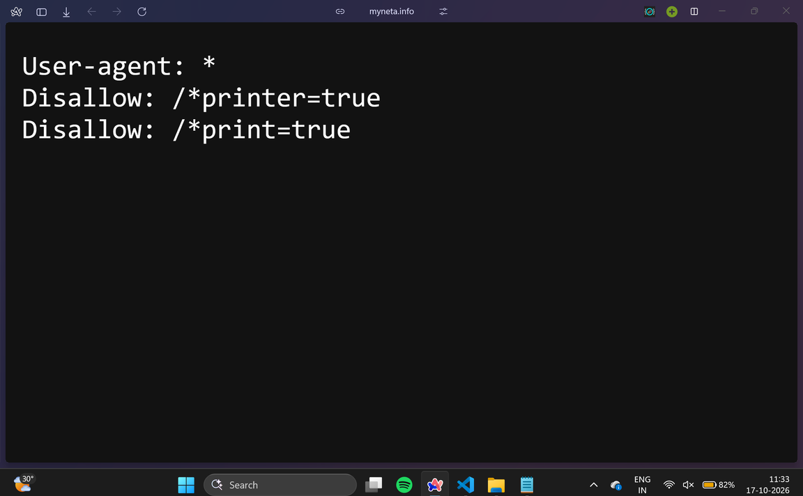
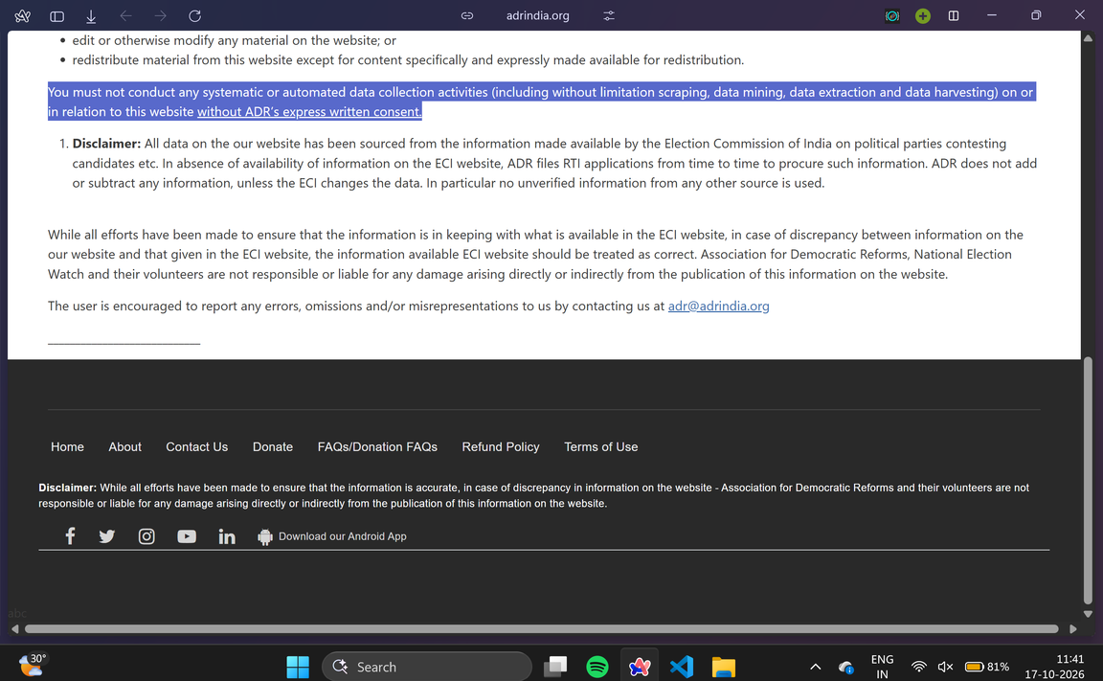
Data and Methods - MyNeta
Note: You must not conduct any systematic or automated data collection activities (including without limitation scraping, data mining, data extraction and data harvesting) on or in relation to this website without ADR’s express written consent.

Slide 4
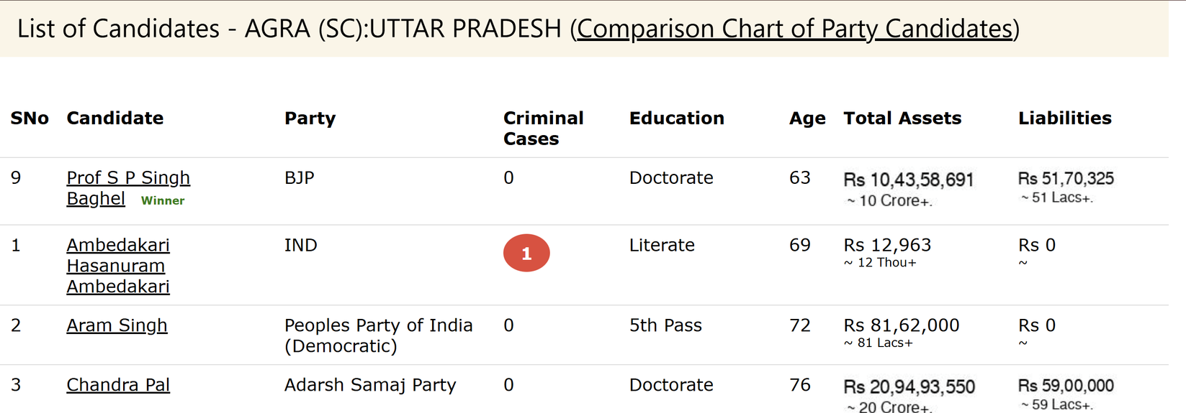
Data and Methods - MyNeta
This is the data of the candidates contested for Lok Sabha 2024 elections in AGRA constitution.
Points to note:
  Small green indicating the winner.
  (SC) in brackets indicating that the seat is reserved
  A few cells under Total Assets, Liabilities look different.

Slide 5
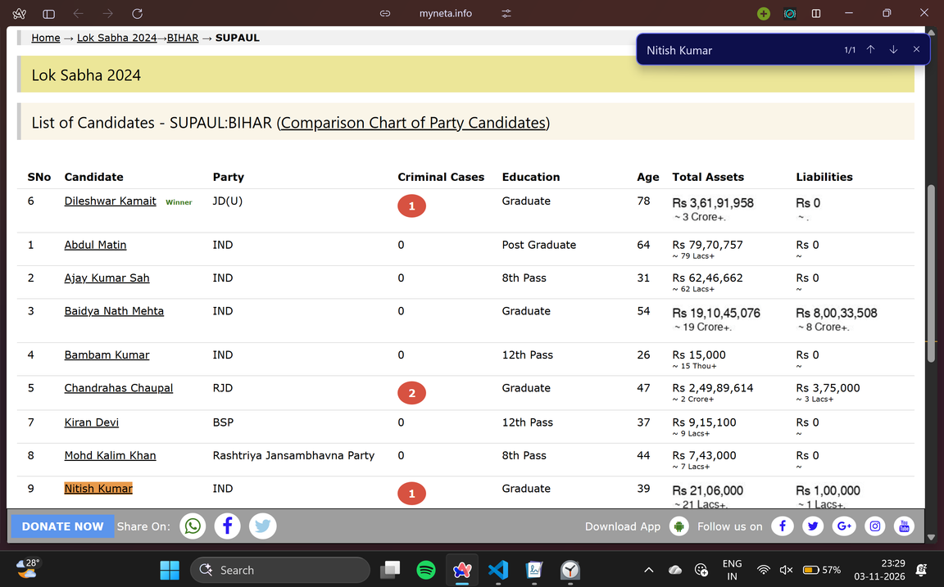
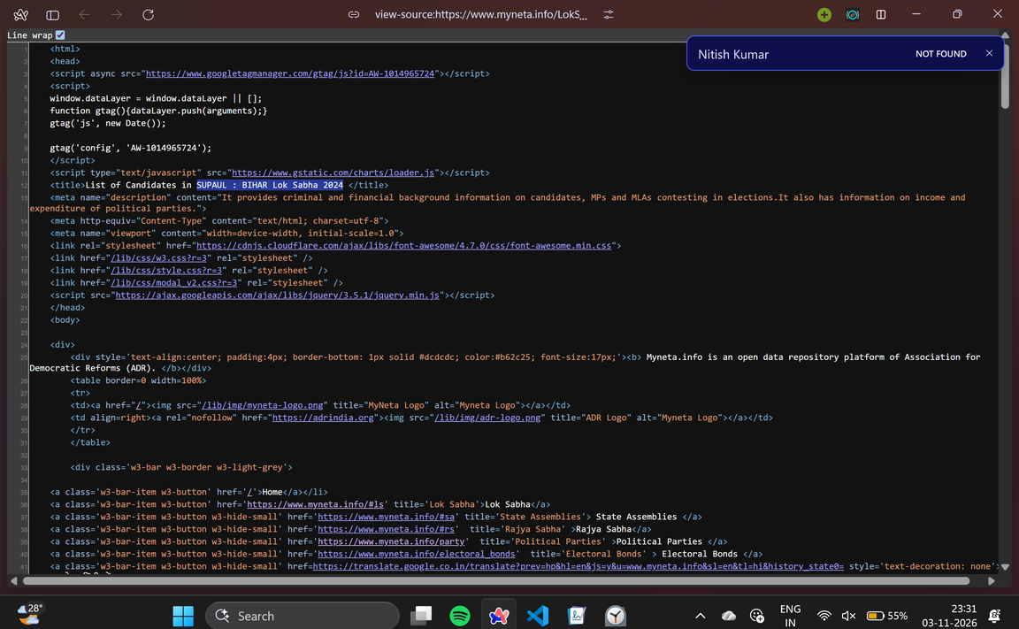
Data and Methods - MyNeta
The candidate “Nitish Kumar” is there in the rendered page but absent in the page source.
He/she contested for SUPAUL:BIHAR Lok Sabha 2024 elections.
So, we are forced to use Selenium to get all the candidates

Slide 6
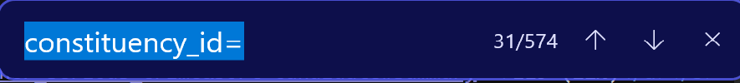
Data and Methods - MyNeta
How do we go to every constiution and scrape using selenium?
We checked the source of MyNeta’s Lok Sabha 2024 affidavit summary page. We found out that all the links for every constituency was there in the source HTML. Hence, we used requests to extract all the links for each constituency.
Just to find that there are 574 entries of constituencies in 2014 Lok Sabha Elections
Turns out that there are BY-ELECTION data points as well. Which correctly brings the count to 543.

Slide 7
Data and Methods - MyNeta
Cleaning and Outlier detection:
  MyNeta shows the asset and liability amounts for every third candidate as a picture instead of text.
  We download each picture (requests was used) from the links saved during scraping, makes it greyscale, and uses OCR, it reads the text in an image and fill the missing values.
  In Assets, every run of spaces, tabs or line breaks becomes one space, and the ends are trimmed.
  In the party names, we reduce each name to lowercase letters only (CPI(ML)L and CPI(ML)(L) both become “cpimll”). Within each group, use the most common spelling.
  To check duplicates, we take year + state + seat + by-election or not + serial number as a key
  Then, we convert money to numbers: from “Rs 1,60,59,806 ~ 1 Crore+”, we keep only the digits. Then cross-check them: 16059806 ÷ 10⁷ rounded down = 1, which matches “1 Crore+”. If they match, the number was read correctly.

Slide 8
Data and Methods - MyNeta
Cleaning and Outlier detection:
  Used Logistic Regression Test to predict missingness mechanism.
  Missing asset images are missing completely at random.
  Age is predicted by year and state, So it is MAR.
  Education is predicted strongly by Assets. Poorer candidates might leave it blank (MAR is what we see, MNAR might be possible.)
  Outliers in assets (log) using IQR and in Criminal cases (log) using Modified Z-score. Checked in MyNeta for any error in data curation and visualization process. Everything seems to be correct according to MyNeta. No other source to verify and the ‘flagged’ ones might be real extremes. [No action was taken on the outliers.]

Slide 9
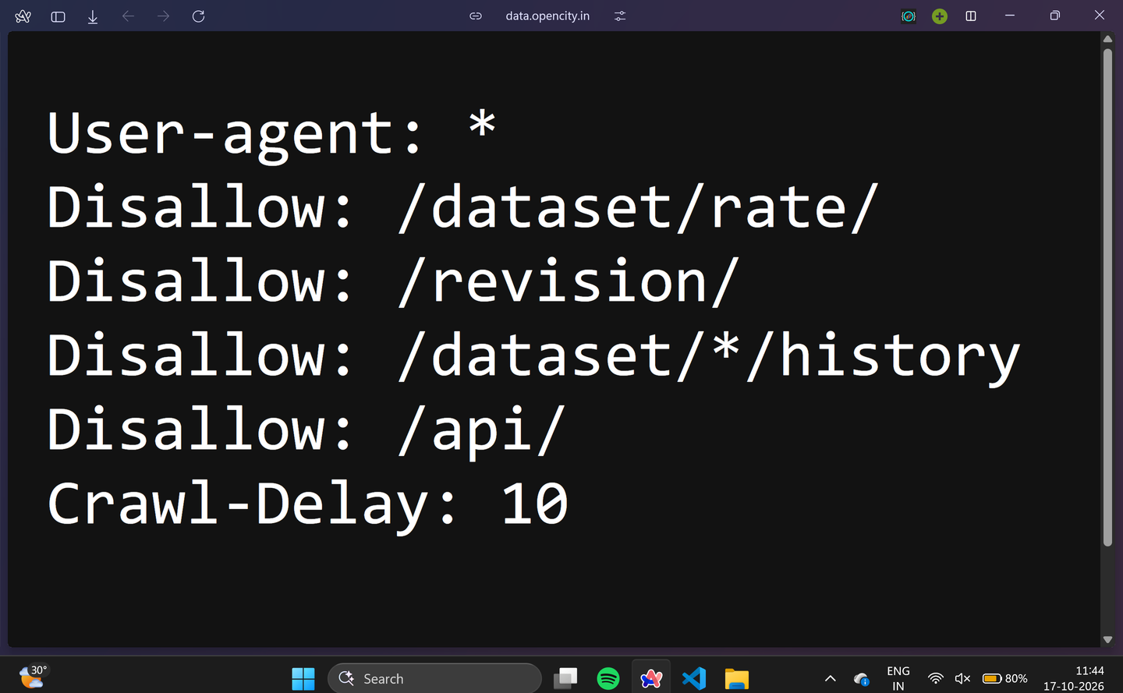
Data and Methods - Open City
License - 2014-19: CC BY-NC-SA 4.0 (non-commercial, share-alike). Credit: Trivedi Centre for Political Data.
License - 2024: Other (Public Domain)

Slide 10
Data and Methods - Open City
  Data is directly downloaded as csv from the Open City site.
  There are 2 csv files, one holds historical data (2014, 2019) and the other 2024 Lok Sabha election data.
  They have different columns.
Steps followed while cleaning:
  Cleaned state names and kept data only for the 4 states that we had chosen.
  Filtered out by-election.
  Cleaned constituency names & seat consistency checks.
  Convert text (votes, vote shares) to numbers.
  Verify that EVM + Postal = Total for all rows.

Slide 11
Data and Methods - Open City
Steps followed while cleaning [continued]:
  Clean candidate and party names. Mapped party names to short codes.
  Identified NOTA rows and computed correct position of all candidates.
  All missing values present were from rows that were NOTA.
  Gave each person a different ID using state + age + name (difflib.SequenceMatcher was used to compare names) + seat No. as a key.
  Checked for outliers in vote counts (log) within a groups of same year and same role (winner, loser, etc.) using modified z-score and IQR methods. All values were real extremes.
  Threw away columns that are not needed.

Slide 12
Data and Methods - Merging
Steps Followed during the process:
  Cleaned the names (converted to upper case, removed titles, etc.)
  Seat names in MyNeta are stripped of symbols like (SC) and looked up to get Open City’s seat number.
  Party Matching via TCPD.
  Matched canddites: compared people within the same seat and election, and pairs them one to one using 7 rules, strictest first: same words → same letters → initials vs full name → name similarity ≥ 0.85 → same party + similarity ≥ 0.70 → last one left on both sides with same party → the winner on both sides. Safety rule: if the two parties clearly differ (and one is a big party), there’s no match by name alone.
  Sanity-check: the winner flag comes from both sources independently, and it agrees on 100% of pairs. That’s the strongest evidence the matching is right.
  MyNeta does not have a winner declared for 3 constituencies [winner row itself is not present].

Slide 13
Results & Conclusions

Slide 14
Limitations
  Self-declared assets: affidavit values are what candidates say they own. Nobody verifies them, and land is often declared at old purchase prices, so real wealth is likely understated.
  Not adjusted for inflation: Rs 1 crore in 2014 is worth more than in 2024, so part of the “growth” is just inflation. Only 4 states (Bihar, Maharashtra, UP, TN). The results don’t speak for all of India.
  MyNeta has gaps: 3 winners are missing from the scraped pages, and the 2022/2024 by-elections aren’t in OpenCity, which stops at 2021.
  Age and education gaps are left missing. If education is MNAR (people with little schooling leave it blank on purpose), education summaries are slightly biased.
  Name-based matching: there’s no common ID across sources, so people are linked by name, seat and party.

Slide 15
Attributions
Libraries:
  standard python libraries (re, difflib, pathlib, urllib, time, os, random)
  Pandas, NumPy, SciPy, statsmodels
  requests, selenium, Beautifulsoup
  Plotly, Dash, Dash Bootstrap Components,matplotlib
  Tesseract OCR engine, pillow
AI Tools: Claude, ChatGPT: Writing codes and generating plots.

Slide 16
Contributions
Index | Task | Contributors(s)
1 | MyNeta Pileline | Nithin
2 | Open City Pipeline | Pravas
3 | Merging | Pravas
4 | Dashboard | Pravas & Nithin
5 | Presentation - Slides | Nithin

Slide 17
Thank
You

