Slide 1

Navigator Desktop Automation using Robot Framework
Presenter: Venkat Bhupathi
06/14/2024

Slide 2
Agenda
Overview of Desktop Application Automation
RPA.Desktop Library
Pywinauto Library
AutoIt Library
Sikuli Library
Limitations
Conclusion

Slide 3
Overview of Desktop Application Automation
Definition:
Desktop application automation refers to the process of using software tools to control and test desktop applications, automating tasks that would otherwise be performed manually.
Importance:
Efficiency: Automates repetitive tasks, saving time and effort.
Consistency: Ensures uniform execution of test cases.
Accuracy: Reduces human error in testing processes.
Coverage: Increases the scope and depth of testing by automating complex scenarios.
Common Tools and Libraries:
Below libraries will support Desktop application automation using Robot framework
RPA Desktop
Pywinauto
Sikuli
AutoIt

Slide 4
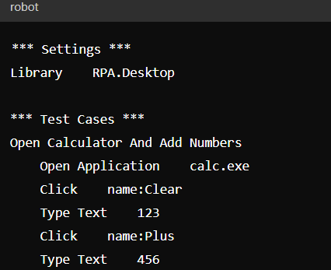
RPA Desktop Library
Overview:
Part of the Robot Framework RPA ecosystem.
Cross-platform support for automating Windows, Mac, and Linux desktop applications.
Key Features:
Keywords for opening applications, interacting with UI elements (click, type, etc.), capturing screenshots, and more.
Built-in error handling and logging.

Slide 5
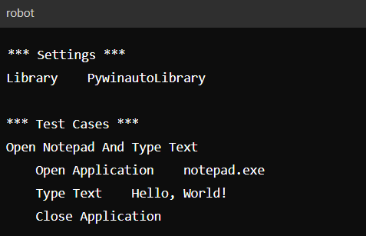
PywinAuto Library
Overview:
A set of Python modules to automate Windows GUI testing.
Provides control over native Windows applications.
Key Features:
Detailed interaction with Windows UI elements like buttons, menus, dialogs.
Supports automation of both simple and complex GUI applications.

Slide 6
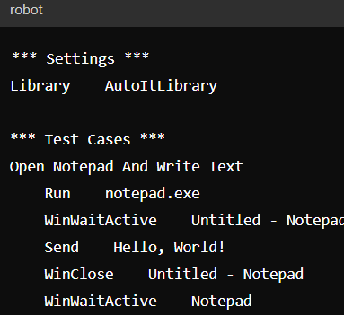
AutoIt Library
Overview:
A freeware automation language for Windows GUI automation.
Can be integrated with Robot Framework using the AutoItLibrary.
Key Features:
Simulates keystrokes, mouse movements, and window commands.
Ideal for automating tasks that involve intricate GUI interactions.

Slide 7
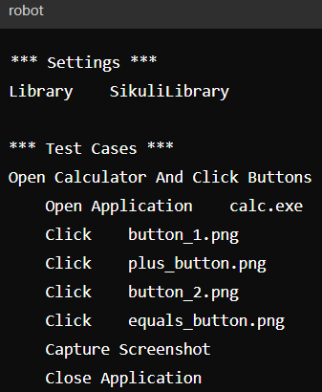
Sikuli Library
Overview:
Uses image recognition to automate GUI interactions.
Can be integrated with Robot Framework using the Sikuli Library
Key Features:
Visual approach to automation by identifying elements on the screen via screenshots.
Useful for applications where traditional object recognition fails.

Slide 8
Limitations
Complex GUI Interactions
Handling dynamic elements
Complex drag-and-drop operations
Ionic objects identification
Platform Dependency
Windows-centric libraries (Pywinauto)
Limited cross-platform support
Performance
Slower execution for highly interactive applications
Resource consumption on large-scale tests

Slide 9
Conclusion
We have tried to automate Navigator desktop application using RPA.Desktop libraries and AutoIt libraries we are able to login to the application but unable to proceed with home screen due to ionic framework objects.
Sikuli libraries are image based automation which is high difficult process of automating the Navigator application because Navigator has more objects and more screens which is highly impossible to automate using image based automation.
PywinAuto libraries not tried due to installation issues as per our automation work experience which is also similar to the RPA.Desktop libraries.
As per our research we can conclude that Robot framework is not supportive for Navigator desktop Automation.

Slide 10
Questions?

