Slide 1
Analyzing current public sentiments on BREXIT using Naive Bayes Classifier
Supervised By: Prof. Vladimir Milosavljevic
MSc Research Project
Bhupender Singh Shekhawat
(X17170214)

Slide 2


01
MOTIVATION
BREXIT is British exit from the European Union.
Brexit is one of the hottest topics in the world.
Therefore, the motivation lies in the understanding the sentiments of the public opinions from different parts of the world and draw conclusions from the same.
02
SENTIMENT ANALYSIS
Classifying sentences into Positive, negative and neutral classes.

Slide 3
METHODOLOGY
Tweets Retrieval
Data-Preprocessing
Sentence Segmentation, tokenization & POS tagging
Sentiment Analysis
Training & Implementing Naïve Bayes Classifier Model.
Textblob
Visualization using Tableau

Slide 4


03
TWEETS RETRIEVAL
Used Twitter streaming API to fetch real time tweets using Tweepy Library in Python.
Consumer_key, consumer token key , access token, access token secret.
04
WHY?
-240 million plus active users on Twitter.
-Short text messages of 140 characters

Slide 5


05
DATA PRE-PROCESSING
Libraries used for pre-processing:
-Pandas
-Regular expression(RE)
-AWS Instance
06
NLP
Tokenization
Lemmatization
POS Tagging
Sentence segmentation

Slide 6


NAÏVE BAYES CLASSIFIER
07
Classification technique based on Bayes Theorem with an assumption of independence among predictors.
Useful among large datasets
Presence of a particular feature in a class is unrelated to the presence of any other feature.
08
TEXTBLOB
Python’s library for natural language processing.
Using TextBlob for sentiment analysis provides with a :
Polarity
Subjectivity

Slide 7
FINAL DATASET
09
-Collected 218,657 tweets.
-UK economy data.
10
VISUALIZATIONS

Slide 8
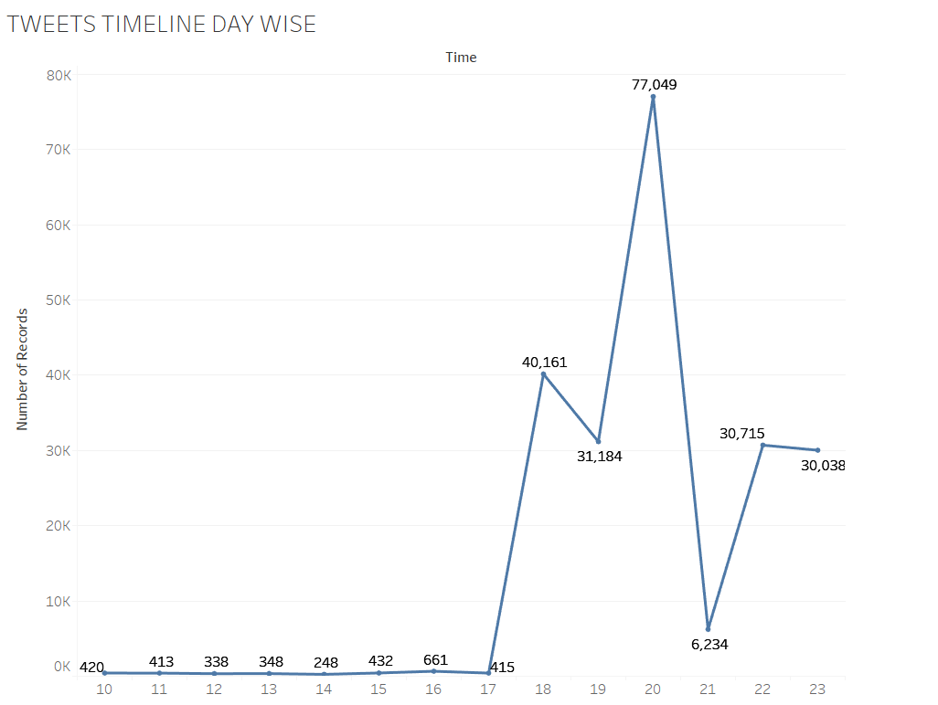

Slide 9
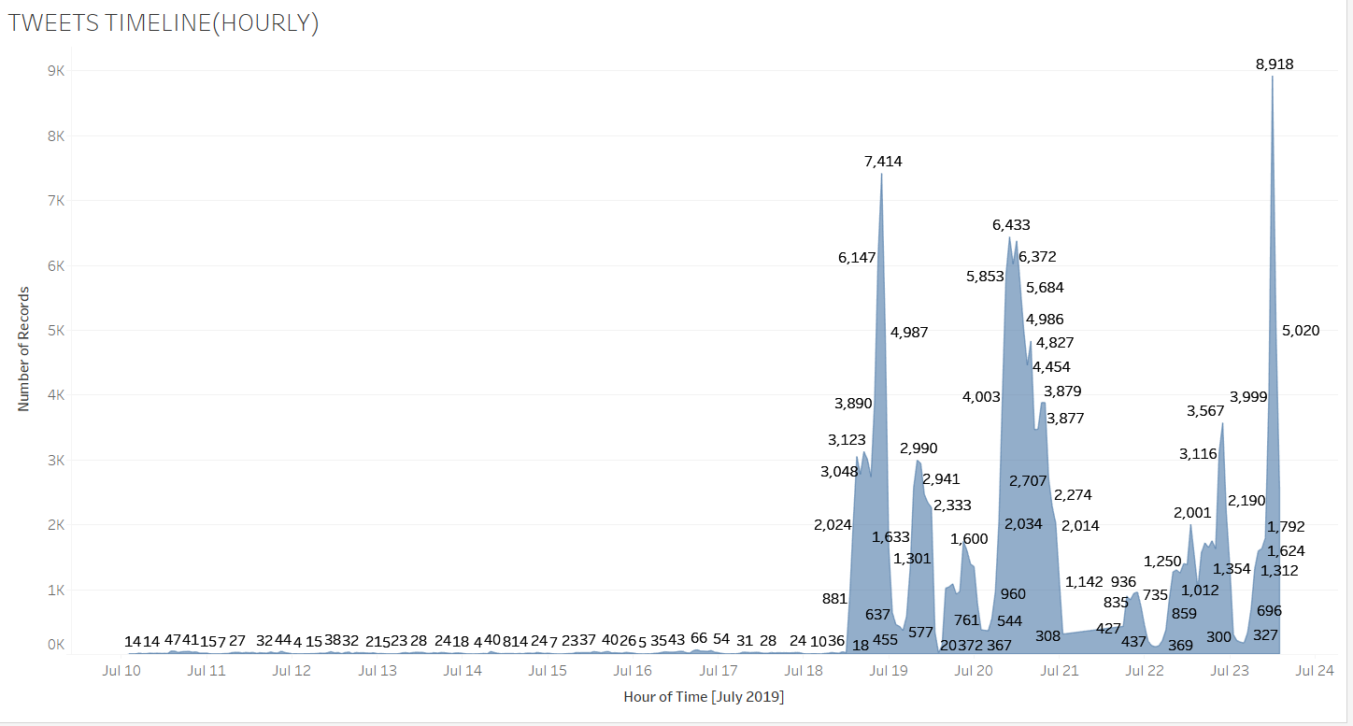

Slide 10
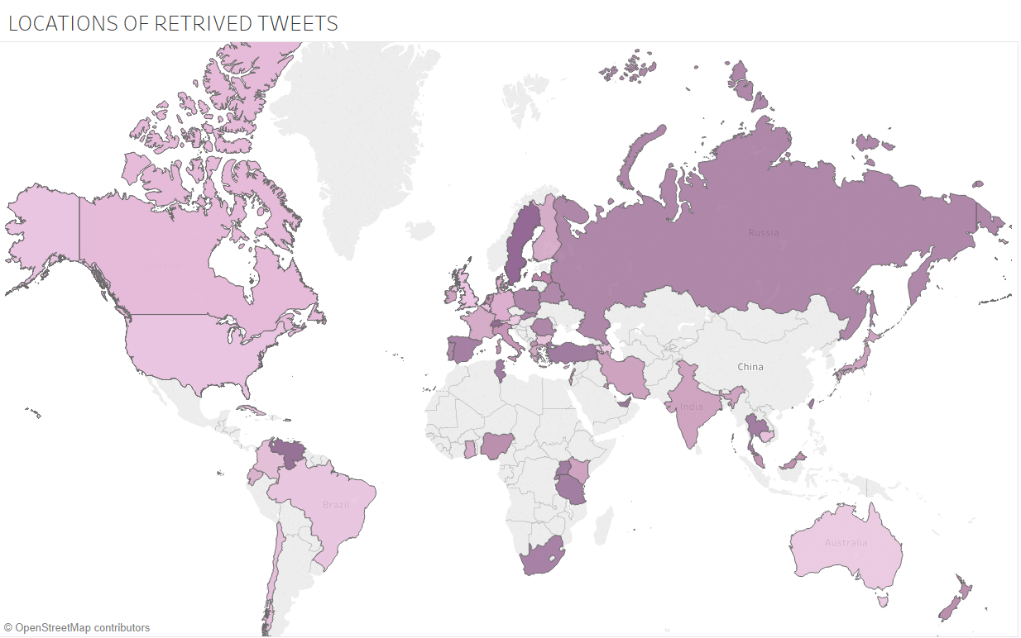

Slide 11
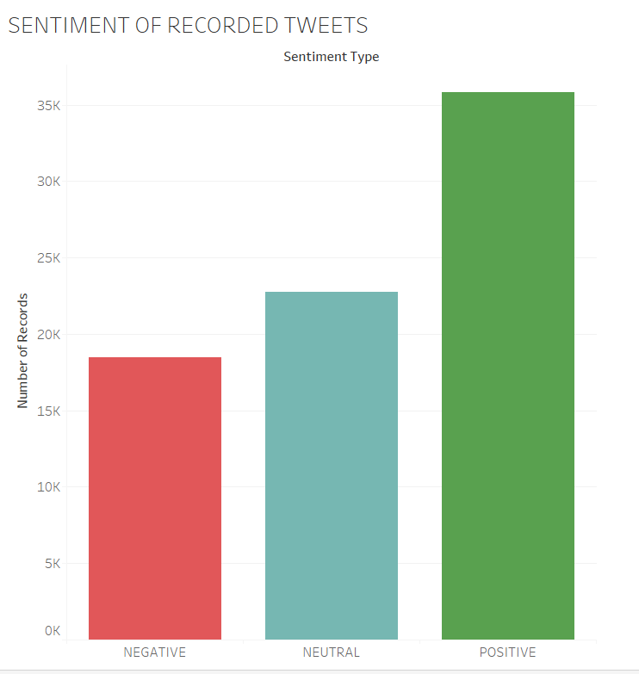

Slide 12
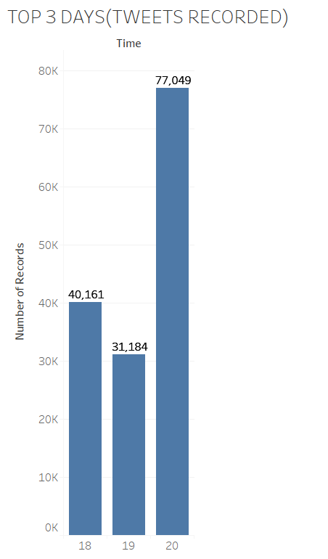

Slide 13
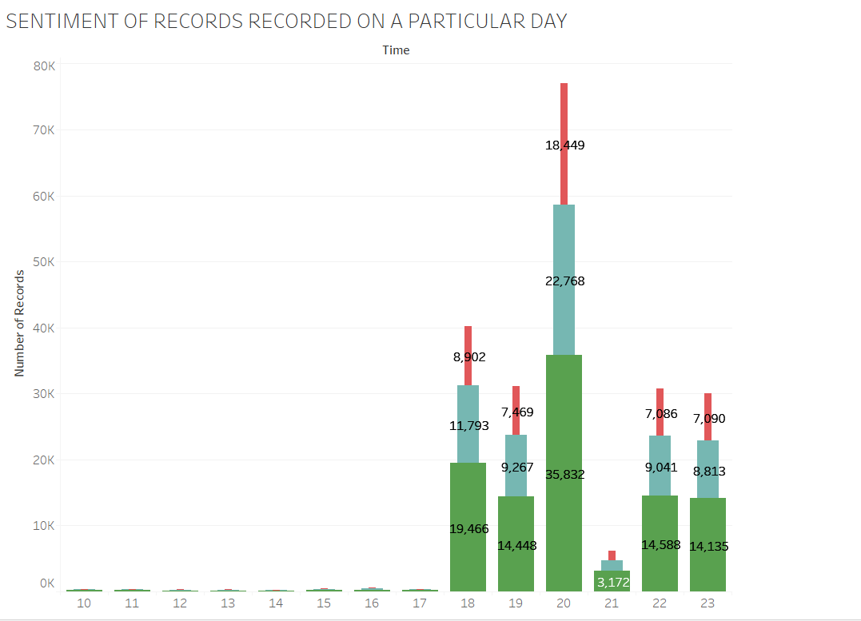

Slide 14
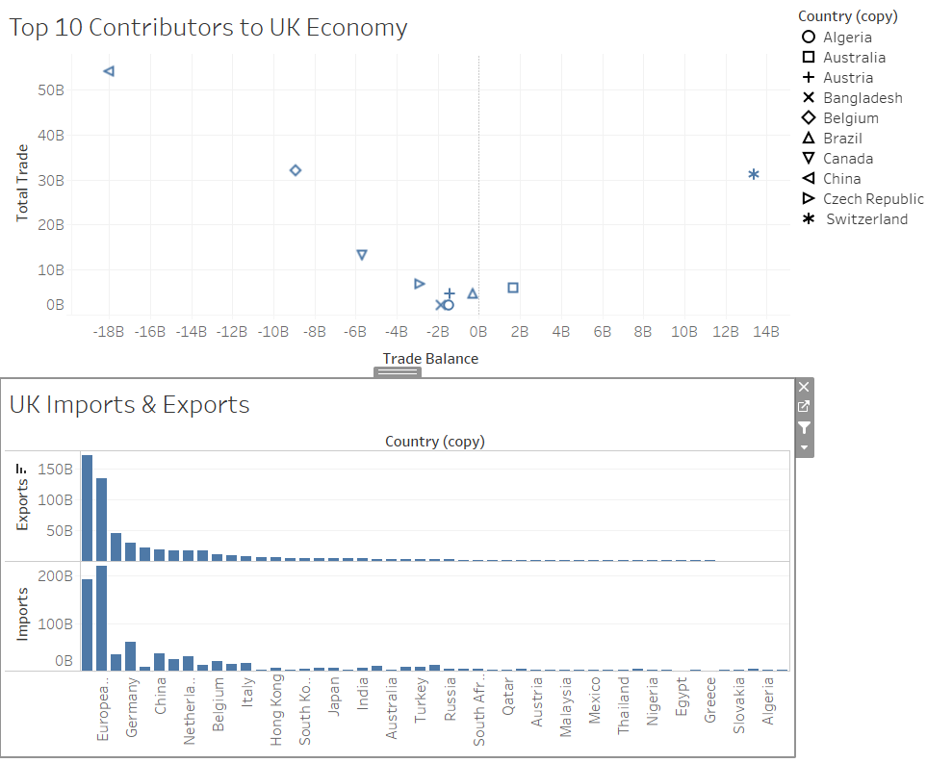

Slide 15
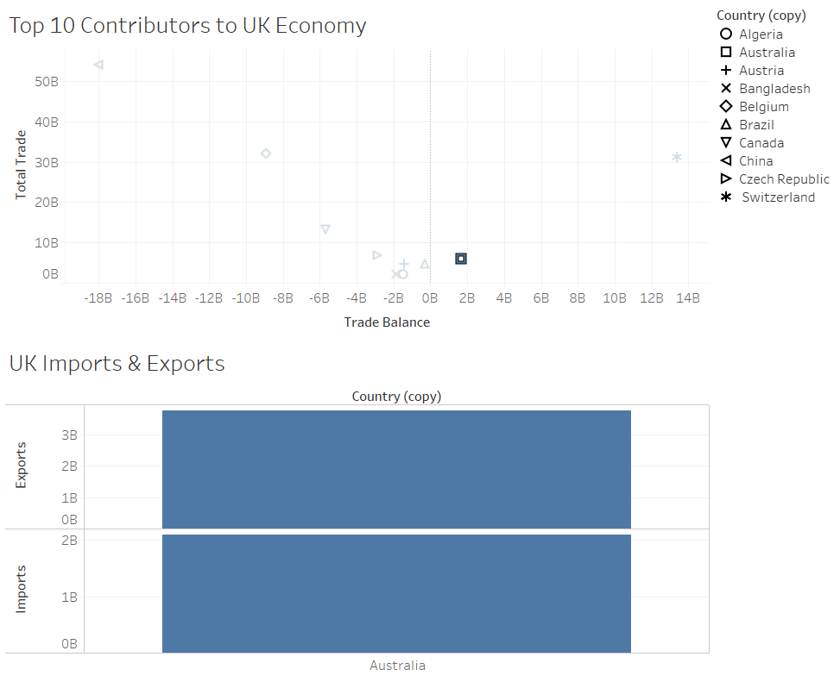

Slide 16
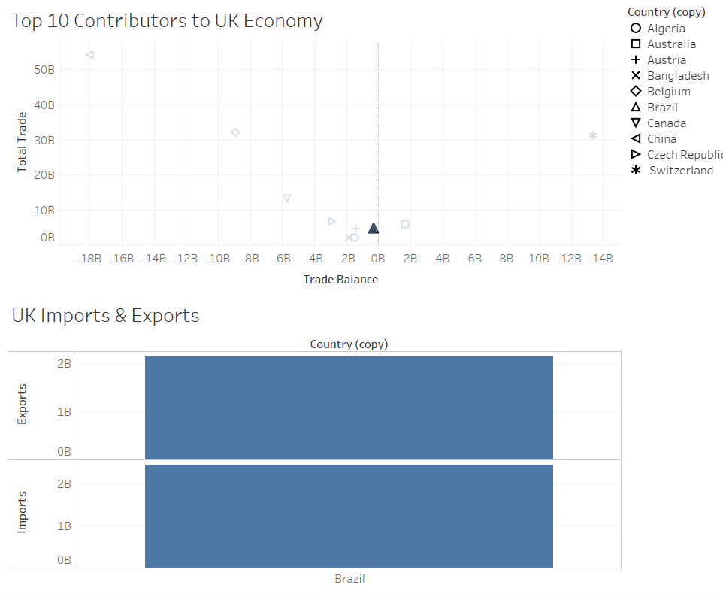

Slide 17
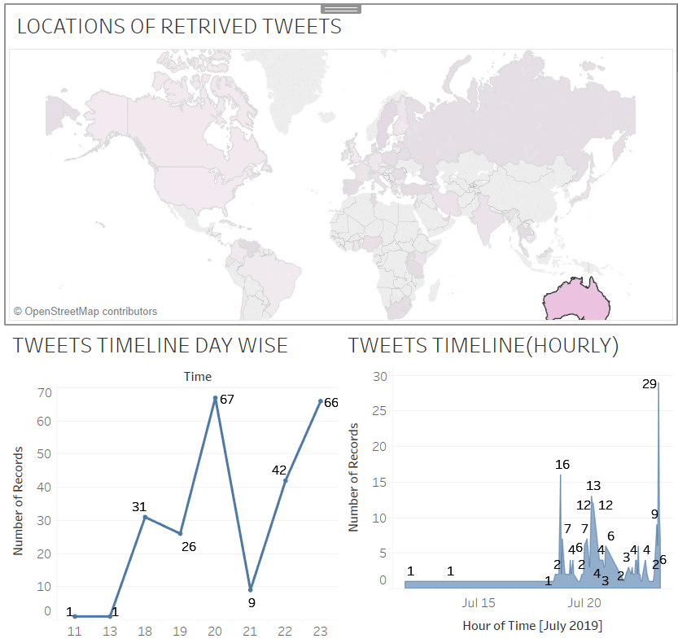

Slide 18
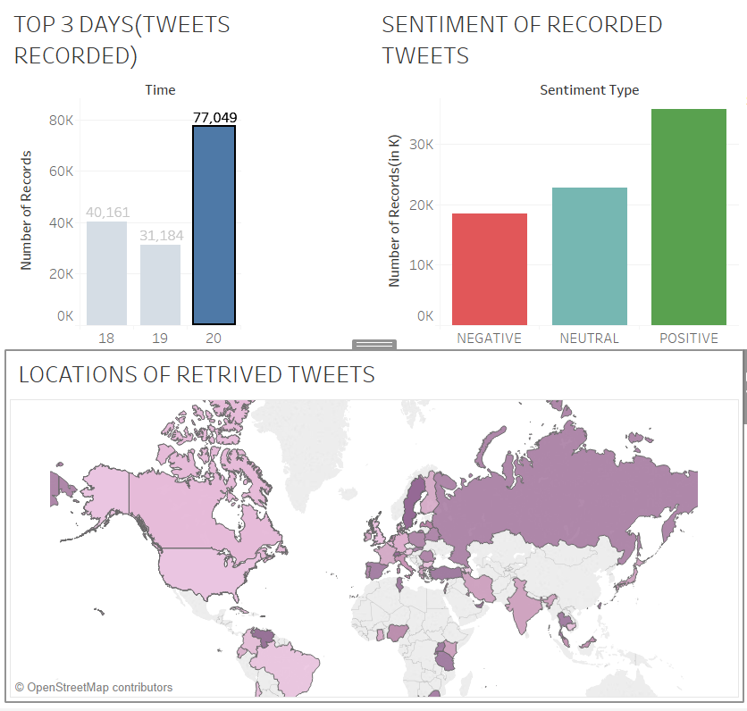

Slide 19
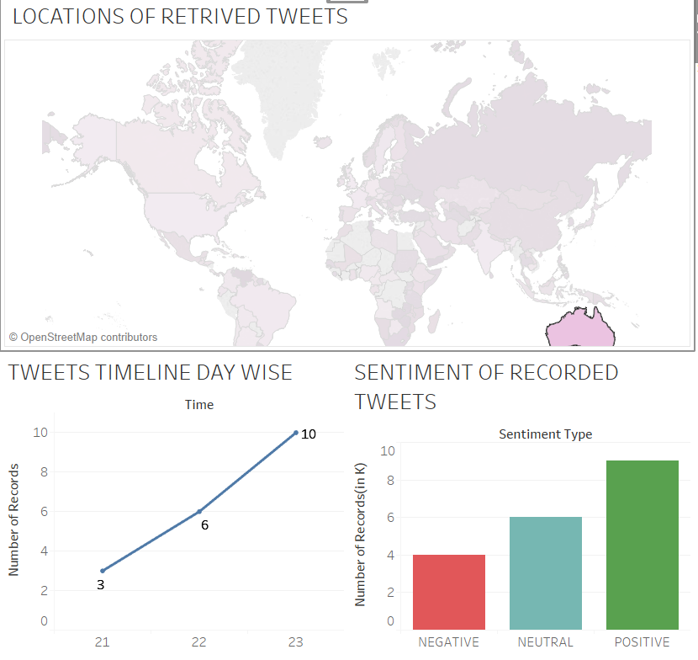

Slide 20


11
CONCLUSIONS
The business-friendly countries of United Kingdom have shown keen interest in events related to BREXIT; this gives us an understanding that there is an impact of BREXIT on such countries.
Its also noted that English speaking countries have also shown interest in BREXIT as compared to non-English-speaking countries.
12
REFERENCES
THANK YOU

