Slide 1

Odd Even vehicle detection based on Registration Plate
Bhupender Kumar

Slide 2

Introduction
A vehicle registration plate is a metal or a plastic plate attached to a motor vehicle for official identification purposes. The license plates are placed on the front and back of the vehicle.
ANPR is an image –processing technology which is used to identify vehicles by their number plates using Optical Character Recognition. This technology is used in various security and traffic applications such as access-control system.

Slide 3
Problem Statement
Now a days, traffic Jam in metro cites like Delhi NCR is creating problem for the commuting. And Heavy traffic causes the Air pollution As well.
So Govt implies the Odd even traffic rule to minimize the Traffic and air pollution.
Everyday there are Lakhs of vehicle running on the road.
now the problem is “How to categorized the vehicle base on Odd even number plate and Penalized the for rule breaking”???

Slide 4
Solution
While the vehicle approaches the road ,the ANPR unit using OCR technology automatically reads the license plate registration number, checks if number plate is Odd or Even and compare it with the odd even calendar date.
Below table Describe the Authorization Status.
Vehicle Number Plate | Calendar Date | Authorization Status
Odd | Odd | Allowed
Odd | Even | Restricted
Even | Odd | Restricted
Even | Even | Allowed

Slide 5
Solution
Automatic Number Plate Recognition (or license plate recognition') is a special form of optical character recognition (OCR).
It enables computer systems to read automatically the registration number (license number) of vehicles from digital pictures.
Reading automatically the registration number means transforming the pixels of the digital image into the ASCII text of the number plate.
OCR technology scans image documents and turn them into electronic, editable files.
Capturing of fast-moving vehicles needs special technique to avoid motion blur .
Although I have used direct image as the input.

Slide 6
Steps involved
1. Install and Import Dependencies
1
2.Read Image, Grayscale filter
2
3. Apply filter and find edges for localization
3
4. Find Contours and Apply Mask
4
5. EasyOCR ToText Reading
5
6. Result
6

Slide 7
Libraries and Dependencies
!pip install easyocr
!pip install imutils
import pandas as pd
import time
import datetime
import cv2
from matplotlib import pyplot as plt
import numpy as np
import imutils
import easyocr

Slide 8
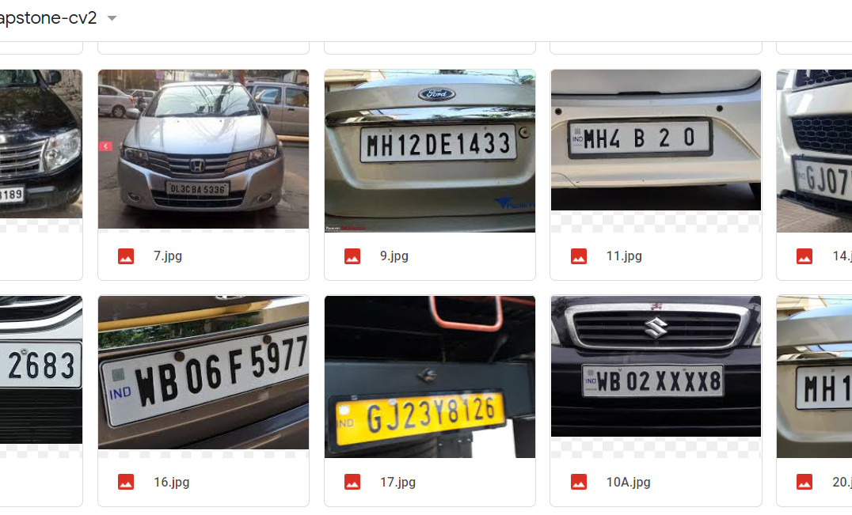
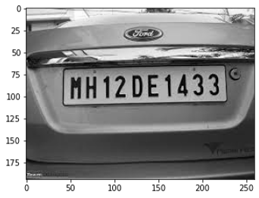
Read in Image
1. Reading the vehicle image from the data folder (Gdrive).
Grayscale apply-It is used for extracting descriptors that grayscale simplifies the algorithm and reduces computational requirements

Slide 9
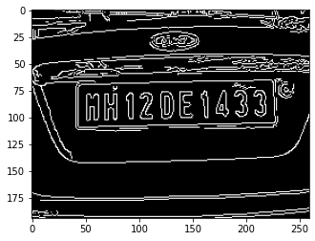
Apply filter and find edges for localization
1 Bilateral filter- It is used for smoothening images and reducing noise.
2. Edge detection- Canny() method of cv2 library to detect edges in an image.

Slide 10
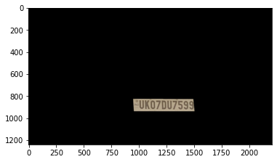
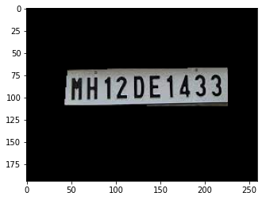
Find Contours and Apply Mask
1. Find Contour- finding the size of the object of interest, and object detection by considering first 10 counter detections.
Locate of license number plate from rectangle shape contour with four sides and closed figure.
Mask the rectangle shape contour- It allows us to focus only on the portions of the image that interests (License Number Plate)

Slide 11
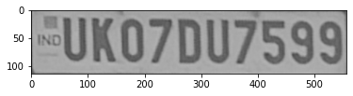
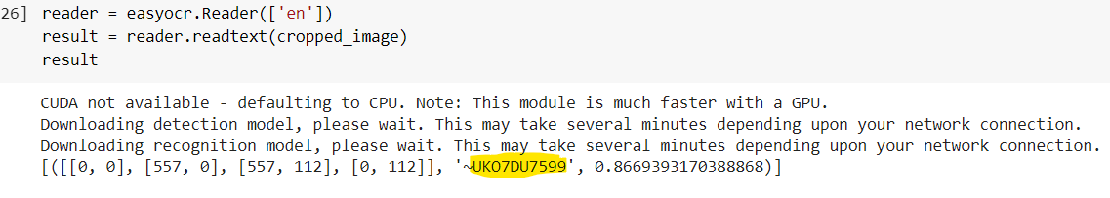
EasyOCR For Text Reading
EasyOCR is a python package that allows the image to be converted to text.
EasyOCR is created by the Jaided AI company.
The Reader class is the base class for EasyOCR here we provide the cropped part of masked imaged for text extraction.

Slide 12
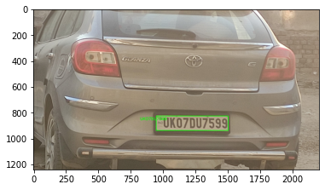
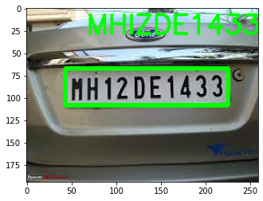
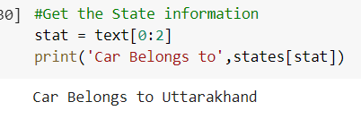
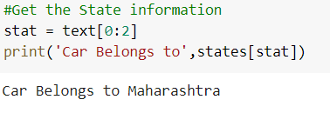
Result
License Plate Text extracted used for:
Getting the Vehicle registered in which state
Vehicle allowed in the Restricted Region (under Odd Even Scheme)

Slide 13
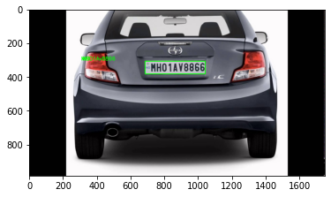
Result

Slide 14
Thank You
Q & A

