Slide 1
CampusEase
A Web-Based College Automation System for
Academic and Administrative Management
Bhupendra Malla, BIT 8th Semester (LC0003001648)
Supervisor: Mr. Saishab Bhattarai
Phoenix College of Management

Slide 2
Introduction
• Colleges run on many disconnected processes: enrollment, attendance, marks, fees, notices, communication.
• Most are still manual or spread across spreadsheets, paper, and separate tools.
◦ Data is duplicated, hard to track, and slow to act on for students, faculty, and staff.
• CampusEase: a single web platform that centralises academic and administrative operations.
• Role-based portals for students, faculty, secretaries, and administrators with automated services.

Slide 3
Problem Statement
• College operations are fragmented and largely manual:
◦ Enrollment, attendance, and marks are tracked by hand or in disconnected files.
◦ Fee collection lacks a digital, trackable, approval-based workflow.
◦ Communication (notices, messaging, events) is scattered across channels.
◦ No single role-aware portal, so each user juggles multiple systems.
• Need: one secure, role-based web system that unifies these workflows and automates routine tasks.

Slide 4
Objectives
• General: a web-based college automation system that centralises academic and administrative operations with role-based, automated services.
• Specific objectives:
◦ Design role-based access control for students, faculty, secretaries, and administrators.
◦ Implement subject enrollment, class scheduling, and academic-record management.
◦ Provide manual, OTP, and face-recognition attendance methods.
◦ Automate assignments, marks entry, and internal-marks calculation.
◦ Integrate secure online fee payment via Khalti with an admin approval workflow.
◦ Enable real-time messaging, discussion forums, events, and clubs.

Slide 5
Functional Requirements
• Role-based registration, email/OTP verification, and authentication.
• Subject enrollment via enrollment keys, class scheduling, academic records.
• Attendance by manual entry, one-time password, and face recognition.
• Assignment distribution/submission, marks entry, automatic internal-marks calculation.
• Online fee payment via Khalti with status tracking and admin approval.
• Real-time messaging, discussion forums, events, clubs, job/CV portal, digital ID cards.

Slide 6
Non-functional Requirements
• Performance: respond to typical actions within a few seconds at institution scale.
• Usability: role-specific dashboards usable with basic technical knowledge.
• Security: bcrypt-hashed passwords, JWT auth, role- and department-based access control.
• Reliability: consistent data via Mongoose schemas and validation.
• Maintainability and portability: modular Angular + Express, runs on any Node.js runtime.

Slide 7
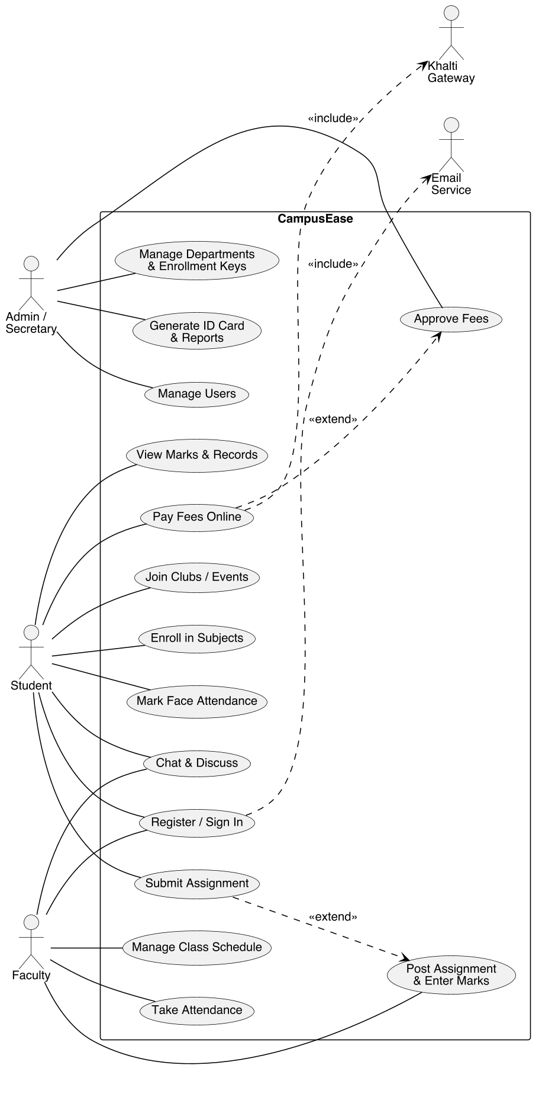
Requirement Modeling: Use-Case Diagram

Slide 8
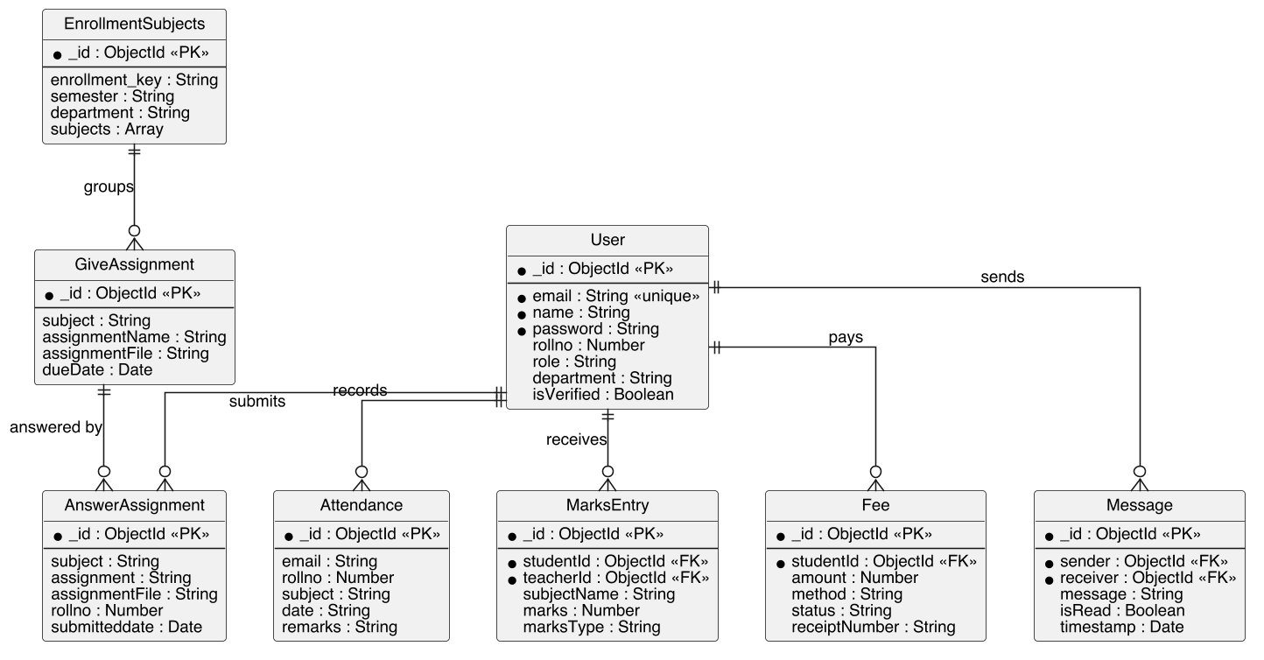
Data Modeling: ER Diagram

Slide 9
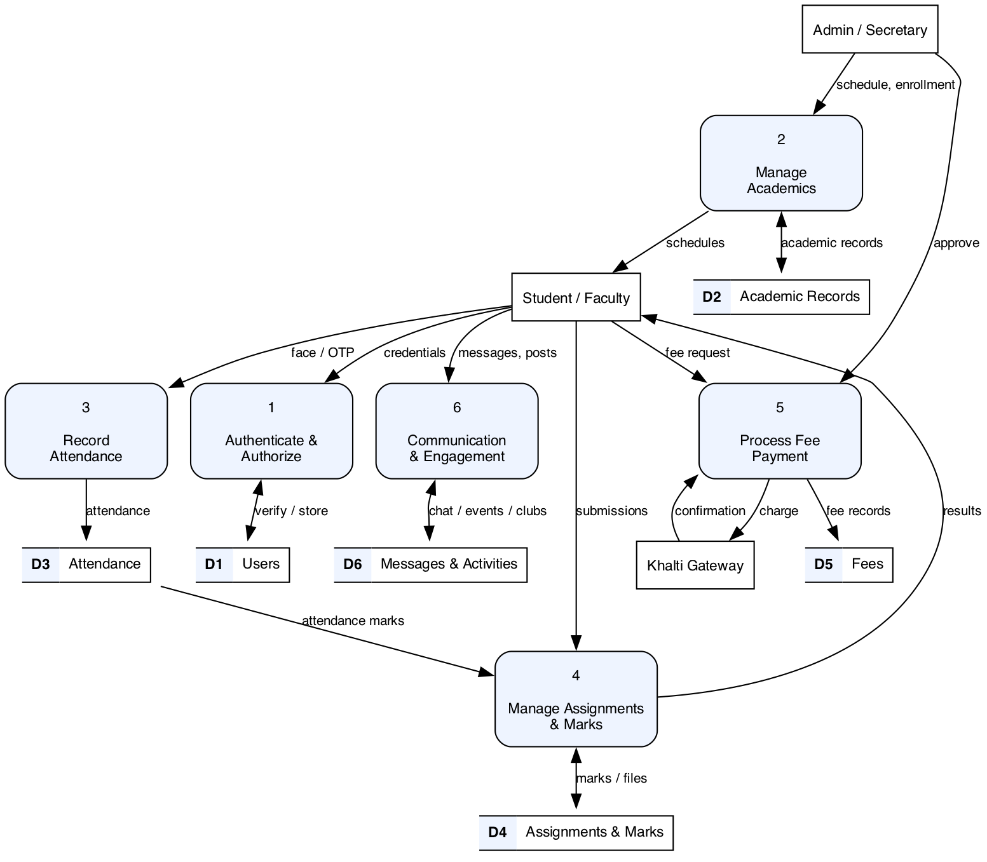
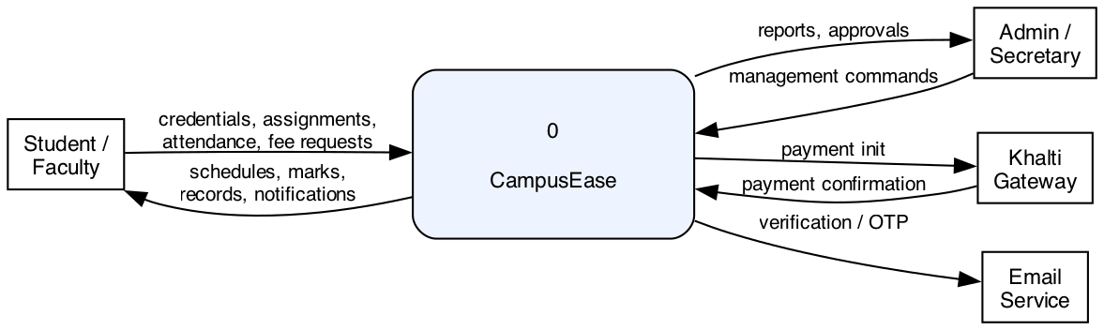
Process Modeling: Data Flow Diagrams
Level 0 (context)
Level 1

Slide 10
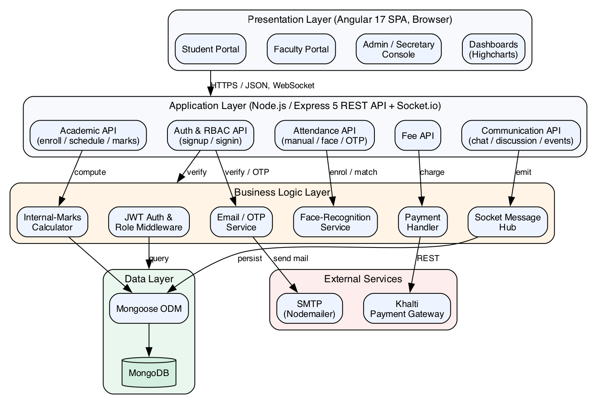
System Architecture

Slide 11
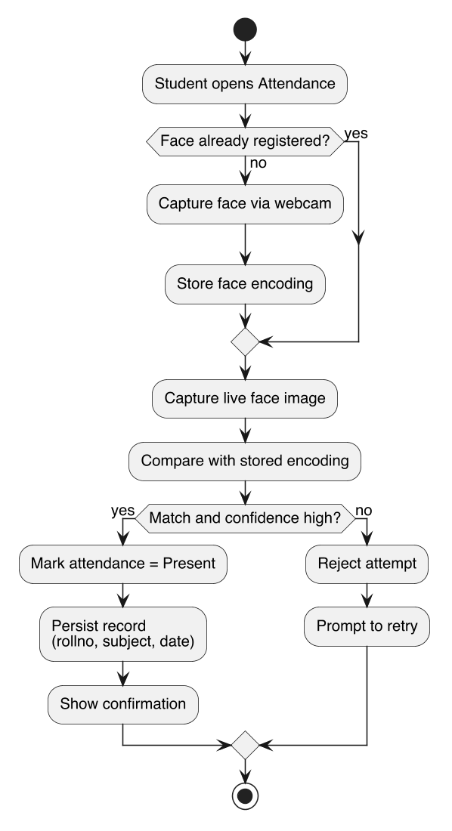
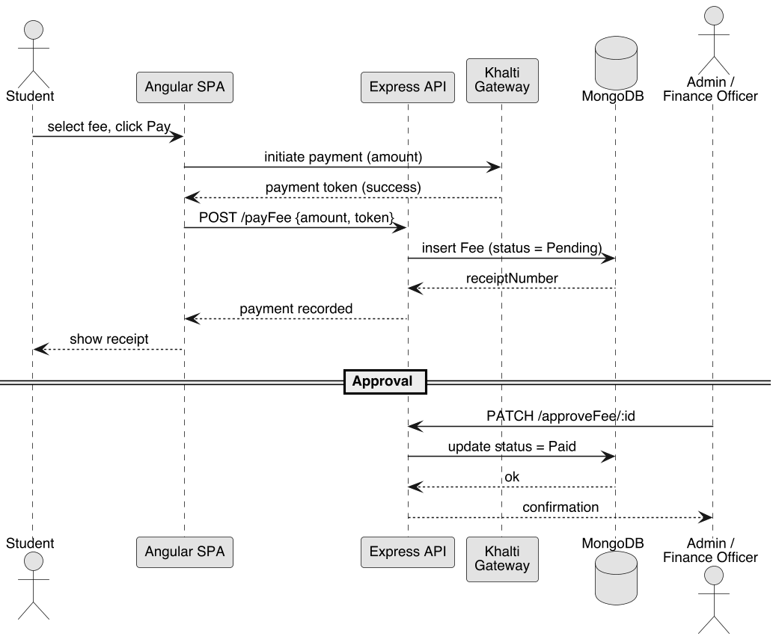
Behavioural Modeling: Activity & Sequence
Activity diagram
Sequence diagram

Slide 12
Implementing Tools
• Angular + TypeScript: role-specific single-page frontend portals.
• Node.js + Express: REST API; Socket.io for real-time messaging and presence.
• MongoDB + Mongoose: document database with schema-based data access.
• JWT + bcrypt: stateless authentication and one-way password hashing.
• Multer (uploads), Nodemailer (verification/OTP email), Highcharts (dashboards).
• Khalti: external gateway for online fee payment. Git/GitHub, VS Code, Angular CLI.

Slide 13
Implementation: Module Details
• Authentication & Role: registration, email verification, JWT login, RBAC middleware by role/department.
• Academic: enrollment-key based subject enrollment, class scheduling, academic records.
• Attendance: manual roll, short-lived OTP, and webcam face-recognition matching.
• Assignments & Marks: post/submit assignments, marks entry, automatic internal-marks calculation.
• Fee Payment: Khalti-initiated online payment, receipt + status, admin/finance approval.
• Communication & Admin: Socket.io messaging, forums/events/clubs, user/department management, job-CV portal, digital ID cards.

Slide 14
Key Workflows
• Role-based access control: JWT carries role + department; middleware gates every endpoint.
• Khalti payment: frontend -> backend initiate -> Khalti checkout -> return callback -> lookup verify -> fee marked Paid.
• Internal marks: assignment marks + attendance marks combined into a computed internal score.
• Attendance OTP: server issues a 5-minute code; student submits it (with location) to mark present.

Slide 15
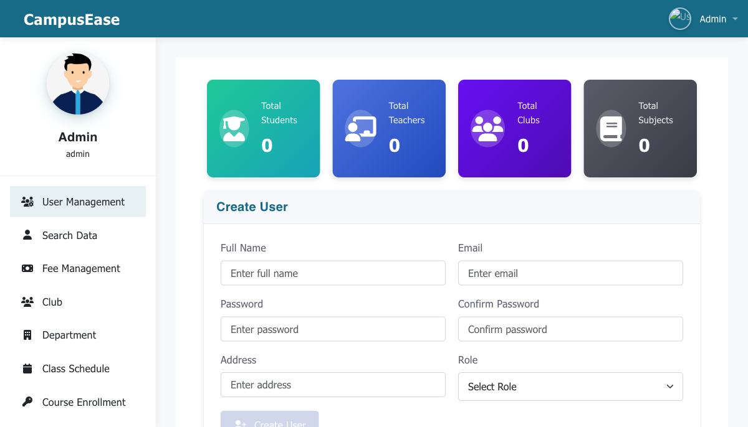
Application Demo: Admin Dashboard

Slide 16
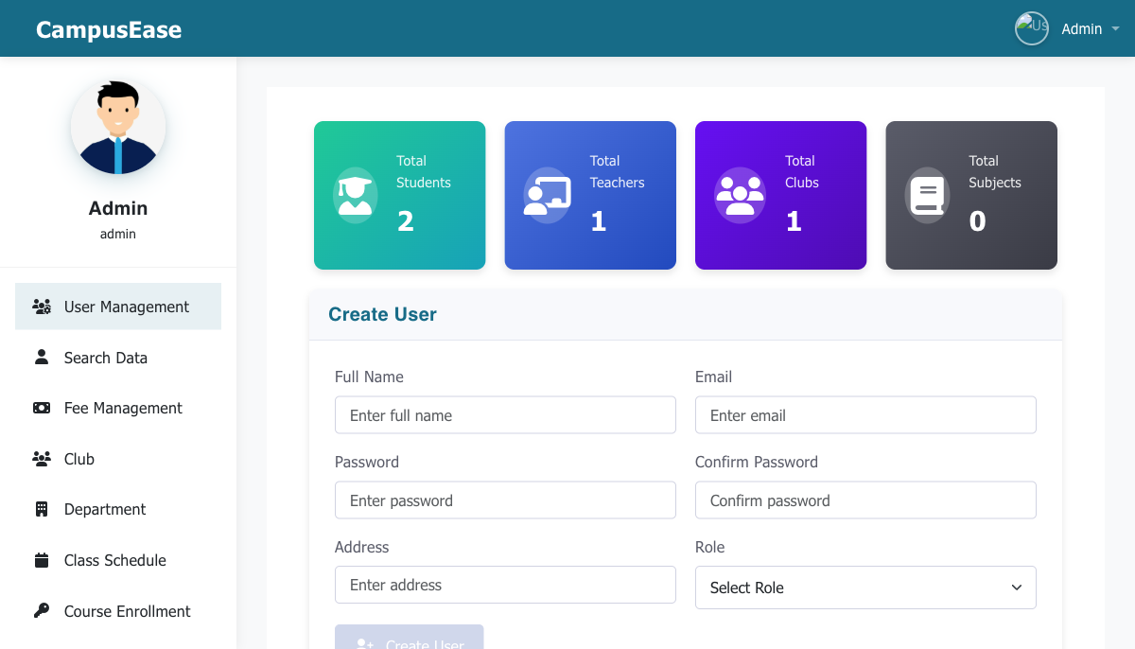
Application Demo: User Management

Slide 17
Conclusion
• A complete, working platform unifying enrollment, attendance, assignments, marks, fees, and communication.
• Role-based portals, three attendance methods, automatic internal marks, and verified Khalti online payment.
• Real-time messaging and engagement features, with secure JWT auth and per-role access control.
• All unit and system test cases passed; end-to-end tested across every role.
• Future work: real-time analytics, mobile app, ML-based insights, and multi-campus scaling.

