Slide 1
SecureLogTI
A Web-Based Threat Intelligence and Log Analysis
System with Automated IP Reputation Scoring
Prashant Sapkota, BIT (LC0003001683)
Supervisor: Mr. Saishab Bhattarai
Phoenix College of Management

Slide 2
Introduction
• Operating systems, servers, firewalls, and applications all produce security logs.
• Attacks (brute force, SQL injection, malware, denial-of-service) leave traces in logs.
◦ But log volume is huge and the few attack lines hide among thousands of routine entries.
• Enterprise SIEM/TIP tools analyse this well but are costly, complex, and expert-only.
• SecureLogTI: a lightweight web threat-intelligence platform for students, small orgs, and junior SOC analysts.

Slide 3
Problem Statement
• Manual log inspection is slow and error-prone:
◦ Volume and complexity: thousands of lines per server per day.
◦ Format fragmentation: syslog, Apache/Nginx, Windows, Docker, JSON, and more.
◦ Existing tools are costly and complex, or too narrow to give a full workflow.
◦ Little prioritization and opaque verdicts that are hard to trust or learn from.
• Need: a lightweight tool that centralises logs, detects threats transparently, and enriches IP reputation.

Slide 4
Objectives
• General: a web platform for centralised log analysis and automated threat classification using rule-based detection and IP reputation scoring.
• Specific objectives:
◦ Study existing log-analysis / threat-intelligence systems and their limits.
◦ Design a CRUD database with per-user data isolation.
◦ Build a multi-format log parser (more than seven formats).
◦ Develop a transparent, rule-based threat-scoring algorithm.
◦ Integrate AbuseIPDB reputation with a local fallback; visualise via dashboards.

Slide 5
Functional Requirements
• User registration and authentication, with per-user data isolation.
• Log ingestion by paste, file upload, or API.
• Automatic parsing of more than seven log formats.
• Rule-based threat detection and per-IP threat scoring.
• IP reputation enrichment via AbuseIPDB, with a local fallback.
• Automatic alert generation, dashboards, and reports.

Slide 6
Non-functional Requirements
• Performance: parse and analyse a typical batch within a few seconds.
• Usability: operable with basic technical knowledge, no configuration.
• Security: hashed passwords and strict per-user data isolation.
• Explainability: every verdict has a human-readable reason.
• Reliability, maintainability, and portability (any Node.js runtime).

Slide 7
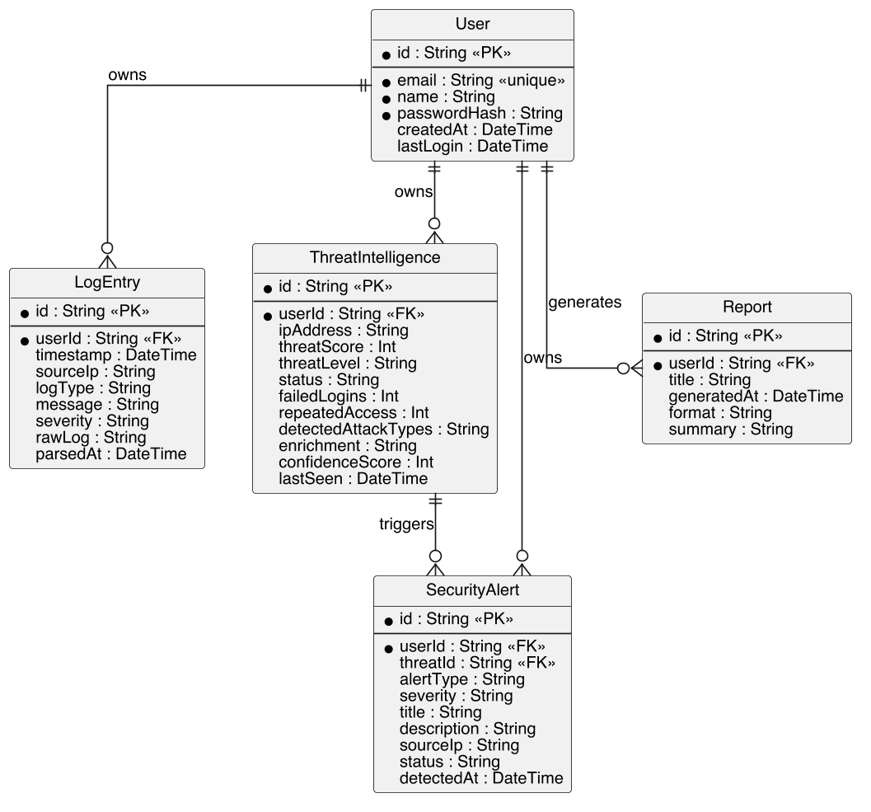
Data Modeling: ER Diagram

Slide 8
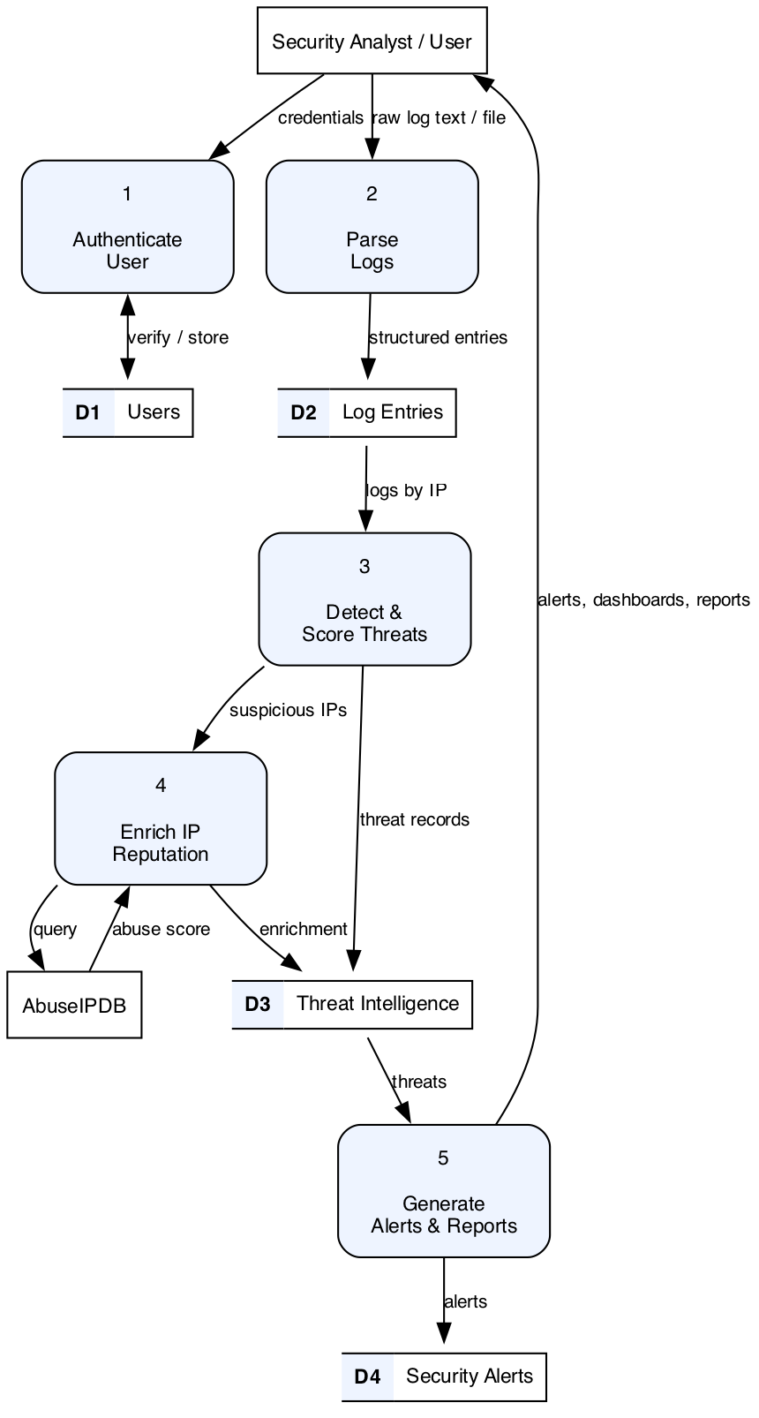
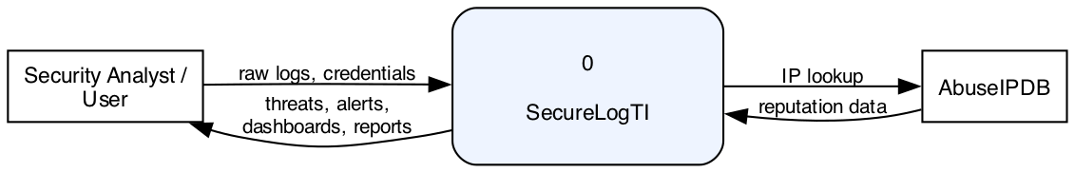
Process Modeling: Data Flow Diagrams
Level 0 (context)
Level 1

Slide 9
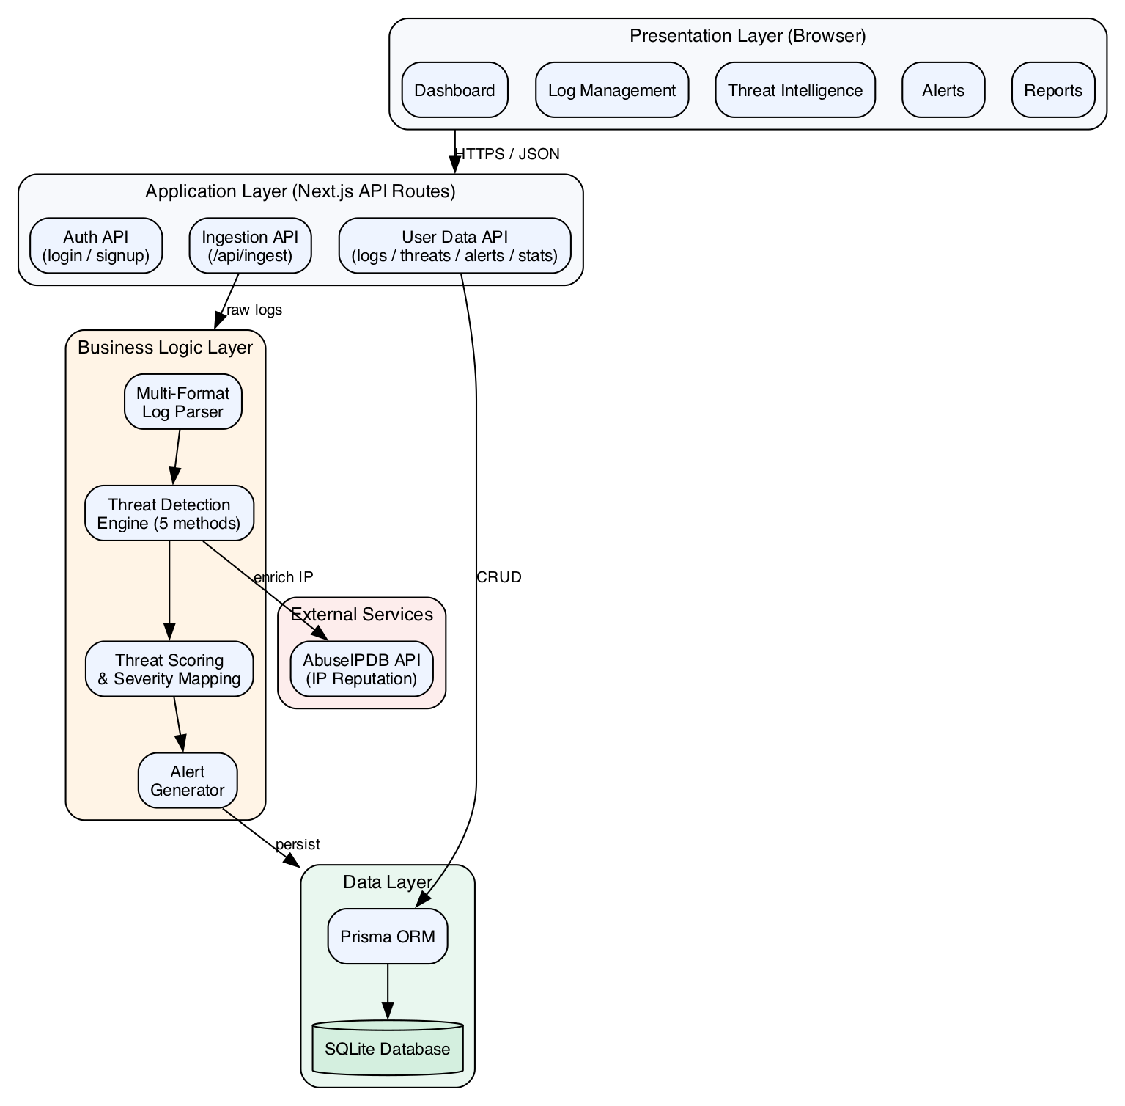
System Architecture

Slide 10
Algorithm Details
• Rule-based threat scoring, aggregated per source IP (additive and transparent):
◦ Failed auth attempts: +10 (1 to 2), +30 (3 to 4), +70 (5 or more).
◦ SQL injection +40, malware +50, denial-of-service +60.
• Final score = min(sum, 100); severity high >= 60, medium >= 30, low < 30.
• Five advanced methods (pattern, anomaly, temporal, escalation, correlation) add a weighted score.
• IP reputation adds a boost of -20 to +50, combining behaviour and external evidence.

Slide 11
Implementing Tools
• Next.js + React + TypeScript: full-stack UI and API routes.
• Prisma ORM over an SQLite database: type-safe, per-user data access.
• Tailwind CSS + Radix UI: responsive, accessible interface; Recharts for charts.
• AbuseIPDB REST API: live IP reputation, with a local fallback database.
• VS Code, Node.js, npm/pnpm, Git/GitHub, Prisma CLI.

Slide 12
Implementation: Module Details
• Authentication: registration, login, hashed passwords, isolated session.
• Log ingestion: paste, file upload, or API; one shared parse/store pipeline.
• Multi-format parser: detects format per line, reduces all to a uniform structure.
• Detection and scoring engine: rule-based score plus five advanced methods.
• IP reputation enrichment, alert generation, and Prisma data access with per-user isolation.

Slide 13
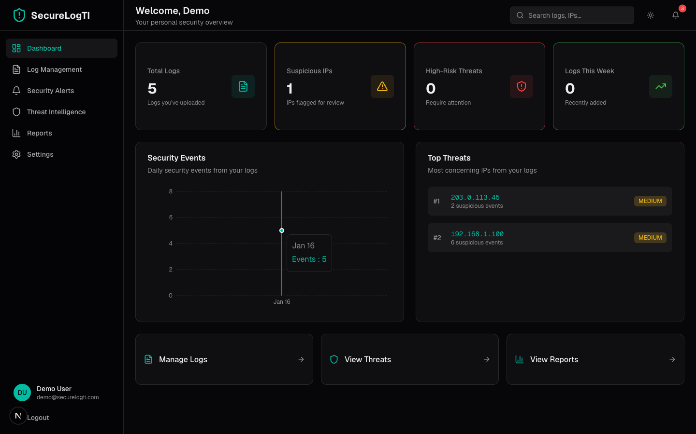
Application Demo: Dashboard

Slide 14
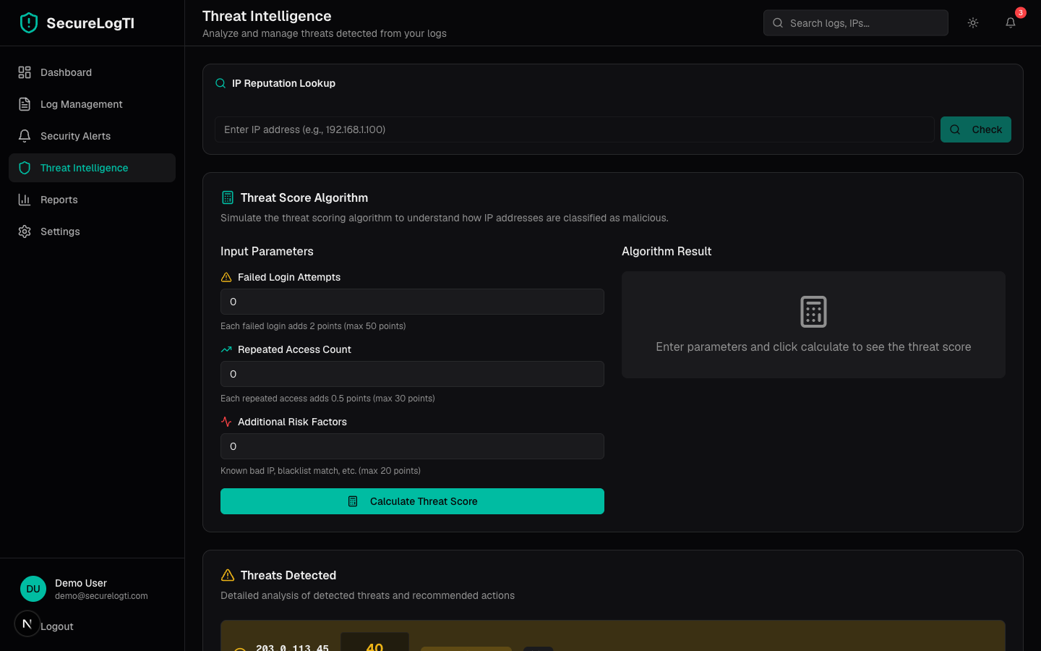
Application Demo: Threat Intelligence

Slide 15
Conclusion
• A complete, working platform: ingest → parse → aggregate → detect/score → enrich → alert → visualise.
• Multi-format parsing, transparent scoring, AbuseIPDB enrichment, prioritized alerts, per-user isolation.
• All unit and system test cases passed; every verdict is explainable, so it doubles as a learning aid.
• Future work: real-time monitoring, machine-learning detection, scalable database, more reputation sources.

