Slide 1

Movie Booking Application – Backend Architecture & Logging
Presented by Bhupesh

Slide 2
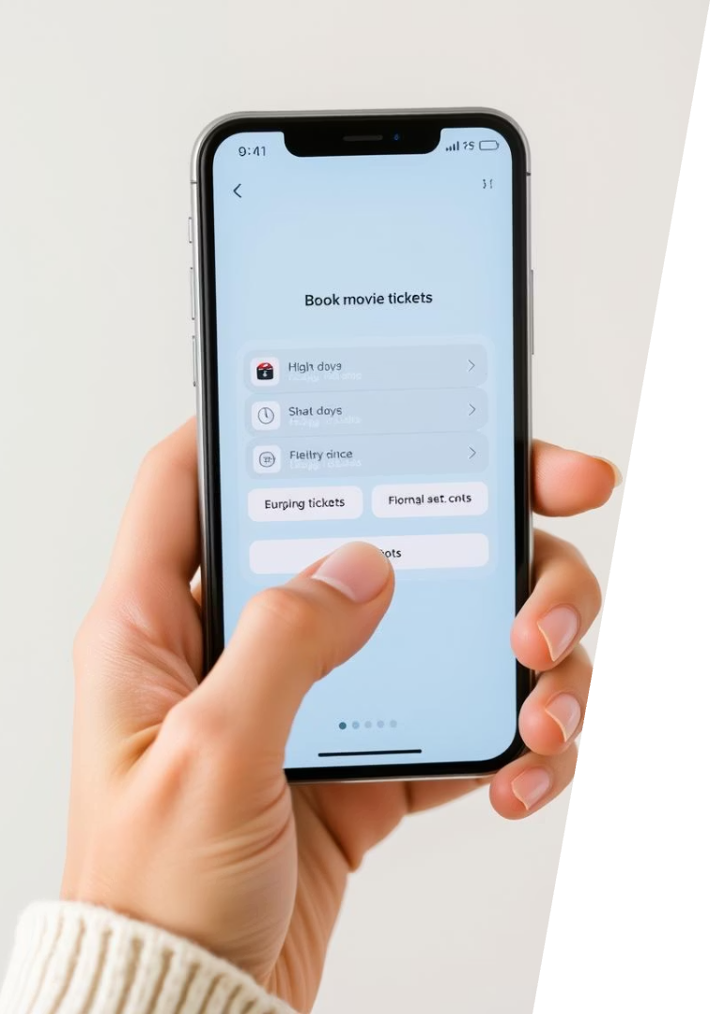
Project Overview
Core Features
User registration & login
Movie browsing
Ticket booking
Admin ticket management
Scope
Backend architecture and logging focus

Slide 3





Technology Stack
Java & Spring Boot
MongoDB
Kafka
Document-oriented NoSQL database
Centralized logging streaming platform
Robust backend service framework
ELK Stack
Log visualization and analytics

Slide 4





Backend Architecture Diagram
Client
Frontend or API consumer
Controller
Handles REST endpoints
Service Layer
Business logic, Kafka logging here
Repository
MongoDB data interaction
MongoDB
NoSQL storage

Slide 5
Module Breakdown
Auth Module
Movie Module
Booking Module
Admin Module
User registration
Retrieve movie listings
Ticket booking and confirmation
Manage seat availability
Login authentication
View and manage bookings

Slide 6
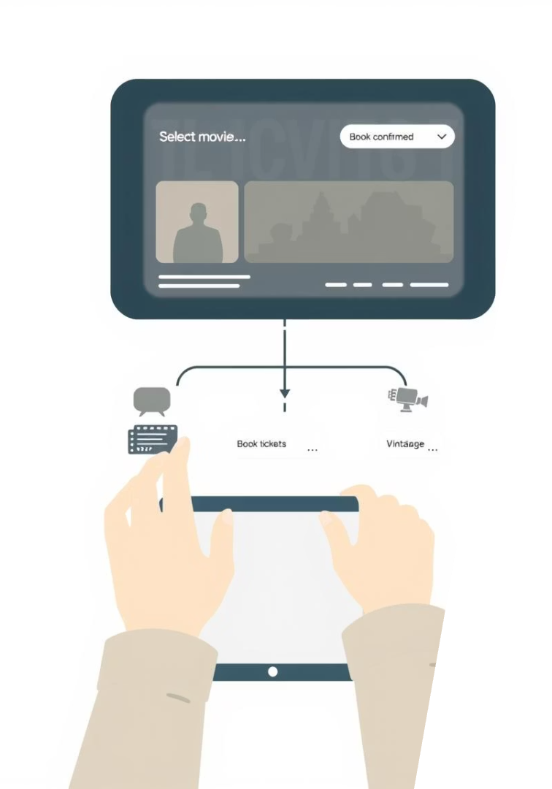
MongoDB Schema & API Workflow
Key Entities
User
Movie
Booking
API Booking Flow
Controller receives request
Service processes business logic
Repository interfaces with MongoDB
Logs sent to Kafka topic

Slide 7
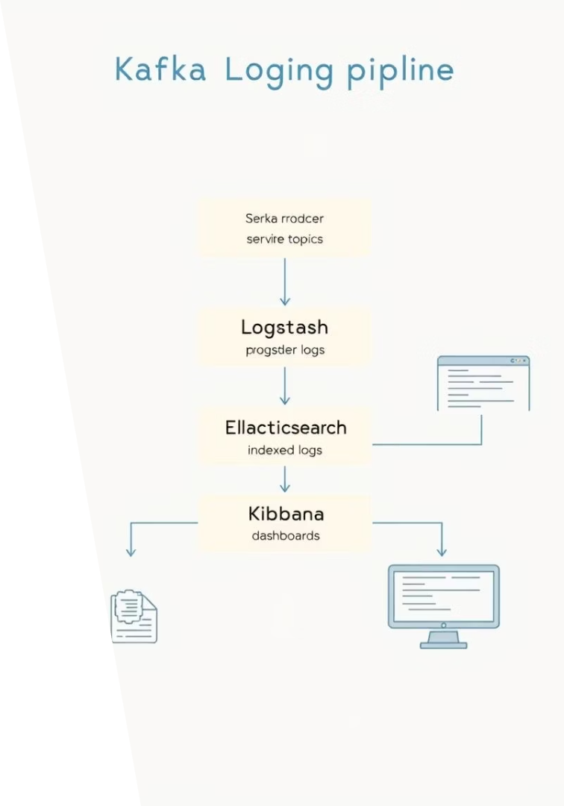
Kafka + ELK Logging Flow
Kafka Producer
Sends service layer logs to Kafka topics
Logstash
Reads from Kafka, filters and processes logs
Elasticsearch
Stores indexed logs for search
Kibana
Visualizes logs with dashboards

Slide 8
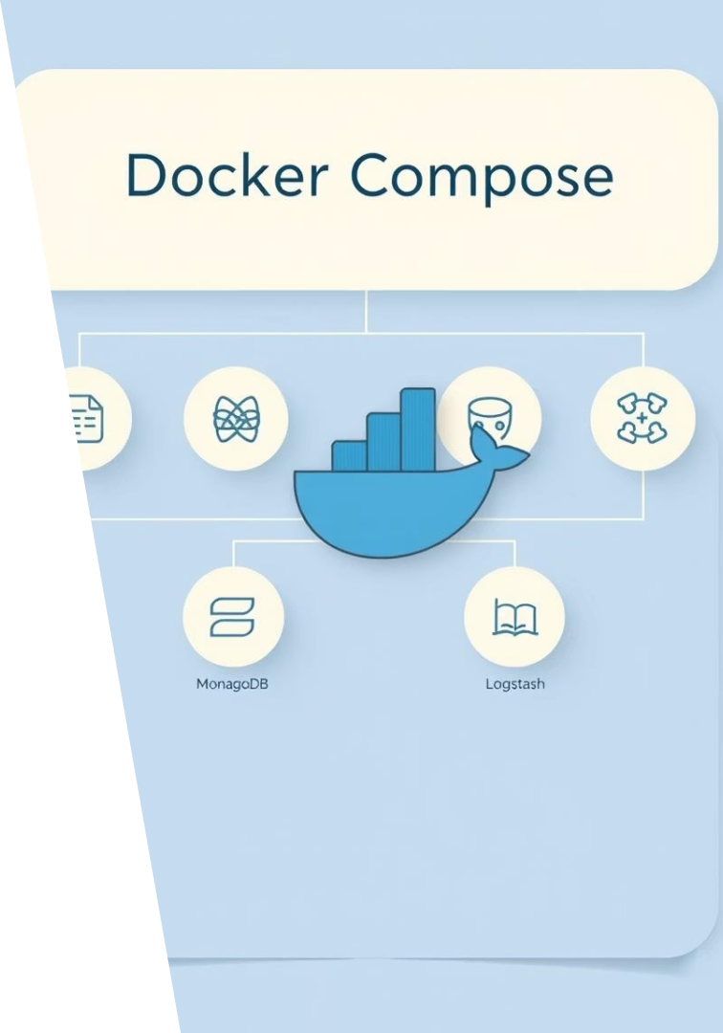
Docker Compose Overview
Services
MongoDB (custom DB)
Kafka (KRaft mode)
Mongo Express (DB admin)
ELK Stack for logging
Summary
Centralized docker network for modular backend
Thank you for your attention!

