Slide 1
Weather Forecasting ML Project (Hackathon - Xto10x)
By Bhupesh and Ashish

Slide 2
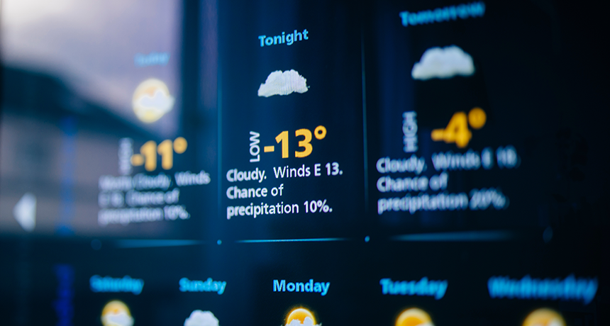
Problem Statement
Weather prediction is complex due to rapidly changing variables.
ML models used to forecast temperature, humidity, wind speed, and more.

Slide 3
Models Used
Linear Regression
Multilayer Perceptron (MLP) / Fully Connected Neural Network (FCNN)

Slide 4
Dataset Overview
Data from 2006 to 2016
Columns: Date-Time, Temperature, Humidity, Wind Speed, Wind Direction, Pressure, Cloud Cover
Target: forecasted_weather (numeric or categorical)
Here is the dataset used in the model -

Slide 5
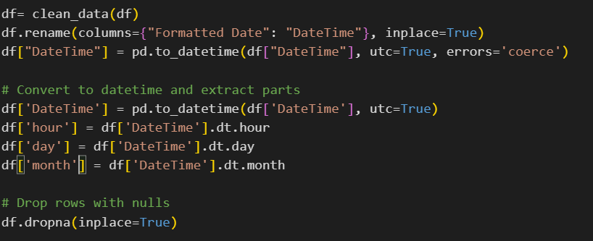
Data Processing Steps
Data Cleaning
Feature Scaling using StandardScaler
Feature Engineering: hour, day, month (scope to improve)
Model Training and Prediction using Date-Time input
Comparison with real data

Slide 6
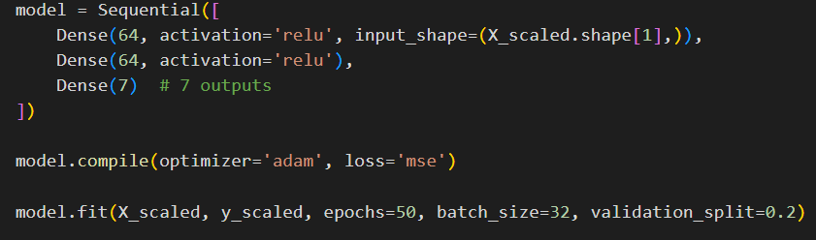
Model Evaluation & Choice
Used MAE and MSE for error evaluation
LSTM dropped due to non-sequential data pattern
MLP selected for better generalization
Model appends API data to improve robustness

Slide 7
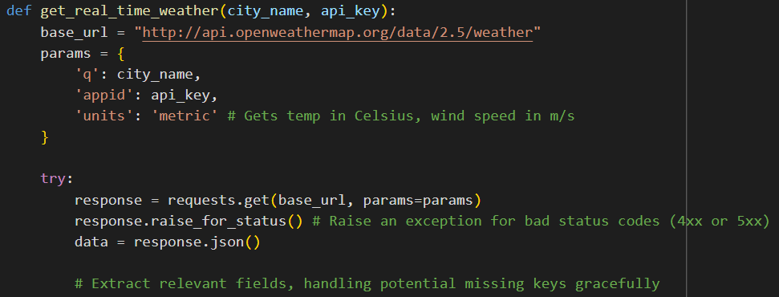
API Integration
Uses OpenWeatherMap API to fetch live weather data
Future plan to automate using cron/Airflow (not yet implemented)
Auto-retraining with updated data planned

Slide 8
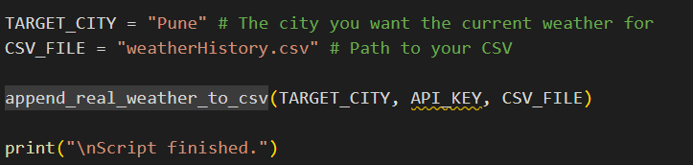
API Saving the data to original dataset

Slide 9
Supaboard Dashboard
Replaced custom dashboard with Supaboard
Live predictions and historical data available
URL: https://app.supaboard.ai/.../weather-test-1

Slide 10
Overall Pipeline
Data Cleaning → Feature Scaling → Model Training
→ Forecasting → API Integration → Supaboard Dashboard

Slide 11
Future Work
Implement automated scheduler for API calls
Enhance feature engineering (lag features, cyclical encoding)
Explore advanced time-series models like GRUs/LSTMs

Slide 12

The End
Special Thanks to Masai and IIT Ropar faculty for this Hackathon opportunity.

