Slide 1
HIT140 · THREE-MINUTE BRIEFING
World Cup 2026
What we asked, how we tested it, and what held up
Four distinct statistical questions, each with a sample, a 95% confidence interval, and a t-test.
Two linear models using only information available before kickoff.
Spain 1–0 Argentina after extra time · 19 July 2026 · MetLife Stadium
Notes:
Good morning. This is a three-minute briefing on World Cup 2026 — the first forty-eight-team tournament, won by Spain, one-nil after extra time against Argentina.
We asked four distinct statistical questions, each with a different focal point, and we built two linear models that try to predict the score using only information you could have known before kickoff.

Slide 2
HOW THE WORK WAS SET UP
Real data, then the same inferential path every time
104
official matches
48
national teams
1,016
players who featured
α = 0.05
every hypothesis test
Each Objective 1 task had a different focal point — discipline, crowds, money, age — so we were not asking the same goals question four times.
Pipeline for every task: formulate the question → wrangle → sample → describe → 95% CI → t-test.
Objective 2 is different: predict the score from eight pre-match variables only. Ranking, squad value, age, host status, rest days, confederation, knockout flag. No shots, no possession, nothing from during the game.
Notes:
The data are real: one hundred and four matches, forty-eight teams, and one thousand and sixteen players who actually appeared.
Every Objective 1 task follows the same path: a question, a sample, descriptive statistics, a ninety-five percent confidence interval, and a t-test at alpha 0.05. Objective 2 then asks: if you only know ranking, squad value, age, host status and rest days before the match, how well can you predict the result?

Slide 3
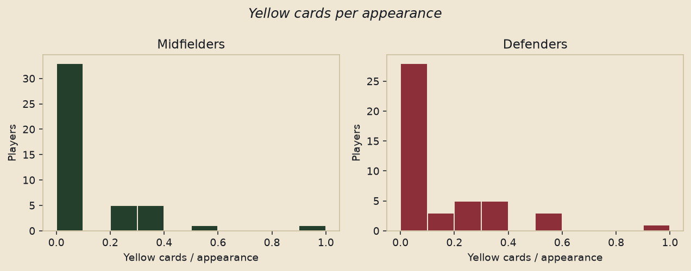
TASK 1 · PLAYER DISCIPLINE
Are midfielders booked more than defenders?
The story people tell
Midfielders fight for the ball in the middle of the pitch, so they should pick up more yellow cards.
How we tested it
Only players with at least one appearance. Outcome is cards per appearance, so a seven-match finalist is compared fairly with a one-match substitute. Simple random sample of 45 midfielders and 45 defenders.
What the chart shows
Both groups pile up at zero. Means: 0.10 vs 0.13. 95% CI for midfielders (0.04, 0.16).
Decision
t-test p = 0.45. Fail to reject H₀. The “dirty midfield” is not supported.
Notes:
First: are midfielders booked more than defenders? People assume they are because they fight for the ball in midfield. We used yellow cards per appearance, so a seven-match finalist is not punished for playing more, and we sampled forty-five players from each position.
Look at the histogram — both groups pile up at zero. Means are 0.10 versus 0.13. p is 0.45, so we fail to reject the null. The “dirty midfield” story is not supported.

Slide 4
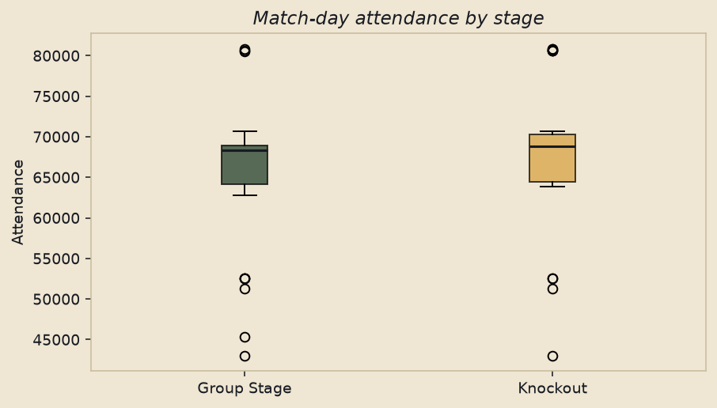
TASK 2 · MATCH-DAY ATTENDANCE
Did knockout games draw bigger crowds?
The story people tell
A 48-team group stage is spread across weekday slots, so knockouts should look fuller.
How we tested it
All 104 matches have official attendance. Stratified sample: every knockout match (32) plus 32 random group matches, so the two groups are the same size.
What the chart shows
The boxes sit on top of each other. Means: 67,701 vs 65,747. Overall 95% CI about (64.5k, 68.9k).
Decision
p = 0.38. Fail to reject H₀. Crowds were large from match one — they did not wait for the knockouts.
Notes:
Second: did knockouts draw bigger crowds? With forty-eight teams you might expect thin weekday group games. We compared all thirty-two knockout matches with a random sample of thirty-two group matches.
The box plots sit on top of each other: about sixty-eight thousand versus sixty-six thousand. p is 0.38. Not significant. This World Cup filled stadiums from match one.

Slide 5
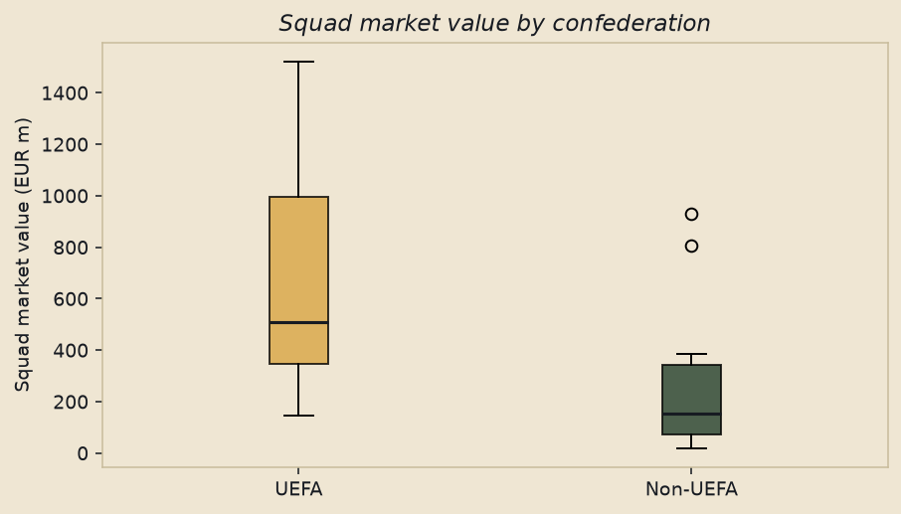
TASK 3 · SQUAD MARKET VALUE
Do UEFA squads carry more value than the rest?
The story people tell
European national teams stock their World Cup squads from the richest club leagues, so they should be worth more.
How we tested it
Transfermarkt value of each 26-man squad. Balanced sample of 14 UEFA teams and 14 from CONMEBOL, CONCACAF, CAF, AFC and OFC. One-sided test: UEFA higher.
What the chart shows
UEFA median and mean sit far above the rest: €670m vs €257m — about 2.6 times.
Decision
p = 0.004. Reject H₀. Large effect (d = 1.08). Europe’s club market shows up at national-team level.
Notes:
Third: money. Are UEFA squads worth more on Transfermarkt? Fourteen European teams against fourteen from the rest of the world.
The gap is large: six hundred and seventy million euros against two hundred and fifty-seven million — about two and a half times. p is 0.004, a large effect. Europe’s club market really does show up in national-team squads.

Slide 6
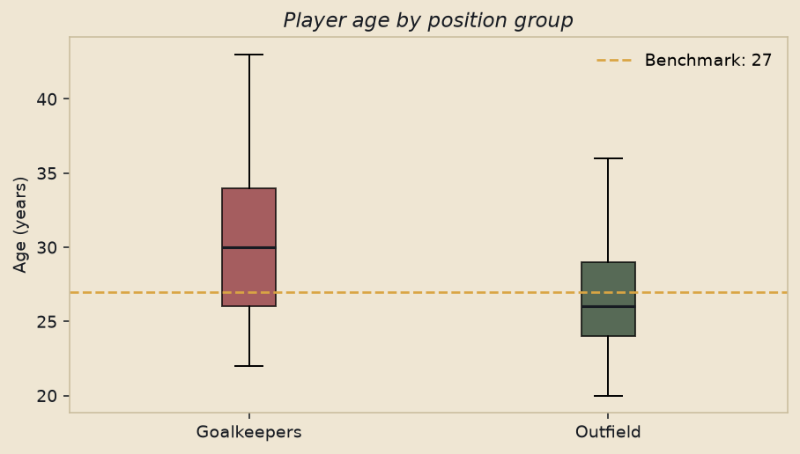
TASK 4 · GOALKEEPER AGE
Do keepers last past the outfield “prime” of 27?
The story people tell
Goalkeepers peak later and keep their place into their thirties, unlike outfield players.
How we tested it
One-sample t-test of keepers who appeared (n = 40) against a fixed 27-year benchmark. Then a supporting two-sample comparison with 40 outfield players.
What the chart shows
The dashed line is 27. The keeper box sits clearly above it. Mean 30.3 years; 95% CI (28.7, 31.9).
Decision
p = 0.0001 vs 27. Also 3.6 years older than outfielders (p = 0.0004). Longer shelf life is real.
Notes:
Fourth: do goalkeepers last longer? We tested keepers who appeared against the usual outfield “prime” of twenty-seven, and against outfield teammates.
The dashed line on the chart is twenty-seven. The keeper box sits clearly above it, at 30.3 years. p is 0.0001. They are also about three and a half years older than outfield players. That longer shelf life is real.

Slide 7
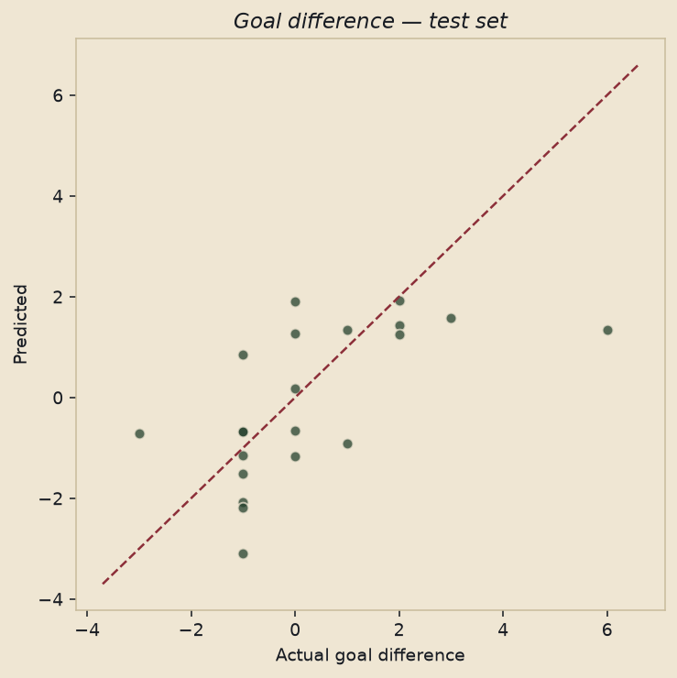
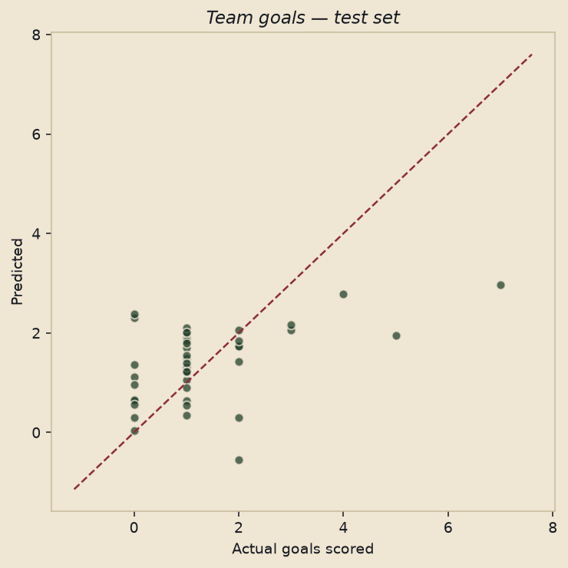
OBJECTIVE 2 · TWO PRE-MATCH MODELS
Can we predict the score before kickoff?
Eight explanatory variables in each model, all knowable before the match — ranking, squad value, age, host, rest, confederation, knockout. No shots. No possession.
2.1 Goal difference · 104 matches
R² = 0.49 · test RMSE 1.57 goals
Significant: FIFA rank gap, squad-value gap
2.2 Team goals · 208 team-matches
R² = 0.29 · test RMSE 1.23 goals
Significant: opponent rank, own squad value
Notes:
Now the two models. Eight predictors each, all knowable before kickoff — no shots, no possession.
On the left, goal difference across one hundred and four matches. R-squared 0.49. Typical error about one and a half goals. What mattered: ranking gap and squad-value gap. Host, rest and age dropped out.
On the right, goals scored by a team, two hundred and eight rows. R-squared 0.29 — noisier, because one tally is harder than a difference. What mattered: opponent’s rank and own squad value. The scatter plots are the held-out tests: they follow the diagonal, with the noise you expect from football.

Slide 8
WALK-AWAY POINTS
What survived the tests
1
Crowds did not wait for knockouts.
Group and knockout attendance were statistically the same. The 48-team format still filled grounds.
2
Europe’s money is a real gap.
UEFA squads were about 2.6 times more valuable. Keepers were also clearly older than 27.
3
Rank and value beat folklore.
They predict goal difference and goals. Host, rest and age drop out once those two are in the model.
Notes:
Three takeaways. Crowds did not wait for knockouts. Europe’s money is a real gap. And before a match, rank and squad value — not rest days or host status — are what move the scoreline. Thank you.

