Slide 1
HIT140 · Foundation of Data Science · Assignment 2
World Cup 2026
Statistical analysis & linear regression
Four inferential tasks and two pre-match linear models on the first 48-team tournament — won by Spain, 1–0 after extra time over Argentina, 19 July 2026 at MetLife Stadium.
MATCHES
104
NATIONAL TEAMS
48
PLAYERS WHO FEATURED
1,016
CHAMPION
Spain
Notes:
This is HIT 140 Assignment 2: World Cup 2026 analytics. Spain won the first 48-team tournament, 1–0 after extra time over Argentina. We analysed 104 matches, 48 national teams, and 1,016 players who featured. There are four inferential tasks and two pre-match linear models, all at alpha 0.05.

Slide 2
How the dataset was compiled
Three independently compiled tables. Own goals and red-card totals reconcile with official FIFA figures.
Table | Grain | Rows | Primary sources
matches_raw.csv | one official match | 104 | FIFA match centre, Wikipedia, worldcup.org.uk
teams_raw.csv | one national team | 48 | FIFA ranking 11 June 2026, Transfermarkt, Wikipedia
players_raw.csv | players with ≥1 appearance | 1,016 | Wikipedia squads, FotMob leaderboards
All 104 attendances are official. Player goals (294) + 14 own goals = 308 tournament goals. Red cards (15) match the official count.
OBJECTIVE 1 · FOUR TASKS
Each task uses a distinct question and the same six skills: formulate, wrangle, sample, describe, 95% CI, t-test at α = 0.05.
Samples are drawn on purpose (seed 42) so the two groups stay balanced — not because the population is unknown.
OBJECTIVE 2 · TWO REGRESSIONS
Exactly eight pre-match predictors. No shots, possession, or in-match events. 20% hold-out, VIF check, Shapiro–Wilk on residuals.
2.1 goal difference (n = 104) 2.2 team goals (n = 208)
Notes:
The data sits in three tables: matches, teams, and players. Player goals plus own goals reconcile to the official 308-goal total, and 15 red cards match FIFA. Each Objective 1 task follows the same six skills: question, wrangle, sample, describe, a 95 percent CI, and a t-test. Objective 2 predicts outcomes using only information knowable before kickoff — ranking, squad value, age, titles, host, rest, confederation, and knockout. No shots, no possession, no in-match events.

Slide 3
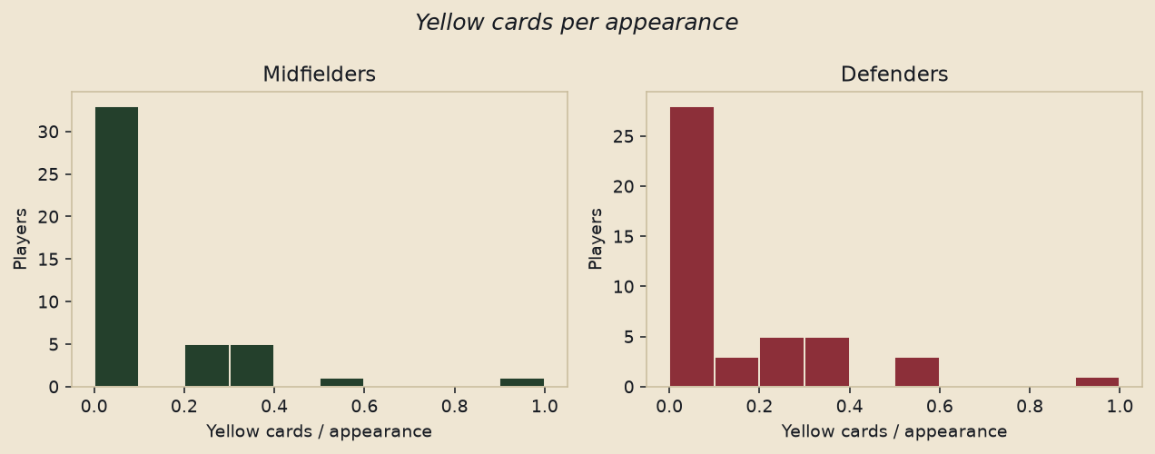
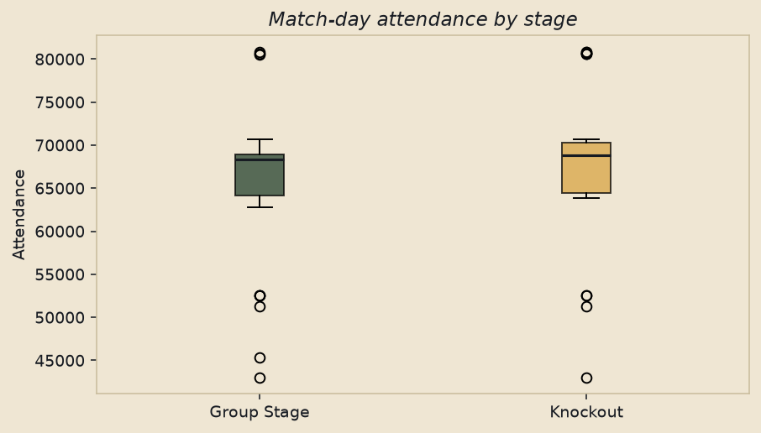
Objective 1 · two questions the data does not support
TASK 1 · PLAYER DISCIPLINE
Do midfielders pick up more yellow cards per appearance than defenders?
TASK 2 · MATCH-DAY ATTENDANCE
Is average attendance different between knockout and group-stage matches?
n = 45 vs 45 · means 0.098 vs 0.131
t(88) = −0.76 · p = 0.4485 · d = −0.16
Fail to reject H₀. The “midfield battle” booking narrative is not supported.
n = 32 vs 32 · means 65,747 vs 67,701
t(62) = 0.88 · p = 0.3801 · d = 0.22
Fail to reject H₀. The extra ~2,000 fans is sampling noise.
Notes:
Two questions came back non-significant. First: do midfielders pick up more yellows per appearance than defenders? In samples of 45, the means were 0.098 versus 0.131. p equals 0.45, Cohen’s d is tiny. We fail to reject. Second: do knockout crowds beat group-stage crowds? About two thousand extra fans, but p is 0.38. The expanded format drew large, comparable crowds throughout.

Slide 4
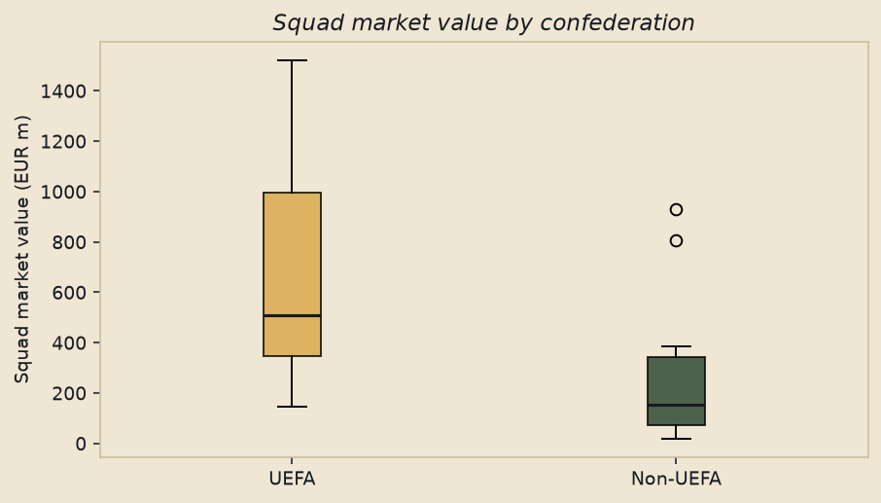
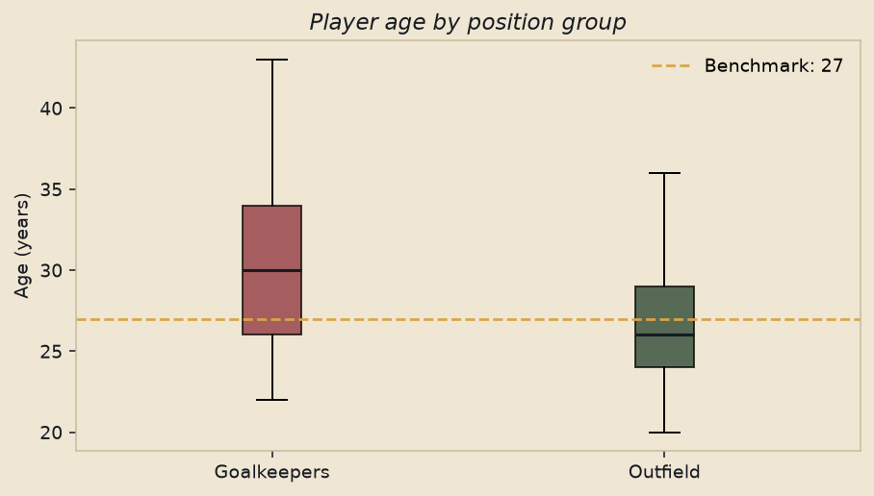
Objective 1 · two findings that hold
TASK 3 · SQUAD MARKET VALUE
Do UEFA squads carry a higher market value than non-UEFA squads?
TASK 4 · GOALKEEPER AGE
Is mean GK age different from 27 — the usual outfield prime?
n = 14 vs 14 · €669.6m vs €257.2m
t(26) = 2.87 · one-sided p = 0.0041 · d = 1.08 (large)
Reject H₀. UEFA squads are roughly 2.6× as valuable.
n = 40 · mean 30.32 years · 95% CI (28.7, 31.9)
t(39) = 4.25 · p = 0.0001 · d = 0.67
Reject H₀. Keepers were also 3.6 years older than outfielders.
Notes:
Two questions were significant. UEFA squads averaged 670 million euros against 257 million for everyone else — about 2.6 times as valuable. The one-sided t-test gives p of 0.004 and a large effect, d of 1.08. We reject. Goalkeepers averaged 30.3 years — well above the outfield prime of 27. The one-sample p is 0.0001, and they were also 3.6 years older than outfield teammates.

Slide 5
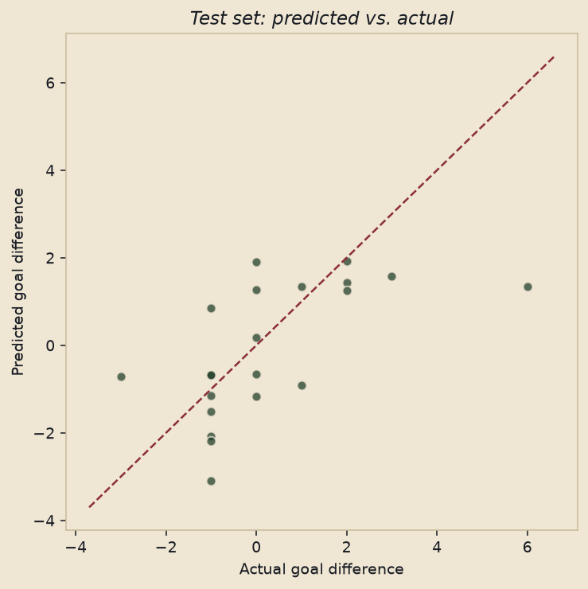
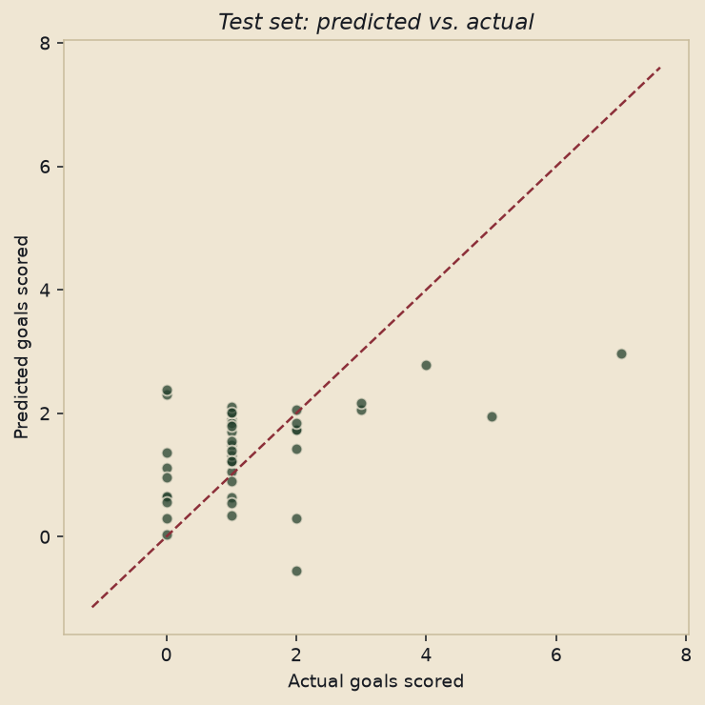
Objective 2 · two pre-match linear models
2.1 GOAL DIFFERENCE · n = 104 matches
Train R² 0.49 · Test R² 0.31 · RMSE 1.57
2.2 TEAM GOALS SCORED · n = 208 team-matches
Train R² 0.29 · Test R² 0.22 · RMSE 1.23
Significant: rank_diff (p = 0.002) · value_diff (p = 0.004)
A €1bn squad-value edge ≈ +1.7 net goals, holding rank fixed.
Max VIF 3.30 · Shapiro–Wilk p = 0.94 · residuals look normal.
Significant: opp_rank (p = 0.038) · team_value (p = 0.035)
Weaker fit is expected — an absolute tally is noisier than a difference.
Shapiro–Wilk p = 0.034 · mild skew · a Poisson model is a natural next step.
Notes:
Objective 2. Model 2.1 predicts match goal difference. Training R-squared is 0.49; on the hold-out it is 0.31. Only FIFA ranking gap and squad-value gap are significant. A billion-euro value edge is about plus 1.7 net goals. Model 2.2 predicts a team’s own goals. Fit is weaker, as expected for a noisy count: test R-squared 0.22. Significant drivers are opponent rank and own squad value. Residuals are slightly skewed, so a Poisson model would be a natural next step.

Slide 6
What to take away
01
Not supported
Midfielders are not booked more than defenders, and knockout crowds are not significantly larger.
02
Europe’s market
UEFA squads are ~2.6× as valuable as the rest of the field — a large, statistically clear gap.
03
Keepers last longer
Goalkeepers averaged 30.3 years, well above the outfield prime of 27. Ochoa featured at 40.
04
Pre-match signal
FIFA ranking and squad market value are the robust drivers of goal difference and goals scored.
Notes:
So: the midfield-booking story and the knockout-crowd premium are not in this data. Europe’s market-value gap is large, and keepers really do last longer. Before kickoff, ranking and squad value are the robust predictors. Thank you.

