Slide 1
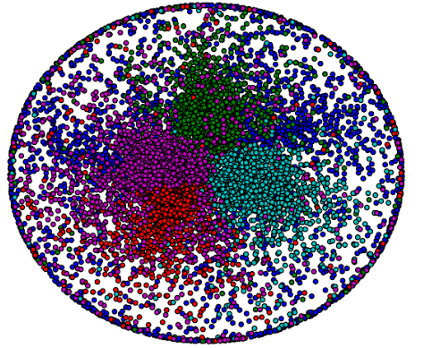
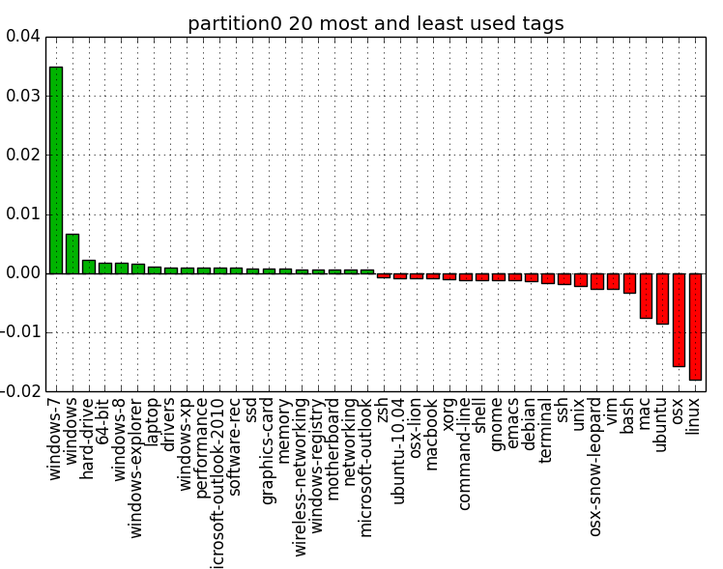
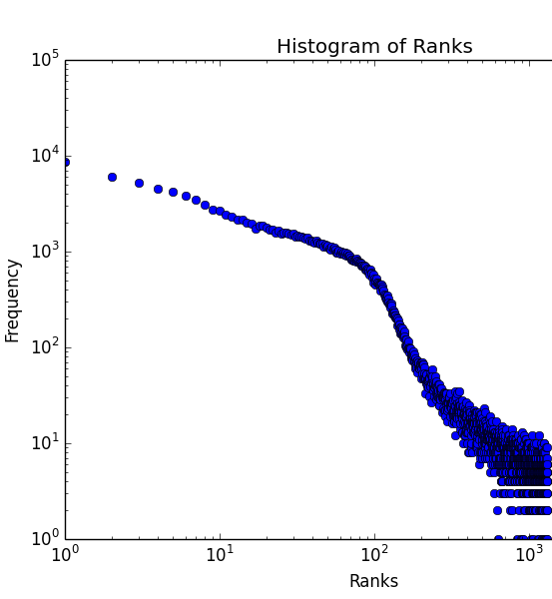
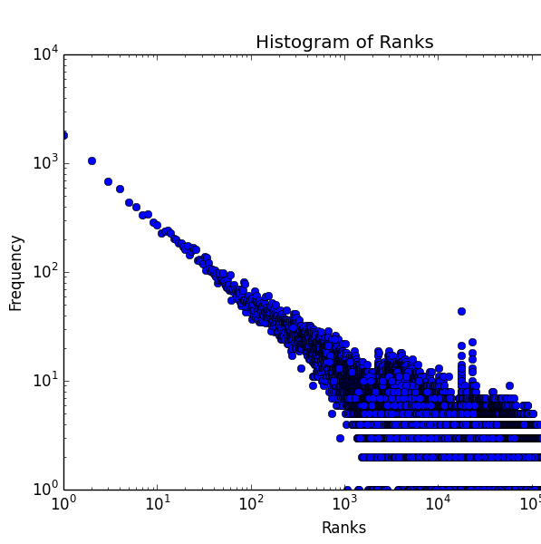
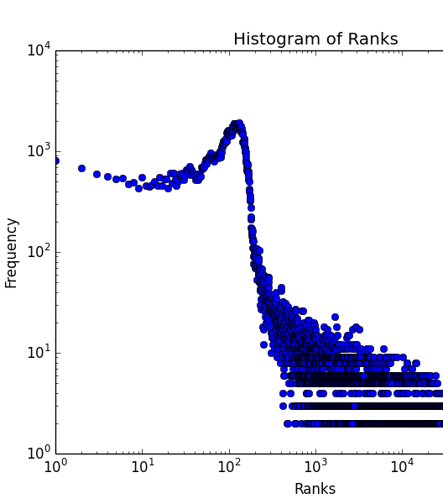
Personalized Recommendation System for Questions to Answer on SuperUser
Group 44: Geza Kovacs, Arpad Kovacs, Shahriyar Pruisken
Problem and Objective
Related Work
WebVVT Format Subtitle
WebVVT Format Subtitle
There are lots of questions on Q/A sites like SuperUser to answer.
Want to recommend questions that are recent/active and relevant to users’ interests
Anderson et al 2012: Predicts activity of a question on StackOverflow
Pazzani et al 2007: Recommendation systems based on content
Our Contribution
WebVVT Format Subtitle
Results
WebVVT Format Subtitle
A system combining tags, community detection, and temporal features to create more accurate recommendations
Over 50% of time, question user answers will be among the top 29 recommendations
Implementation Components
WebVVT Format Subtitle
User communities detected in SuperUser
An example user community’s tag distribution
Topic-relevance: How much question’s tags match those of questions user has previously answered
Question-activity model: Likelihood question will be answered, given elapsed
Community-relevance: Detects user communities based on tags, and supplement user’s tags with those from his community.
With combined model, half the questions answered will be top 29 recommendations
With only topic relevance model, half the questions answered will be in top 19219 recommendations
With only question activity model, half the questions answered will be in top 108 recommendations

