Slide 1
MySQL Project on Amazon Prime Users Dataset
Name: Bhushan Deshmukh
Guide Name: Madhuri Shingade

Slide 2
Introduction
Project Title: Amazon Prime Users Data Analysis
Objective:
Analyze user behavior, subscription trends, and engagement metrics using SQL queries.
Identify patterns in user interaction with Amazon Prime services.
Provide insights for business strategies and improvements.
Dataset Used: Amazon Prime Users (includes user data such as subscription details, device usage, feedback, and purchase history).
Tools: MySQL Workbench, SQL Queries for Data Analysis.

Slide 3
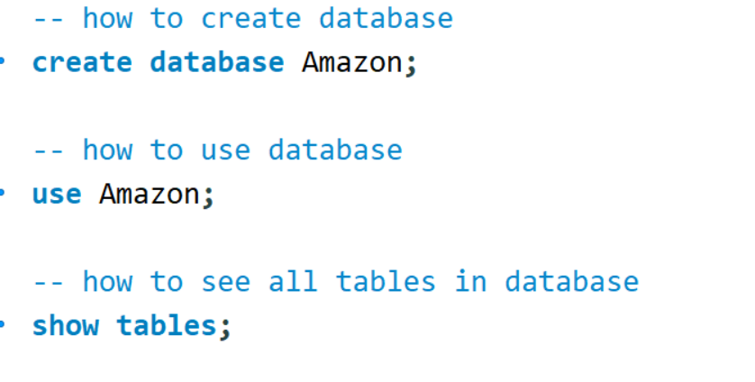
Creating & Using Database
The CREATE DATABASE command is used to create a new database named Amazon.
The USE Amazon; command selects the database to perform operations on it.
A database is essential for storing and managing user data in a structured format.

Slide 4

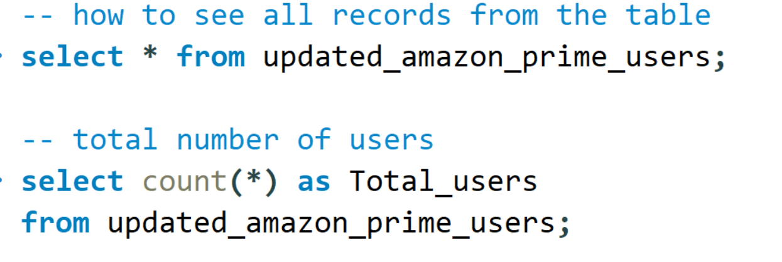
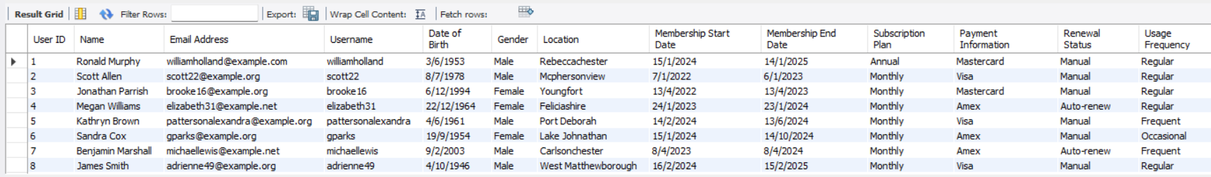
Viewing Data and Tables
SHOW TABLES; lists all the tables present in the selected database.
SELECT * FROM updated_amazon_prime_users; retrieves all the records from the updated_amazon_prime_users table.
This step is important to understand the structure and contents of the dataset before analysis.

Slide 5
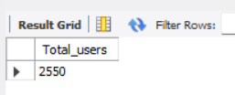
Total Number of Users
The COUNT(*) function returns the total number of records in the table.
This gives a clear idea of the user base size and is useful for further analysis.

Slide 6
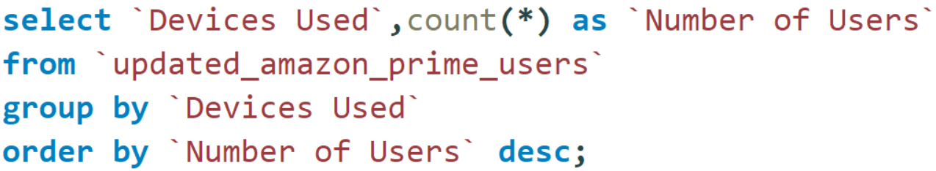
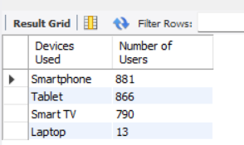
Most Used Devices
This query groups the data based on the Devices Used column and counts how many users use each device.
ORDER BY Number of Users DESC; sorts the results in descending order to highlight the most popular devices.
Helps in understanding which devices are preferred for streaming, enabling Amazon to optimize app performance accordingly.

Slide 7
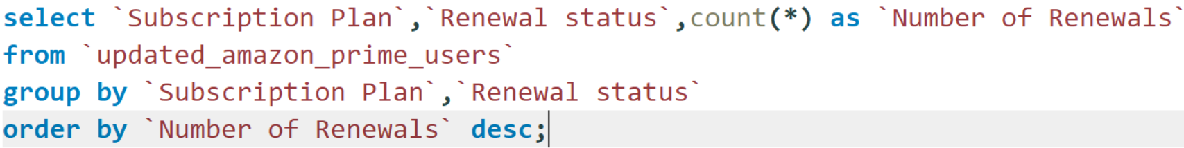
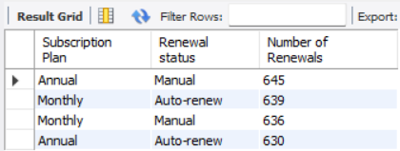
Subscription Plan & Renewal Trends
Groups users by subscription plan and renewal status to identify renewal trends.
Helps in understanding which plans have the highest renewal rates and which ones face user drop-offs.
Can be used to develop strategies to improve user retention.

Slide 8
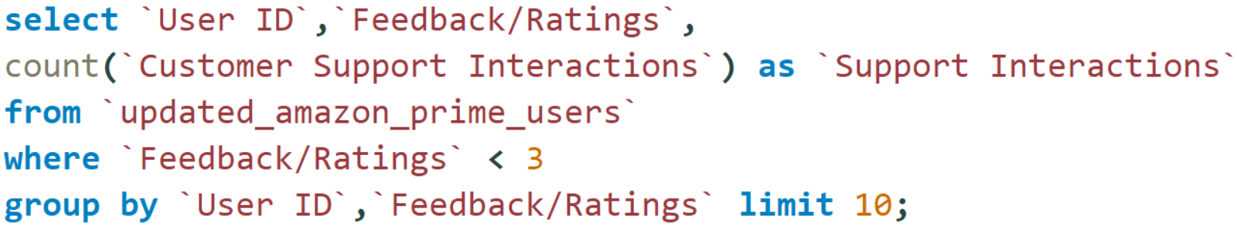
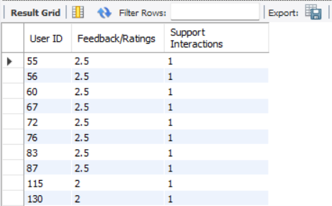
Users with Low Ratings & Customer Support Interactions
Identifies users who have given low ratings and frequently interact with customer support.
Helps in addressing user concerns, improving service quality, and reducing churn rates.
Useful for customer service teams to focus on improving satisfaction.

Slide 9
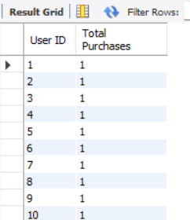
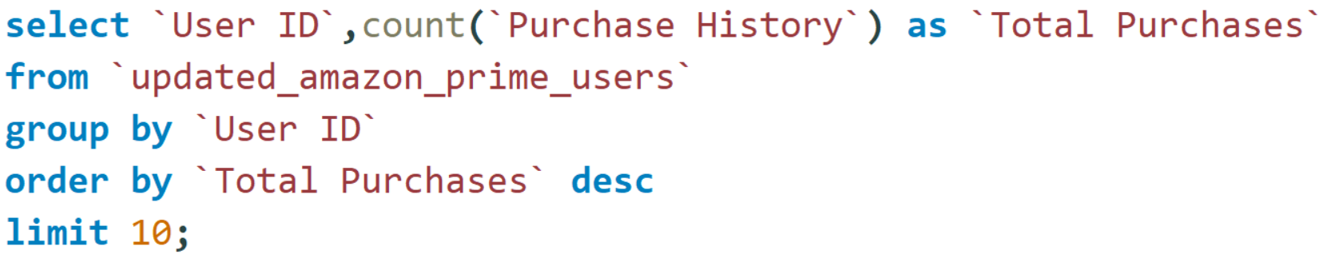
Top 10 Users with Highest Purchases
Identifies users who have given low ratings and frequently interact with customer support.
Helps in addressing user concerns, improving service quality, and reducing churn rates.
Useful for customer service teams to focus on improving satisfaction.

Slide 10
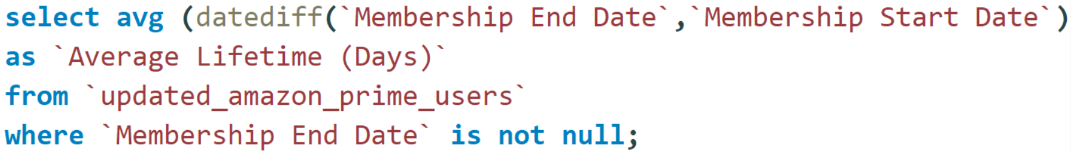
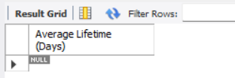
Average User Subscription Lifetime
Calculates the average duration of user subscriptions.
Helps in understanding overall customer retention and lifecycle trends.

Slide 11
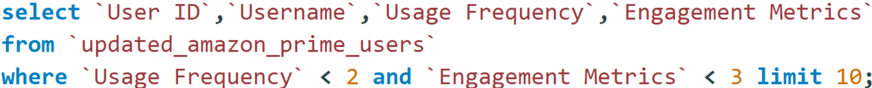
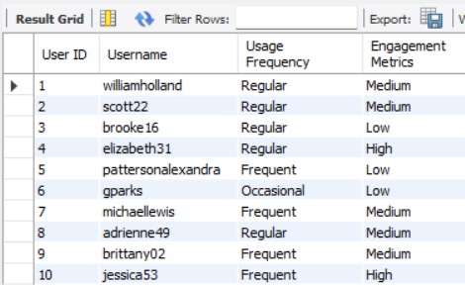
Inactive Users (Low Engagement)
Identifies users with minimal activity on Amazon Prime.
Helps in targeting inactive users with re-engagement strategies such as personalized offers.

Slide 12
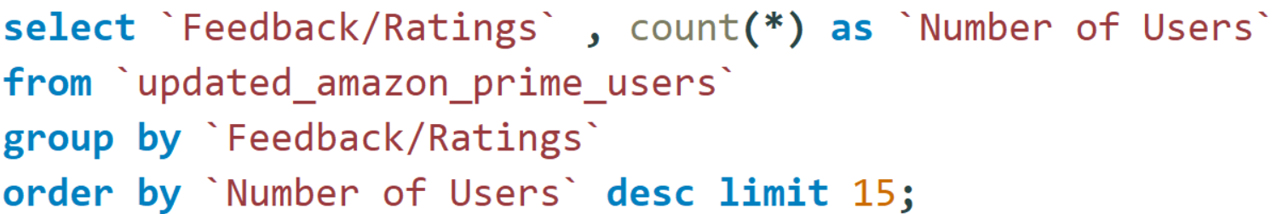
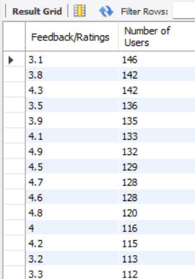
Feedback Rating Distribution
Analyzes the distribution of user feedback ratings.
Helps in assessing overall customer satisfaction levels.
Useful for identifying areas that need improvement in service quality.

Slide 13
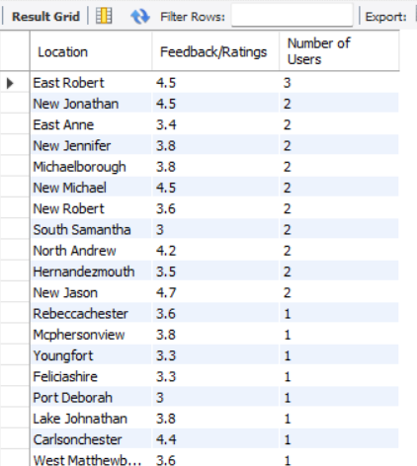
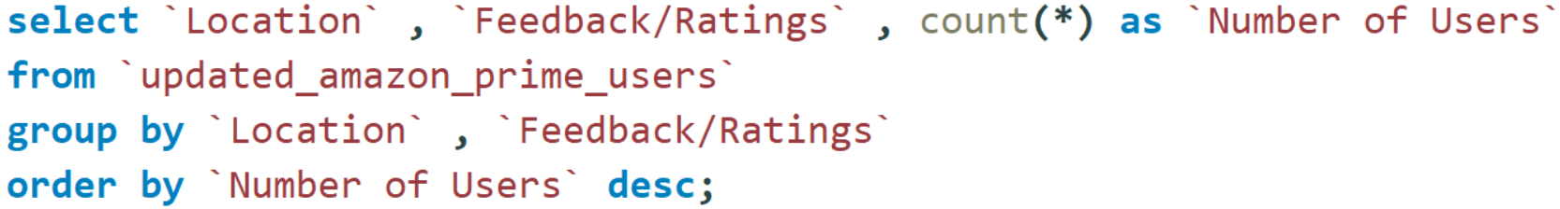
User Feedback by Location
Identifies how user feedback varies by location.
Helps in region-specific service improvements and targeted marketing.

Slide 14
Conclusion
Key Findings:
Identified top-performing and inactive users.
Analyzed feedback, engagement, and renewal trends.
Provided data-driven insights for improving user retention.
Future Scope:
Implement machine learning models for predicting user churn.
Enhance customer service strategies using data insights.
Improve subscription plans based on engagement data.

