Slide 1
IBM University Engagement Project Submission
AI Agent for Smart Farming Advice
“Exploring the Power of Agentic AI with IBM Granite and LangFlow”

Slide 2
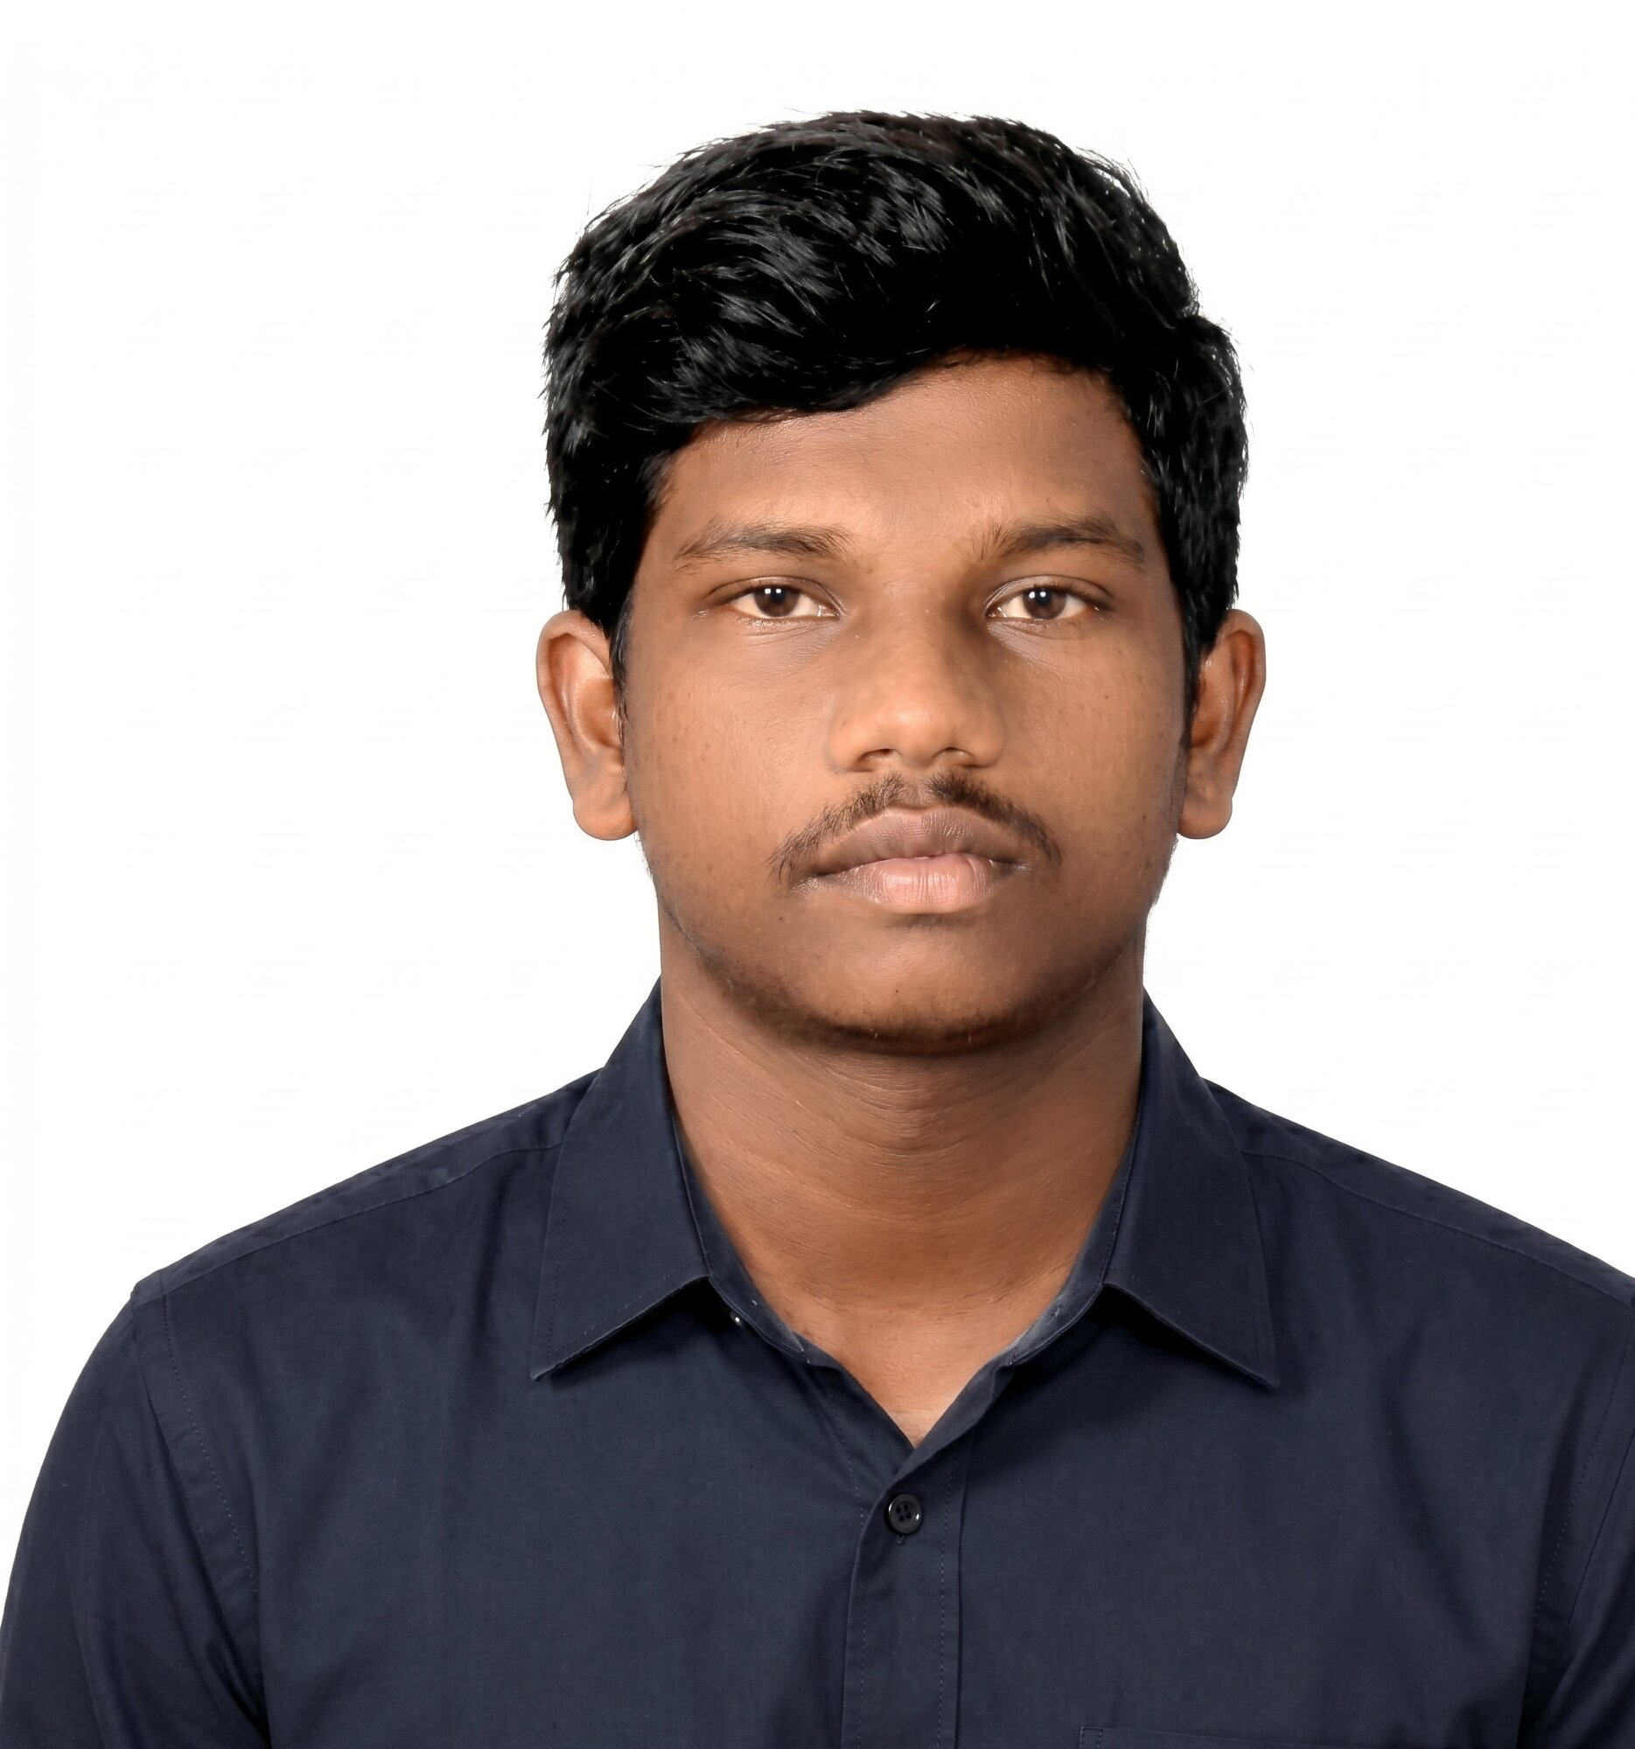
Project Title – AI Agent for Smart Farming Advice
Domain of Project – Agriculture
Student Name | Recent Passport Photo | Email ID | Mobile number [WhatsApp]
Bhushan Sonune |  | sonunebhushan2@gmail.com | 9545818255

Slide 3
Problem Statement -
Problem Statement: AI Agent for Smart Farming Advice
Challenge:
Small farmers struggle to access localized information on crops, weather, soil, pests, and mandi prices.
Objective:
Build an AI-powered farming assistant that provides:
• Crop recommendations
• Weather-aware advice
• Soil-based suggestions
• Pest management guidance
• Real-time mandi prices
• Local language interaction
Multi-Agent System:
1. Crop Recommendation Agent
2. Weather Intelligence Agent
3. Market Price Agent
4. Pest Detection Agent
5. Knowledge Retrieval Agent (RAG)

Slide 4
Technology Used
• IBM Granite Models
• IBM watsonx.ai
• IBM Cloud Lite
• LangFlow
• FAISS Vector DB
• FastAPI
• Weather APIs
• Agriculture Datasets
Approach Used:
LangFlow + IBM watsonx.ai + Granite Models + RAG

Slide 5
Proposed Solution -
Proposed Solution: AI powered Farming advice
A multilingual farming assistant using RAG and IBM Granite.
Workflow:
Farmer Query → Retriever → Agriculture Knowledge Base/API → Granite Model → Personalized Advice
Features:
• Local language support
• Soil + crop recommendation
• Market price lookup
• Pest control guidance
• Seasonal farming insights
• Continuous learning via feedback

Slide 6
Langflow Components Used
Chat Input – Farmers enter queries through text or voice in local languages.
IBM watsonx AI Agent – Processes farmer queries using IBM Granite models.
Granite 4.0 Instruct Model – Generates farming recommendations and contextual advice.
RAG Retriever – Retrieves trusted agriculture data from crop, soil, pest, and weather knowledge bases.
Vector Store (FAISS) – Stores embeddings for fast retrieval of agricultural information.
API Connectors – Connects to weather APIs, mandi price APIs, soil databases, and agricultural sources.
Multi-Agent Coordinator – Coordinates Crop, Pest, Weather, and Market agents.
Chat Output – Displays localized farming recommendations and responses to farmers.

Slide 7
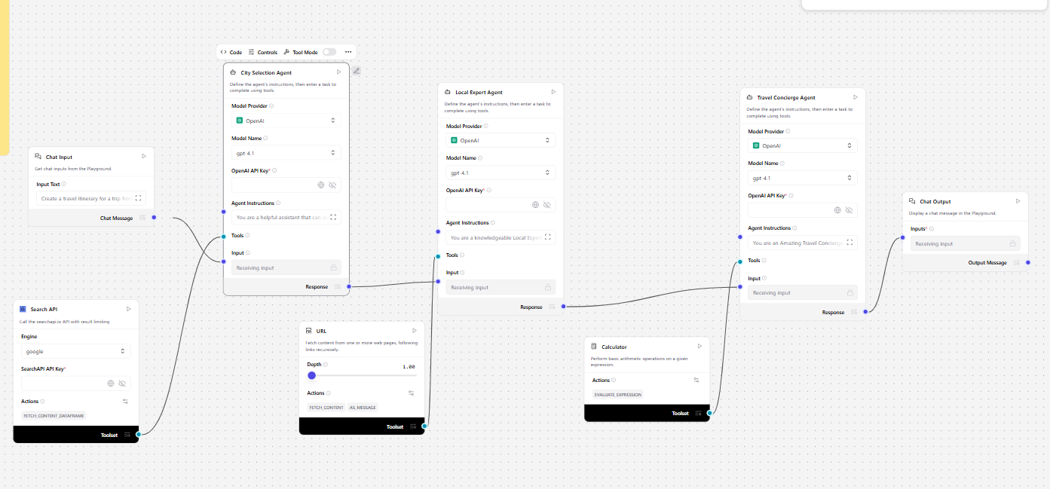
LangFlow Workflow
User Input
↓
Language Detection
↓
RAG Retriever
↓
IBM Granite Model
↓
Reasoning Layer
↓
Personalized Farming Advice

Slide 8

Architecture Blueprint
Farmer App
↓
FastAPI Backend
↓
LangFlow Orchestration
↓
IBM Granite + watsonx
↓
RAG + Vector DB
↓
External APIs (Weather / Mandi / Soil)

Slide 9

Role of Agentic AI
• Coordinates multiple farming agents
• Provides localized recommendations
• Uses contextual reasoning
• Dynamically adapts advice
• Reduces dependency on manual consultations
Role of Agentic AI in Nutrition Agent
Agentic AI enables the Nutrition Agent to function as an intelligent, autonomous system rather than a simple chatbot. Using IBM watsonx.ai and IBM Granite models, it coordinates multiple specialized agents to deliver personalized nutrition guidance.
Each agent performs a specific role—such as retrieving nutritional data, generating diet plans, providing health advice, and analyzing food logs—while working collaboratively. This multi-agent approach ensures efficient task execution and accurate results.
Agentic AI also brings context awareness, understanding user details like age, health conditions, and fitness goals to generate tailored recommendations. It supports real-time adaptation, continuously updating suggestions based on user inputs like daily meals.
Additionally, agents communicate with each other, enabling better decision-making and improved outcomes.
Overall, Agentic AI makes the system proactive, personalized, and goal-driven, acting like a smart digital nutritionist that helps users maintain a healthy lifestyle.

Slide 10
Technology Used
IBM Cloud Lite – Deployment and scalable cloud infrastructure
IBM Granite Models – Natural language reasoning and agricultural recommendations
LangFlow – Designing and orchestrating multi-agent workflows
RAG (Retrieval-Augmented Generation) – Retrieves trusted farming information before generating responses
FAISS Vector Database – Stores agricultural knowledge embeddings for fast retrieval
FastAPI – Backend APIs for farmer queries and agent communication
Weather APIs – Provides real-time weather forecasts for farming decisions
Mandi Price APIs – Fetches live crop market prices
Agricultural Datasets – Crop, soil, pest, and fertilizer knowledge sources
IBM watsonx.ai – Model deployment, embeddings, and governance

Slide 11
Novelty and Uniqueness
• Localized Multilingual Support – Farmers interact in their preferred local language for better accessibility.
• Multi-Agent Architecture – Specialized agents collaborate for weather, crop recommendation, pest control, soil analysis, and market intelligence.
• RAG-Powered Trusted Retrieval – Uses Retrieval-Augmented Generation to fetch verified agricultural data before generating advice.
• Real-Time Decision Support – Integrates live weather forecasts, mandi prices, and seasonal farming information.
• Personalized Farming Recommendations – Suggestions adapt according to soil conditions, location, crop type, and farmer requirements.
• Market + Crop Intelligence Combination – Combines weather, market trends, crop suitability, and pest insights in one system.
• IBM Granite + Agentic AI Integration – Uses IBM Granite models with agent-based workflows for contextual reasoning.
• Scalable for Rural Communities – Designed for small-scale farmers with low-resource accessibility and future offline support.

Slide 12
Bhushan-Sonune/Smart-farming-by-AI-Agent
Create your own repository:
github.com/<Bhushan-Sonune>/Smart-farming-by-AI-Agent
· Please create public github repository (Enable Add README button while creating repository) with format –
Please test and Paste the working Github URL – https://github.com/Bhushan-Sonune/Smart-farming-by-AI-Agent.git
Make sure you have Uploaded following three files into your github repository 1) app.json file , 2) yourproblemstatement.pdf file 3) your projectpresntation.pptx file 4)any other files
·
·
·

Slide 13
Future Scope
• IoT Sensor Integration – Connect soil moisture, temperature, humidity, and nutrient sensors for real-time field monitoring.
• Drone & Satellite Integration – Use drones and satellite imagery for crop monitoring, yield prediction, and disease detection.
• AI-Based Disease Detection – Detect crop diseases from uploaded plant images using computer vision models.
• Voice Assistant with Local Languages – Support multilingual voice interactions for farmers with low literacy levels.
• Offline Mode for Rural Areas – Provide recommendations even in low-connectivity regions using cached agricultural knowledge.
• Smart Irrigation Recommendations – Suggest irrigation schedules using weather forecasts and soil conditions.
·
·
·

Slide 14


