Slide 1

Bike Rental

Slide 2
In Kaggle knowledge competition – Bike Sharing Demand, the participants are asked to forecast bike rental demand of Bike sharing program in Washington, D.C based on historical usage patterns in relation with weather, time and other data.

Slide 3
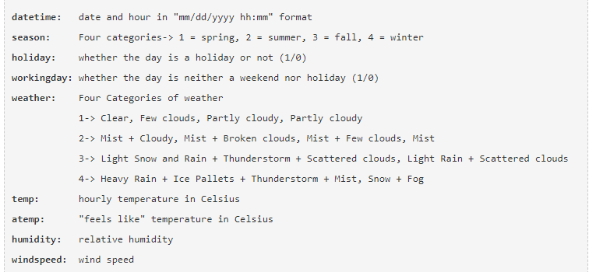
Independent Variables

Slide 4
Dependent Variables
registered: number of registered user
casual: number of non-registered user
count: number of total rentals (registered + casual)

Slide 5
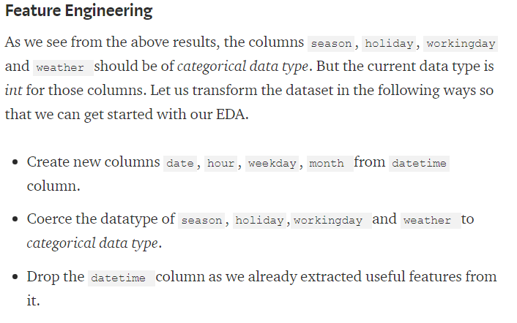

Slide 6
Missing value analysis
Once we get the hang of the data and attributes, the next step we generally do is to find out whether we have any missing values in our data. Luckily we do not have any missing value in the data.

Slide 7
Outlier Analysis
At first look, count variable contains a lot
of outlier data points that skew the
distribution towards the right
There are more data points beyond
Outer Quartile Limit.

Slide 8
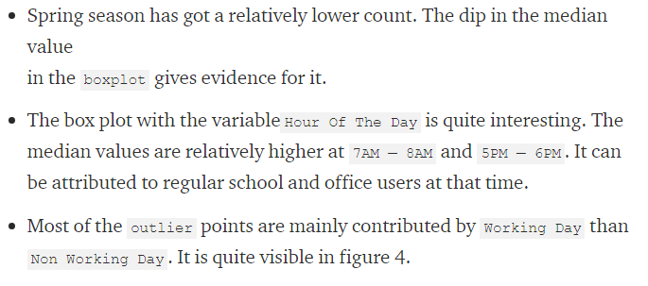

Slide 9
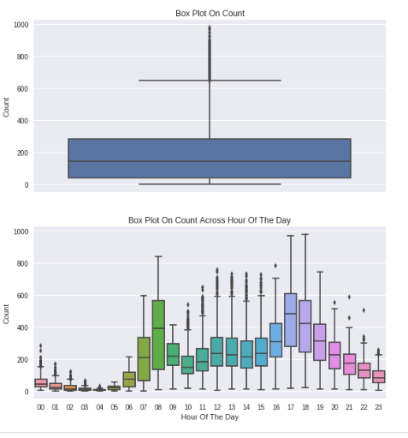

Slide 10
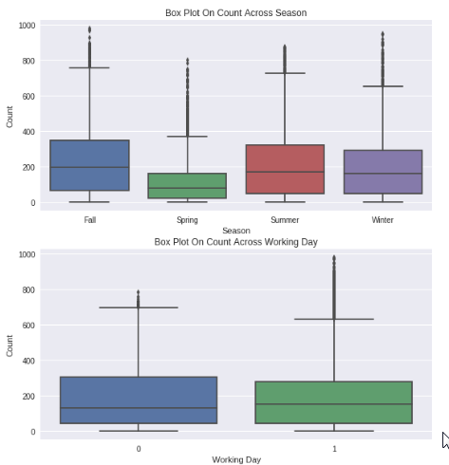

Slide 11
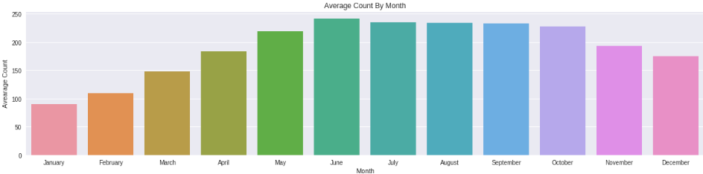
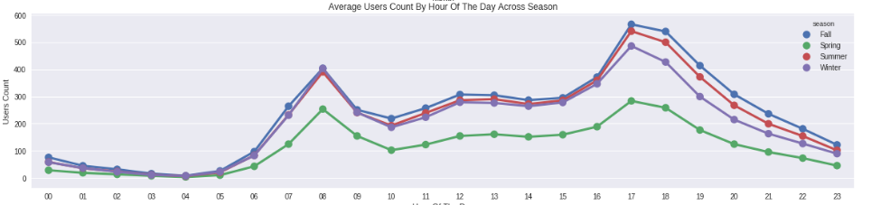

Slide 12
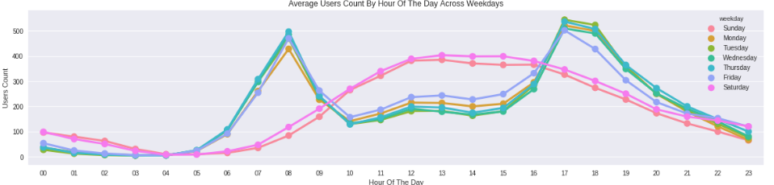
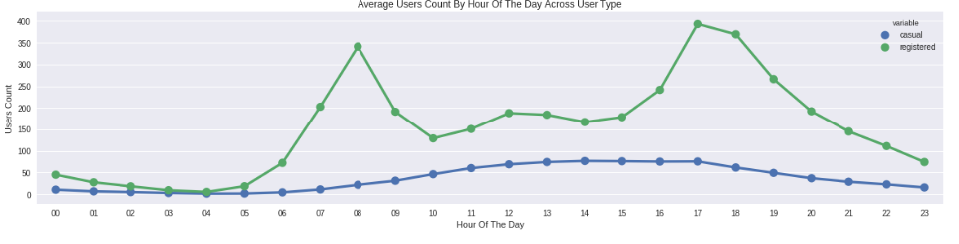

Slide 13
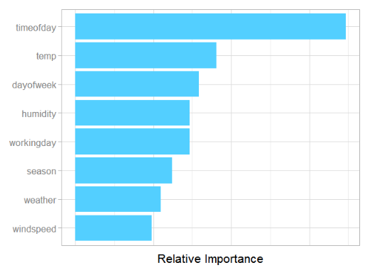

Slide 14
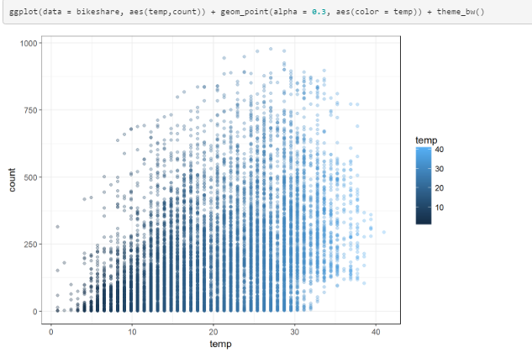
Temperature V/S Rental Count

Slide 15
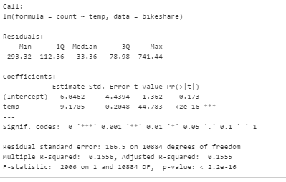

Slide 16
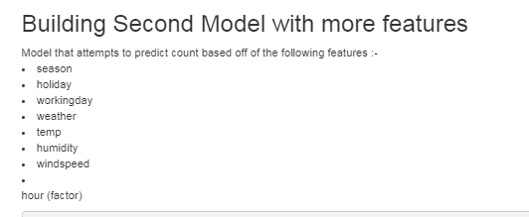

Slide 17
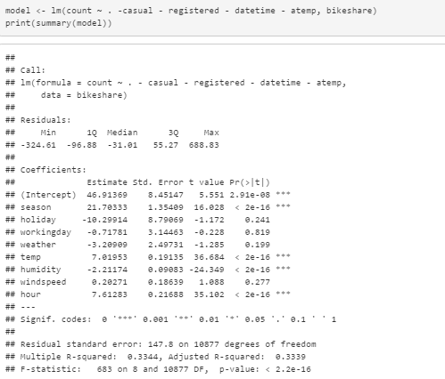

Slide 18
END

