Slide 1
Customer Satisfaction Analytics
Project ID: PTID-CDA-FEB-23-121
Submitted By:-
Bhushan Wanjale

Slide 2
Overview of Customer Satisfaction
Significance of Evaluating Customer Satisfaction
Customer satisfaction is a key metric for assessing the success of a business.
It helps identify areas for improvement and opportunities to enhance the customer experience.
Measuring customer satisfaction allows businesses to understand customer needs and preferences, leading to better product development and service delivery.
Analyzing Customer Satisfaction
Analyzing customer satisfaction data provides valuable insights into customer perceptions and sentiments.
It helps identify trends, patterns, and areas of strength or weakness.
By analyzing customer satisfaction, businesses can make data-driven decisions to improve customer satisfaction and loyalty.
Customer satisfaction analytics enable businesses to track performance over time and compare against industry benchmarks.

Slide 3
TABLE OF CONTENTS
Dataset Overview
Data Retrieval
01
02
Data Cleaning and Transformation
04
Visualizations in Power BI
03
Number of Columns and Rows
Key attributes and their meanings
Explanation of the database credentials
Steps to connect and retrieve data
Explanation of each chart and its purpose
Insights derived from visualizations
Handling imbalance in counts
Transformations applied to the dataset
Insights and Analysis
Conclusion
05
06
Key patterns and trends identified
Interpretation of visualizations
Summary of findings
Recommendations or insights for the company

Slide 4
Dataset Overview
Number of Columns and Rows:
The Initial dataset comprises 12 columns and a total of 32,941 records.
Key Attributes and Meanings:
id: Unique identifier for each customer service call.
customer_name: Name of the customer initiating the call.
sentiment: Reflects the overall sentiment (positive, negative, or neutral) expressed during the call.
csat_score: Numeric score indicating customer satisfaction.
call_timestamp: Date and time of the customer call.
call_dayname: Day of the week when the call occurred.
reason: Purpose of the customer's call (question, complaint, request).
city and state: Location where the call took place.
channel: Communication channel used (phone, email, chat).
response_time: Time taken to respond to the initial inquiry.
call duration in minutes: Length of the call in minutes.
call_center: Identifies the specific call center handling the call.

Slide 5
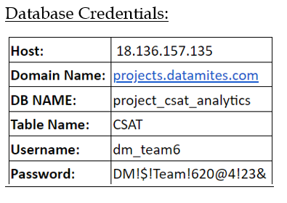
Data Retrieval from Database
Used MySQL Workbench to establish a connection to the provided database.
Examined the structure of the table to understand available datasets.
Transformed data in Power Query and loaded it into Microsoft Power BI Desktop for modeling.
In Power BI > Get Data > MySQL Database > Connect

Slide 6
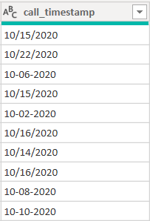
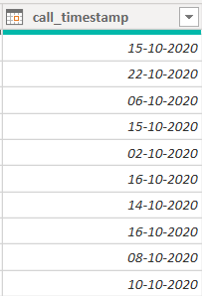
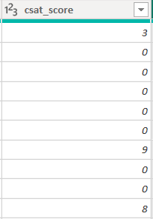
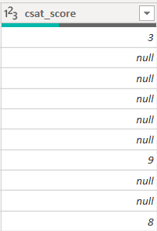
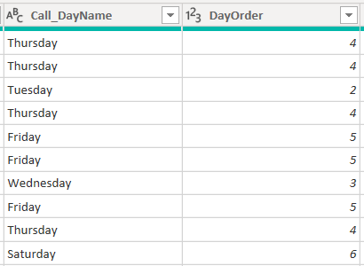
Data Cleaning and Transformation in Power Query
csat_score
Call_DayName and DayOrder
call_timestamp
Replacing the value in the csat_score column from "0" to "null" to handle the imbalance in counts.
Creating two new columns, Call_DayName and DayOrder, for additional insights and to categorize weekdays.
Adjusting the call_timestamp column format to a single date format by using the "Locale" option.

Slide 7
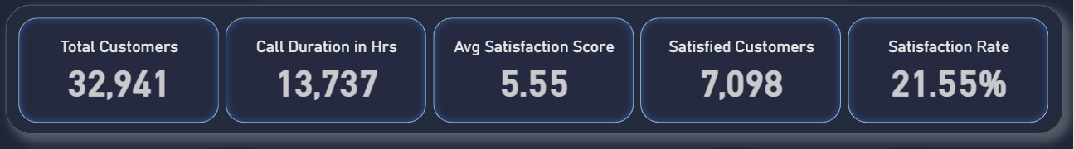
DAX Measures Used In Visualization
total_call_duration_hrs = DIVIDE(SUM(CSAT[call_duration_in_minutes]),60)
Positive Sentiment Count = CALCULATE(COUNT(CSAT[sentiment]), FILTER(CSAT, CSAT[sentiment] IN {"positive", "very positive"}))
Total Customers = COUNT(CSAT[customer_name])
avg_csat_score = AVERAGE(CSAT[csat_score])
Customer Satisfaction Rate = DIVIDE([Positive Sentiment Count], [Total Customers], 0)

Slide 8
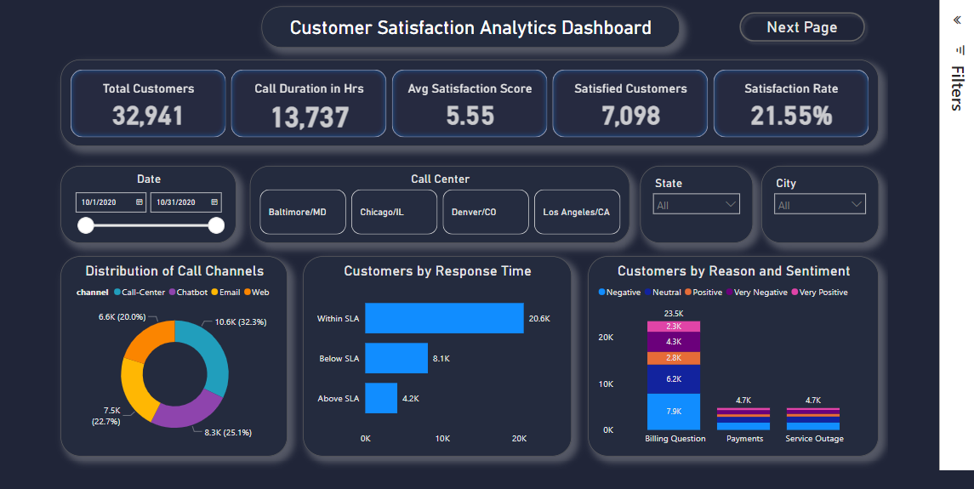
Visualizations in Power BI

Slide 9
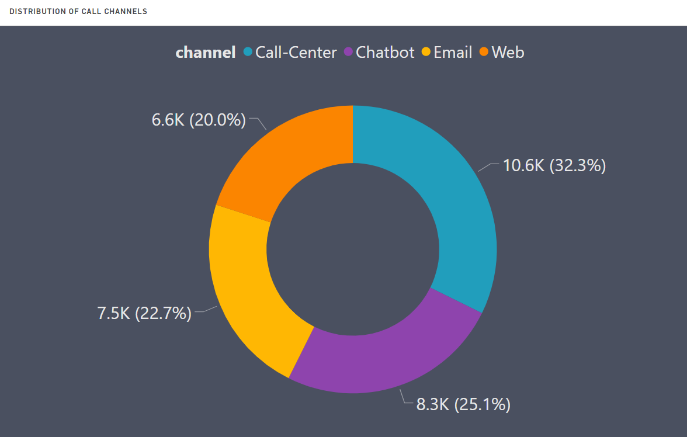
Distribution of Call Channels
Insights:
Call Center dominates interactions, showing a preference for personalized service despite digital alternatives.
Chatbots rank second, reflecting the increasing acceptance of AI-driven customer support solutions.
Email remains relevant, chosen by a substantial customer base for formal communication.
The Web channel, though less utilized, signifies a noteworthy portion of interactions, suggesting room for improvement in web-based support offerings.
Implications:
A need for ongoing investment in call center training and technology to maintain high customer satisfaction for the most popular channel.
Continued development and refinement of chatbot technology to handle more complex inquiries, as a quarter of customers are engaging with this channel.
Ensuring email support is managed effectively, as it remains a significant channel for customer communication.
Evaluating the user experience of web-based support to increase its usage and effectiveness, potentially through better integration with other channels or enhanced self-service options.
The Donut chart showcases the distribution of customer interactions across various channels, revealing insights into their preferences.

Slide 10
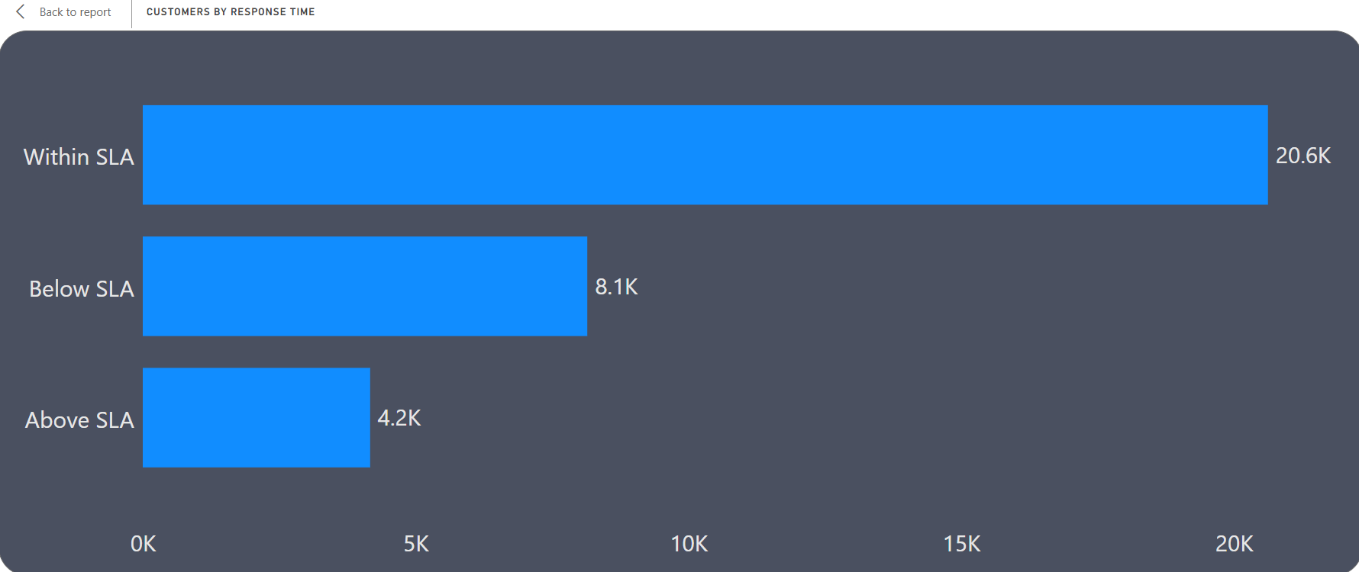
Customers by Response Time
Insights:
Within SLA Category: The largest group, around 20.6K customers, suggests that the majority of responses meet the expected Service Level Agreement (SLA) time, showcasing the company's efficient performance.
Below SLA Category: With approximately 8.1K customers, there is a notable portion where responses fall short of the expected SLA time. This highlights an area for potential improvement to enhance customer satisfaction.
Above SLA Category: This category has the fewest customers, around 4.2K, indicating instances where response times exceed SLA expectations but are still within an acceptable range.
Findings:
The company excels in responding within SLA times, reflecting overall efficiency.
Opportunities for improvement exist in reducing instances falling below SLA, and enhancing service quality.
Low numbers in the "Above SLA" category suggest acceptable performance, but critical instances may require attention.
The Clustered Bar Chart illustrates the distribution of customer responses based on different response time categories: "Within SLA," "Below SLA," and "Above SLA."

Slide 11
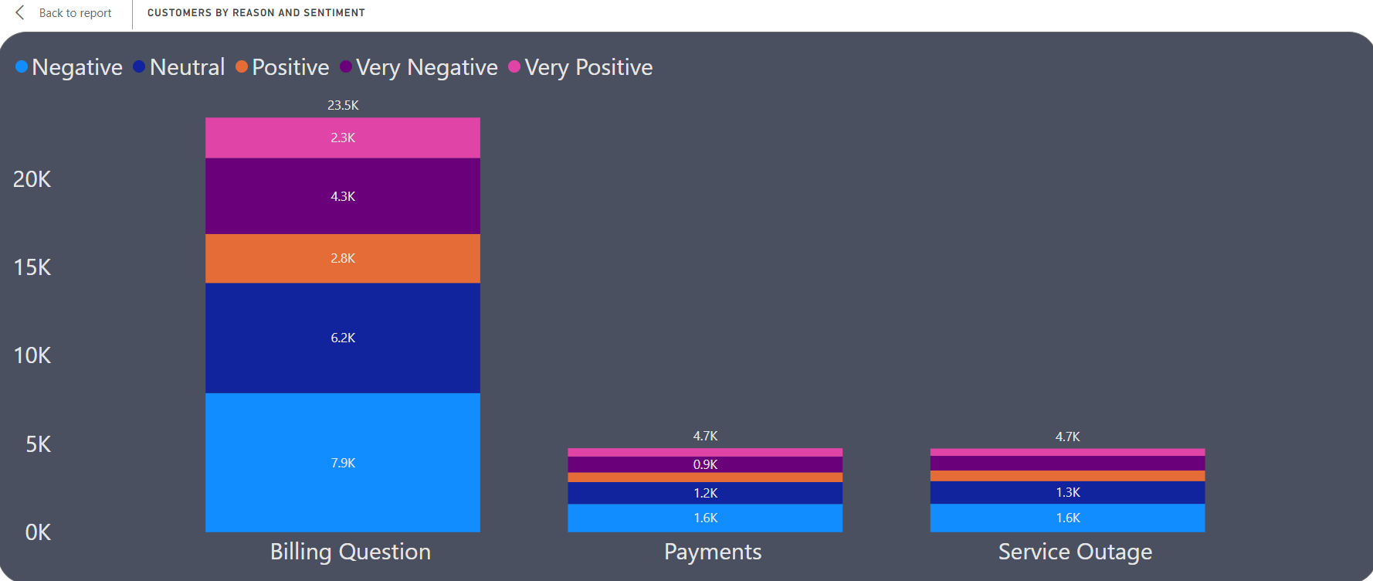
Customers by Reason and Sentiment
Insights:
Billing Question: Negative sentiment dominates (7.9K), followed by Neutral (6.2K), Positive (2.8K), Very Positive (2.3K), and Very Negative (4.3K).
Payments: Fewer total customers compared to Billing Questions, with Negative sentiments leading (1.6K), followed by Neutral (1.2K), Positive (0.5K), Very Negative (0.9K), and Very Positive (0.4K).
Service Outage: Similar to Payments, with Negative sentiments most common (1.6K), Neutral followed by (1.3K), Positive (0.6K), Very Negative (0.8K), and Very Positive (0.4K).
Findings:
Billing Questions drive the highest customer contact, suggesting a mix of confusion and satisfaction.
Payments and Service Outages have similar sentiment distributions but with fewer customer contacts.
Neutral sentiment prevails across all reasons, indicating an opportunity for enhancing overall customer experience.
The presence of Very Negative sentiments, especially in Billing Questions, highlights specific pain points for potential improvement.
The Stacked Column Chart visually dissects customer sentiment based on the reasons for contact, including Billing Question, Payments, and Service Outage. Sentiments are categorized as Negative, Neutral, Positive, Very Negative, and Very Positive.

Slide 12
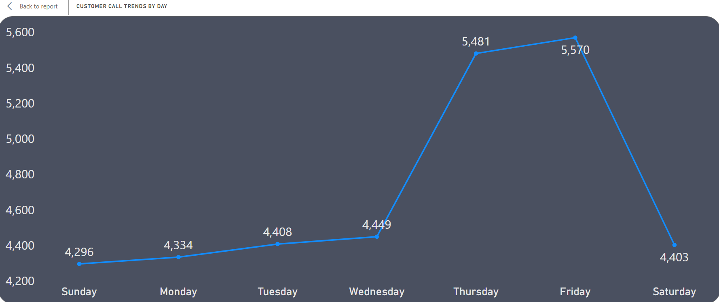
Customer Call Trends by Day
Details:
Y-axis represents 'Total Customers,' ranging from approximately 4,200 to 5,600.
X-axis represents 'Call_DayName' with days from Sunday to Saturday.
Insights:
Customer Peaks:
Friday exhibits the highest customer activity with 5,570 customers.
Thursday closely follows with significant activity, reaching 5,481 customers.
Weekend Decline:
A substantial drop in customer activity is observed on Saturday, down to 4,403 customers.
Activity Trend:
Customer engagement gradually increases throughout the week.
The peak towards the end of the week suggests heightened engagement.
Implications:
This pattern implies that customers are more active towards the end of the week, with a decline during the weekend.
Useful for resource allocation, staffing decisions, and targeted marketing efforts based on peak customer engagement days.
The Line Chart visualizes the total number of customers across different days of the week, presenting insights into customer activity patterns.

Slide 13
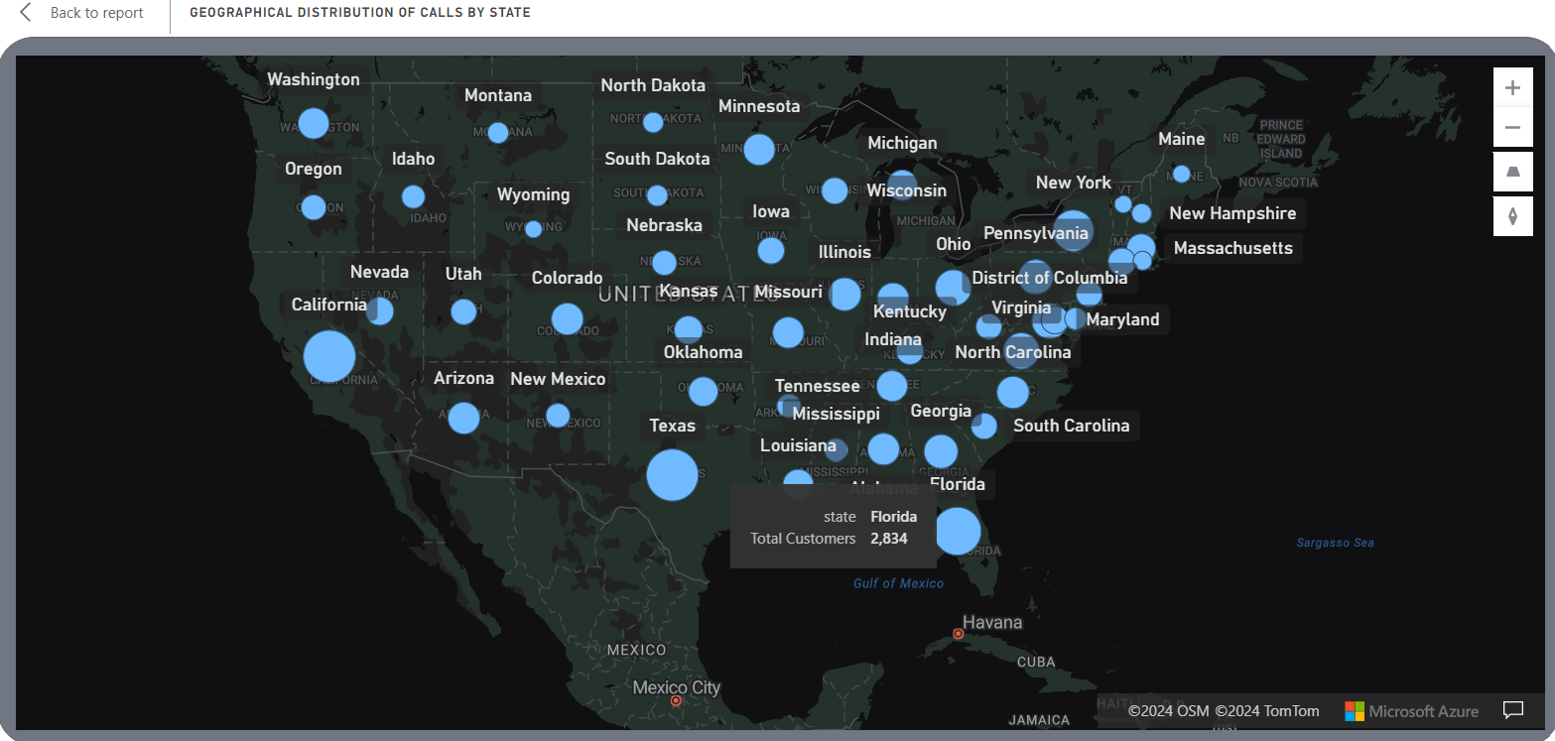
Geographical Distribution of Calls by State
Observations:
Largest Bubbles:
California, Texas, and Florida show the largest bubbles, indicating a high volume of customers or interactions.
States in the Midwest and Northeast, like Illinois, Ohio, and Pennsylvania, also exhibit notably large bubbles.
Smaller Bubbles:
States like Oregon, Colorado, and Mississippi have smaller bubbles, suggesting fewer customer interactions or a smaller customer base.
Insights:
Regional Presence:
Strong customer presence in populous states aligns with a larger population potentially leading to more customers.
Less populous states exhibit a smaller customer base or interaction level.
Strategic Implications:
Tailoring marketing and resource allocation strategies based on customer distribution.
Focusing efforts on states with larger bubbles to maximize existing customer base.
Considering growth strategies in states with smaller bubbles.
The Azure Map visualizes customer distribution across states using bubbles, with each bubble size representing the 'Total Customers' data field.

Slide 14
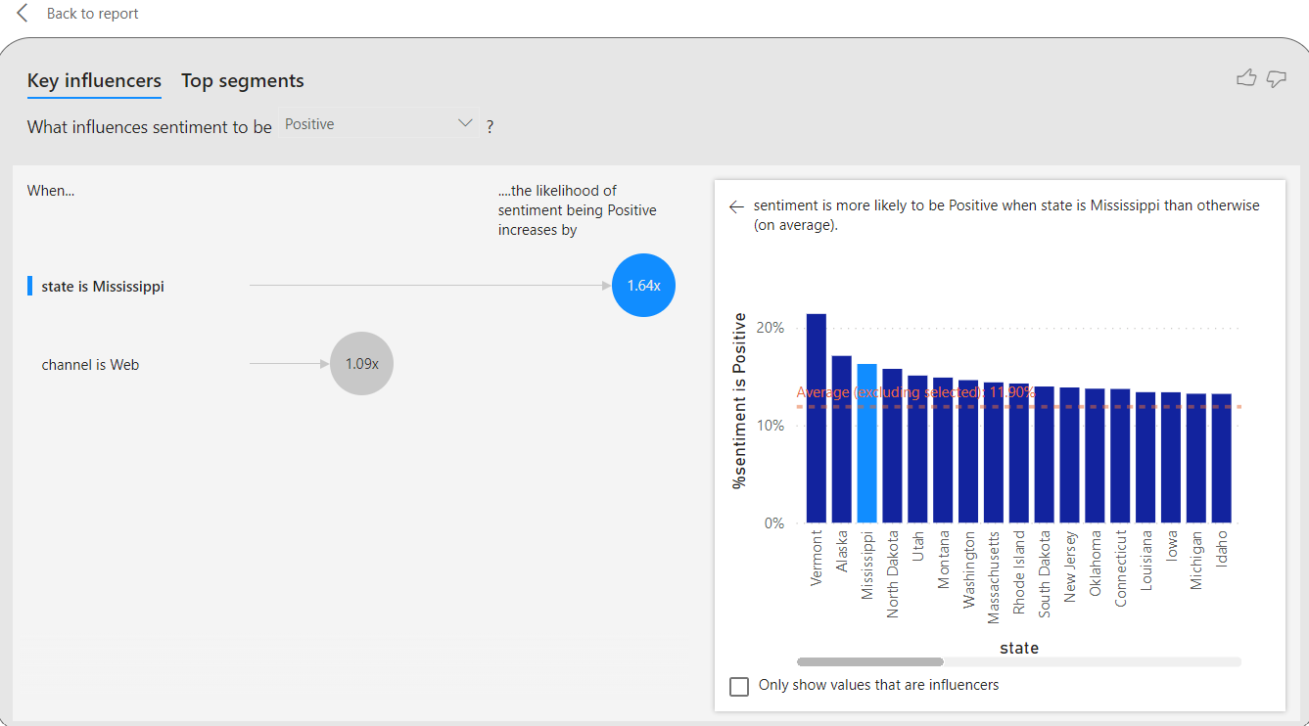
Key Influencers
Key Influencers Feature in Power BI:
The Key Influencers feature in Power BI analyzes given data to identify factors that significantly influence a chosen outcome. In our case, we selected sentiment as the outcome and specified channel, reason, and state as potential influencers. The feature then provides insights based on statistical analysis.
Analysis Results:
State is Mississippi (1.64x):
Customers from Mississippi are 1.64 times more likely to express positive sentiment than the average. The state seems to have a positive influence on sentiment.
Channel is Web (1.09x):
Customers using the Web channel are 1.09 times more likely to express positive sentiment than the average. The Web channel shows a positive impact on sentiment.
These insights help to understand the specific influences on positive sentiment in the dataset, allowing us to tailor strategies and actions accordingly. The Key Influencers chart provides valuable information for targeted decision-making and enhancing customer satisfaction.

Slide 15
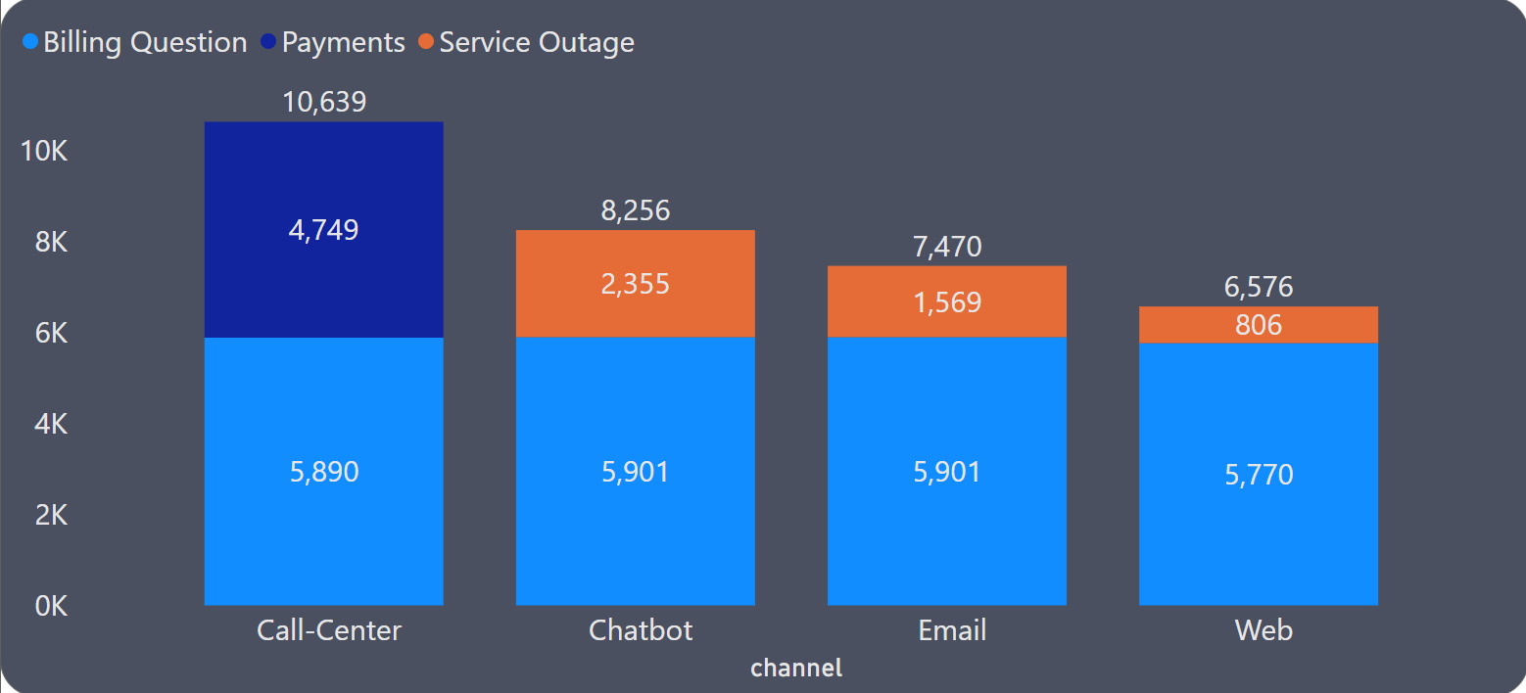
Customers by Channel and Reasons
Insights:
Billing Questions Dominance: Billing Questions are the most common reason for customer contact across all channels, with Call-Center having the highest volume.
Service Outage Significance: Service Outage is consistently the second most common reason for contact across channels, except for the Web, where it is slightly less common than Billing Questions.
Payments Less Common: Payments are the least common reason for customer contact across all channels.
Similarities in Chatbot and Email: Chatbot and Email channels exhibit similar distribution patterns across the three reasons for contact.
Web Channel Specifics: The Web channel has the lowest number of customers contacting for service outage.
Implications:
Understanding customer preferences and behaviors in utilizing different service channels for specific reasons can guide resource allocation and enhance customer service strategies, particularly in areas with higher contact volumes.
A Stacked Column Chart visualizes customer interactions across four channels: Call-Center, Chatbot, Email, and Web, segmented by reasons for contact - Billing Question, Payments, and Service Outage.

Slide 16
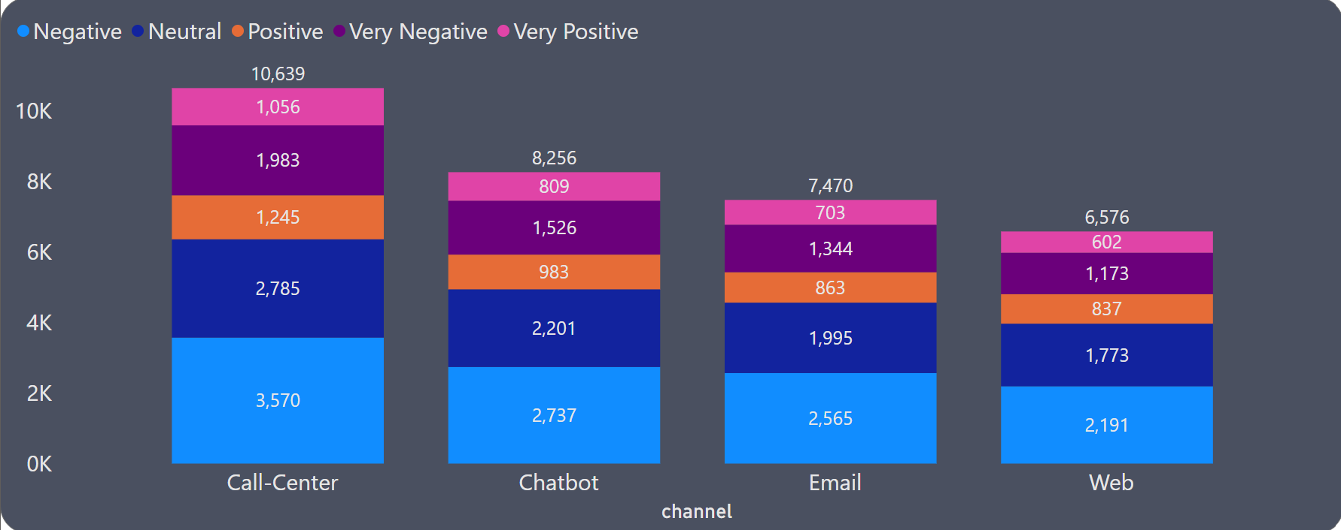
Customers by Channel and Sentiment
Insights:
Call-Center: This channel has the highest number of total customers, with a significant portion being negative. However, it also has the highest number of very positive sentiments.
Chatbot: While having fewer total customers than the Call-Center, the Chatbot channel shows a relatively high number of neutral sentiments.
Email: The Email channel has a balanced distribution of sentiments but leans towards negative and neutral.
Web: This channel has the lowest number of total customers and the lowest number of very negative sentiments. It also has a notable number of neutral sentiments.
Implications:
Addressing the Call-Center's high negative sentiments is paramount, requiring focused efforts through training and quality assurance. Optimizing the Chatbot experience, enhancing Email engagement, and improving the Web channel's usability present opportunities to shift sentiments positively and attract more customers. Recognizing the uniqueness of each channel, channel-specific strategies are essential for an effective, tailored approach to elevate overall customer satisfaction.
A Stacked Column Chart visualizes customer sentiment (Negative, Neutral, Positive, Very Negative, Very Positive) across four communication channels: Call-Center, Chatbot, Email, and Web.

Slide 17
Insights and Analysis: Unveiling Customer Dynamics
Key Patterns and Trends:
Channel Dynamics:
Call Center dominates interactions, emphasizing a preference for personalized service.
Chatbots reflect a rising trend in AI-driven solutions.
Email remains relevant, and the Web channel shows potential for improvement.
Response Time Efficiency:
Efficient SLA response times highlight overall service excellence.
Opportunities for improvement exist in reducing responses below SLA.
Sentiment Analysis:
Call Center feedback is diverse, with potential areas for improvement.
Web channel stands out with low Very Negative sentiments, indicating positive experiences.
Interpretation of Visualizations:
Tailoring Strategies:
Channel-specific strategies are essential for optimal customer satisfaction.
Web channel presents an opportunity for enhancement due to higher satisfaction.
Customer Behavior Insights:
Peak customer activity towards the end of the week suggests targeted marketing efforts.
Geographic analysis provides insights for strategic decisions in marketing and customer service.
Service Improvement:
Addressing negative sentiments in the Call Center is crucial for enhancing overall satisfaction.

Slide 18
Conclusion: Unveiling Opportunities for Enhancement
Summary of Findings:
Diverse Channel Importance: Acknowledge the significance of both online (Chatbot, Email) and traditional (Call-Center) communication methods, with the Call-Center dominating at 32.3%.
Strategic Action Points: Prioritize efforts to refine service quality, especially in instances falling below SLA expectations. Target the Call-Center's negative sentiments through focused training and quality assurance, while also optimizing the Chatbot, boosting Email engagement, and improving the Web channel's usability.
Recommendations or Insights for the Company:
Diversify Channel Strategies: While the Call-Center is prominent, consider diversifying channel strategies to cater to varied customer preferences. Enhance online channels like Chatbot and Email to provide comprehensive support options.
Optimize Service Quality: Focus on refining service quality, especially in instances falling below SLA expectations. Implement measures to ensure a consistent and efficient response across all customer interactions.
Strategic Resource Allocation: Utilize insights from weekday engagement and geographic distribution to strategically allocate resources. Concentrate marketing efforts in states with high customer presence, aligning with the company's strategic goals.
Address Call-Center Challenges: Given the elevated negative sentiments in the Call-Center, prioritize targeted efforts in training and quality assurance. Identify pain points and implement solutions to enhance the overall customer experience.
Enhance Online Experience: Leverage opportunities to improve the Chatbot, Email, and Web channels. Prioritize initiatives to make these channels more user-friendly, engaging, and effective in positively influencing customer sentiments.

Slide 19
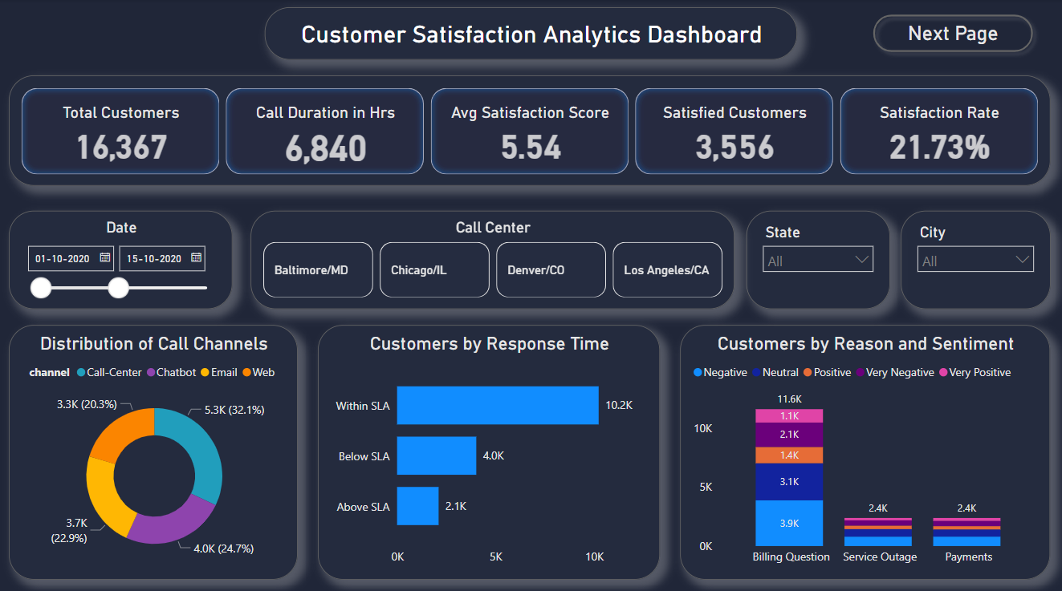
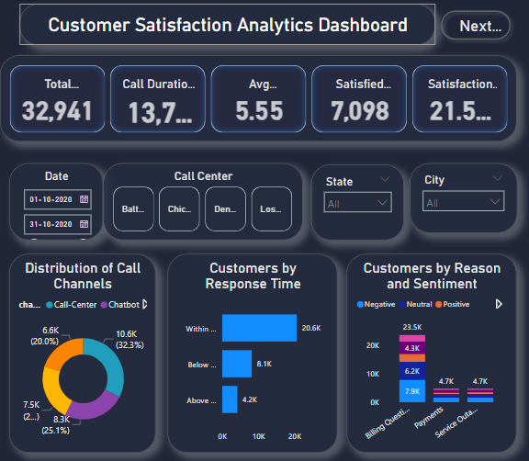
THANK YOU!

