Slide 1

World Layoffs Analysis
Data Cleaning And Exploratory Data Analysis
Presented By: Bhushan Wanjale

Slide 2


Objectives
Data Cleaning
Ensure the data used for analysis is clean, standardized, and free of duplicates, leading to more accurate and reliable insights.
Exploratory Data Analysis
Run various SQL queries to extract meaningful insights from the cleaned layoff data.

Slide 3

01
Data Cleaning
Ensuring Data Accuracy and Consistency
Click Here For SQL File

Slide 4
01
02
03
04
Data Cleaning Process
Create Staging Table
Remove Duplicates
Create a new table ‘layoff_staging’ as a duplicate of ‘layoffs’ to perform data cleaning without altering the original data.
Copy all data from ‘layoffs’ into ‘layoff_staging’.
Identify duplicates by assigning a unique row number to each row.
Create a CTE to filter duplicates (rows with ‘row_num’ > 1).
Remove duplicates by creating a new table ‘layoff_staging2’ including the ‘row_num’ column.
Standardize Data
Adjust Null or Blank Values
Trim whitespace from ‘company’ column.
Standardize industry names (e.g., "cryptocurrency" variations to "Crypto").
Standardize country names (e.g., variations of "United States").
Convert `date` column to DATE datatype.
Identify and fill null or blank `industry` values using self-join based on `company`.
Remove rows with both `total_laid_off` and `percentage_laid_off` as null values.

Slide 5
Exploratory Data Analysis
02
Analyzing Layoff Data to Reveal Key Patterns and Insights
Click Here For SQL File

Slide 6
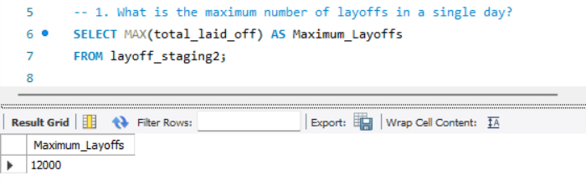
Exploratory Data Analysis- Q1
What is the maximum number of layoffs in a single day?
Insights
The query reveals the highest number of layoffs that occurred in a single day, providing an understanding of the peak layoff event.

Slide 7
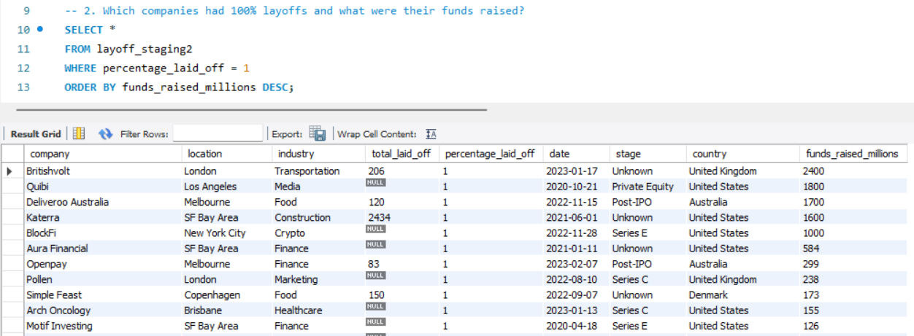
Exploratory Data Analysis- Q2
Which companies had 100% layoffs and what were their funds raised?
Insights
Identifies companies that completely laid off their workforce and shows their fundraising amounts, highlighting potential financial distress despite significant capital.

Slide 8
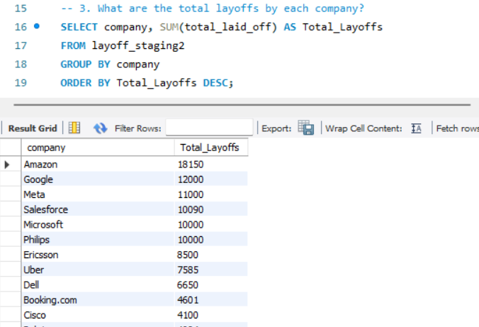
Exploratory Data Analysis- Q3
What are the total layoffs by each company?
Insights
Shows which companies had the highest total layoffs, helping to identify which firms were most affected by layoffs.

Slide 9
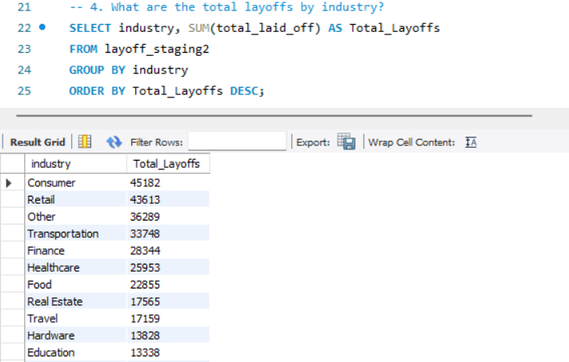
Exploratory Data Analysis- Q4
What are the total layoffs by industry?
Insights
Provides an overview of layoffs across different industries, indicating which sectors experienced the most job cuts.

Slide 10
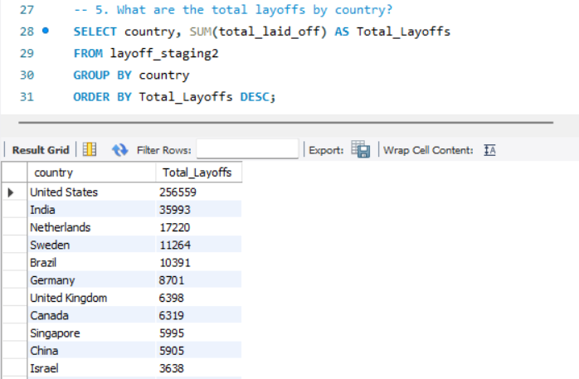
Exploratory Data Analysis- Q5
What are the total layoffs by country?
Insights
Displays the total layoffs by country, highlighting geographic regions most impacted by layoffs.

Slide 11
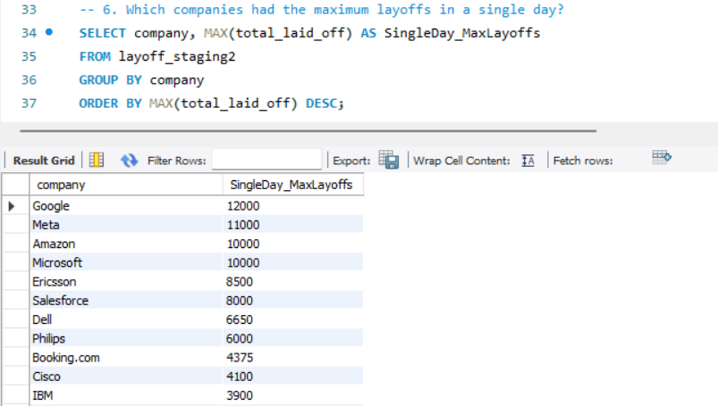
Exploratory Data Analysis- Q6
Which companies had the maximum layoffs in a single day?
Insights
Identifies companies with the highest number of layoffs in a single day, providing insight into severe layoff events.

Slide 12
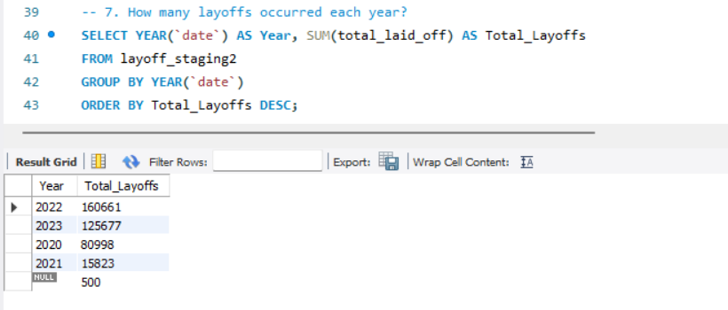
Exploratory Data Analysis- Q7
How many layoffs occurred each year?
Insights
Shows the annual layoff totals, helping to understand layoff trends over time.

Slide 13
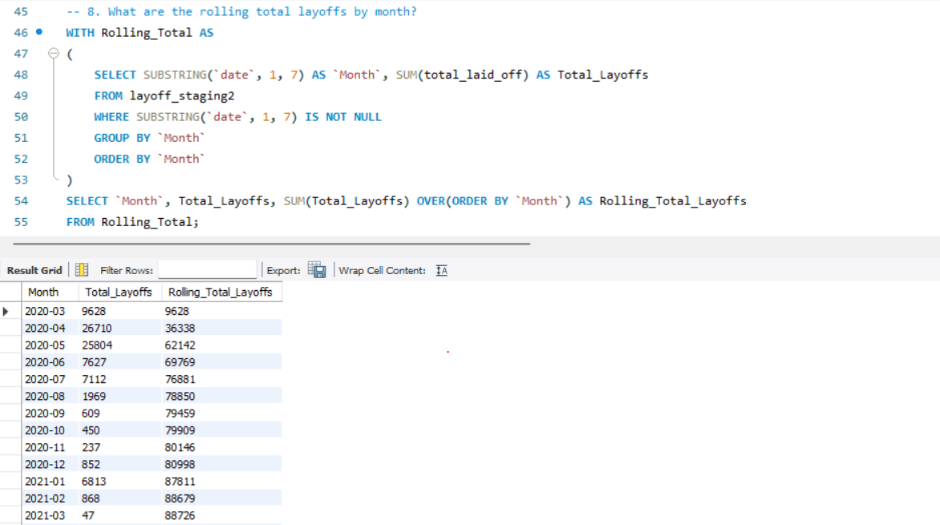
Exploratory Data Analysis- Q8
What are the rolling total layoffs by month?
Insights
Calculates the cumulative total of layoffs month by month, showing how layoffs accumulated over time.

Slide 14
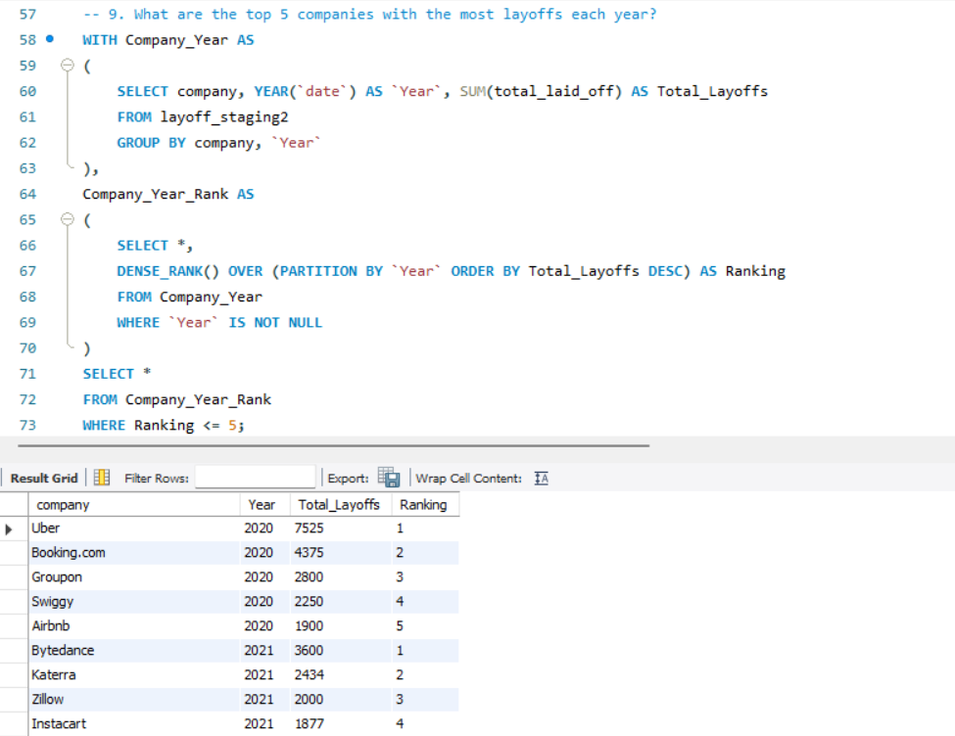
Exploratory Data Analysis- Q9
What are the top 5 companies with the most layoffs each year?
Insights
Ranks companies by layoffs for each year, highlighting the top 5 companies with the highest layoffs annually.

Slide 15
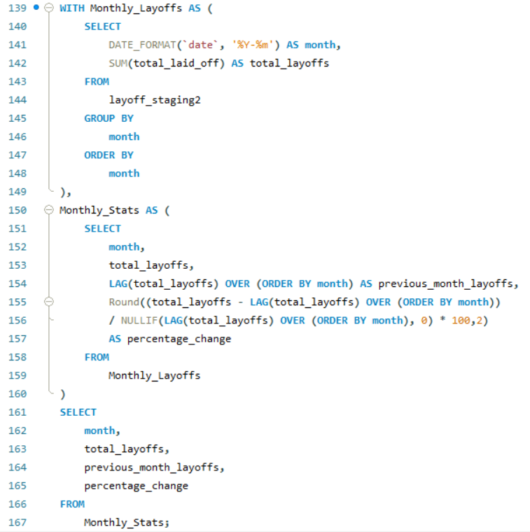
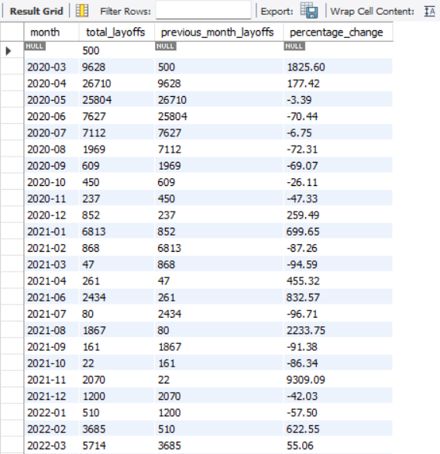
Exploratory Data Analysis- Q10
How do monthly layoffs trend over time, and which months have the highest and lowest layoffs?
Insights
This query helps identify layoff trends over time, revealing months with significant spikes or drops in layoffs.

Slide 16


Thank You!
I appreciate your time and attention. If you have any suggestions or advice, please feel free to share them.
Connect with me:
CREDITS: A special thanks to, ALEX THE ANALYST for providing the dataset and guidance for this project.

