Slide 1


Slide 2




Outline
Prerequisites
Supported Platforms
Required Software
Hadoop Operation Modes
Installation
Pre-Installation Setup
Standalone Installation
Pseudo Mode Installation
Fully Distributed Installation
Hadoop Web Interfaces

Slide 3

Prerequisites
Supported Platforms
Hadoop is supported by GNU/Linux platform and its flavors.
Hadoop can also be installed on a Windows platform.

Slide 4

Prerequisites
Required Software
Required software for Linux and Windows include:
JavaTM 1.6.x, preferably from Sun, must be installed.
ssh must be installed and sshd must be running to use the Hadoop scripts that manage remote Hadoop daemons.
Additional requirements for Windows include:
Cygwin - Required for shell support in addition to the required software above.

Slide 5

Hadoop Operation Modes
Local/Standalone Mode
After downloading Hadoop in your system, by default, it is configured in a standalone mode and can be run as a single java process.
Pseudo Distributed Mode
It is a distributed simulation on single machine. Each Hadoop daemon such as hdfs, yarn, MapReduce etc., will run as a separate java process. This mode is useful for development.
Fully Distributed Mode
This mode is fully distributed with minimum two or more
machines as a cluster.

Slide 6

Terms to Know before Installation
Namenode
Datanode
Secondary Namenode
Node Manager
Resource Manager

Slide 7


Slide 8

Pre-Installation Setup
Creating a dedicated Hadoop user
Installing Java
Installing SSH
SSH Key Generation

Slide 9

Creating Hadoop User
It is recommended to create a separate user for Hadoop to
isolate Hadoop file system from Unix file system.
Follow the steps given below to create a user:
Create a separate group to which the Hadoop user would
belong.
sudo groupadd hadoop
Create a hadoop user.
sudo useradd -G hadoop -p hdpuser123 hdpuser
Open the new user account.
su hdpuser

Slide 10

Installing Java
Java is the main prerequisite for Hadoop. First of all, you should verify the existence of java in your system.
$ java -version
If everything is ok, it will give you the following output.
java version "1.7.0_71" Java(TM) SE Runtime Environment (build 1.7.0_71-b13) Java HotSpot(TM) Client VM (build 25.0-b02, mixed mode)

Slide 11

Installing Java
If Java is not installed, follow the following steps:
Download the JDK from Oracle’s site
http://www.oracle.com/technetwork/java/javase/downloads/j dk8-downloads-2133151.html
For 64-bit OpenSUSE, download the ‘Linux x64‘ version rpm. For 32 bit systems download the ‘i586′ version of the package.
Install the JDK by opening a terminal, becoming root and switching to the directory where you downloaded the RPM package.
For x64 version execute: rpm -i jdk-8u5-linux-x64.rpm
For 32-bit version execute: rpm -i jdk-8u11-linux-i586.rpm

Slide 12

Installing Java
Make Oracle Java the default system JDK by executing the following sequence of commands:
update-alternatives --install /usr/bin/java java /usr/java/jdk1.8.0_05/bin/java 1551
update-alternatives --install /usr/bin/javadoc javadoc /usr/java/jdk1.8.0_05/bin/javadoc 1551
update-alternatives --install /usr/bin/jar jar /usr/java/jdk1.8.0_05/bin/jar 1551
update-alternatives --install /usr/bin/javap javap /usr/java/jdk1.8.0_05/bin/javap 1551
update-alternatives --install /usr/bin/javac javac /usr/java/jdk1.8.0_05/bin/javac 1551
update-alternatives --install /usr/bin/javaws javaws /usr/java/jdk1.8.0_05/bin/javaws 1551
update-alternatives --install /usr/bin/javah javah /usr/java/jdk1.8.0_05/bin/javah 1551
update-alternatives --install /usr/bin/jarsigner jarsigner /usr/java/jdk1.8.0_05/bin/jarsigner 1551
Define JAVA_HOME environment variable.
Type ‘exit‘ at the terminal to become your normal everyday user again.
Open .bashrc in your favorite command line text editor and the following:
 export JAVA_HOME=/usr/java/jdk1.8.0_05
Save the file and exit from the editor.
$source .bashrc
Verify Java version by typing ‘java –version’.

Slide 13

Installing SSH
SSH setup is required to do different operations on a cluster such as starting, stopping, distributed daemon shell operations.
To authenticate different users of Hadoop, it is required to provide public/private key pair for a Hadoop user and share it with different users.
Most linux distributions come with pre-installed ssh.
Verify if SSH is installed on the system

Slide 14

SSH Key Generation
The following commands are used for generating a key value pair using SSH.
Copy the public keys from id_rsa.pub to authorized_keys.
Make sure you are logged in as Hadoop User
$ ssh-keygen -t rsa –P “”
$ cat ~/.ssh/id_rsa.pub >> ~/.ssh/authorized_keys

Slide 15

Downloading Hadoop
Download the desired Hadoop distribution from Apache Software
Foundation
Version used in our setup: 2.7.3
Extract the downloaded distribution
$ tar xvzf hadoop-2.7.3.tar.gz
Copy the directory to /usr/local/
$ sudo mv hadoop-2.7.3 /usr/local/
Change permissions of the directory to make it accessible to Hadoop
user
$ cd /usr/local
$ sudo chown -R hdpuser:hadoop hadoop-2.7.3
Finally create a soft link to the distribution to give a generic name
$ sudo ln -s hadoop-2.7.3 hadoop

Slide 16

Local/Standalone Mode
By default, Hadoop is configured to run in a non- distributed mode, as a single Java process.
There are no daemons running and everything runs in a single JVM.
Standalone mode is suitable for running MapReduce programs during development, since it is easy to test and debug them.

Slide 17

Local/Standalone Mode
You can set Hadoop environment variables by appending the following commands to ~/.bashrc file.
export HADOOP_HOME=/usr/local/hadoop
Before proceeding further, you need to make sure that Hadoop is working fine. Just issue the following command:
$ hadoop version
If everything is fine with your setup, then it should display the hadoop distribution installed.

Slide 18

Pseudo Distributed Mode
Step 1: Setting up Hadoop environment
Step 2: Hadoop Configuration
Step 3: Formatting Namenode
Step 4: Starting Hadoop Daemons
Step 5: Verifying Hadoop Installation

Slide 19

Step 1: Setting up Hadoop environment
You can set Hadoop environment variables by appending the following
commands to ~/.bashrc file.
export JAVA_HOME=/usr/lib64/jvm/jre-1.7.0-openjdk
export HADOOP_HOME=/usr/local/hadoop
export HADOOP_MAPRED_HOME=$HADOOP_HOME
export HADOOP_COMMON_HOME=$HADOOP_HOME
export HADOOP_HDFS_HOME=$HADOOP_HOME
export YARN_HOME=$HADOOP_HOME
export HADOOP_COMMON_LIB_NATIVE_DIR=$HADOOP_HOME/lib/native
export PATH=$PATH:$HADOOP_HOME/sbin:$HADOOP_HOME/bin
export HADOOP_INSTALL=$HADOOP_HOME
Now apply all the changes into the current running system.
$ source ~/.bashrc

Slide 20

Step 2: Hadoop Configuration
Next we need to configure some of the Hadoop files, namely:
hadoop-env.sh
core-site.xml
hdfs-site.xml
mapred-site.xml
yarn-site.xml
These files are located in $HADOOP_HOME/etc/hadoop

Slide 21

Step 2: Hadoop Configuration
 hadoop-env.sh
 In this file, add the following line to define the Java home
 export JAVA_HOME=/usr/lib64/jvm/jre-1.7.0-openjdk

Slide 22

Step 2: Hadoop Configuration
 mapred-site.xml
 This file may not be present with the same name. In that case we need to first copy this file from the template file
 cp mapred-site.xml.template mapred-site.xml
 Then add the following property configuration tabs
<property>
<name>mapreduce.framework.name</name>
<value>yarn</value>
</property>
within the

Slide 23

Step 2: Hadoop Configuration
 core-site.xml
 Add the following property in the configuration tabs
<property>
<name>fs.defaultFS</name>
<value>hdfs://localhost:9000</value>
<description>The name of the default file system. A URI whose scheme and authority determine the FileSystem implementation. The uri's scheme determines the config property (fs.SCHEME.impl) naming the FileSystem implementation class. The uri's authority is used to determine the host, port, etc. for a filesystem.</description>
</property>

Slide 24

Step 2: Hadoop Configuration
hdfs-site.xml
We need to create a couple of directories that would be used by the namenode and the datanode in the Hadoop cluster.
$ sudo mkdir -p /usr/local/hadoop_store/hdfs/namenode
$ sudo mkdir -p /usr/local/hadoop_store/hdfs/datanode
$ sudo chown -R hdpuser:hadoop /usr/local/hadoop_store

Slide 25

Step 2: Hadoop Configuration
 Next we add the following properties within the configuration tabs
<property>
<name>dfs.replication</name>
<value>1</value>
<description>Default block replication.
The actual number of replications can be specified when the file is created. The default is
used if replication is not specified in create time.
</description>
</property>
<property>
<name>dfs.namenode.name.dir</name>
<value>file:/usr/local/hadoop_store/hdfs/namenode</value>
</property>
<property>
<name>dfs.datanode.data.dir</name>
<value>file:/usr/local/hadoop_store/hdfs/datanode</value>
</property>

Slide 26

Step 2: Hadoop Configuration
 yarn-site.xml
 Add the following property in the configuration tabs
<property>
<name>yarn.nodemanager.aux-services</name>
<value>mapreduce_shuffle</value>
</property>

Slide 27

Step 3: Format the Hadoop Namenode
Once the Hadoop configuration is over, we need to format the Namenode.
The Hadoop system can be formatted by the following command:
 hadoop namenode –format
The Namenode should be successfully formatted before proceeding further.

Slide 28

Step 4: Starting Hadoop Daemons
Next we need to start the Hadoop Daemons which run as individual Java services.
Hadoop provides a set of scripts to start and stop the Daemons.
 To start the DFS Daemons, command in the terminal:
 start-dfs.sh
issue the following
 To start the Yarn Daemons, command in the terminal:
 start-yarn.sh
issue
the following

Slide 29

Step 5: Verifying Hadoop Installation
 Hadoop installation can be verified by checking if all the Daemons are running successfully.
Since all the Daemons are Java following command on the terminal:
$ jps
It should list the following processes:
Namenode
SecondaryNamenode
Datanode
NodeManager
ResourceManager
processes, issue the

Slide 30

Fully Distributed Mode
Step 1: Setting up Hadoop environment
Step 2: Setting hosts file on all nodes
Step 3: Setting password-less ssh across all nodes
Step 4: Hadoop Configuration
Step 5: Setting Master and Slaves files
Step 6: Copying Hadoop distribution across all nodes
Step 7: Formatting Namenode
Step 8: Starting Hadoop Daemons
Step 9: Verifying Hadoop Installation

Slide 31

Step 1: Setting up Hadoop environment
Same as Pseudo distributed mode
You can set Hadoop environment variables by appending the following commands to ~/.bashrc file.
export JAVA_HOME=/usr/lib64/jvm/jre-1.7.0-openjdk
export HADOOP_HOME=/usr/local/hadoop
export HADOOP_MAPRED_HOME=$HADOOP_HOME
export HADOOP_COMMON_HOME=$HADOOP_HOME
export HADOOP_HDFS_HOME=$HADOOP_HOME
export YARN_HOME=$HADOOP_HOME
export HADOOP_COMMON_LIB_NATIVE_DIR=$HADOOP_HOME/lib/native
export PATH=$PATH:$HADOOP_HOME/sbin:$HADOOP_HOME/bin
export HADOOP_INSTALL=$HADOOP_HOME
Now apply all the changes into the current running system.
$ source ~/.bashrc

Slide 32

Step 2: Setting up hosts file
Need to state the names of the nodes in the cluster in
/etc/hosts file.
$ sudo vi /etc/hosts
Add the ip addresses of the Master and Slave nodes
 192.9.200.172
 192.9.200.173
HadoopMaster HadoopSlave
 Follow the same step on all nodes

Slide 33

Step 3: Setting up password-less ssh
To manage (start/stop) all nodes of Master-Slave architecture, hdpuser (hadoop user of Masternode) need to login to all Slaves and vice-versa which can be possible through setting up password-less SSH login.
Fire the following command for sharing public SSH key
On the Slave Machine
$ ssh-copy-id -i $HOME/.ssh/id_rsa.pub hdpuser@HadoopMaster
On the Master Machine
$ ssh-copy-id -i $HOME/.ssh/id_rsa.pub hdpuser@HadoopSlave

Slide 34
Step 4: Hadoop Configuration
 core-site.xml
 Add the following property in the configuration tabs
<property>
<name>fs.defaultFS</name>
<value>hdfs://HadoopMaster:9000</value>
<description>The name of the default file system. A URI whose scheme and authority determine the FileSystem implementation. The uri's scheme determines the config property (fs.SCHEME.impl) naming the FileSystem implementation class. The uri's authority is used to determine the host, port, etc. for a filesystem.</description>
</property>

Slide 35

Step 4: Hadoop Configuration
hdfs-site.xml
Create a couple of directories that would be used by the namenode and the datanode on all the nodes in the Hadoop cluster.
$ sudo mkdir -p /usr/local/hadoop_store/hdfs/namenode
$ sudo mkdir -p /usr/local/hadoop_store/hdfs/datanode
$ sudo chown -R hdpuser:hadoop /usr/local/hadoop_store

Slide 36

Step 4: Hadoop Configuration
 Next we add the following properties within the configuration tabs
<property>
<name>dfs.replication</name>
<value>2</value>
<description>Default block replication.
The actual number of replications can be specified when the file is created. The default is
used if replication is not specified in create time.
</description>
</property>
<property>
<name>dfs.namenode.name.dir</name>
<value>file:/usr/local/hadoop_store/hdfs/namenode</value>
</property>
<property>
<name>dfs.datanode.data.dir</name>
<value>file:/usr/local/hadoop_store/hdfs/datanode</value>
</property>

Slide 37

Step 4: Hadoop Configuration
 mapred-site.xml
 Add the following property within the configuration tabs
<property>
<name>mapred.framework.name</name>
<value>yarn</value>
</property>

Slide 38

Step 4: Hadoop Configuration
 yarn-site.xml
 Add the following property within the configuration tabs
<property>
<name>yarn.resourcemanager.resource-tracker.address</name>
<value>HadoopMaster:8025</value>
</property>
<property>
<name>yarn.resourcemanager.scheduler.address</name>
<value>HadoopMaster:8035</value>
</property>
<property>
<name>yarn.resourcemanager.address</name>
<value>HadoopMaster:8050</value>
</property>

Slide 39

Step 5: Setting up master and slaves file
In directory $HADOOP_HOME/etc/hadoop
Create ‘master’ file (if not already present)
$ vi master
Add the following line
HadoopMaster
Add the slaves entries to slaves file
$ vi slaves
Add the following line
HadoopMaster
HadoopSlave

Slide 40

Step 6: Copying Hadoop Distribution across all nodes
Copy the Hadoop directory to all the nodes in the cluster
$ scp -r /usr/local/hadoop-2.7.3 hdpuser@HadoopSlave:~/
Go the HadoopSlave
$ sudo mv hadoop-2.7.3 /usr/local/
$ cd /usr/local
$ sudo ln -s hadoop-2.7.3 hadoop

Slide 41

Step 7: Format the Hadoop Namenode
Once the Hadoop configuration is over, we need to format the Namenode.
The Namenode should be formatted only from the Master node.
The Hadoop system can be formatted by the following command:
 hadoop namenode –format
The Namenode should be successfully formatted before proceeding further.

Slide 42

Step 8: Starting Hadoop Daemons
Next we need to start the Hadoop Daemons which run as individual Java services.
The Hadoop Daemons should be run from the Master node only.
 To start the DFS Daemons, command in the terminal:
 start-dfs.sh
issue the following
 To start the Yarn Daemons, command in the terminal:
 start-yarn.sh
issue
the following

Slide 43

Step 9: Verifying Hadoop Installation
Hadoop installation can be verified by checking if all the Daemons are running successfully.
Issue the following command on the Master:
$ jps
It should list the following processes:
Namenode
SecondaryNamenode
Datanode
NodeManager
ResourceManager
Issue the following command on each Slave:
$ jps
It should list the following processes:
Datanode
NodeManager

Slide 44
Hadoop Web Interfaces
Hadoop Namenode and ResourceManager monitored using the web interfaces.
Usually used by Hadoop Administrators.
can be

Slide 45

Hadoop Web Interfaces
For NameNode:
http://HadoopMaster:50070
For ResourceManger:
http://HadoopMaster:8088
For Secondary NameNode:
http://HadoopMaster:50090
For DataNode:
http://HadoopMaster:50075

Slide 46

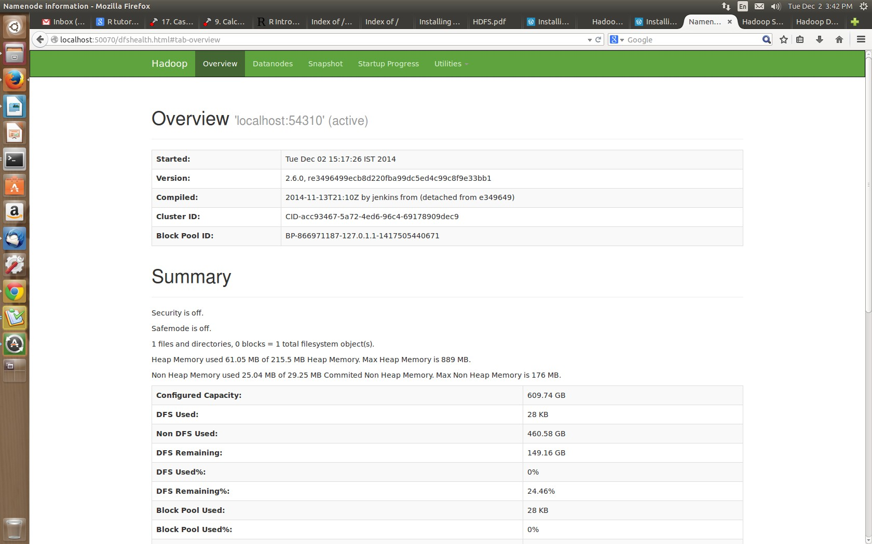
Hadoop Web Interfaces: NameNode
NameNode

Slide 47

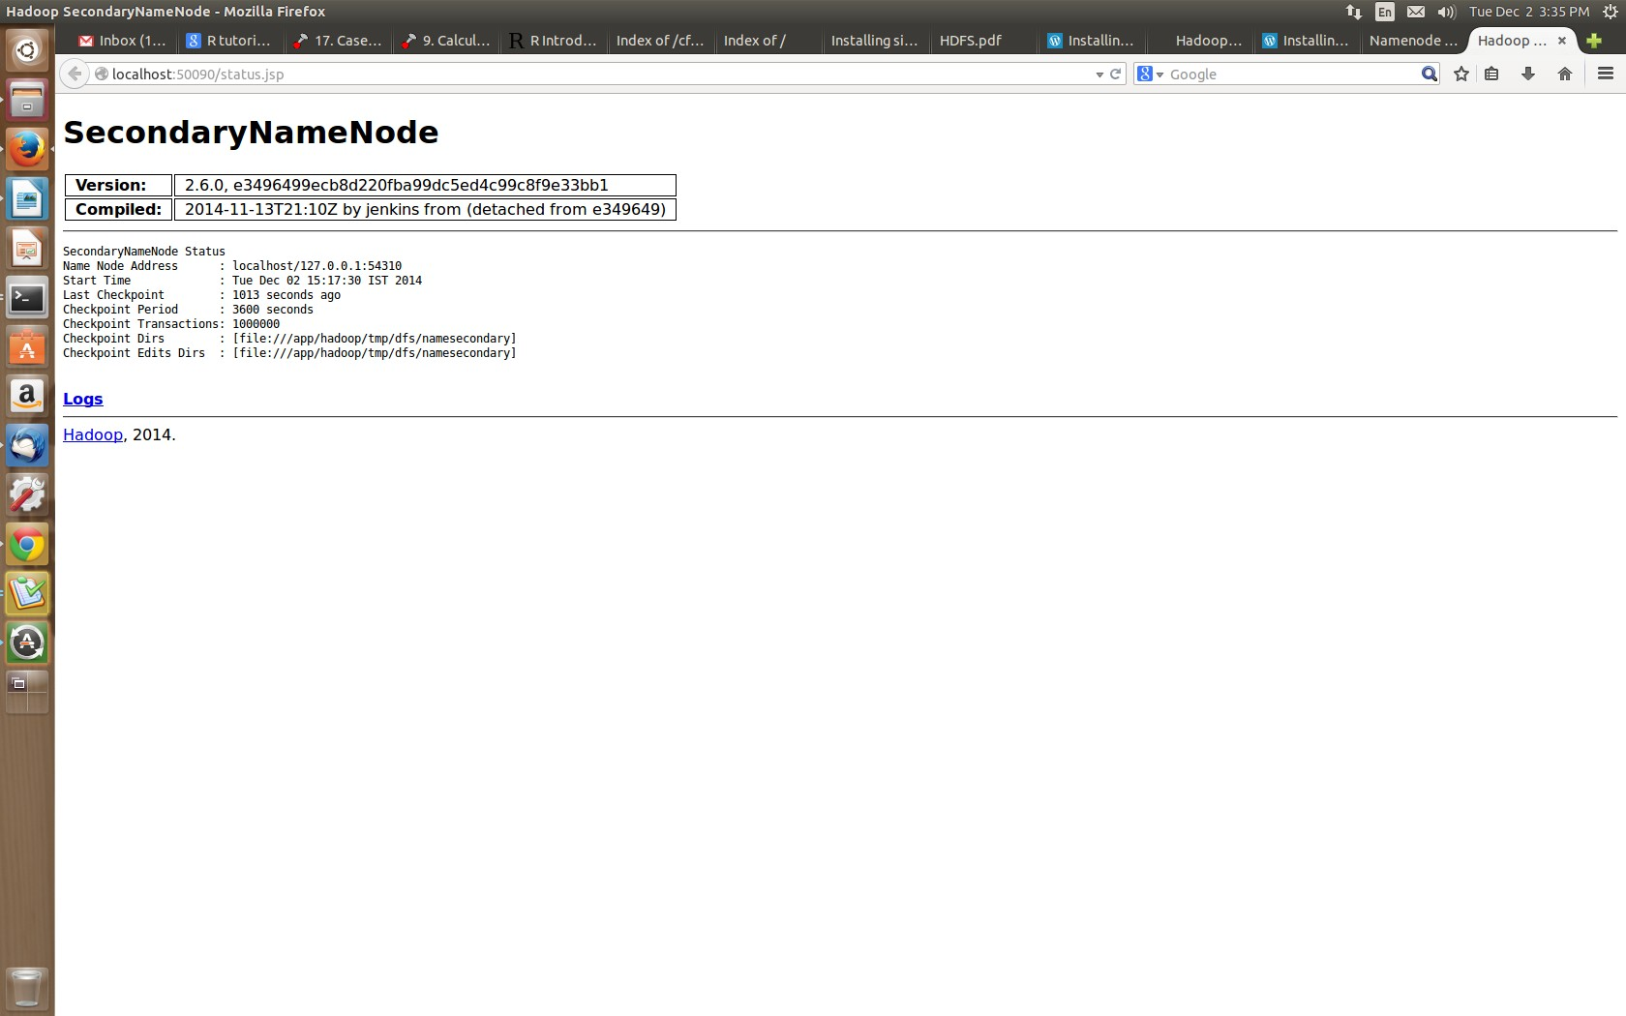
Hadoop Web Interfaces: Secondary NameNode

Slide 48

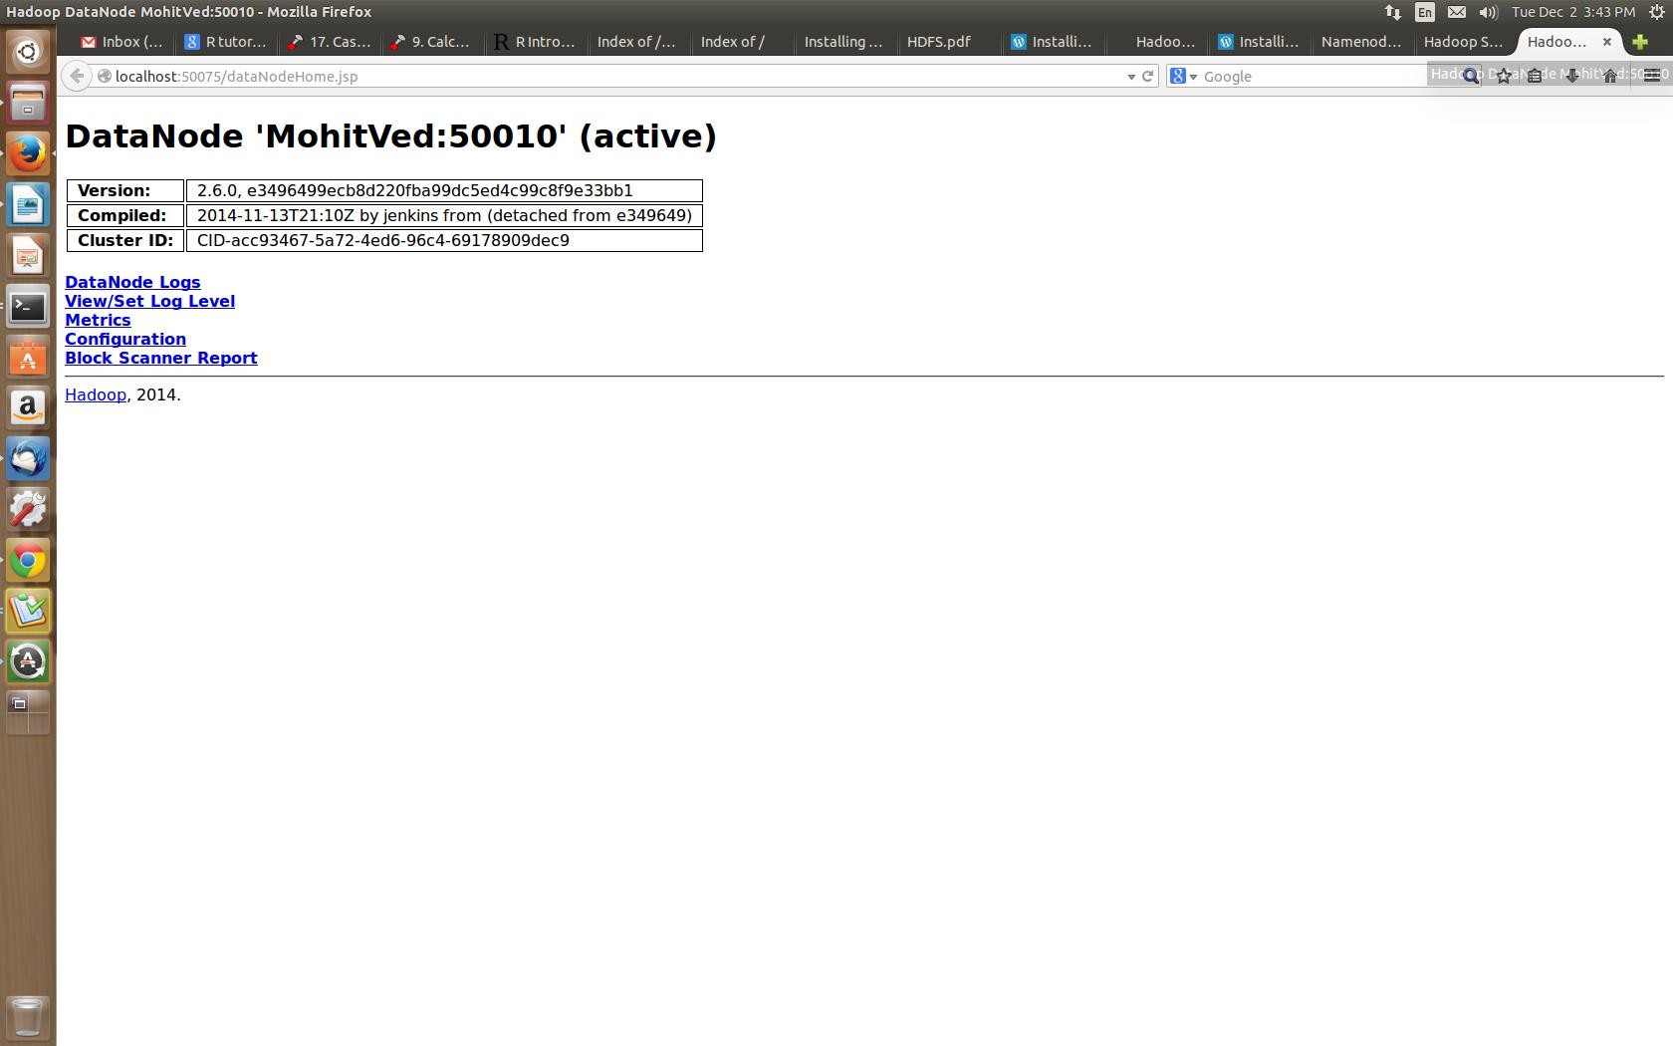
Hadoop Web Interfaces: DataNode

Slide 49

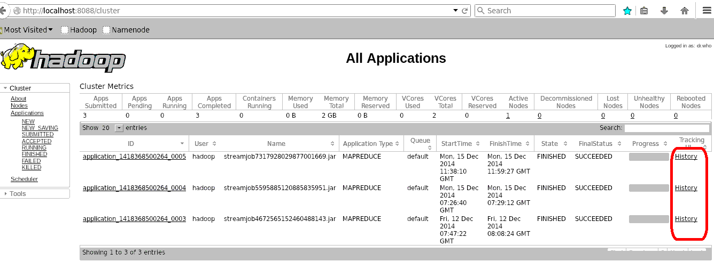
Hadoop Web Interfaces: Resource Manager

Slide 50


That’s All For Today

