Slide 1


Hadoop for Big Data
‹#›

Slide 2
Outline
Hadoop
History of Hadoop
Hadoop Components
Hadoop Architecture
How Hadoop Works?
Hadoop Distributed File System (HDFS)
Hadoop MapReduce
Hadoop1 vs Hadoop2
‹#›

Slide 3
Large Dataset Challenges
Storing large VOLUMES (TB/PB/XB)
Processing In Timely Manner
Processing Variety of DATA (St/SS/US)
Costly High End Infrastructure
‹#›

Slide 4

HADOOP
‹#›

Slide 5





Hadoop’s History
2005: Doug Cutting and Michael J. Cafarella developed Hadoop to support distribution for the Nutch search engine project.
The project was funded by Yahoo.
2006: Yahoo gave the project to Apache
Software Foundation.
Doug Cutting

Slide 6



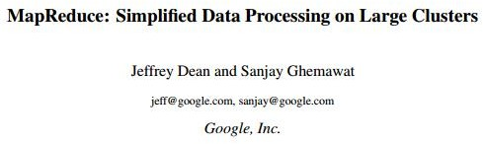


Google Origins
2003
2004

Slide 7
Some Hadoop Milestones
2008 - Hadoop Wins Terabyte Sort Benchmark (sorted 1 terabyte of data in 209 seconds, compared to previous record of 297 seconds)
2009 - Avro and Chukwa became new members of Hadoop Framework family
2010 - Hadoop's Hbase, Hive and Pig subprojects completed, adding more computational power to Hadoop framework
2011 - ZooKeeper Completed
2013 - Hadoop 1.1.2 and Hadoop 2.0.3 alpha.
- Ambari, Cassandra, Mahout were added

Slide 8

Hadoop in the Wild
Hadoop is in use at most organizations that handle big data:
Yahoo!
Facebook
Amazon
Netflix
Google
Etc…
Some examples of scale:
Yahoo!’s Search Webmap runs on 10,000 core Linux cluster and powers Yahoo! Web search
FB’s Hadoop cluster hosts 100+ PB of data & growing at ½ PB/day

Slide 9
What is Hadoop?
Hadoop is a software framework for distributed processing of
large datasets across large clusters of computers
Large datasets → Terabytes or petabytes of data
Large clusters → hundreds or thousands of nodes
Hadoop is
the open-source implementation for Google
MapReduce
Hadoop is based on a simple data model, any data will fit.
‹#›

Slide 10






What does Hadoop promise?
Scalability (petabytes of data, thousands of machines)
Flexibility in accepting all data formats (no schema) Efficient and simple fault-tolerant mechanism
Commodity inexpensive hardware
Performance (tons of indexing, tuning, data organization tech.)
Features:
Provenance tracking
Annotation management
- ….
‹#›

Slide 11
Design Principles of Hadoop
Need to process big data
Need to parallelize computation across thousands of nodes
Commodity hardware
Large number of low-end cheap machines working in parallel to solve a computing problem
This is in contrast to Parallel DBs: small number of high-end expensive
machines
Automatic parallelization & distribution
Hidden from the end-user
Fault tolerance and automatic recovery
Nodes/tasks will fail and will recover automatically
Clean and simple programming abstraction
Users only provide two functions “map” and “reduce”

Slide 12






Hadoop Concepts
Read Many Times
Write Once!
----------
----------
----------
----------
----------
-
Update
Hadoop 0.19.0 onwards supports appending in the file
Hadoop is ideal for:
Applications that need sequential data access.
Applications that need WORM characteristics.
Hadoop does not support updating of data once the file is
closed.

Slide 13
Hadoop Core Components
Large file stored in Blocks (128 MB)
Replication
Scalable to thousands of Nodes in single cluster
Minimal Data movement
HDFS
Batch Job Processing
Map-Distributed and localized to clusters
Fault Tolerant
Massive Parallelism
MapReduce
PIG
Other Libs
HIVE
HBASE
SQOOP
…….

Slide 14
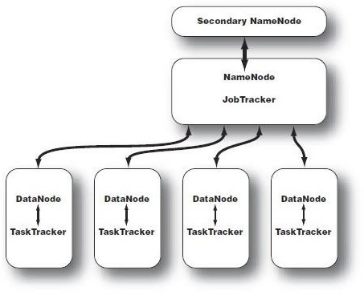
Hadoop Hardware Components

Slide 15
NameNode
Master Node
Manages File System Namespace
Executes File System operation like opening, closing and renaming files and directories
Replica placement using Rack-Aware Replica Placement Policy
Check pointing
Load Balancing
RACK 1 RACK 2
D1 D2
1
5 1
3
{Filename, numReplicas, block-ids}
/user/hdfs/data/file1, r:2, {1,3}
/user/hdfs/data/file2, r:3, {2,4,5}
2
4 4
D3
D4
4
2
2
5
3
5

Slide 16
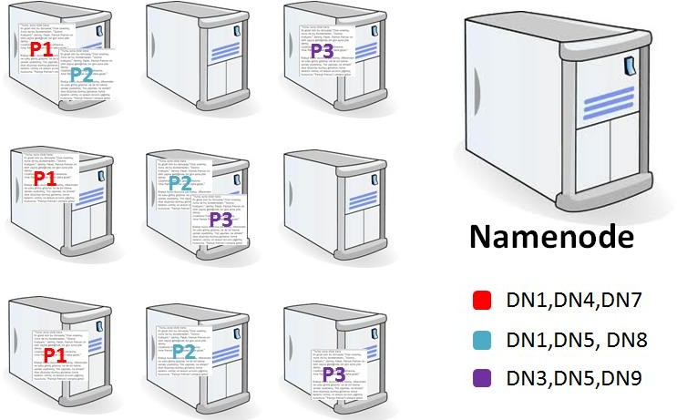
DataNode
Slave Node
Responsible for
serving
read/write requests
to file systems from the
clients.
Physical storage
files.
for the
Performs block creation, deletion and replication
as instructed by Name node.
Data nodes can scale up
to 1000’s.
Datanodes

Slide 17


Secondary Name Node
It has the same configuration as Name node
Periodic check pointing
Updates FSImage File periodically
Periodic
Sync
Primary Name Node
Secondary Name Node

Slide 18
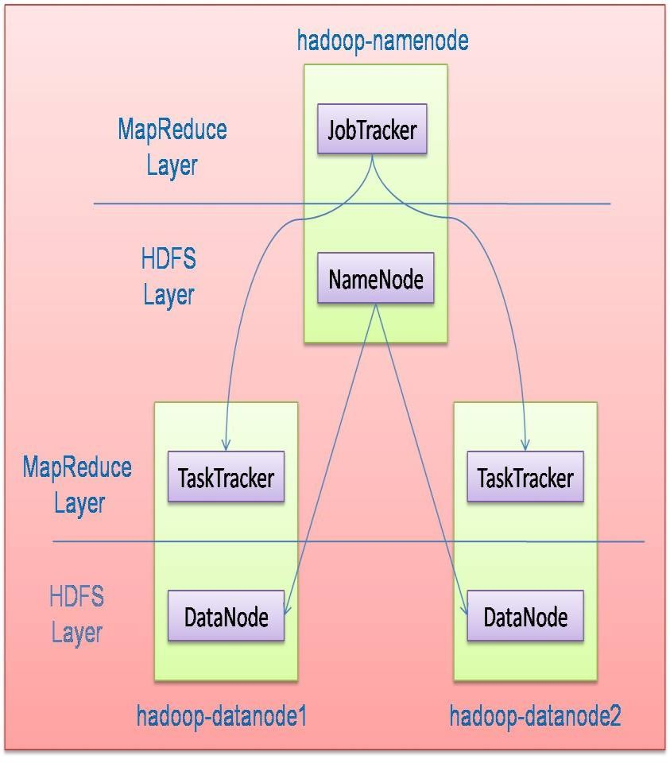


Hadoop Architecture
Hadoop is designed as a master-slave shared-nothing architecture.
Hadoop framework consists of two main layers:
Distributed file system (HDFS)
Execution engine (MapReduce)
Master node (single node)
Many slave nodes

Slide 19
Hadoop: How does it Work?

Slide 20
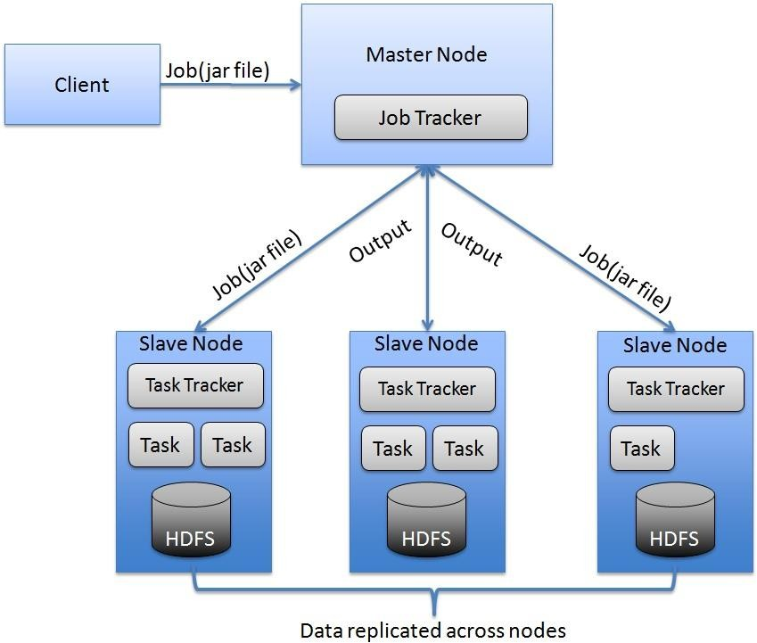
Hadoop Workflow

Slide 21
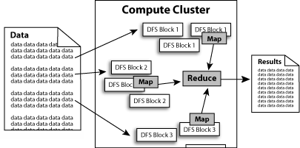
What does it do?
Hadoop implements Google’s MapReduce, using HDFS
MapReduce divides applications into many small blocks of work.
HDFS creates multiple replicas of data blocks for reliability, placing them on compute nodes around the cluster.
MapReduce can then process the data where it is located.

Slide 22
HDFS

Slide 23
Hadoop Distributed File System
A distributed file system designed to be fault tolerant and deployed on low cost hardware.
High throughput access to the data, suitable for applications with large datasets.
Streaming access to file system data.
HDFS Goals:
Resilient to hardware failure.
Handle large data sets.
Moving computation closer to the data.
Portable across all platforms as developed in java.

Slide 24
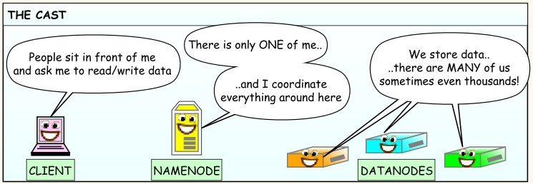
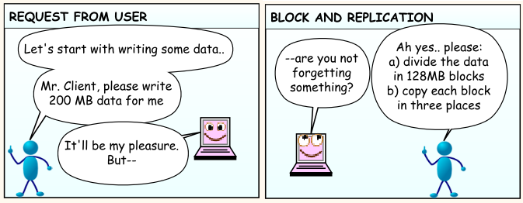
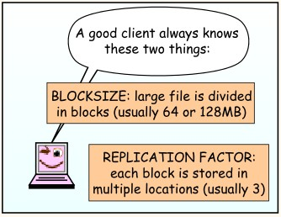
HDFS

Slide 25
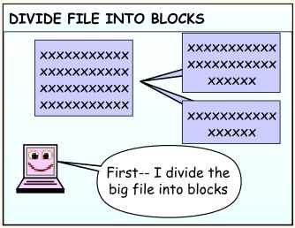
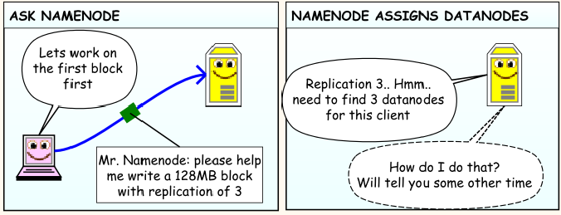
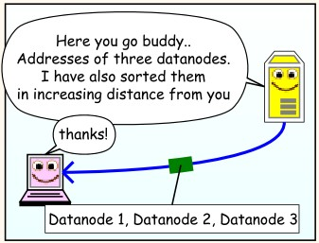
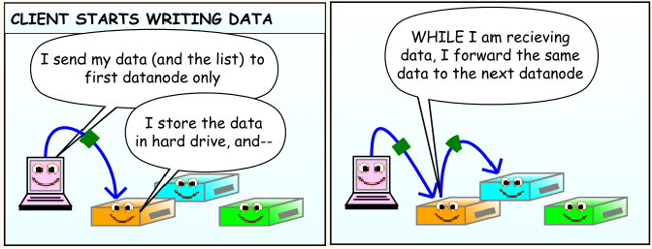

Slide 26
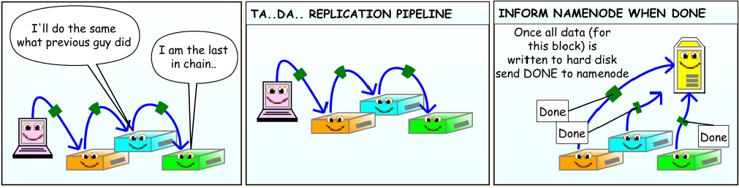
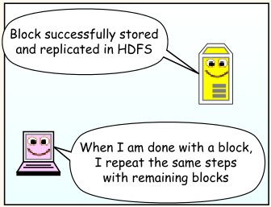
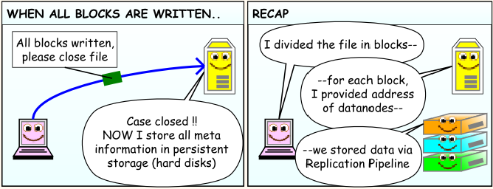

Slide 27
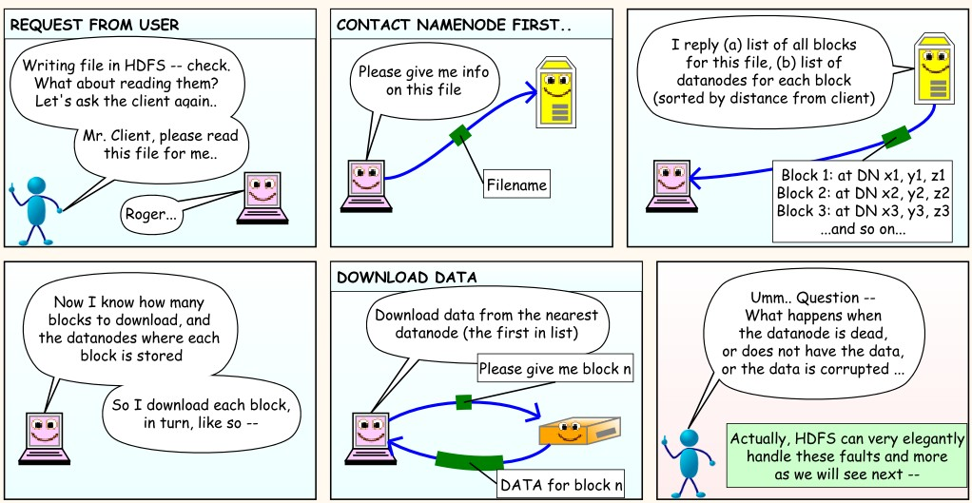
Reading Data in HDFS Cluster

Slide 28
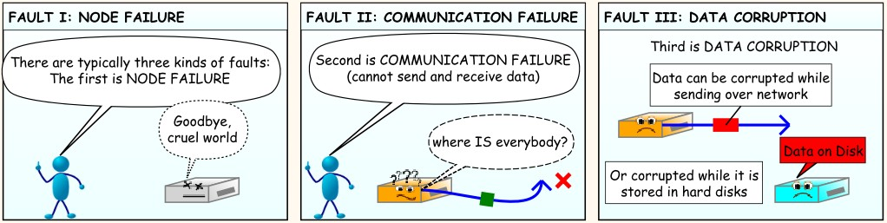
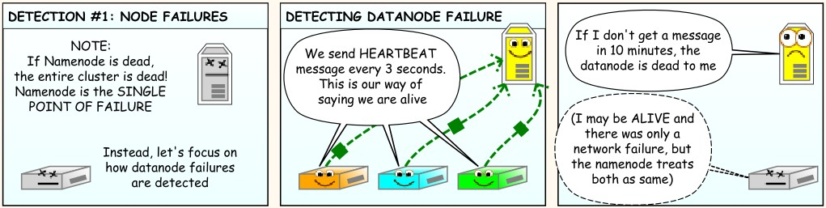
Fault Tolerance in HDFS
FAULT DETECTION

Slide 29
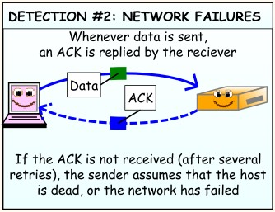
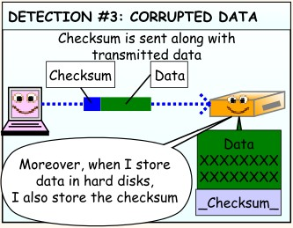
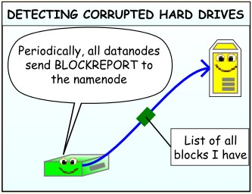
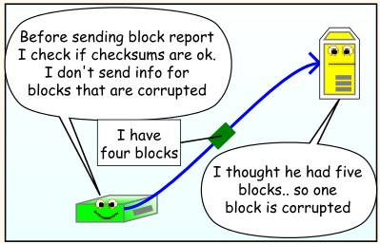
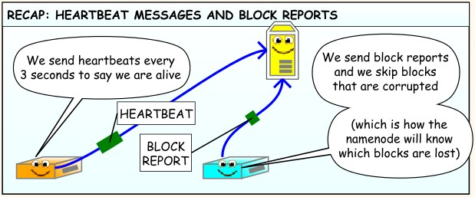

Slide 30
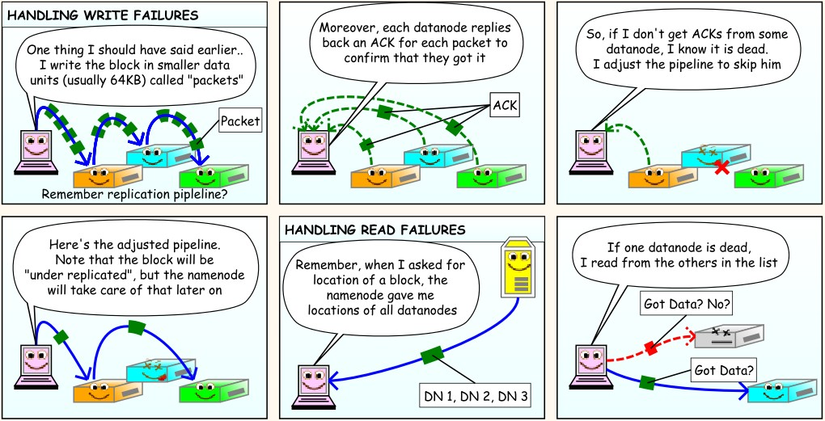
Handling Read/Write Failures

Slide 31
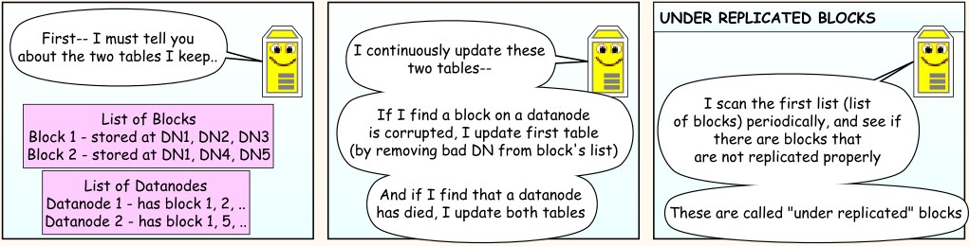
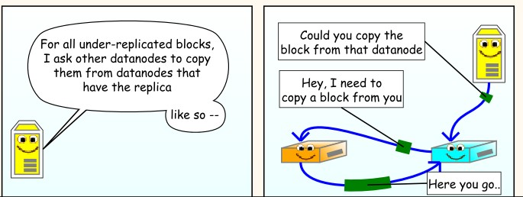
Handling Datanode Failure

Slide 32
Map-Reduce

Slide 33

MapReduce
Map Reduce was proposed by
A programming paradigm to process huge data sets in small chunks parallely.
MR allows complex data analysis in realtime.
Follows simple strategy:
“Divide & Conquer”
<Key, Value> pair

Slide 34
MapReduce Framework
JobTracker: Master
Takes care of scheduling
and job submission
TaskTracker: Slave
Starts Mappers & Reducers assigned by JobTracker
Sends heart beats to the
JobTracker
Sends task progress to the JobTracker
Does not know about the rest of the cluster (shared nothing)
Splits jobs into tasks (Mappers and Reducers)
Assigns tasks to worker
nodes
Reassigns tasks in case of failure
Keeps track of job progress
Keeps track
of worker
nodes through heartbeats

Slide 35
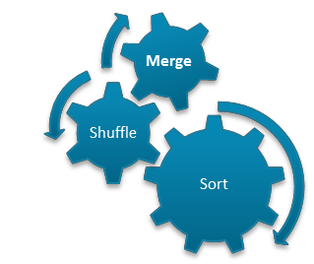
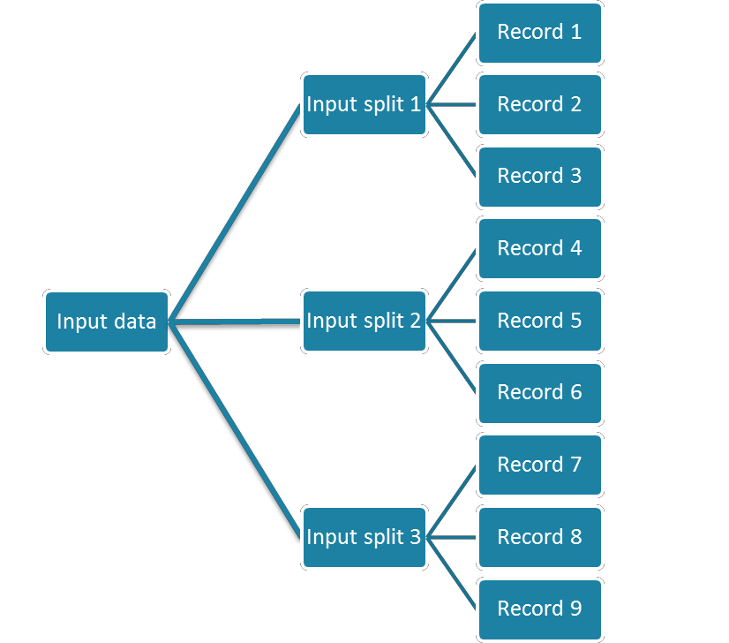










MapReduce in a nutshell
Task1
Aggregated
Result
Task 2
Output data
Aggregated
Result
Task 3
‹#›

Slide 36


























Map-Reduce Execution Engine
(Example: Color Count)
Shuffle & Sorting
based on k

Slide 37
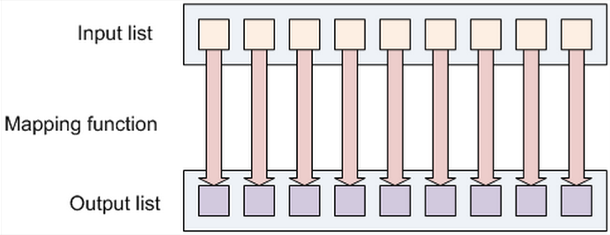
Mapper
Mapper maps input key/value pairs to a set of intermediate key/value
pairs
Mapper implementations are specified in the Job
Each mapper processes a piece of the total input
– Typically blocks that reside on the same machine as the mapper (local datanode)
Mappers sort output by key and store it on the local disk
Mapping creates a new output list by applying a function to individual elements of
an input list.
37

Slide 38
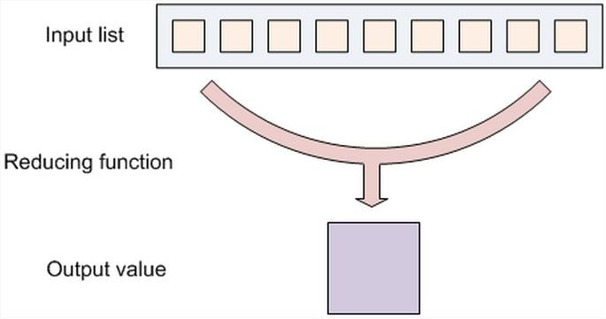
Reducer
Collects sorted input KeyValue pairs over the network from Mappers
Performs (on disk) sort & merge on outputs from different mappers
Calls the reduce method for each unique key
List of values for each key is read from local disk (the result of the
merge)
Writes output KeyValue pairs to HDFS
Typically blocks go to local data node
Number of reducers can be set by users.
38

Slide 39
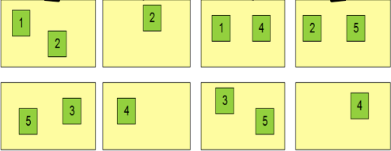
Properties of MapReduce Engine
Job Tracker is the master node (runs with the namenode)
Receives the user’s job
Decides on how many tasks will run (number of mappers)
Decides on where to run each mapper (concept of locality)
Node 1
Node 2
Node 3
This file has 5 Blocks → run 5 map tasks
Where to run the task reading block “1”
Try to run it on Node 1 or Node 3
‹#›

Slide 40

Properties of MapReduce Engine
Task Tracker is the slave node (runs on each datanode)
Receives the task from Job Tracker
Runs the task until completion (either map or reduce task)
Always in communication with the Job Tracker reporting progress

Slide 41
Key-Value Pairs
Mappers and Reducers are users’ code (provided functions)
Just need to obey the Key-Value pairs interface
Mappers:
Consume <key, value> pairs
Produce <key, value> pairs
Reducers:
Consume <key, <list of values>>
Produce <key, value>
Shuffling and Sorting:
Hidden phase between mappers and reducers
Groups all similar keys from all mappers, sorts and passes them to a certain reducer in the form of <key, <list of values>>
‹#›

Slide 42
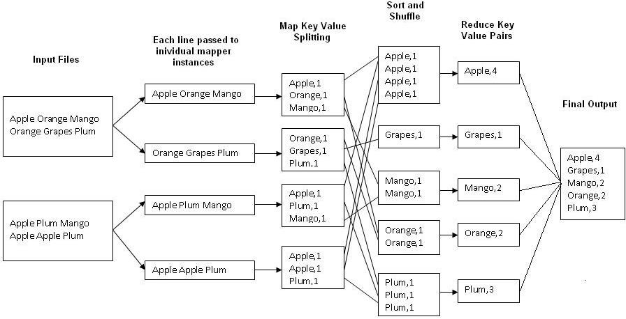
Example: Word Count
Job: Count the occurrences of each word in a data set.
Map Tasks
Reduce Tasks
‹#›

Slide 43
Hadoop vs. Other Systems
 | Distributed Databases | Hadoop
Computing Model | Notion of transactions Transaction is the unit of work ACID properties, Concurrency control | Notion of jobs Job is the unit of work No concurrency control
Data Model | Structured data with known schema Read/Write mode | Any data will fit in any format (un)(semi)structured ReadOnly mode
Cost Model | - Expensive servers | - Cheap commodity machines
Fault Tolerance | Failures are rare Recovery mechanisms | Failures are common over thousands of machines Simple yet efficient fault tolerance
Key Characteristics | - Efficiency, optimizations, fine-tuning | - Scalability, flexibility, fault tolerance
‹#›

Slide 44
Limitations of Hadoop1
JobTracker can become bottleneck as it alone does the tasks of
resource management,
job scheduling and
monitoring
Only one namespace for managing HDFS
Map and reduce slots are static. That means once it assigns resources to Map/Reduce jobs, it cannot re-use them even though some slots are idle.
Only job to run is Mapreduce
Supports only upto 4000 nodes per cluster.
‹#›

Slide 45
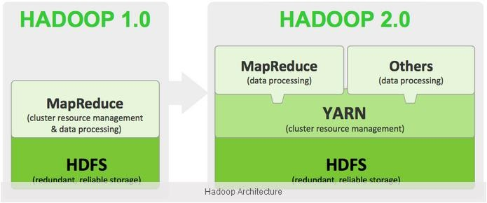
Hadoop2
‹#›

Slide 46
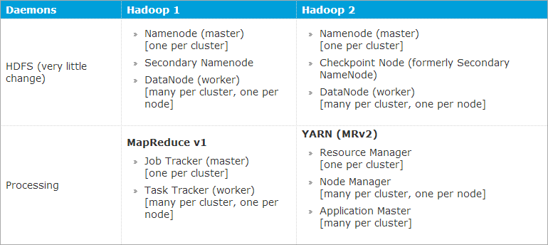
Hadoop1 Vs Hadoop2
‹#›

Slide 47

Happy Hadooping!
•
1
0
47

Slide 48
Thank You
48

