Slide 1






Bank Loan Analysis
Bhushan Gawali

Slide 2



Introduction
Overview:
This project aims to analyze bank loan data to provide insights into loan applications, funding, repayment, and borrower profiles.
Importance:
Understanding loan metrics is crucial for making data-driven decisions to improve lending operations and manage risks.

Slide 3
Problem Statement
Objective:
The primary objective is to analyze loan data to identify key performance indicators and provide insights into loan applications, funding, and repayment processes.
Dashboards :
Summary
Overview
Details

Slide 4
DASHBOARD 1: SUMMARY
Key Performance Indicators (KPIs) Requirements:
Total Loan Applications: We need to calculate the total number of loan applications received during a specified period. Additionally, it is essential to monitor the Month-to-Date (MTD) Loan Applications and track changes Month-over-Month (MoM).
Total Funded Amount: Understanding the total amount of funds disbursed as loans is crucial. We also want to keep an eye on the MTD Total Funded Amount and analyse the Month-over-Month (MoM) changes in this metric.
Total Amount Received: Tracking the total amount received from borrowers is essential for assessing the bank's cash flow and loan repayment. We should analyse the Month-to-Date (MTD) Total Amount Received and observe the Month-over-Month (MoM) changes.
Average Interest Rate: Calculating the average interest rate across all loans, MTD, and monitoring the Month-over-Month (MoM) variations in interest rates will provide insights into our lending portfolio's overall cost.
Average Debt-to-Income Ratio (DTI): Evaluating the average DTI for our borrowers helps us gauge their financial health. We need to compute the average DTI for all loans, MTD, and track Month-over-Month (MoM) fluctuations.

Slide 5
DASHBOARD 1: SUMMARY
Good Loan v Bad Loan KPI’s
Good Loan:
Good Loan Application Percentage
Good Loan Applications
Good Loan Funded Amount
Good Loan Total Received Amount
Bad Loan
Bad Loan Application Percentage
Bad Loan Applications
Bad Loan Funded Amount
Bad Loan Total Received Amount
Loan Status Grid View
In order to gain a comprehensive overview of our lending operations and monitor the performance of loans, we aim to create a grid view report categorized by 'Loan Status.’ By providing insights into metrics such as 'Total Loan Applications,' 'Total Funded Amount,' 'Total Amount Received,' 'Month-to-Date (MTD) Funded Amount,' 'MTD Amount Received,' 'Average Interest Rate,' and 'Average Debt-to-Income Ratio (DTI),' this grid view will empower us to make data-driven decisions and assess the health of our loan portfolio.

Slide 6
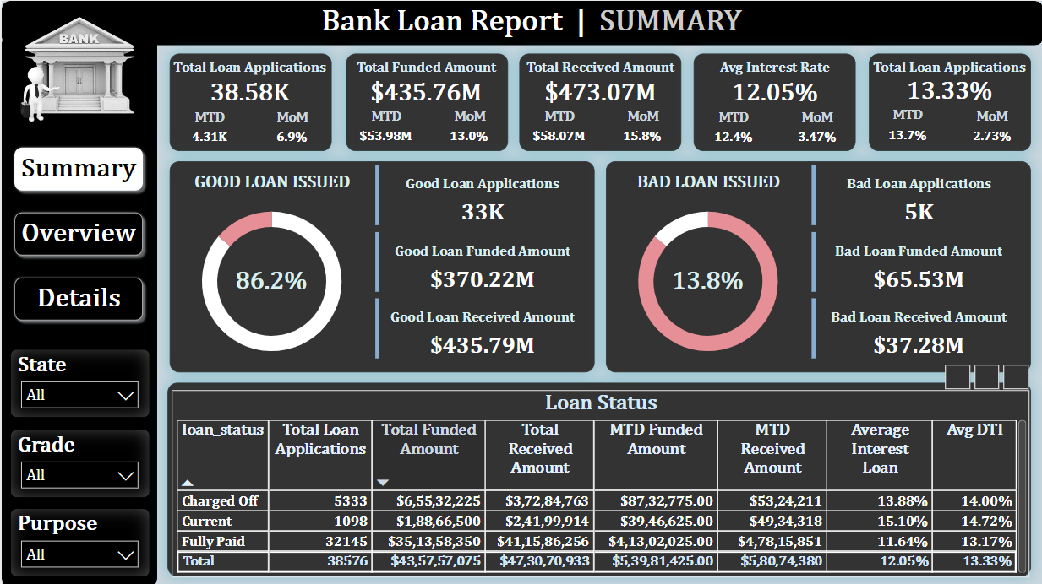

Slide 7
DASHBOARD 2: OVERVIEW
CHARTS
Monthly Trends by Issue Date (Line Chart): To identify seasonality and long-term trends in lending activities
Regional Analysis by State (Filled Map): To identify regions with significant lending activity and assess regional disparities
Loan Term Analysis (Donut Chart): To allow the client to understand the distribution of loans across various term lengths.
Employee Length Analysis (Bar Chart): How lending metrics are distributed among borrowers with different employment lengths, helping us assess the impact of employment history on loan applications.
Loan Purpose Breakdown (Bar Chart): Will provide a visual breakdown of loan metrics based on the stated purposes of loans, aiding in the understanding of the primary reasons borrowers seek financing.
Home Ownership Analysis (Tree Map): For a hierarchical view of how home ownership impacts loan applications and disbursements.

Slide 8
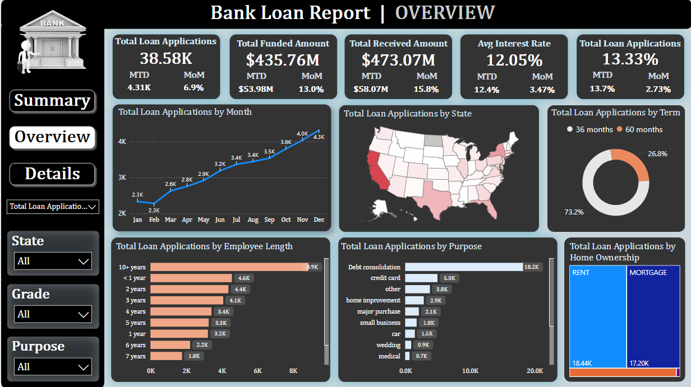

Slide 9
DASHBOARD 3: DETAILS
GRID
Need for a comprehensive 'Details Dashboard' that provides a consolidated view of all the essential information within our loan data. This Details Dashboard aims to offer a holistic snapshot of key loan-related metrics and data points, enabling users to access critical information efficiently.
Objective:
The primary objective of the Details Dashboard is to provide a comprehensive and user-friendly interface for accessing vital loan data. It will serve as a one-stop solution for users seeking detailed insights into our loan portfolio, borrower profiles, and loan performance.

Slide 10
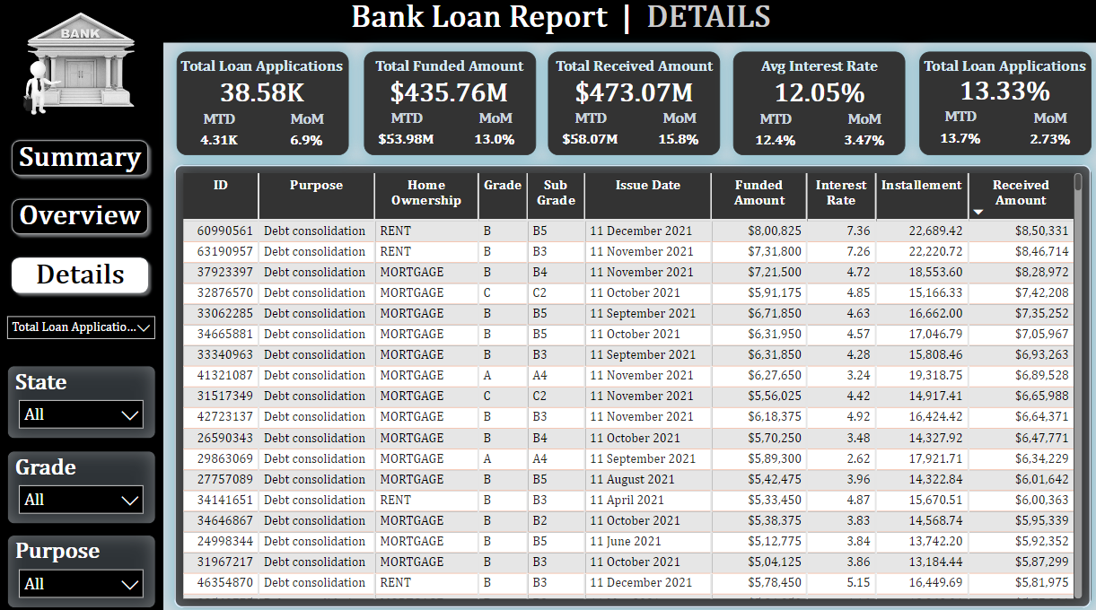

Slide 11
Objectives
Calculate the total number of loan applications.
Track the total amount of loans funded.
Monitor the total amount received from borrowers.
Compute the average interest rate of loans.
Evaluate the average debt-to-income ratio (DTI) of borrowers.

Slide 12

Data Collection and Tools
Data Sources:
Bank loan data from MS SQL Server
Tools and Technologies:
MS SQL Server for data storage and querying
Power BI for data visualization and dashboard creation

Slide 13
Data Processing and Cleaning
Methods:
Importing data into MS SQL Server
Creating databases and tables
Writing SQL queries for data extraction
Cleaning and transforming data using SQL

Slide 14
Analysis and Methodology
SQL Queries:
Selecting and filtering data
Aggregating data for KPIs
Calculating metrics like interest rates and DTI
Power BI Visualizations:
Connecting Power BI to MS SQL Server
Creating dashboards for summary and detailed views
Visualizing data using line charts, bar charts, donut charts, maps, and tree maps

Slide 15
Insights and Recommendations
Insights:
Seasonal trends in loan applications
Regional disparities in lending
Impact of employment length on loan applications
Primary purposes for loan requests
Influence of home ownership on loan approvals
Recommendations:
Focus on regions with high lending activity for targeted marketing
Adjust interest rates based on borrower profiles
Improve loan approval rates by understanding borrower employment history

Slide 16
Conclusion
Summary:
This analysis provides a comprehensive view of the bank’s loan portfolio, highlighting key metrics and trends to aid in decision-making.

Slide 17
Q&A
Feel free to ask any questions regarding the analysis and findings.
Bhushan Gawali

