Slide 1

Airline Safety
Bhushan Suryawanshi
(Bellevue University)

Slide 2
Overview
Due to recent unfortunate airline crashes, the media has been promoting statistics stating air is no longer a safe way to travel.
The news and media outlets have been bombarding the public with reports and figures about the trends of airline safety and that things are not looking good. What was previously thought as the safest way to travel, especially when compared to automobiles, is now being presented as one of the most dangerous to the public.
Our team looked at the data from different sources to come up with answers to airline safety.

Slide 3
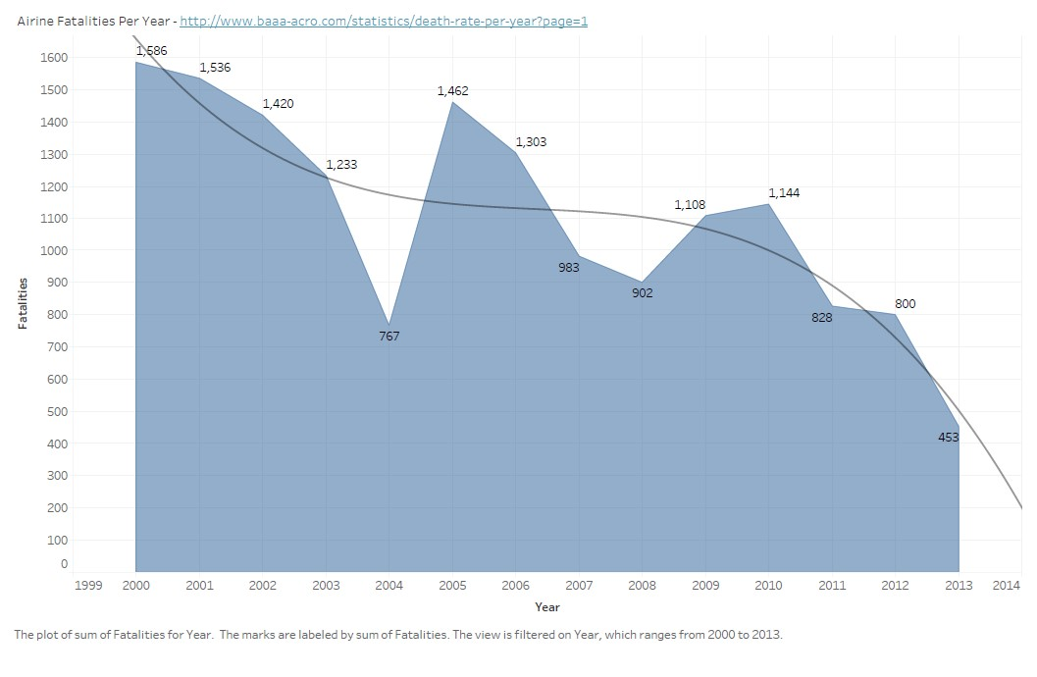
Air Travel Fatalities
For last 10yrs Air Travel fatalities are in downward trend.
There are minor peaks but overall trend is decreasing.
Reference - https://github.com/fivethirtyeight/data/tree/master/airline-safety

Slide 4
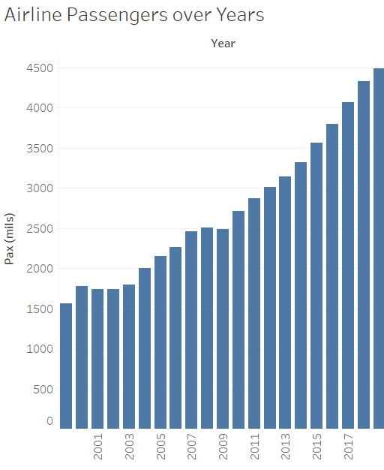
Airline Passengers Over Year
Airline Passenger Capacity is showing increasing trend.
Reference - https://www.airlines.org/dataset/world-airlines-traffic-and-capacity/#

Slide 5
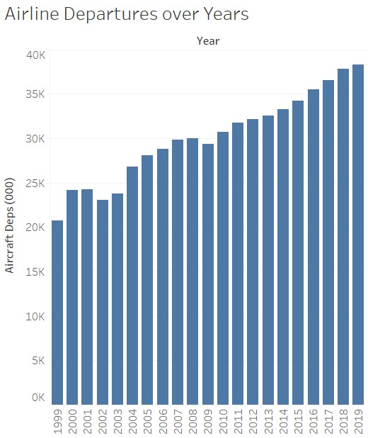
Airline Departures Over Year
Airline Departures is showing increasing trend.
Reference - https://www.airlines.org/dataset/world-airlines-traffic-and-capacity/#

Slide 6
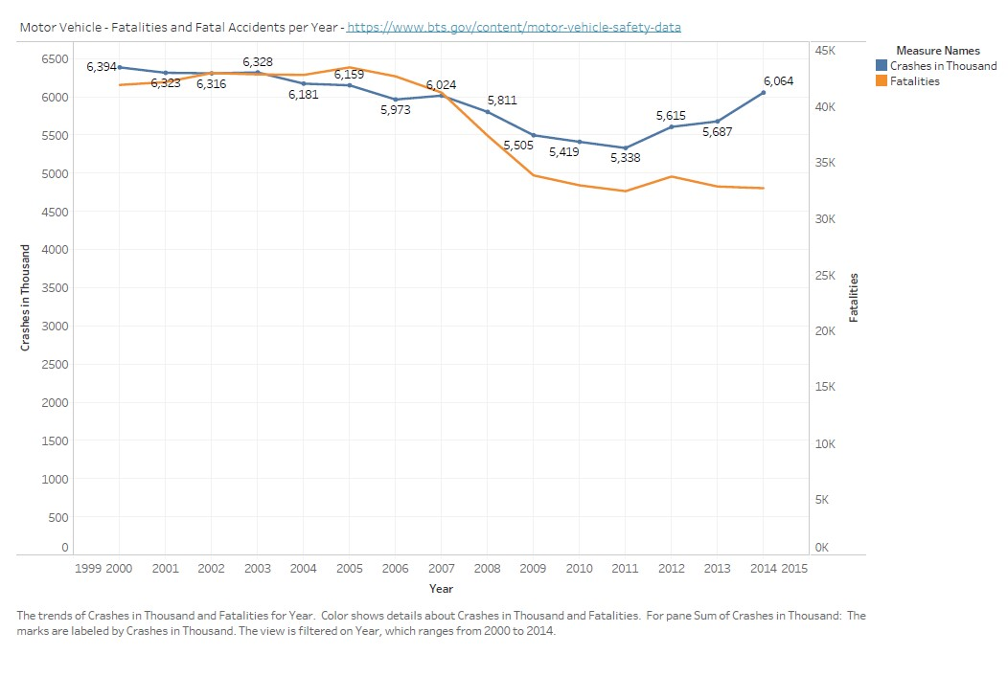
Road Accidents and Fatalities
Reference - https://www.bts.gov/content/motor-vehicle-safety-data

Slide 7
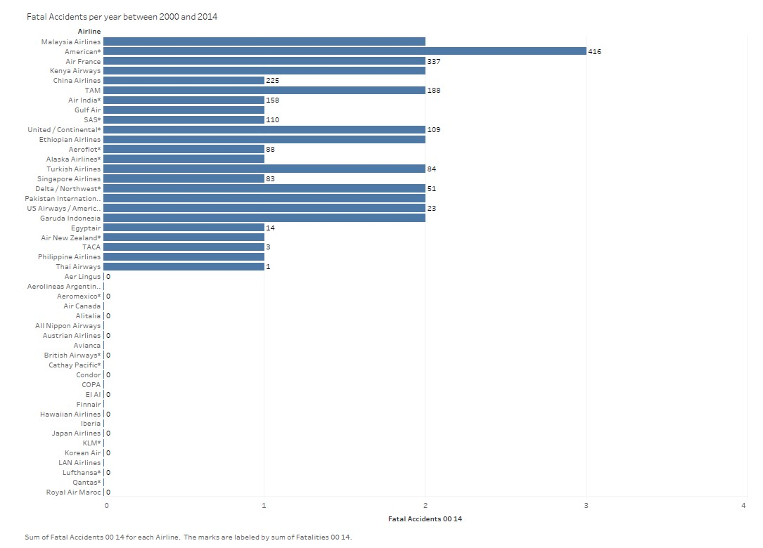
Airline Accidents and Fatalities
averaged 31,779 fatal automobile related accidents annually since 2009.
U.S. airlines have been involved in 2 fatal accidents over the same time period.
Reference - https://github.com/fivethirtyeight/data/tree/master/airline-safety

Slide 8
Conclusion
In last decade automobiles had over 500,000 fatalities compared to 3,000 for air travel.
Since 2000, there has been a consistent downward trend
in global fatalities related to air travel.
Number of passengers are increased in last decade by about 150%.
Economic Impact: The aviation industry supports $3.5 trillion (4.1%) of the world's gross domestic product (GDP). If aviation were a country, it would rank 17th in size by GDP.
10 Million jobs alone in North America
Reference - https://www.bts.gov/content/us-air-carriera-fatal-accidents-first-phase-operationb

Slide 9
Thank You!!

