Slide 1
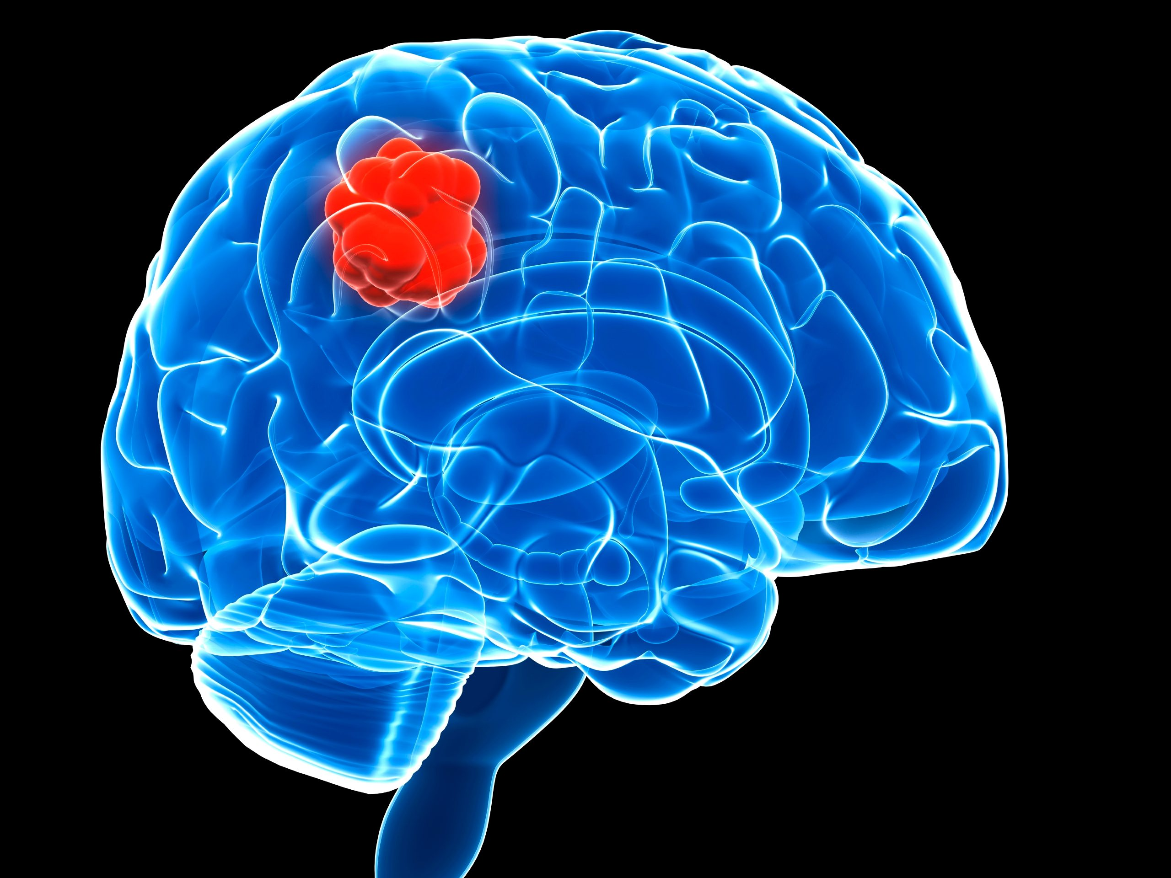
Brain tumor Classification
Bhushan Suryawanshi
Bellevue University

Slide 2
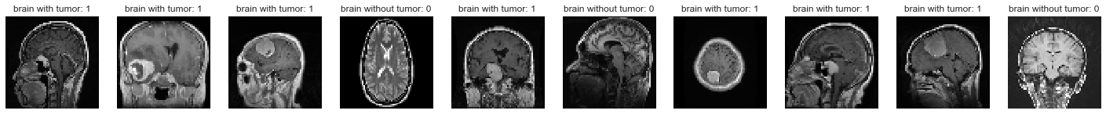
Introduction
What is brain Tumor ?
700000 American living with brain tumors
69.8% benign 30.2% malignant
Estimated 87,240 people in 2020

Slide 3
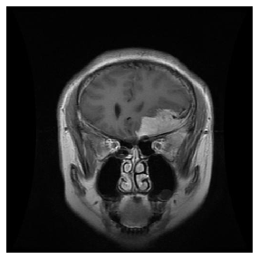
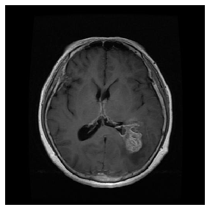
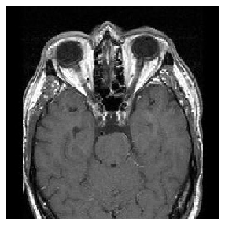
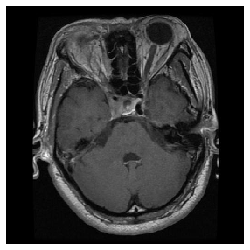
Types Of Tumors
Meningioma - 822
Glioma - 826
No Tumor - 395
Pituitary - 827

Slide 4
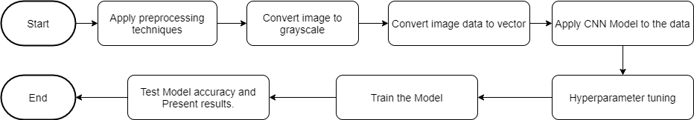
Workflow

Slide 5
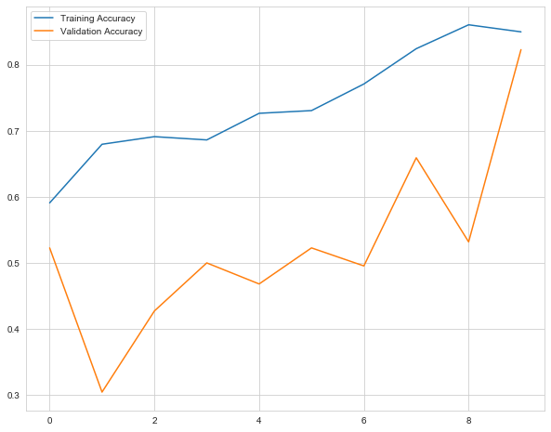
Binary Classification
Classification Model Layers
Results -
Validation Accuracy:
80%
Model: "sequential"
_________________________________________________________________
Layer (type) Output Shape Param #
=================================================================
conv2d (Conv2D) (None, 63, 63, 32) 160
_________________________________________________________________
max_pooling2d (MaxPooling2D) (None, 31, 31, 32) 0
_________________________________________________________________
conv2d_1 (Conv2D) (None, 30, 30, 64) 8256
_________________________________________________________________
max_pooling2d_1 (MaxPooling2 (None, 15, 15, 64) 0
_________________________________________________________________
conv2d_2 (Conv2D) (None, 14, 14, 128) 32896
_________________________________________________________________
max_pooling2d_2 (MaxPooling2 (None, 7, 7, 128) 0
_________________________________________________________________
conv2d_3 (Conv2D) (None, 6, 6, 256) 131328
_________________________________________________________________
max_pooling2d_3 (MaxPooling2 (None, 3, 3, 256) 0
_________________________________________________________________
conv2d_4 (Conv2D) (None, 2, 2, 512) 524800
_________________________________________________________________
max_pooling2d_4 (MaxPooling2 (None, 1, 1, 512) 0
_________________________________________________________________
flatten (Flatten) (None, 512) 0
_________________________________________________________________
dropout (Dropout) (None, 512) 0
_________________________________________________________________
dense (Dense) (None, 256) 131328
_________________________________________________________________
dense_1 (Dense) (None, 1) 257
=================================================================
Total params: 829,025
Trainable params: 829,025
Non-trainable params: 0

Slide 6
Augmentation
1. Random transformation and normalization.
2. Instantiate generators of augmented image batches
ImageDataGenerator(
featurewise_center=False,
samplewise_center=False,
featurewise_std_normalization=False,
samplewise_std_normalization=False,
zca_whitening=False,
rotation_range=0,
zoom_range = 0,
width_shift_range=0,
height_shift_range=0,
horizontal_flip=True,
vertical_flip=False)

Slide 7
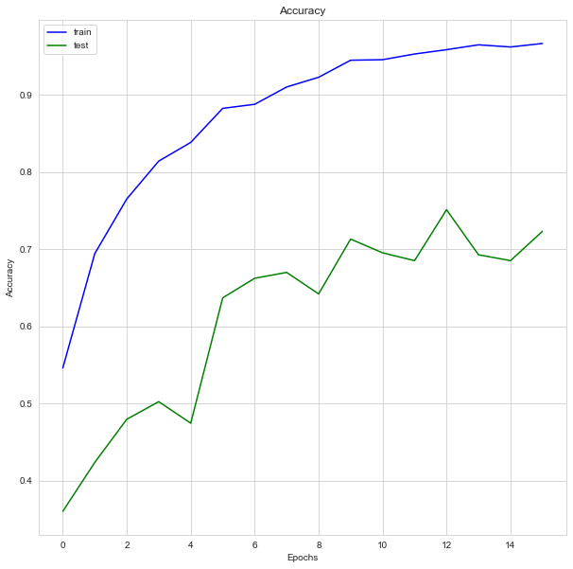
MultiClass Classification
Classification Model Layers
Results -
Validation Accuracy: 73%
Model: "sequential_14"
_________________________________________________________________
Layer (type) Output Shape Param #
=================================================================
conv2d_70 (Conv2D) (None, 128, 128, 64) 1664
_________________________________________________________________
max_pooling2d_70 (MaxPooling (None, 64, 64, 64) 0
_________________________________________________________________
dropout_14 (Dropout) (None, 64, 64, 64) 0
_________________________________________________________________
conv2d_71 (Conv2D) (None, 64, 64, 128) 73856
_________________________________________________________________
max_pooling2d_71 (MaxPooling (None, 32, 32, 128) 0
_________________________________________________________________
dropout_15 (Dropout) (None, 32, 32, 128) 0
_________________________________________________________________
conv2d_72 (Conv2D) (None, 32, 32, 256) 131328
_________________________________________________________________
max_pooling2d_72 (MaxPooling (None, 16, 16, 256) 0
_________________________________________________________________
dropout_16 (Dropout) (None, 16, 16, 256) 0
_________________________________________________________________
flatten_14 (Flatten) (None, 65536) 0
_________________________________________________________________
dense_28 (Dense) (None, 1024) 67109888
_________________________________________________________________
dropout_17 (Dropout) (None, 1024) 0
_________________________________________________________________
dense_29 (Dense) (None, 4) 4100
=================================================================
Total params: 67,320,836
Trainable params: 67,320,836
Non-trainable params: 0

Slide 8
Future Plans
More aggressive data augmentation.
More aggressive dropout.
Use of L1 and L2 regularization (also known as "weight decay").
Use segmentation.

Slide 9
Thank You!!

