Slide 1

Breast Cancer Prediction
Bhushan Suryawanshi
Bellevue University

Slide 2

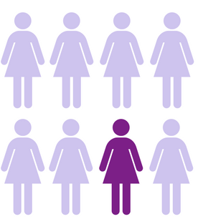
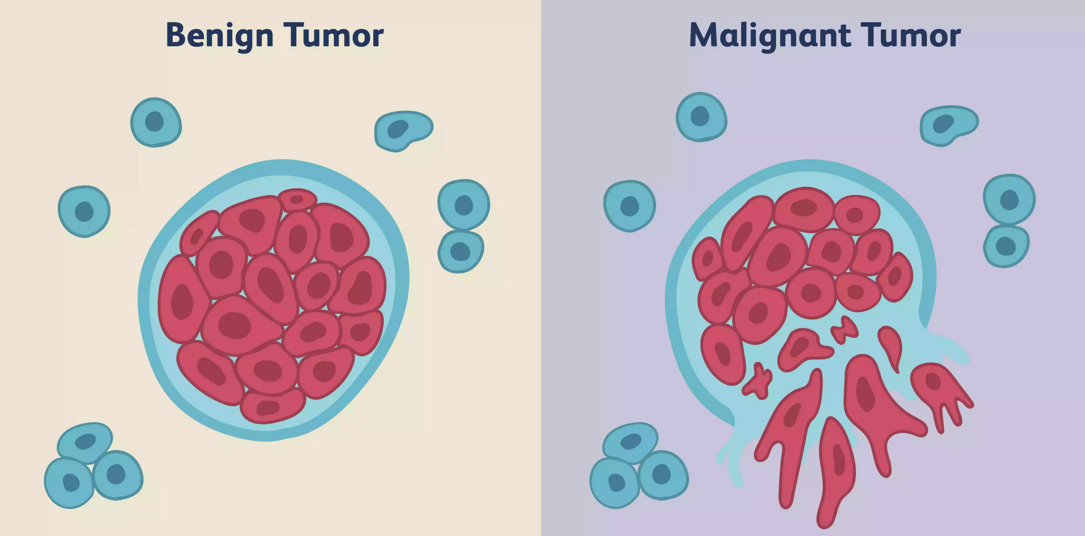
Background
In 2021, expected number of women with breast cancer : 281,550
Reference – breastcancer.org

Slide 3
Data Details
Diagnostic Wisconsin Breast Cancer Database
Fine Needle Aspirate (FNA) of a breast mass biopsy
Features :
  radius (mean of distances from center to points on the perimeter)
  texture (standard deviation of gray-scale values)
  perimeter
  area
  smoothness (local variation in radius lengths)
  compactness (perimeter^2 / area - 1.0)
  concavity (severity of concave portions of the contour)
  concave points (number of concave portions of the contour)
  symmetry
  fractal dimension ("coastline approximation" - 1)
Statistical values
  mean
  standard error
  worst (mean of three largest standard error)
Reference:
1. https://archive.ics.uci.edu/ml/datasets/Breast+Cancer+Wisconsin+(Diagnostic)
2. https://www.kaggle.com/uciml/breast-cancer-wisconsin-data

Slide 4
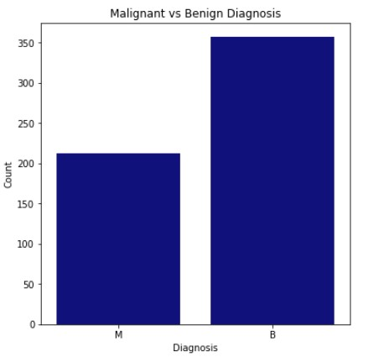
Data Summary
Total Observations: 569
Benign Observations: 357 (62.74%)
Malignant Observations: 212 (37.26%)

Slide 5
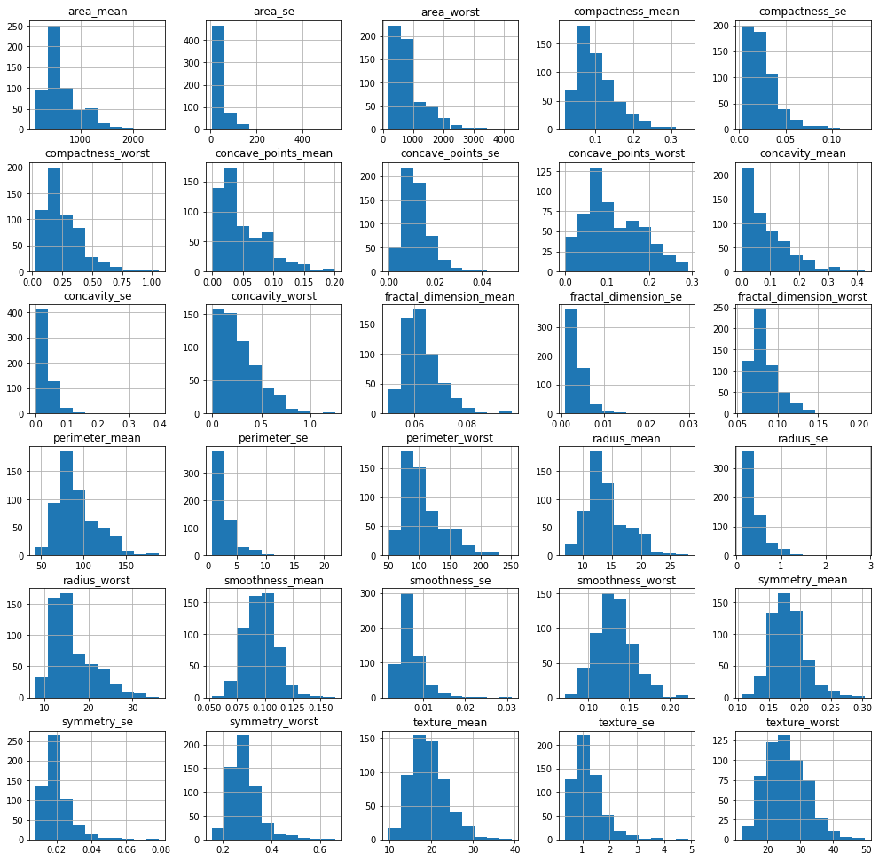
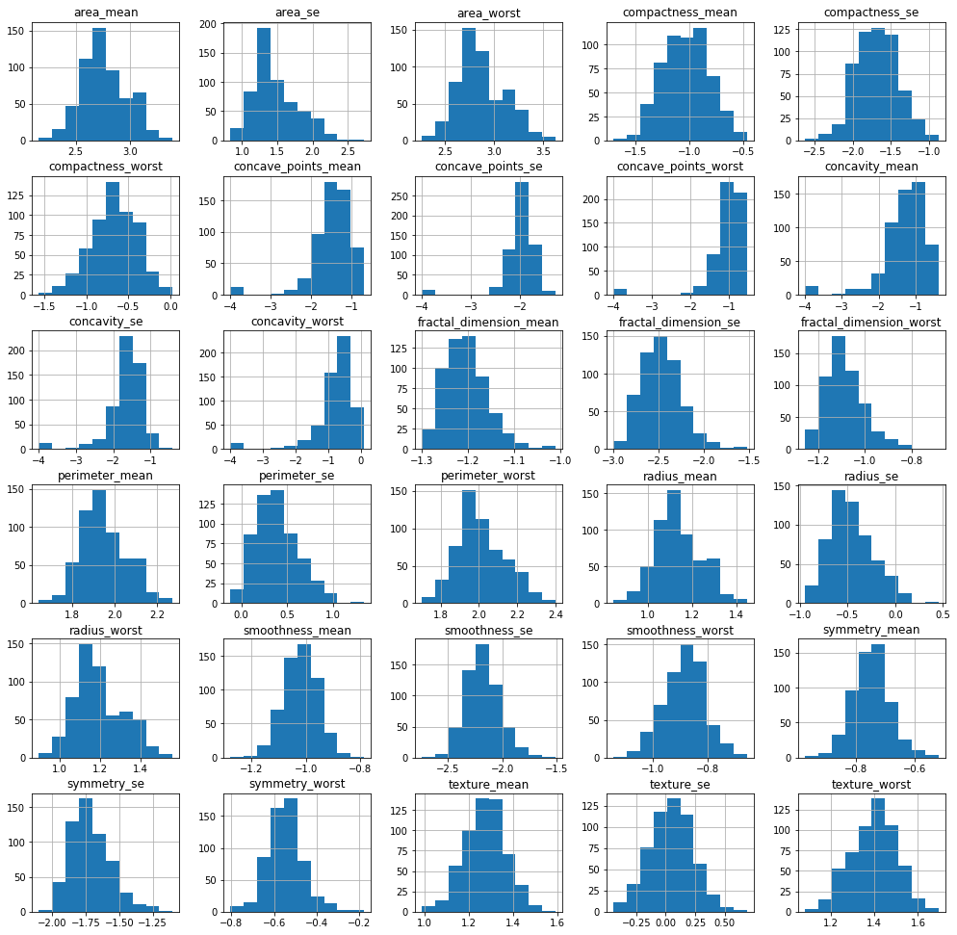
Data Analysis
Original Data Histogram
Log Transformed Data Histogram

Slide 6
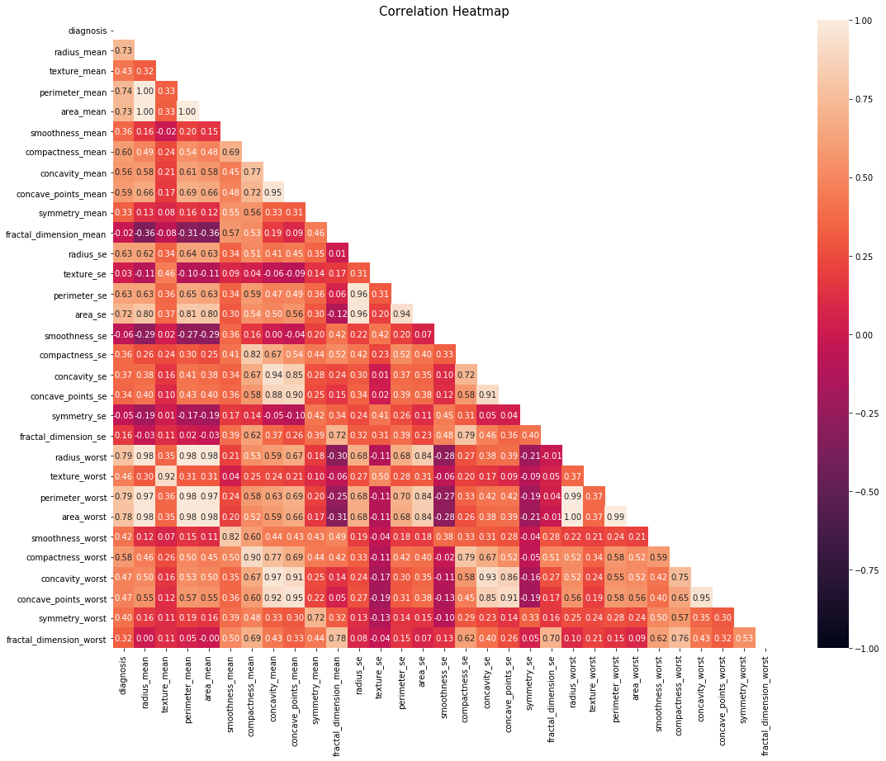
Feature Correlation

Slide 7
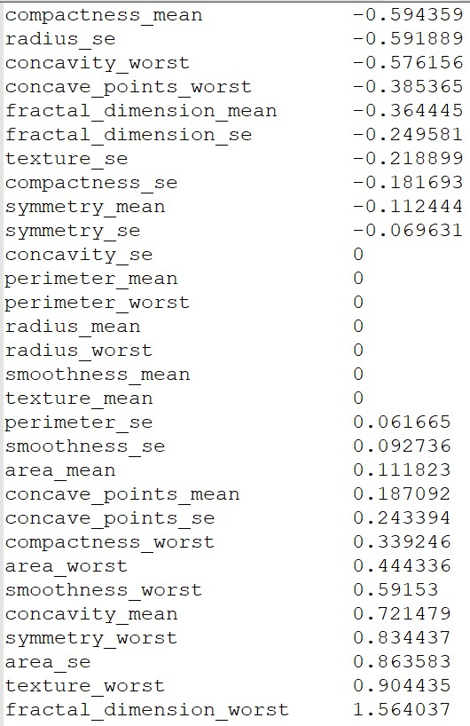
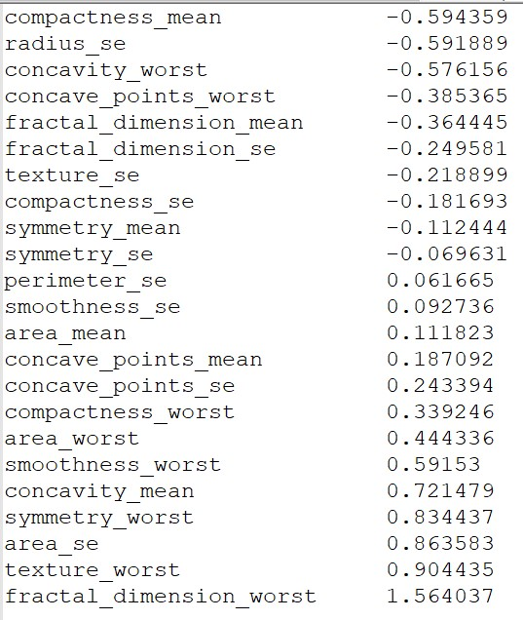
Feature Selection
LassoCV shrinks the coefficients to zero for less relevant features.
Feature reduction from 30 to 23.

Slide 8
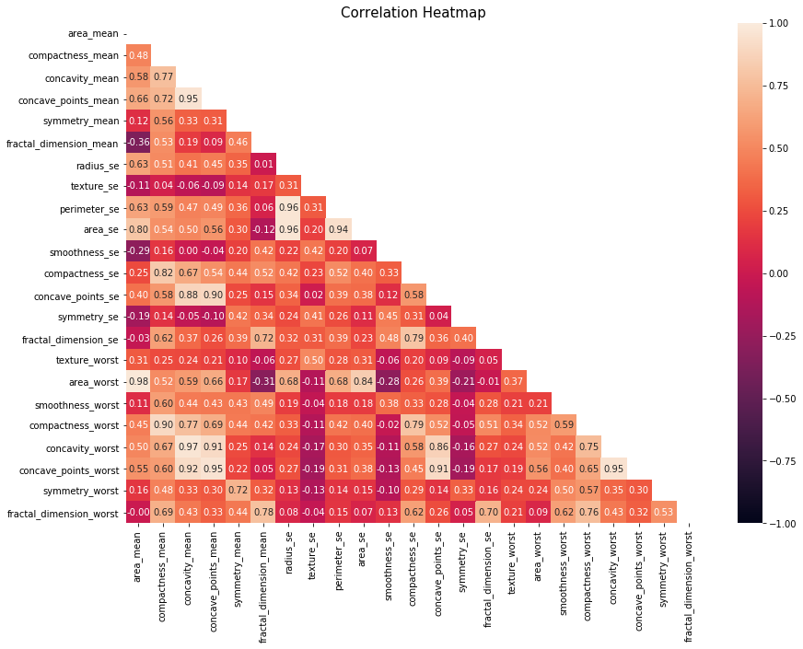
Feature Correlation

Slide 9
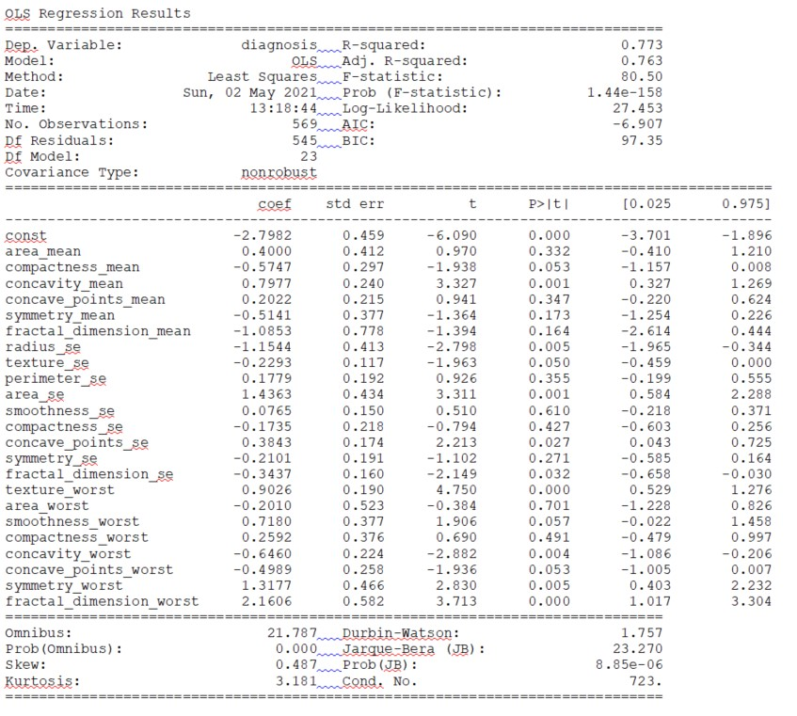
Feature Selection Continued..
Final Features
compactness_mean
concavity_mean
fractal_dimension_mean
radius_se
area_se
fractal_dimension_se
texture_worst
smoothness_worst
concavity_worst
symmetry_worst
fractal_dimension_worst
Ordinary Least
Squares Regression

Slide 10
Final Data
Training set sample size: 455
Testing set sample size: 114
Training Data
Benign : 282
Malignant : 173
Test Data
Benign : 75
Malignant : 39

Slide 11
Model Results
Model Metrics | Train Accuracy Mean (CV=10) | Test Accuracy Mean (CV=10) | AUC Score | Precision | Recall | F1 Score | Accuracy
Random Forest | 0.9273 | 0.9303 | 0.9672 | 0.96 | 0.97 | 0.96 | 0.96
Logistic Regression | 0.9714 | 0.9561 | 0.9415 | 0.94 | 0.94 | 0.94 | 0.95
KNN (n=3) | 0.9472 | 0.9561 | 0.9605 | 0.95 | 0.96 | 0.95 | 0.96
SVM | 0.9582 | 0.9644 | 0.9477 | 0.94 | 0.95 | 0.94 | 0.95

Slide 12
Summary/Conclusion
All models performed higher than expected.
Retrain model on larger set.
Study shows benign and malignant tumor can be predicted.
Subject matter expert and Data scientist collaborate for greater confidence and accuracy of the model.

Slide 13
Thank You!

