Slide 1
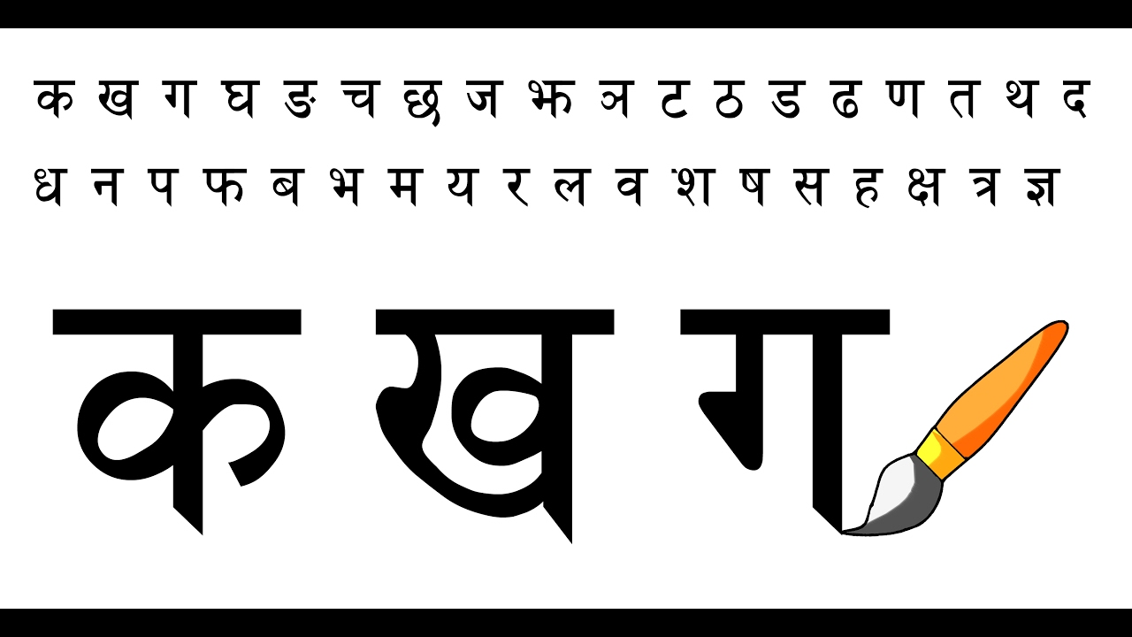
Classification of Letters in Indian Language (Devnagari)
Bhushan Suryawanshi
Bellevue University

Slide 2
Background
Advancement in machine learning / deep learning.
CNN improved computer vision.
500 million people speak Devnagari (the national language of India).

Slide 3
Problem Statement
Less concentration on language other than English.
Historical document retrieval and analysis of rich literature.
Benefit to Consumer and Education industry.
Expectation
Predictive analytics to classify handwritten Devnagari letters.

Slide 4
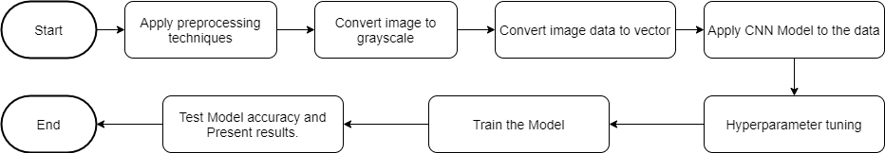
Workflow

Slide 5
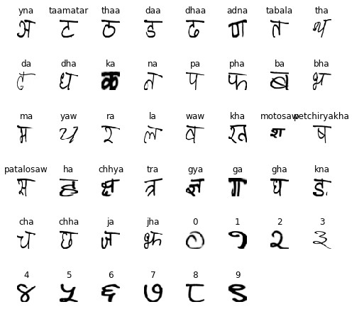
Dimensionality of Data
Distinct Classes : 46
Sample Size of Each Class : 1700
Image Resolution : 32 x 32
Features size = (78200, 1024)
Labels size = (78200,)

Slide 6
Challenges with Structural Similarities
1. Character and Number having similar structure. Look at following where first one is character and second is number 6 in devnagari.
2.Two characters with difference of only one dot.
3.Two characters with difference of small line or circle.

Slide 7
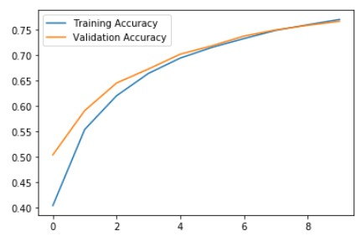
Model: Convolutional Neural Network (CNN)
Model Layers
Results -
Model Accuracy: 76%
Layer (type) Output Shape Param #
=================================================================
conv2d_1 (Conv2D) (None, 30, 30, 32) 320
_________________________________________________________________
conv2d_2 (Conv2D) (None, 28, 28, 4) 1156
_________________________________________________________________
max_pooling2d_1 (MaxPooling2 (None, 14, 14, 4) 0
_________________________________________________________________
conv2d_3 (Conv2D) (None, 12, 12, 4) 148
_________________________________________________________________
conv2d_4 (Conv2D) (None, 10, 10, 4) 148
_________________________________________________________________
max_pooling2d_2 (MaxPooling2 (None, 5, 5, 4) 0
_________________________________________________________________
flatten_2 (Flatten) (None, 100) 0
_________________________________________________________________
dense_1 (Dense) (None, 20) 2020
_________________________________________________________________
dense11 (Dense) (None, 1024) 21504
_________________________________________________________________
dense_2 (Dense) (None, 46) 47150
=================================================================
Total params: 72,446
Trainable params: 72,446
Non-trainable params: 0

Slide 8
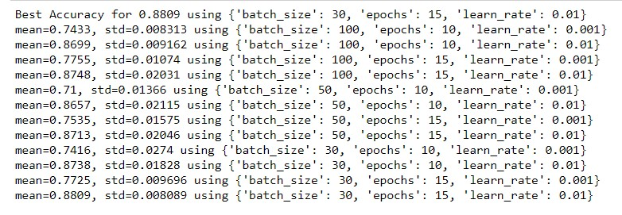
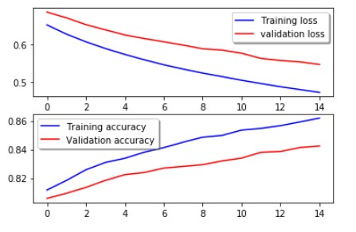
Results

Slide 9
Future Plans
Many methods are available for hyperparameter tuning.
The results above are using GridSearchCV.
Try out other methods of hyperparameter tuning.
Find other hyperparameters that can improve accuracy.

Slide 10
Thank You!!

