Slide 1

Wine Quality Prediction
Bhushan Suryawanshi
Bellevue University

Slide 2
Background
27% Increase in wine consumption since 2005.
Yearly 2.99 gallons per person
USA Consumption : 966 million gallons.
Reference: https://www.statista.com/statistics/233734/average-wine-consuimption-of-the-us-per-resident/

Slide 3
Data Details
Features :
fixed_acidity
volatile_acidity
citric_acid
residual_sugar
chlorides
free_sulfur_dioxide
total_sulfur_dioxide
density
pH
sulphates
alcohol
quality
Total Observations: 1600
Total Number of Features: 12
Good Quality Wine with “quality” value >6.5
Reference: https://www.kaggle.com/uciml/red-wine-quality-cortez-et-al-2009

Slide 4
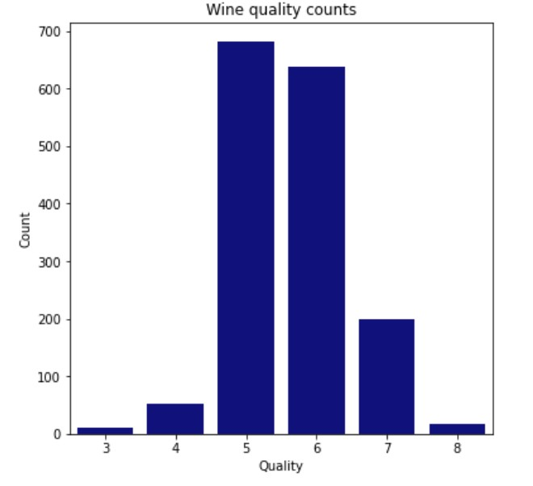
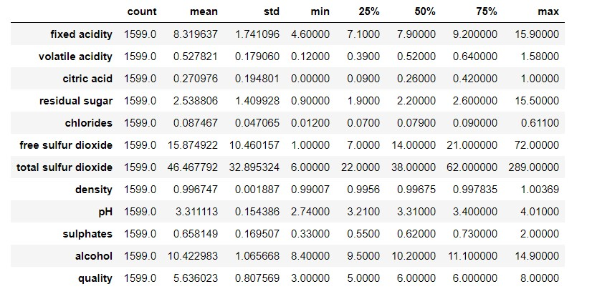
Data Summary

Slide 5
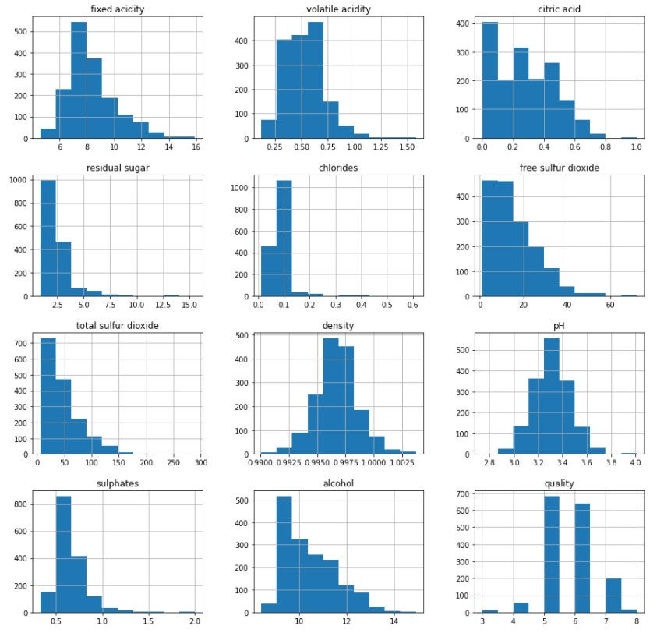
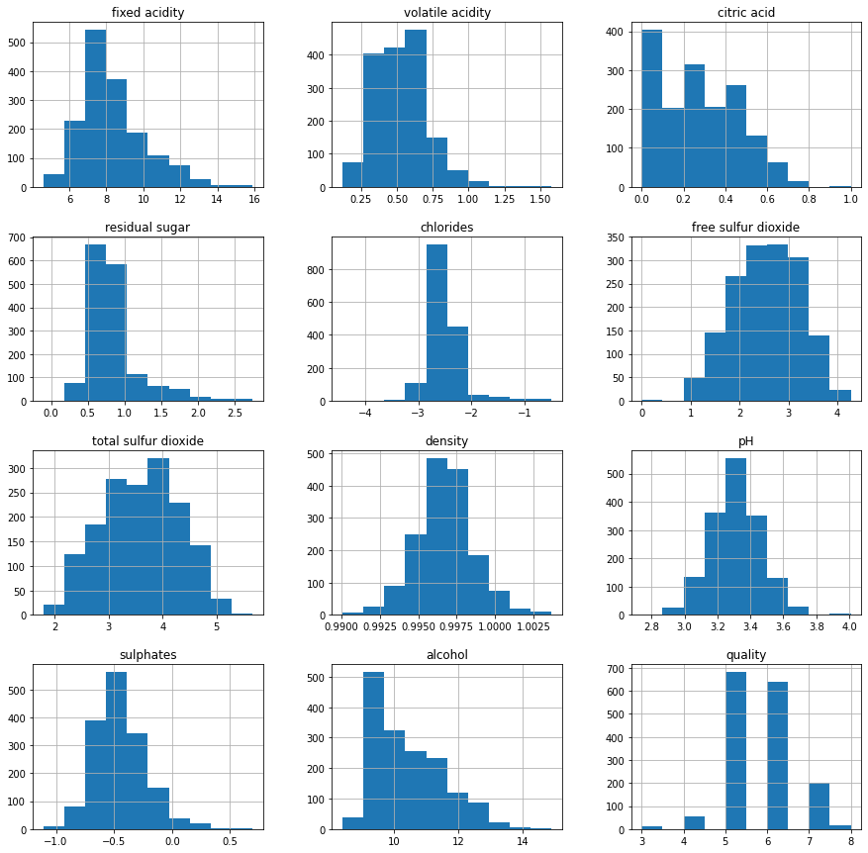
Data Analysis
Original Data Histogram
Log Transformed Data Histogram

Slide 6
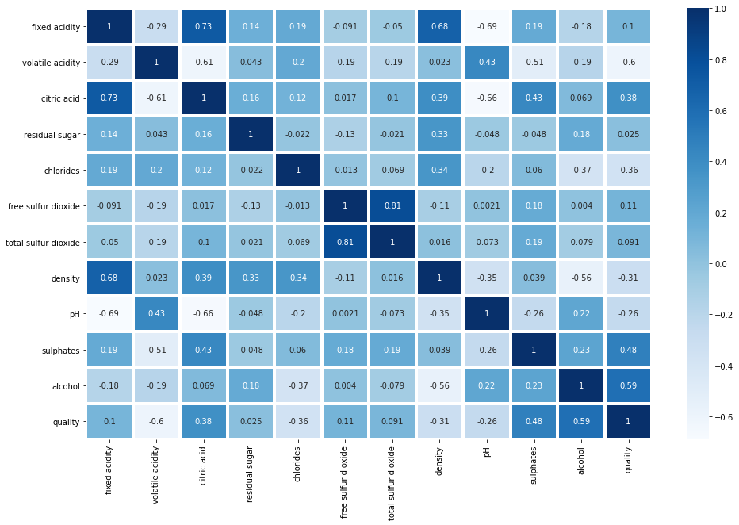
Feature Correlation

Slide 7
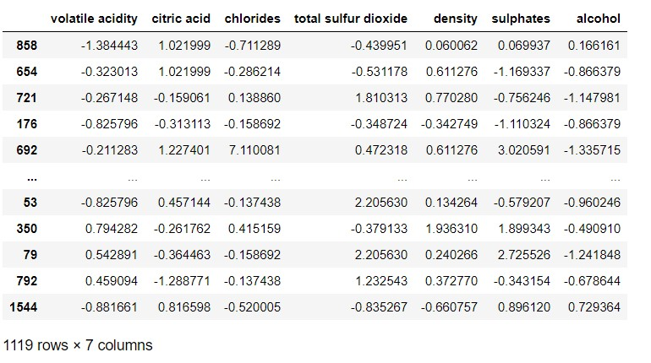
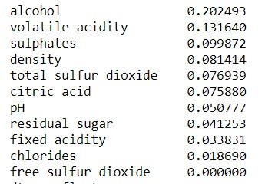
Feature Selection
Using mutual_info_classif
for feature selection.
Top 7 features selected

Slide 8
Final Imbalanced Dataset
Training set sample size: 1119
Testing set sample size: 480
Training Data
Quality:Count
5:477
6:445
7:140
4:36
8:14
3:7
Test Data
Quality:Count
5:204
6:193
7:59
4:17
8:4
3:3

Slide 9
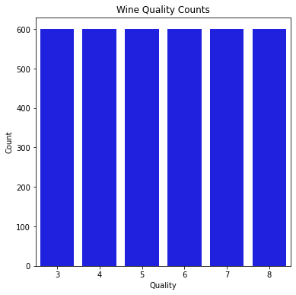
Balanced Dataset
Training set sample size: 2412
Testing set sample size: 1188
Training Data
Quality:Count
3:403
4:421
5:399
6:398
7:405
8:386
Test Data
Quality:Count
3:197
4:179
5:201
6:202
7:195
8:214

Slide 10
Model Results
Logistic Regression
Unbalanced
60
59
56
59
56
Model
Dataset Type
Training Accuracy
Testing Accuracy
Precision
Recall
F1-Score
KNN
Unbalanced
70
62
60
62
60
Random Forest
Unbalanced
100
67
64
67
65
Decision Tree
Unbalanced
100
57
57
57
57
Neural Network
Unbalanced
70
62
-
-
-
KNN
Balanced
100
85
84
85
84
Random Forest
Balanced
100
66
66
66
64
Decision Tree
Balanced
100
58
58
58
58
Neural Network
Balanced
71
64
-
-
-

Slide 11
Summary/Conclusion
All models performed higher than expected.
Retrain model on larger set.
Study shows Chemical properties can be used for wine quality prediction.
Wine tasting experts, chemical engineers and Data scientist can collaborate for greater confidence and accuracy of the model.

Slide 12
Thank You!

