Slide 1

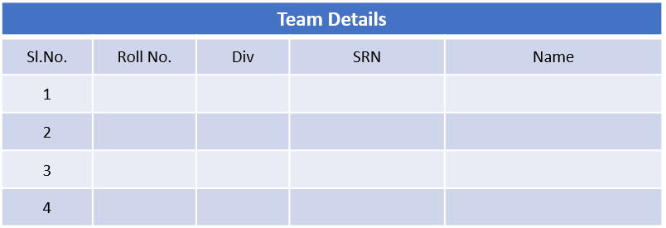
MINOR PROJECT 2
Title: Adaptive Driver Review System for Optimal Passenger Experience
Team:A27 Guide: Dr.Ujwala Patil
316
C
01fe21bec122
Amogh
358
C
01fe21bec169
Vinayak
561
E
01fe21bec312
Bhushan
515
E
01fe21bec258
Akhilesh

Slide 2
Problem Statement :
Developing an intelligent driver review system that dynamically suggests optimal routes based on traffic conditions, while monitoring driver behavior to ensure passenger comfort and safety.
Objectives:
Design an algorithm to identify shortest and most traffic-free routes between given start and destination points.
Develop a comprehensive review system to provide feedback to drivers based on their route choices and driving behavior.
Integrate a comprehensive dataset to analyze driver behavior, focusing on factors such as hard accelerations and sharp turns.

Slide 3
Introduction:
The project focuses on developing an intelligent driver review system that dynamically suggests optimal routes based on real-time traffic conditions while continuously monitoring driver behavior to ensure passenger comfort and safety. The system collects GPS data to map routes, employs advanced algorithms like Dijkstra's for path optimization, and integrates traffic data to avoid congestion. Additionally, it analyzes driving behaviors such as hard braking and rapid acceleration to provide real-time feedback and comprehensive driver ratings. This approach not only enhances route efficiency but also promotes safer and more comfortable driving experiences for passengers.

Slide 4
Literature Survey
Machine Learning Algorithm for Driver Rating (2022): This paper focuses on using smartphone sensors to detect driving events and analyze facial expressions, employing machine learning to evaluate driver behavior and assign ratings. It emphasizes the use of sensor data like speed changes, braking, and steering angles to monitor and assess driving performance.
Advanced Vehicle Telematics Analysis for Enhanced Safety and Efficiency (2019): This study explores vehicle telematics and sensor data to optimize safety and fuel efficiency. Techniques such as Kernel Density Estimation are used to analyze gear shifts and engine performance, highlighting strategies to reduce carbon emissions and improve driving efficiency.
Integrating Multi-Source Data and Advanced Analytics for Comprehensive Traffic Accident Analysis: Insights from the Trafficalmr Project (2022): The Trafficalmr project integrates various data sources and employs statistical and machine learning models to analyze traffic accident patterns. It utilizes methods like Kernel Density Estimation and machine learning models such as Random Forests and SVMs to identify accident hotspots and predict accident rates.

Slide 5
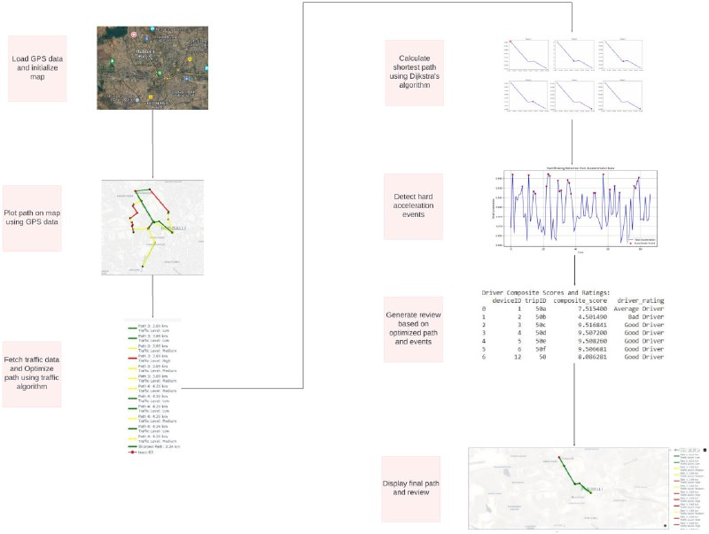
Proposed Model for Driver Review and Route Optimisation

Slide 6
Model Explaination:
1. Raw GPS dataset: This block represents the raw data collected from the GPS unit. This data includes the device's location, speed, direction, and timestamp.
2.Plotting the paths on the map: This block refers to the process of converting the raw GPS data into a visual representation on a map. The map itself is not shown in the block diagram.
3. Dijkstra's algorithm: This block refers to a specific route-finding algorithm commonly used in GPS navigation systems. It is designed to find the shortest path between two points, considering one-way streets, traffic lights, and other restrictions.
4. Shortest path with low traffic: This text likely refers to the output of the traffic algorithm and Dijkstra's algorithm working together. It suggests that the system prioritizes finding the shortest route while also considering traffic conditions.
5. Review Generation: This block is a little less clear in the context of the image. It is possible that it refers to a process that analyzes the traffic conditions along different routes and generates recommendations for the user based on their preferences.
6. Analysis of Hard Acceleration: This block likely refers to the system's ability to detect and analyze harsh acceleration events. This information could be used to improve the passenger comfort level or to identify risky driving behaviors.

Slide 7
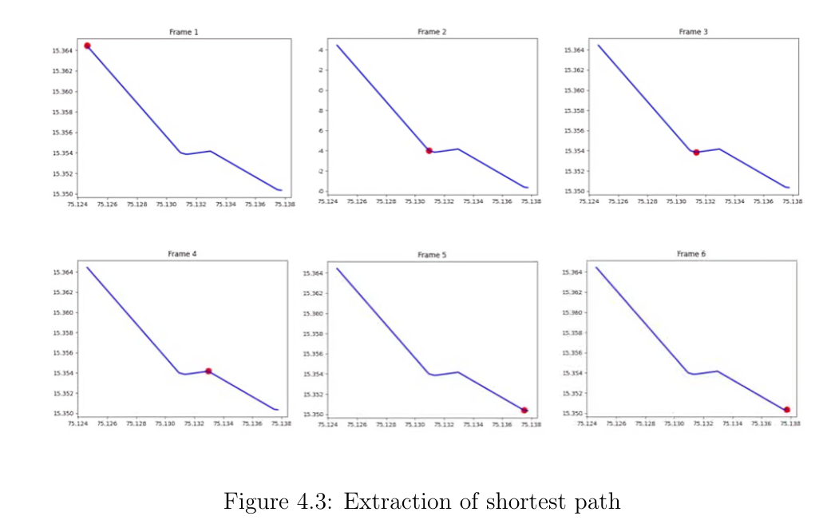
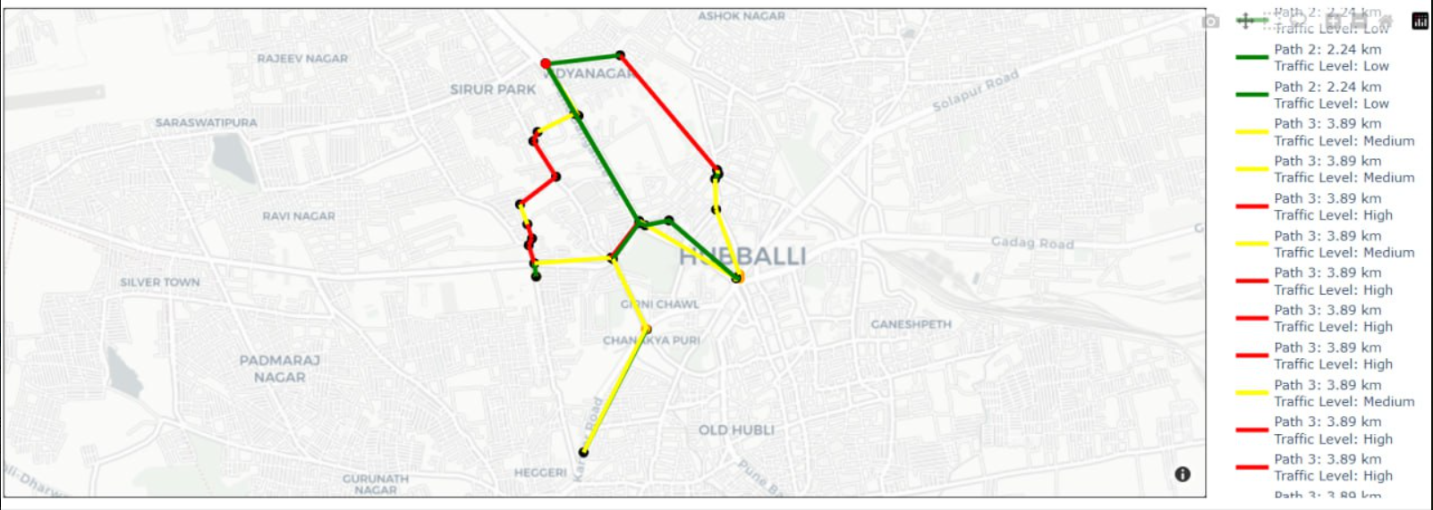
Results
A(start)
Fig. All paths available from A to B
B(end)

Slide 8
Results
The provided images depict the visualization of an intelligent driver review system implemented in a Google Colab notebook, designed to dynamically suggest optimal routes based on traffic conditions while monitoring driver behavior to ensure passenger comfort and safety. The maps highlight multiple paths with varying traffic levels, where Path 2 (2.24 km) shows low traffic (green), and Path 3 (3.89 km) displays sections of low (green), medium (yellow), and high (red) traffic. The second image further shows the script generating the map, with Path 4 (4.26 km) also displaying varied traffic conditions and the shortest path marked as ”trace 83”. Specific regions around Hubballi, such as Dyananagar and Sirur Park, are highlighted, demonstrating the system’s route suggestions and traffic analysis. This comprehensive visualization integrates real-time traffic data and advanced algorithms to enhance overall safety and comfort by providing valuable insights and route recommendations.

Slide 9
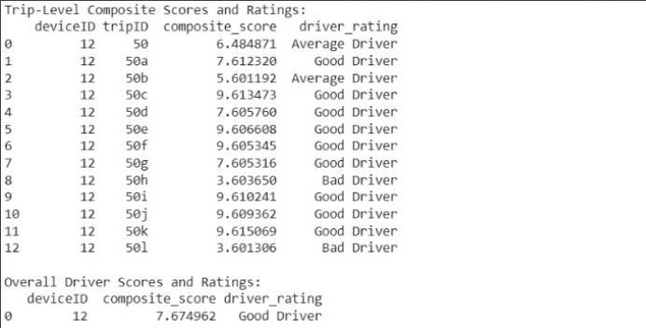
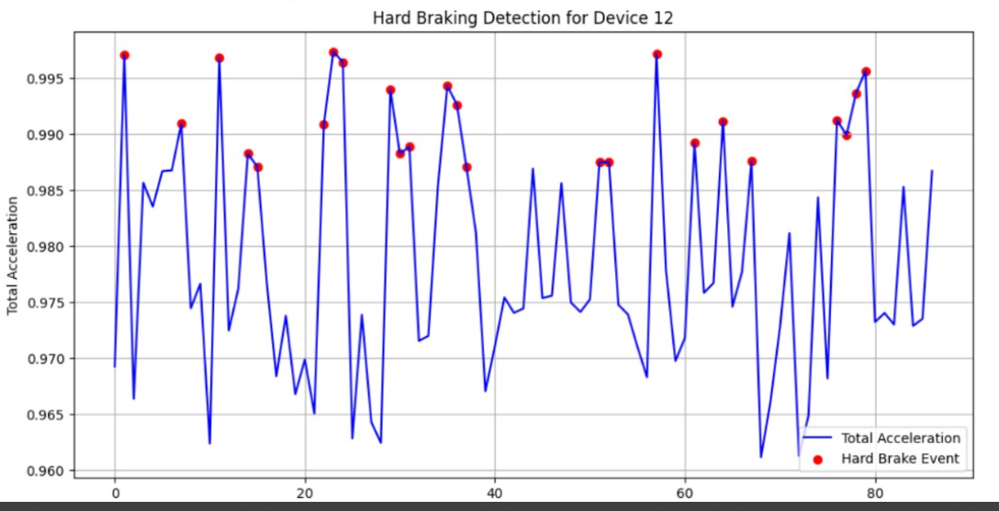
Results

Slide 10
Results
The provided data showcases a detailed analysis of a driver’s performance using device ID 12. The table lists individual trip IDs, composite scores, and corresponding driver ratings, indicating that the driver is generally rated as ”Good Driver” with an overall composite score of 7.674962. However, there are variations in ratings across different trips, with some being labeled as ”Average Driver” and ”Bad Driver.” The accompanying graph titled ”Hard Braking Detection for Device 12” illustrates the driver’s braking behavior by plotting total acceleration over time and marking hard braking events with red dots. This combination of tabular and graphical data helps in understanding and evaluating the driver’s performance and driving habits.

Slide 11
Conclusion
To conclude, the implementation of the GPS navigation system with integrated route optimization and passenger comfort adjustment has demonstrated significant improvements in driving safety and efficiency. By combining real-time data processing, sophisticated algorithms like Dijkstra’s, and user-defined comfort preferences, the system ensures optimal route selection and enhanced passenger experience. The use of telematics data to monitor driving behavior further aids in identifying risky behavior.

