Slide 1
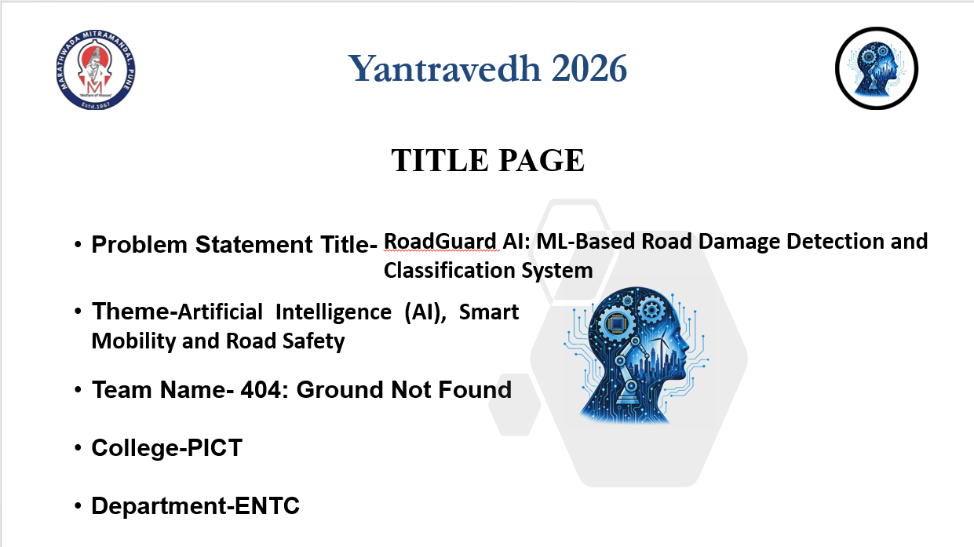



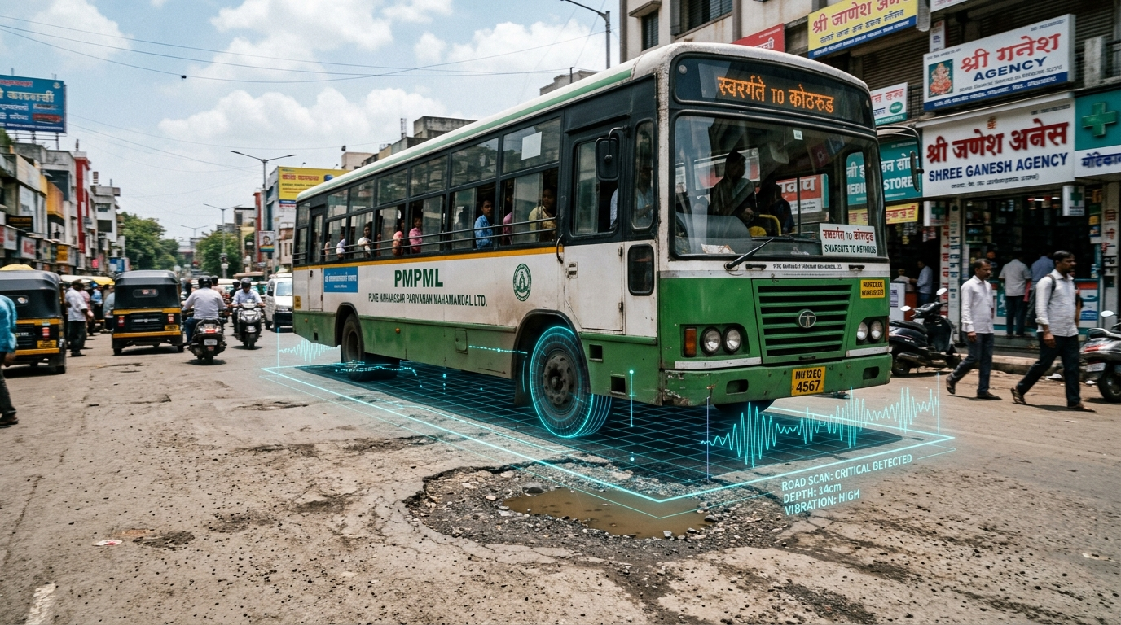
Yantravedh 2026
TITLE PAGE
RoadGuard AI
ML-Based Road Damage Detection Using PMPML Buses
• Problem Statement Title: RoadGuard AI: ML-Based Road Damage Detection and Classification System
• Theme: Artificial Intelligence (AI), Smart Mobility and Road Safety
• Team Name: 404: Ground Not Found
• College: PICT (Pune Institute of Computer Technology)
• Department: ENTC (Electronics & Telecommunication)
Track: Hardware Hackathon | Platform: Edge-AI & PMPML Transit Fleet
PMPML Transit Bus • Real-Time AI Road Vibration Telemetry Scan (Pune)
Passive Mobile Road Inspection via Operational Public Transportation Fleet

Slide 2
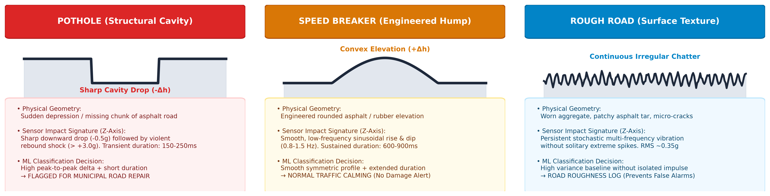
IDEA TITLE
Idea Title: RoadGuard AI – Intelligent Road-Vibration Classification System
@SIH Idea submission- Template
2
Notes:
2

Slide 3
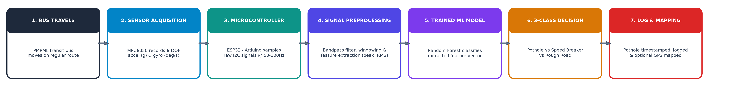
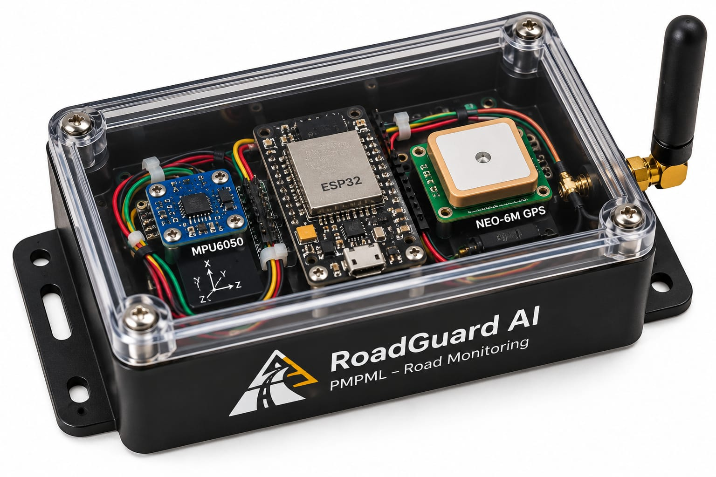

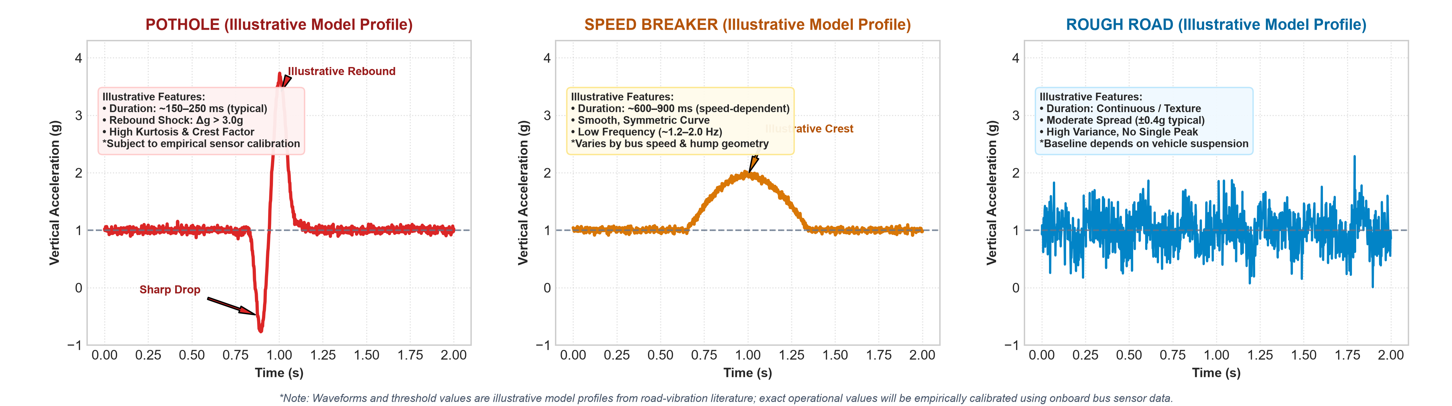
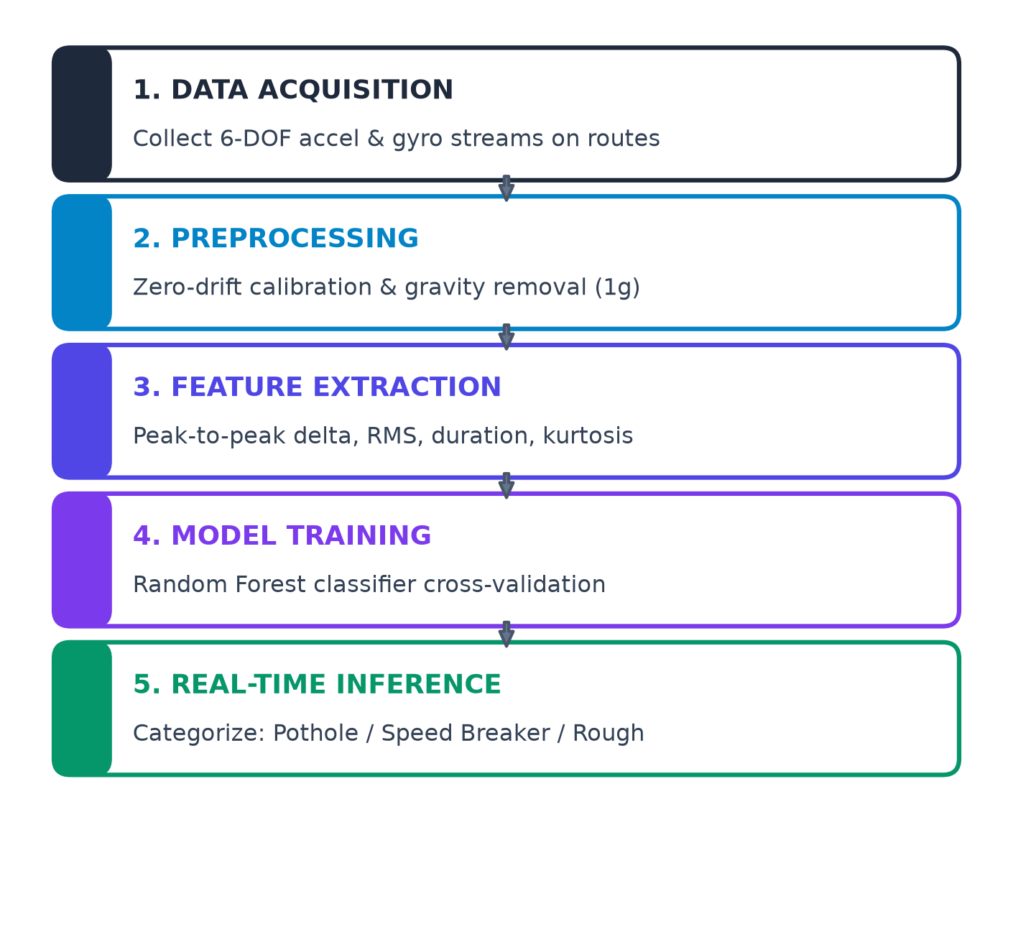
TECHNICAL APPROACH
EXPECTED PROTOTYPE SETUP (HARDWARE)
VIBRATION SIGNATURE ANALYSIS (Z-AXIS ACCEL)
5-STEP ML WORKFLOW
ILLUSTRATIVE WAVEFORM DISCRIMINATION PATTERNS
• Pothole (Cavity): Sharp negative drop followed by high rebound spike (illustrative ~150–250ms transient). Characterized by high kurtosis and high delta-g relative to baseline.
• Speed Breaker (Hump): Smooth, symmetrical low-frequency elevation (illustrative ~600–900ms duration at ~20–30 km/h). Distinct low-frequency sinusoidal profile without sharp shock.
• Rough Road (Texture): Continuous irregular vibration chatter (illustrative ±0.4g spread around 1.0g gravity baseline). High variance without isolated high-energy peaks.
• * Calibration Note: Waveforms and thresholds shown are illustrative benchmarks from published research; final operational thresholds will be empirically calibrated using onboard bus sensor data.
• Sensor: MPU6050 6-Axis IMU (Acc ±2g to ±16g, 3-Axis Gyro)
• Microcontroller: ESP32 / Arduino Uno (I2C Bus @ 50–100Hz)
• Enclosure: Rigid IP65 Casing with Vibration-Damped Chassis Mount
• Telemetry & Power: 5V/3.3V Regulated; Optional NEO-6M GPS & GSM
• Firmware Stack: Arduino C++, Scikit-learn Random Forest Model
Prototype Configuration Note:
Exact ML algorithm, deployment platform (edge MCU vs companion PC), and optional modules depend on final prototype setup.
@SIH Idea submission- Template
3
Notes:
3

Slide 4
FEASIBILITY AND VIABILITY
1. FEASIBILITY (Why It Works)
2. POTENTIAL CHALLENGES
3. MITIGATION STRATEGIES
[ ✔ ] Sub-$2 Sensor Hardware: Uses commodity MPU6050 MEMS sensor (sub-$2), keeping build cost negligible.
[ ✔ ] Rapid Microcontroller Setup: Easily prototyped with ESP32 / Arduino Uno interfaced with a laptop for data capture.
[ ✔ ] Lightweight Machine Learning: Random Forest runs with tiny compute footprint—zero costly GPU infrastructure needed.
[ ✔ ] Proposed Field Testing: Planned experimental trials and calibration across diverse Pune road surfaces and PMPML transit routes using labeled sensor runs.
[ ✔ ] Modular Architecture: Decoupled data collection, preprocessing, and classification for easy incremental upgrades.
[ ! ] Bus Chassis & Suspension Variance: Different bus models and mounting locations produce shifted baseline vibration readings.
[ ! ] Vibration Waveform Overlap: Steep speed breakers crossed at speed can mimic acceleration peaks of shallow potholes.
[ ! ] Vehicle Speed & Payload Dynamics: Fluctuating passenger weight and driving speeds influence raw vibration amplitudes.
[ ! ] Representative Dataset Needs: Accurate ML categorization requires high-quality, ground-truthed training datasets.
[ ! ] Transit Environmental Shocks: Hardware deployed on city buses faces continuous vibration, dust, and temperature shifts.
[ ★ ] Standardized Rigid Axle Mount: Enclose sensor in rigid, damped IP65 casing bolted to the chassis to ensure clean vibration transfer.
[ ★ ] Multi-Speed Calibration Data: Collect labeled calibration data across varying speeds (15–50 km/h) and varied pavement textures.
[ ★ ] Multi-Feature Pattern Decision: Classify complete waveforms (duration, RMS, kurtosis, peak-to-peak delta) rather than simple thresholds.
[ ★ ] Rigorous Cross-Validation: Evaluate model on separate, unseen test routes with k-fold validation before operational claims.
[ ★ ] Adaptive Baseline Filtering: Implement dynamic moving-average filtering to compensate for bus payload changes.
Feasibility Summary: Sub-$15 Hardware BOM • High Municipal Scalability • Robust Multi-Feature ML Classification
@SIH Idea submission- Template
4
Notes:
4

Slide 5
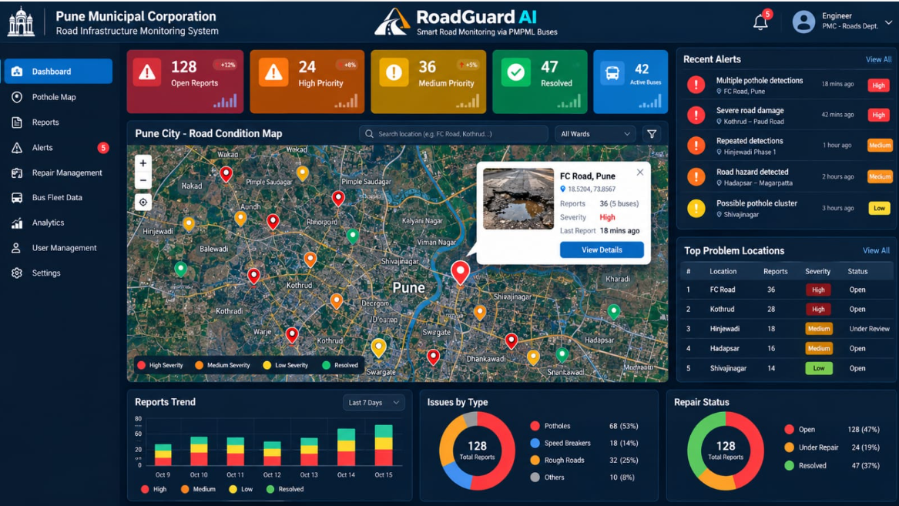
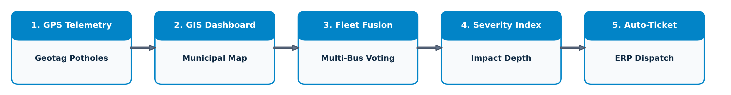
IMPACT AND BENEFITS
SOCIAL IMPACT (ROAD SAFETY & COMMUTER WELFARE)
• Safer Urban Commutes: Continuous passive road auditing enables proactive maintenance for safer roads.
• Prevents Fatal Accidents: Early detection of hazardous potholes directly prevents two-wheeler skids & vehicle damage.
ECONOMIC IMPACT (COST EFFICIENCY & RESOURCE ALLOCATION)
• Reduces Survey Expenditure: Automates audits, drastically cutting manual survey labor & dedicated vehicle fuel costs.
• Data-Driven Prioritization: Provides objective damage records to help municipal authorities triage repair budgets.
ENVIRONMENTAL & OPERATIONAL IMPACT (SUSTAINABLE MOBILITY)
• Zero Dedicated Survey Emissions: Uses scheduled in-service buses—zero extra survey trips or added carbon emissions.
• Non-Intrusive City Coverage: Runs silently during regular passenger service without traffic disruptions or road closures.
PROPOSED MUNICIPAL GIS CONCEPT (ILLUSTRATIVE DEMO DASHBOARD)
FUTURE SCOPE & SYSTEM ROADMAP (PROPOSED EXTENSIONS)
Smart-City Fleet Monitoring Concept (Pune Municipal Corporation):
• Illustrative Demo Data Notice: All statistics, report counts (e.g., 128 reports, 42 active buses), incident alerts, and map pin coordinates shown on this interface are synthetic demonstration data for UI/concept visualization only.
• Prototype Scope Notice: Real-time GPS mapping, automated cloud telemetry, and centralized municipal dashboard integration represent proposed future extensions and are not part of the initial standalone hardware prototype.
• Note: No guaranteed financial savings, confirmed government integration, or unverified detection accuracies are claimed.
• Proposed Stages: [1] GPS Geotagging → [2] GIS Municipal Map → [3] Multi-Bus Fleet Fusion → [4] Severity Estimation → [5] Municipal ERP Ticketing.
• Objective: Enable automated work order generation directly into municipal maintenance workflows.
@SIH Idea submission- Template
5
Notes:
5

Slide 6
RESEARCH AND REFERENCES
1. HARDWARE SPECIFICATION (MPU-6050)
2. MACHINE LEARNING FRAMEWORK (RANDOM FOREST)
• Primary Source: TDK InvenSense MPU-6050 Specification (Doc PS-MPU-6000A-00)
• Technical Scope: Integrated 6-axis MEMS MotionTracking (±2g to ±16g Accel, 3-Axis Gyro, I2C interface).
• Project Role: High-rate road vibration capture and transient chassis impact sampling.
• Primary Source: Pedregosa et al., "Scikit-learn: Machine Learning in Python" (JMLR 2011)
• Technical Scope: Supervised ensemble classification using RandomForestClassifier algorithm.
• Project Role: Multi-class categorization (Pothole vs Speed Breaker vs Rough Road) with noise robustness.
3. VALIDATION METHODOLOGY (EVALUATION PROTOCOLS)
4. PEER-REVIEWED RESEARCH (TRANSIT ROAD SENSING)
• Primary Source: Buitinck et al., "API Design for Machine Learning Software" (ECML PKDD)
• Technical Scope: Train/test split protocols (train_test_split), k-fold cross-validation, and multi-class metrics.
• Project Role: Ensures model generalization across independent test routes; prevents test data leakage.
• Mednis et al. (IEEE DCOSS 2011): Real-time pothole detection using mobile accelerometers.
• De Zoysa et al. (IEEE ICIAfS 2007): Public transport bus-based road condition monitoring.
• Mohan et al. (ACM SenSys 2008): Nericell: Mobile sensing for road and traffic classification.
PROJECT SUMMARY & CORE INNOVATION
“RoadGuard AI combines low-cost vibration sensing and Machine Learning to distinguish potholes from common road irregularities, supporting smarter road inspection.”
Hardware Hackathon Track: AI, Smart Mobility and Road Safety | Target Deployment: Public Transit Bus Fleets (PMPML, Pune)
@SIH Idea submission- Template
6
Notes:
6

