Slide 1
Batch Processing for Customer Data
Bhushan
Rishab
Saket
Santhoshini

Slide 2
Agenda
Problem Statement
Tech Stack
Architecture
Demo
Challenges

Slide 3
Problem Statement
"Develop a comprehensive telecom data solution that integrates various datasets, such as call records, customer usage data, billing history, network performance metrics, and customer complaints. The objective is to improve decision-making processes and provide customers with personalized insights via APIs."

Slide 4




Tech Stack
1. Azure Blob Storage
2. Azure Data Factory
Alternative- Spark
3. Azure Data Lake
Alternative- HDFS
4. Databricks-
Alternative- Apache Spark
5. PySpark
6. Azure Functions
7. ML Library
Alternative- Scikit-learn/TensorFlow + Keras
8. Flask API -
Alternative- FastAPI/Django

Slide 5
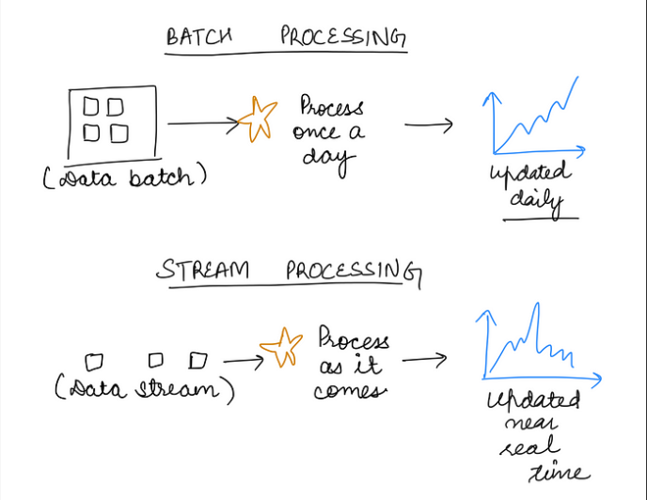
What is BATCH PROCESSING?

Slide 6
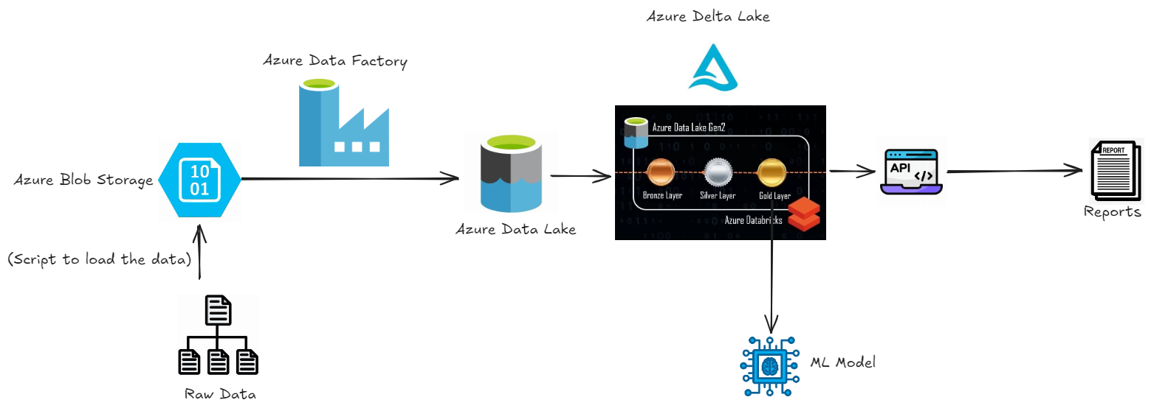
Architecture

Slide 7
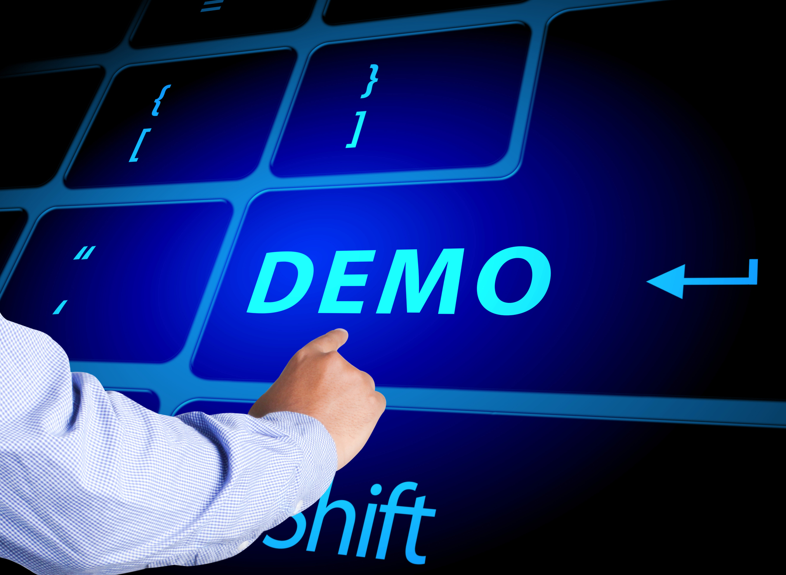

Slide 8
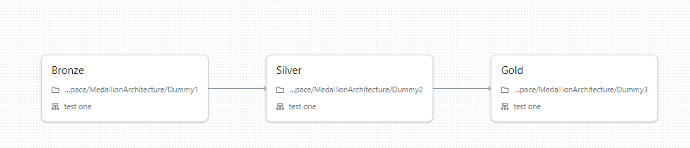
Pipeline

Slide 9
Challenges
Inconsistent Data :
Data given to us was very inconsistent and cleaning and making it fit for Processing was very challenging
API Connection:
Unable to expose the API for a public IP address because Databricks only allows it to run locally due to security issues
ML accuracy:
Increasing ML accuracy was among the most difficult challenges which was solved with the help of Hyperparameter Tuning

Slide 10
Thank you

