Slide 1
B V RAJU INSTITUTE OF TECHNOLOGY (UGC Autonomous) Vishnupur, Narsapur, Medak District
Department of CSE(Artificial Intelligence and Machine Learning)
Minor Project – Abstract Review
TITLE: Enhancing the quality of noisy and informal text for improved performance in sentiment analysis
Supervisor: Dr. Neelam Sharma
Co-Supervisor : Mrs. K Chaitanya
Presented by :
S Navdeep 23211A66E8
Sri Bhuvan P 23211A66F9
Suraj Paswan 23211A66G5
L Sai Vardhan 24215A6612

Slide 2
Outline
Introduction
Abstract
Problem Statement
Review of Literature
Methodology Adopted
Architecture or Framework Used
Implementation Details
Results and Discussion
Conclusion
References

Slide 3
Introduction
Sentiment analysis is a key area in , helping businesses, researchers, and organizations analyze public opinion. However, social media and online comments are often noisy, informal, and filled with emojis and slang, making traditional sentiment analysis models less accurate.
This project focuses on enhancing sentiment analysis by:
Preprocessing noisy text (cleaning slang, typos, and emojis)
Combining text and emoji sentiment for better classification
Using Logistic Regression as a machine learning model for sentiment prediction

Slide 4
Abstract
This project improves sentiment analysis on noisy social media text by combining traditional text features with emoji sentiment scores. YouTube comments are cleaned and preprocessed, with sentiment extracted using VADER and an emoji ranking dataset.
A Logistic Regression model is trained to classify comments as Positive, Negative, or Neutral. This approach ensures better interpretation of informal language commonly found in user-generated content.

Slide 5
Problem Statement
Many people use social media platforms like YouTube to share opinions through comments. These comments often include slang, spelling mistakes, and emojis, which makes it difficult for normal sentiment analysis models to understand the true meaning.
This project aims to solve that problem by improving how we detect emotions and opinions in noisy and informal text using both words and emojis together.

Slide 6
Review of Literature
Title | Reference and Year | Advantages | Disadvantages
VADER: A Rule-based Model for Sentiment Analysis of Social Media Text | Hutto, C. & Gilbert, E. (2014) | - Easy to use and interpretable. - Performs well on social media text with emojis, slang, and punctuation | Limited in capturing context and sarcasm.
Sentiment of Emojis | Novak, P. K. (2015) | - Adds sentiment signals from emojis. - Enhances emotion detection in informal communication. | Limited emoji lexicon and cultural interpretation issues.

Slide 7
Review of Literature
Title | Reference and Year | Advantages | Disadvantages
Enriching Word Vectors with Subword Information | Bojanowski, P. et al. (2017) | - Improves vector representation for rare and misspelled words. - Useful in multilingual scenarios. | Computationally heavier than traditional word embeddings.

Slide 8
Methodology Adopted
1.Data Collection: We collected noisy and informal text from YouTube comments. These comments often contain slang, typos, and emojis.
2.Text Preprocessing: We cleaned the text by removing URLs, special characters, and user mentions. All text was converted to lowercase for consistency.
3.Normalization: Slang and abbreviations were expanded using a custom dictionary (ex: “u” → “you”). Typos were fixed using basic spell correction tools.
4.Emoji Sentiment Mapping: Emojis in the comments were matched with their sentiment scores using an emoji sentiment dataset.
5.Feature Extraction:
Text features were extracted using TF-IDF, and sentiment scores were calculated using the VADER tool.
6.Model Training: We used a Logistic Regression model to classify each comment as Positive, Negative, or Neutral based on both text and emoji signals.

Slide 9
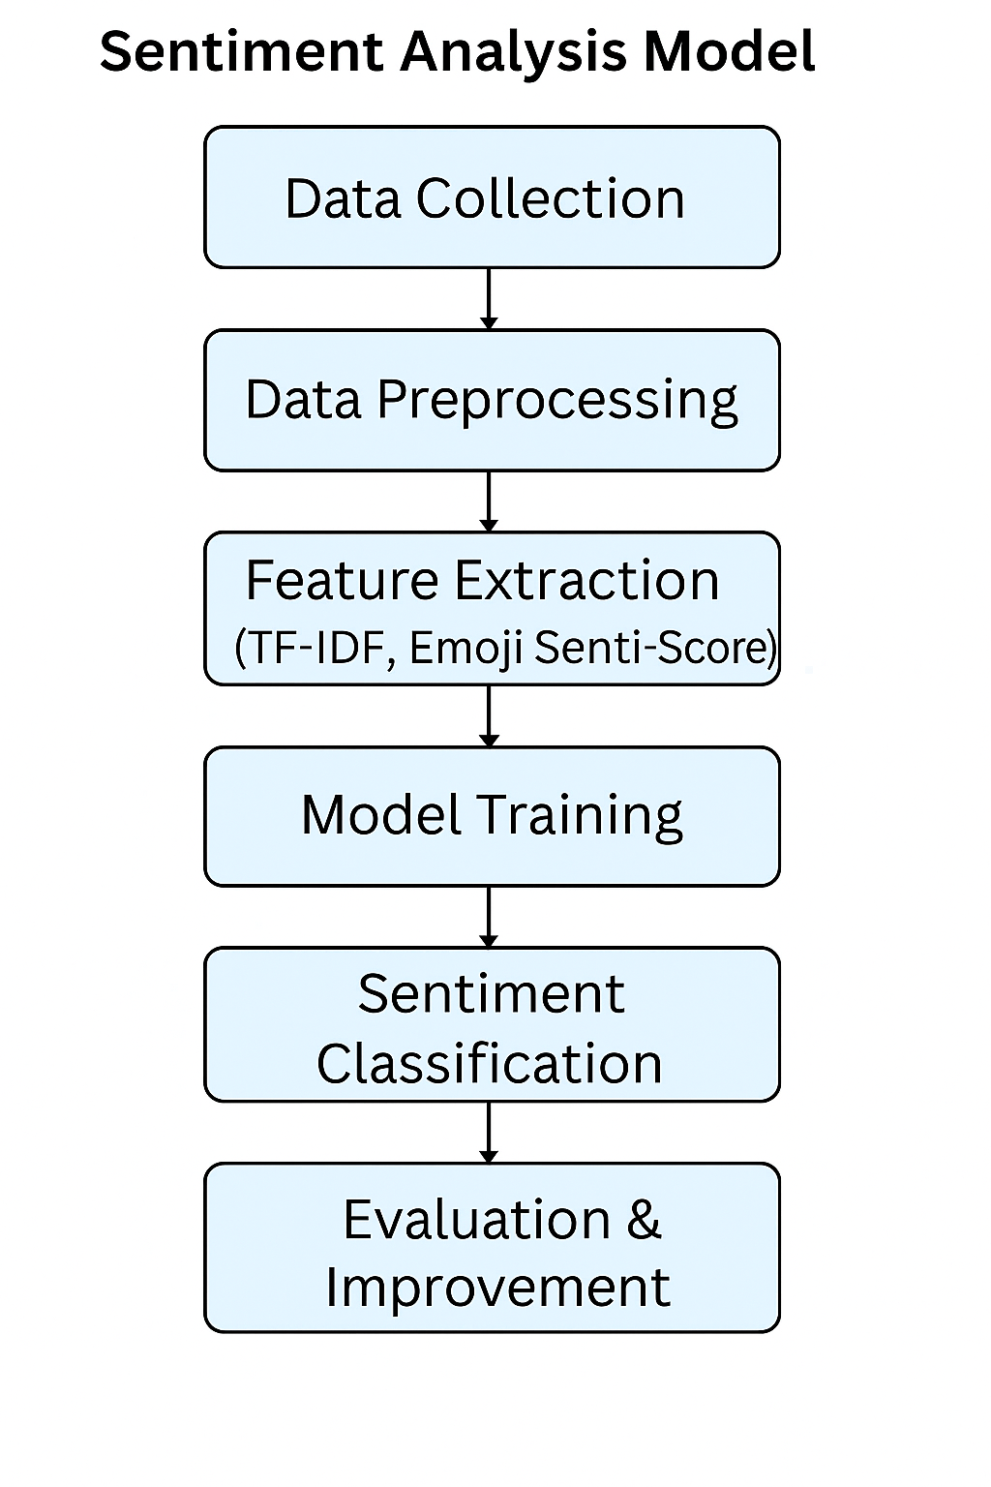
Architecture Used

Slide 10
Implementation Details
Pandas: Used to load, clean, and manage the dataset (YouTube comments).
Scikit-learn: Used for TF-IDF feature extraction and Logistic Regression model training.
TF-IDF: Converts cleaned text into numerical vectors so that the model can understand it.
VADER: Calculates sentiment score of the text using a rule-based method.
Emoji Sentiment Dataset: Provides predefined sentiment scores for emojis to include emotional context.
Logistic Regression: A simple and fast machine learning model used to classify sentiments.
Matplotlib : Used to visualize results like sentiment distribution and performance metrics.

Slide 11
Results and Discussions
The model achieved around 79% accuracy. It performed best on positive comments and slightly lower on neutral ones. Including emoji sentiment and slang handling helped improve prediction quality for informal text.
Classification Report:
Class Precision Recall F1-score Support Positive 0.82 0.82 0.82 17574 Neutral 0.79 0.54 0.64 8765 Negative 0.75 0.90 0.82 13705
Accuracy: 0.787
Macro avg 0.79 0.75 0.76 40046 Weighted avg 0.79 0.79 0.78 40046

Slide 12
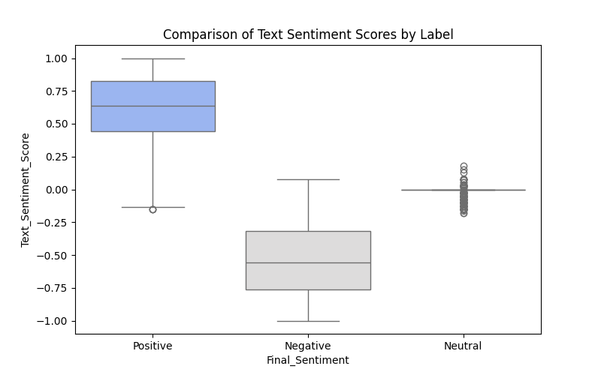
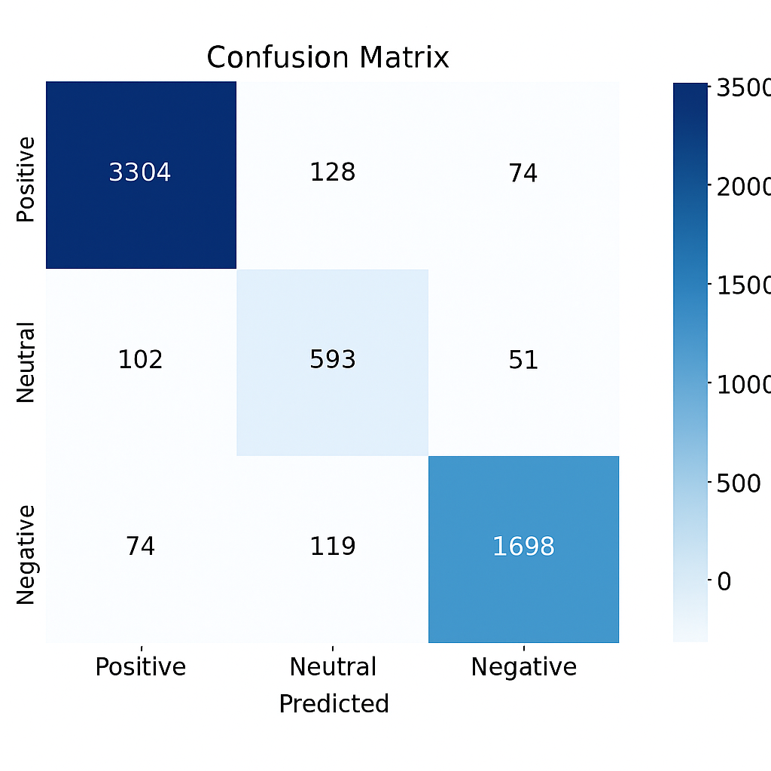
Results and Discussions

Slide 13
Conclusion
This project successfully improves sentiment analysis on noisy and informal text by combining text features with emoji sentiment scores. By cleaning the data, handling slang, and mapping emojis to sentiments, the model becomes more accurate and better suited for social media comments.
The final system effectively classifies comments as Positive, Negative, or Neutral and performs well on real-world, unstructured data.

Slide 14
References
Hutto C Gilbert, E. (2014) VADER: A Rule-based Model for Sentiment Analysis of Social Media Text.
Novak, P. K (2015). Sentiment of Emojis
Bojanowski Petal. (2017). Enriching Word Vectors with Subword Information.
Open Source Tools: TF-IDF, VADER, Scikit-learn
Dataset: Emoji Sentiment Ranking

Slide 15
Thank You

