Slide 1
COMPUTER NETWORKS (18CSC302J) Topic – Home automation
SUBJECT HANDLING FACULTY : Mrs.d.viji

Slide 2
Team members:-
1. ANUJ (RA2011003010910)
2. RHYTHM PAHWA(RA2011003010936)
3. KARTIK AGAL(RA2011003010948)
4. P BHUVANESH(RA2011003010961)

Slide 3
INDEX
S.NO. TITLE PAGE NO.
1. INTRODUCTION TO HOME AUTOMATION 4
2. OBJECTIVES OF HOME AUTOMATION 5-6
3. LITERATURE SURVEY 7-11
4. OVERVIEW 12-13
5. ARCHITECTURE DIAGRAM 14-15
6. MODEL EXPLANATION 16-18
7. FUNCTIONAL BLOCK DIAGRAM 19
8. RESULT 20-21
9. OUTPUT SCREENSHOTS 22-24
10. REFERENCE 25

Slide 4
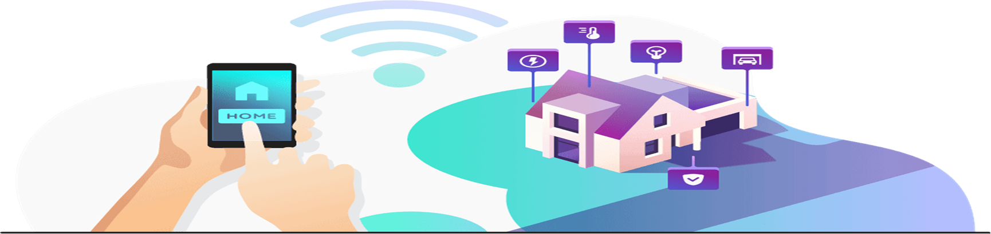
INTRODUCTION TO HOME AUTOMATION
Home automation is a wireless home appliance control system accessed by a remote device such as mobile phone (Android or ios)to allow a home owner to control , monitor and coordinate home appliances , without changing the home infrastructure.

Slide 5

OBJECTIVES OF HOME AUTOMATION:
The main objective of this system is to control the home appliances and electronic devices with the help of a supervisory system. The supervisory system is designed in such a way that everyone can access it.
Home automation systems are composed of hardware , communication and electronic interface that work to integrate electrical devices with one another.

Slide 6

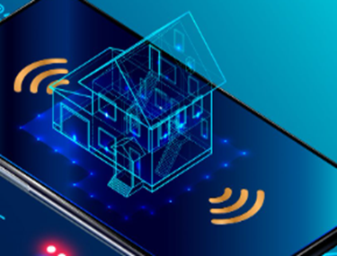
OBJECTIVES OF HOME AUTOMATION:
Another objective of home automation include that it can be regulated with the touch of a button. For any remote location , users can adjust the controls on home entertainment systems , limit the amount of sunlight give to houseplants , or change the temperature in certain rooms . Home automation system is often connected through computer networks so that the user can adjust settings on their personal devices

Slide 7
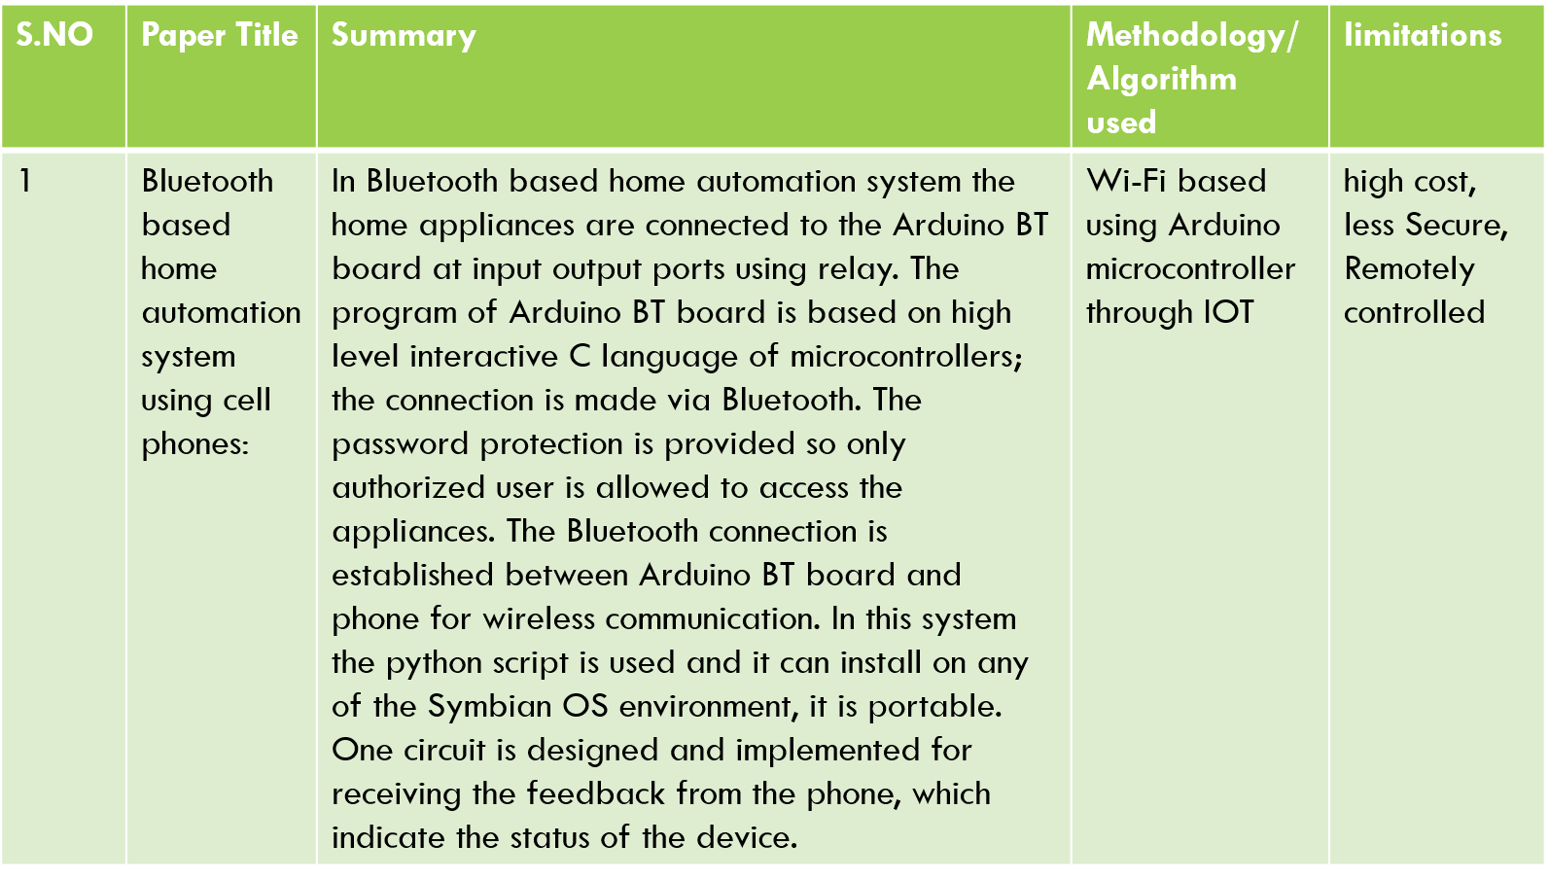
LITERATURE SURVEY

Slide 8
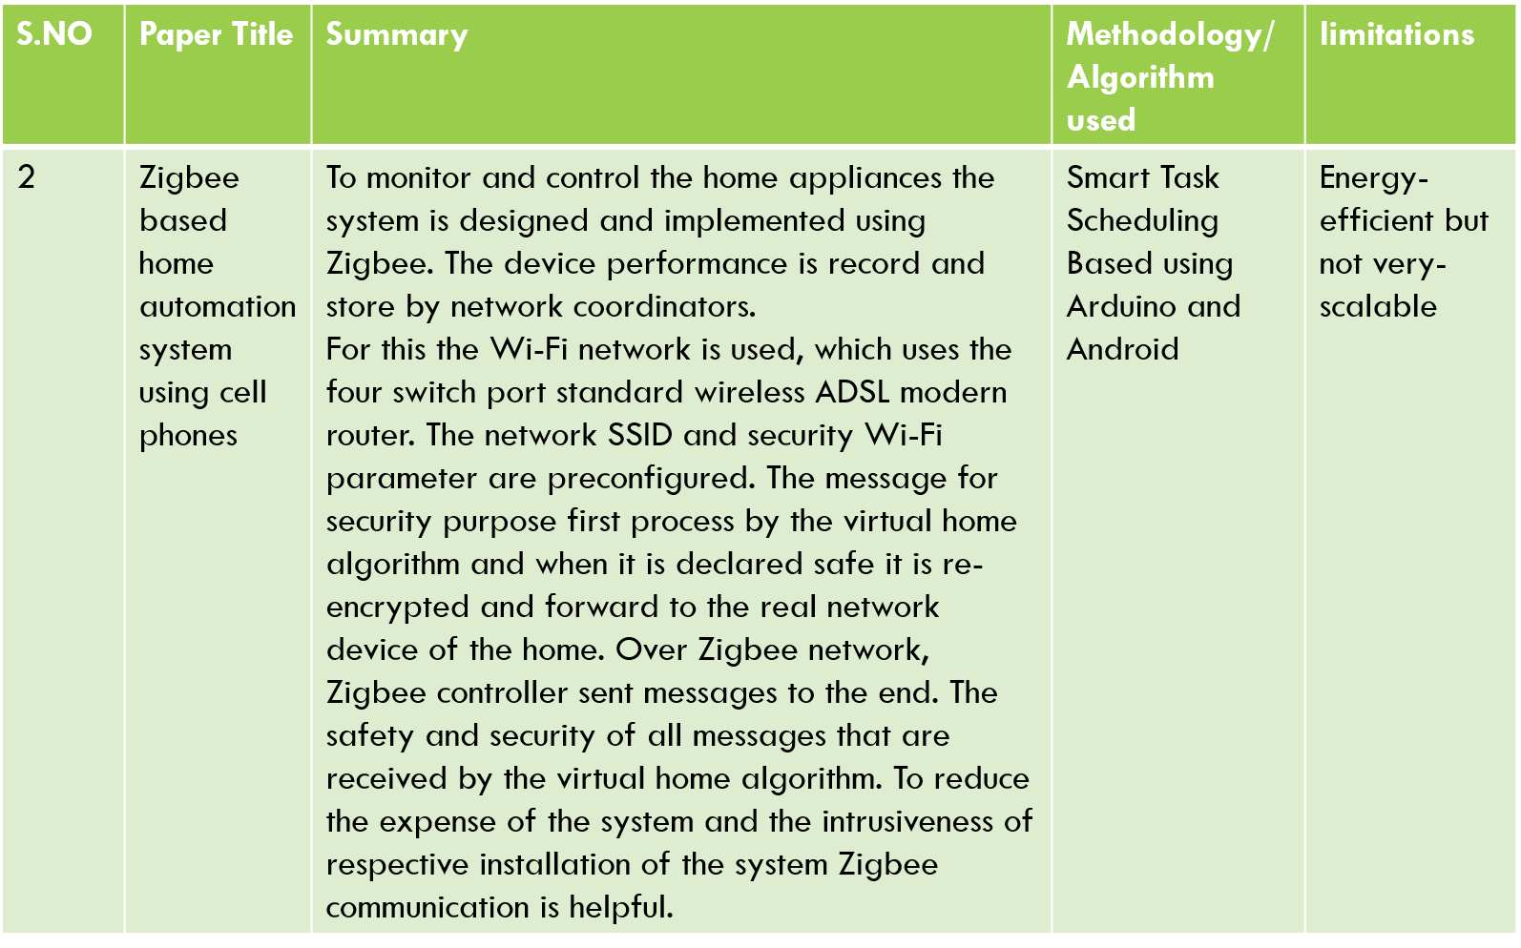

Slide 9
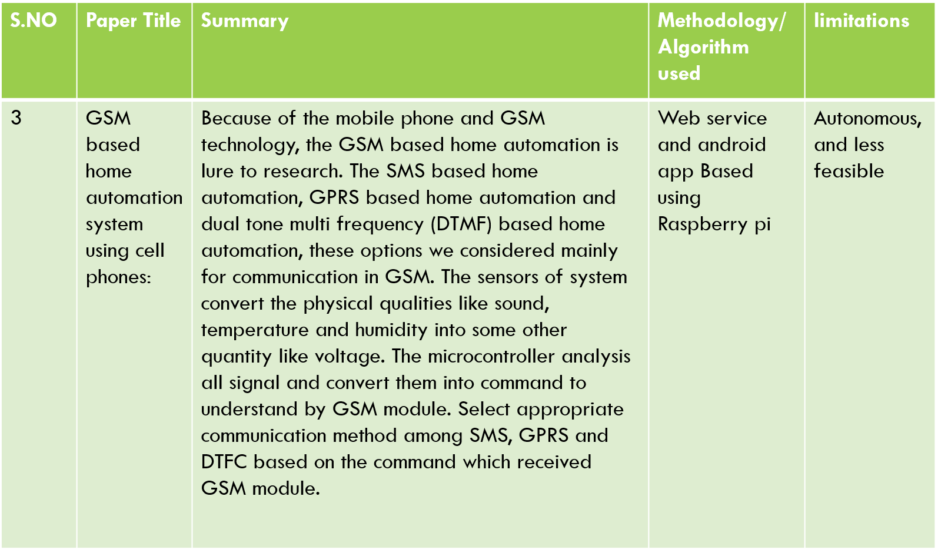

Slide 10
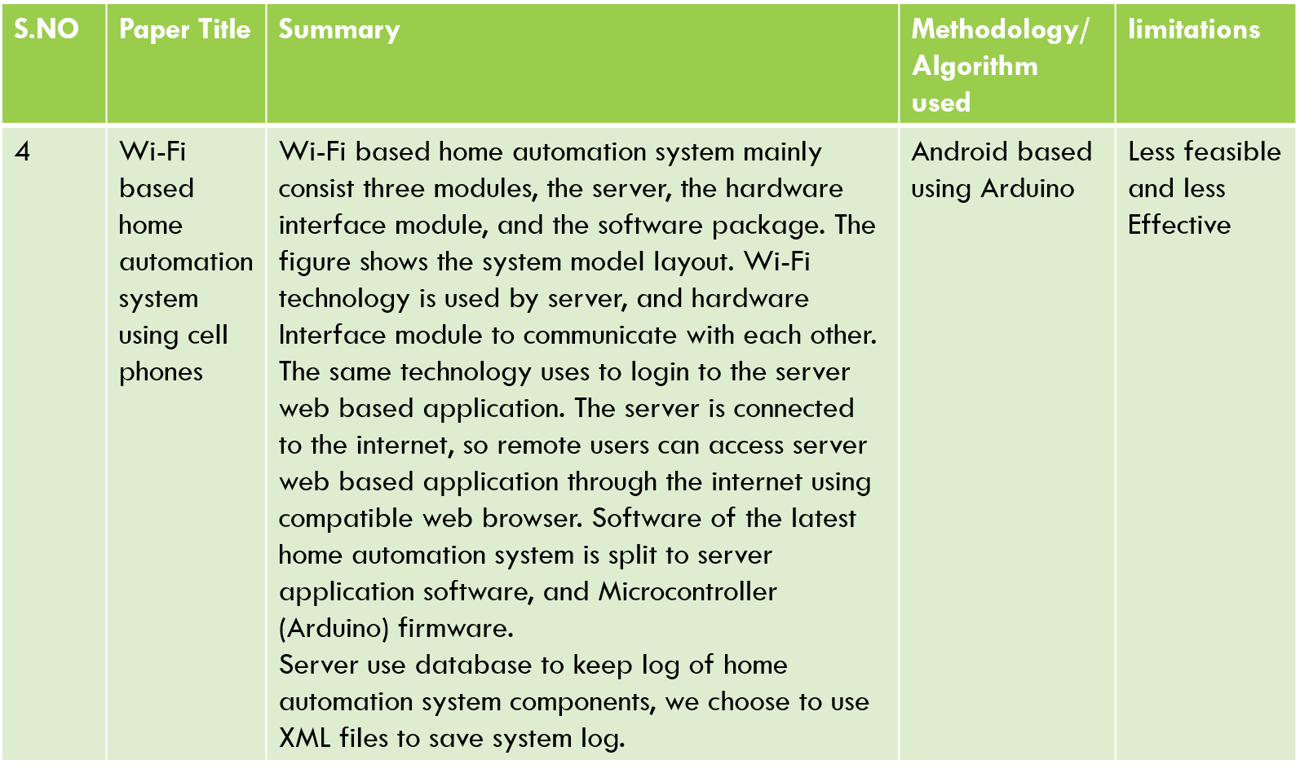

Slide 11
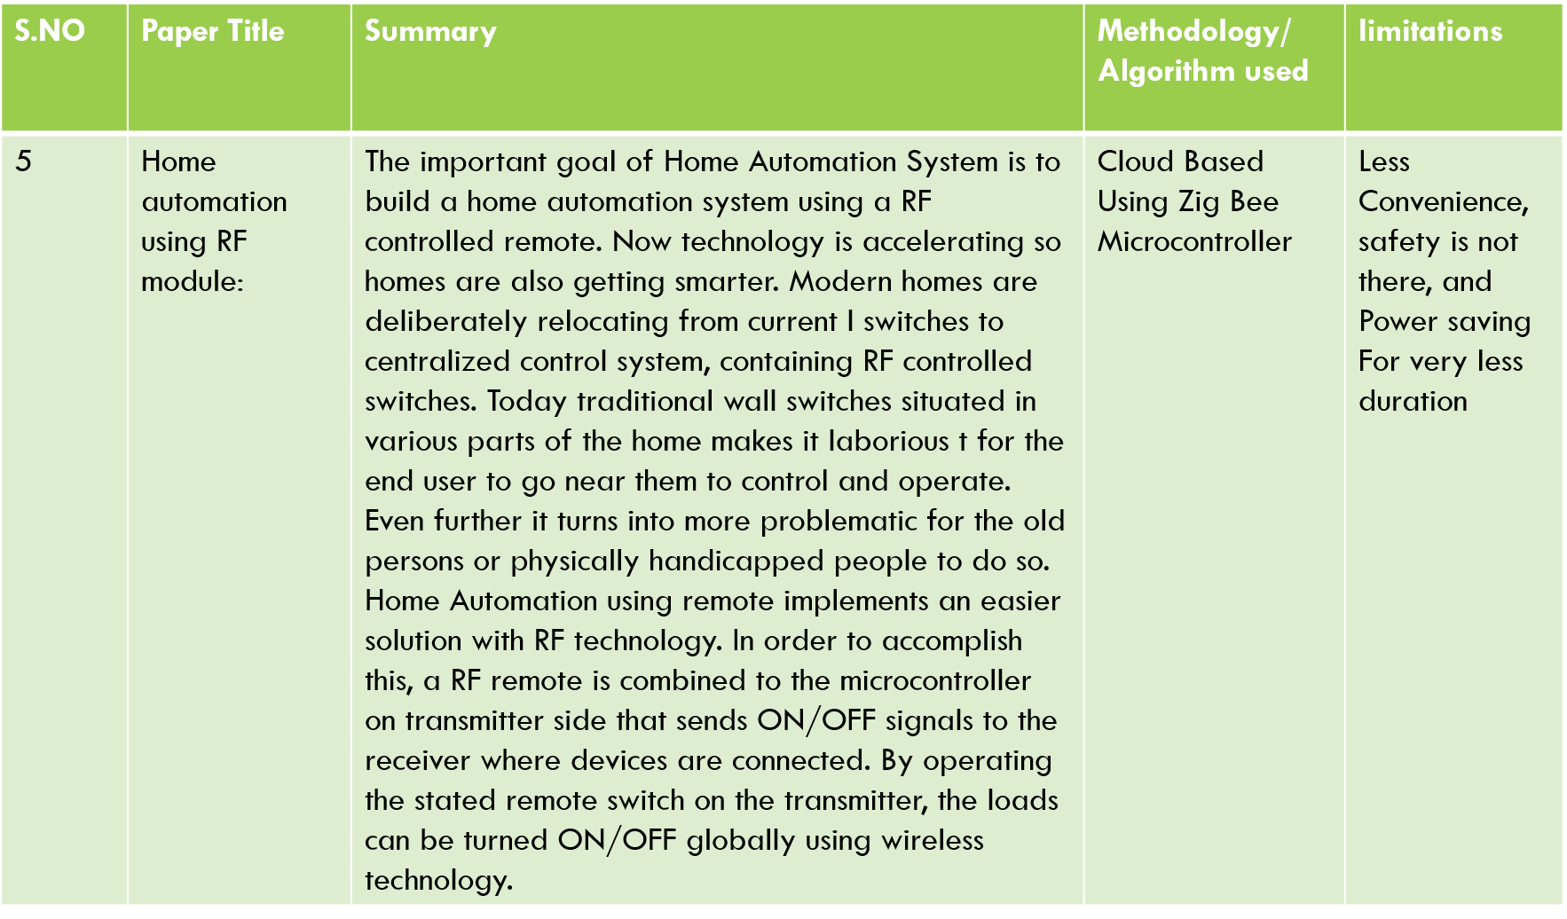

Slide 12
OVERVIEW
With the evolution of Internet of Things (IOT) all these manually controlled electrical and electronic devices can be controlled automatically. In 2011 it was predicted that IOT'S application will focus on mainly on the smart city construction and digital agriculture construction. China Communication Standards Association gives three layer structure of IOT: The first layer is the sensing layer mainly used for collecting information; The second layer is the network layer used for information transmission and processing; The third layer is the application layer used for storage and decision making . The main concept of IOT is that it can create a virtual connection between a hub or a network and electronic and electrical objects.

Slide 13
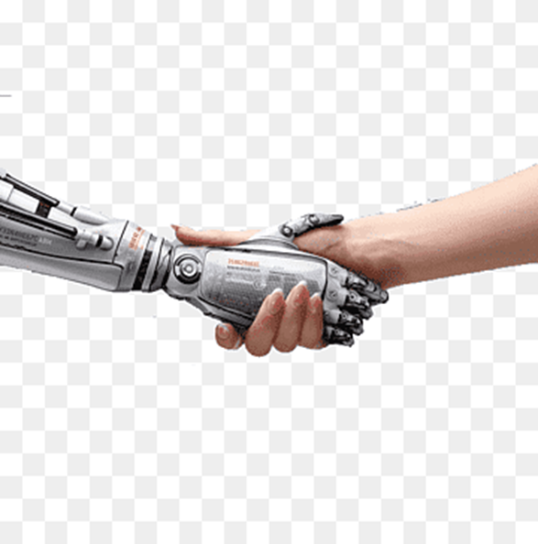
OVERVIEW
. This virtual connection helps to control, locate, and track down these connected objects. On the basis of device-to-device connectivity concept the development of smart sensor together with communication technologies such as Wi-Fi, Bluetooth etc. and supported by cloud computing technologies, IOT has become reality and it's goal is to make devices more aware, interactive and efficient for a better and safer world

Slide 14
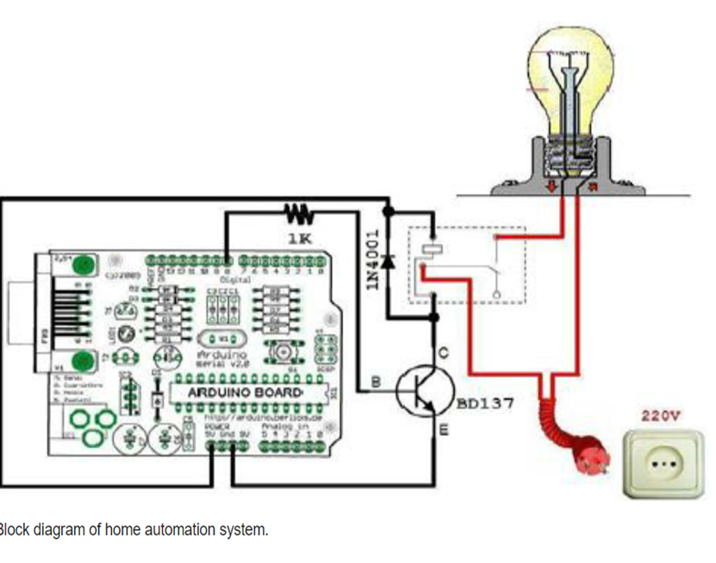
Architecture diagram:

Slide 15
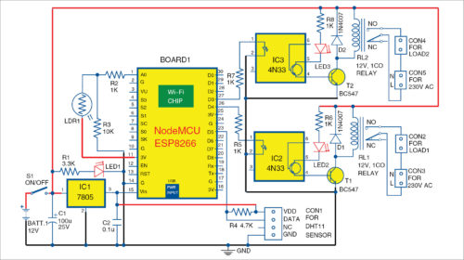
Architecture diagram:

Slide 16
Model explanation
The PHP programming language is used to create a point to-point web socket and a web application. After creation of such a socket, it is connected to the Amazon cloud server with the help of the internet connection. Now as the whole system is now online, it will look for the received messages from the connected IOT devices as shown . Ones the data is received, it will show notification and will refresh the data after certain interval. This refreshed data will be send to the control user interface. The control user interface is everything that the user has to act upon. The received data in the control user interface is shown in the monitor or on the control screen. Now to change the status of any devices the user needs to obtain the registered id from the Google Cloud Messaging (GCM). To register the user needs to send a request to the GCM.

Slide 17
MODEL EXPLANATION
In response to that the GCM will send the registration id and a unique password shown. The registration id is then send to the subscription API which sends notification and registration id to the GCM. The GCM in turn sends the notification to the client having that registration id. As now the user has the registration id, the user can send command to the connected IOT devices. As the user login, the user can control all the electrical and electronic devices in every section of the house. By entering to each window as shown in fig. The user can change the status of each appliances and can control the security system. This cycle continues until the server or the connected IOT devices is not connected with the internet.

Slide 18
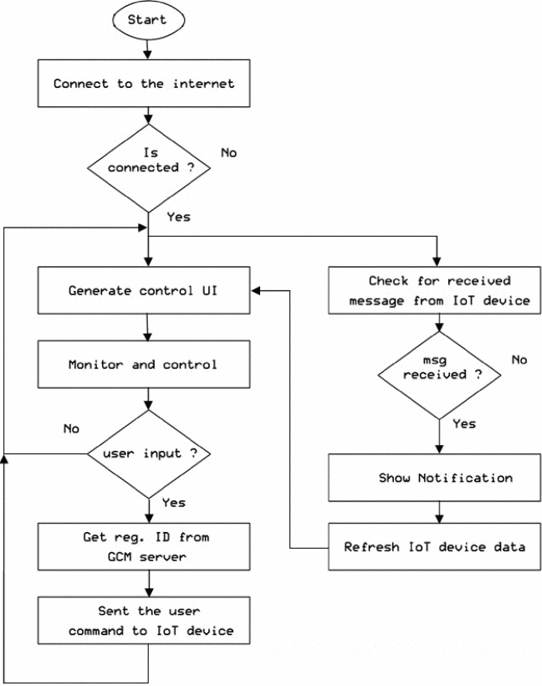
MODEL EXPLANATION

Slide 19
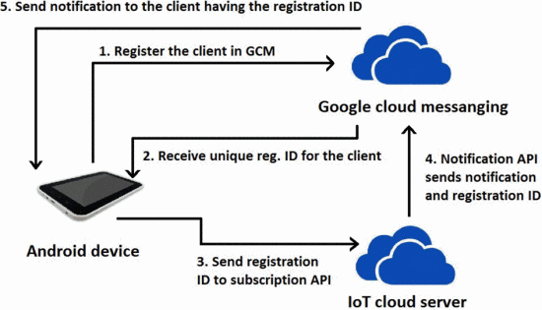
FUNCTIONAL BLOCK DIAGRAM:

Slide 20
RESULT
The IOT system we have developed is tested by installing smart sensor units and setting up a server for few houses. After installing the smart sensor units, the user needs to install the software to his/her laptop or smart android phone. After proper installation of the provided software the user needs to sign-up on the home automation server. Once the user is registered, a unique user id and a password is provided to the users of each house in which the sensor units are installed. After the user id and the unique password are obtained user can login from our android application. When user start the android application first a login page will appear as shown . It was observed that the user can successfully login.

Slide 21
RESULT
As soon as the user login, a home page will appear in which the user could keep a track of all the electronic and electrical devices which are connected with the server as shown. Our designed model of home automation can also controlled by using any web browser. To operate home automation system user need to go web-page of home automation system then a login page as shown will be appeared. By login in this page the main home automation page as shown will showed. From this page user can control his/her home appliances and change the security settings. This was possible due to the database present with the server which stores all the data received from the server. A threshold value is provided to each sensor connected. If the sensor parameter exceeds the threshold value provided an automatic alarm is triggered.

Slide 22
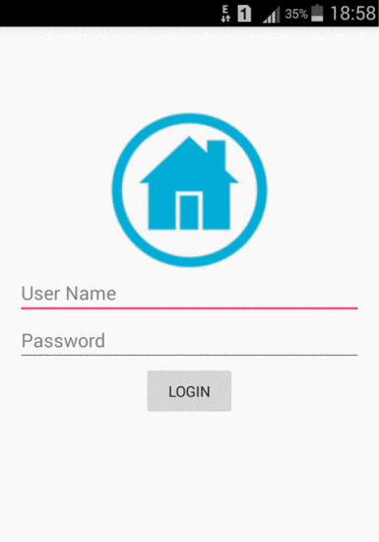
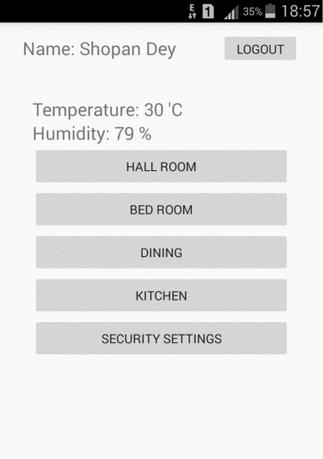
OUTPUT SCREENSHOTS:

Slide 23
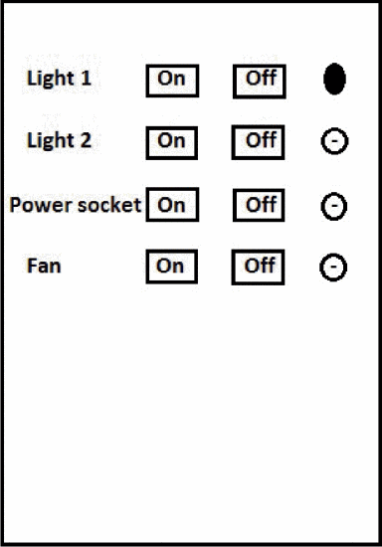
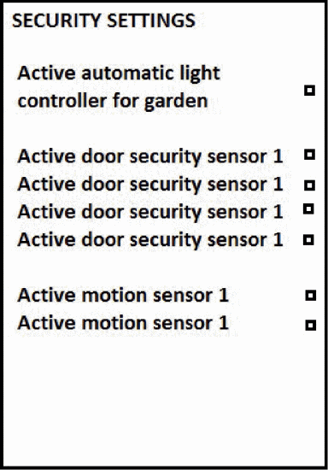
OUTPUT SCREENSHOTS:

Slide 24
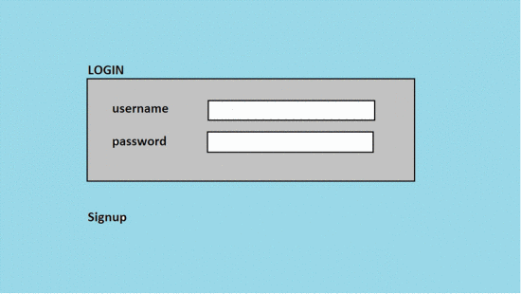
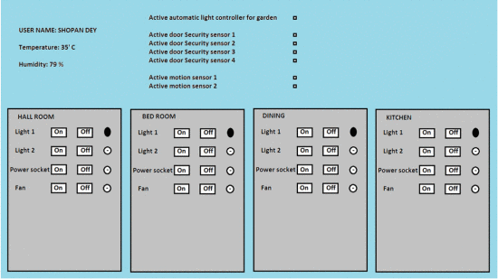
OUTPUT SCREENSHOTS:

Slide 25
REFERENCE
“The Internet of Things” by Samuel Greengard textbook .
“Learning Internet of Things” by Peter Waher textbook.
www.google.com
www.ieee.org research paper reference.
www.wikepedia.com

