Slide 1
SMARTEVENT-PRO

Slide 2
Problem Statement
Manual task and schedule management leads to inefficiencies, missed deadlines, and disorganization.
Impact:
High stress levels
Reduced productivity
Poor time utilization

Slide 3
Proposed Solution
An AI-based assistant that automates task scheduling by integrating with calendars and understanding user habits.
Core Features:
Input preferences (working hours, breaks, task priorities)
Real-time calendar sync
Dynamic rescheduling based on context and urgency
Benefits:
Saves time
Reduces manual planning
Boosts productivity

Slide 4
Technology Stack
Frontend:
React.js
Styled-components
Backend:
Spring Boot (Java)
Database:
MySQL
AI Integration:
Gemini API(for intelligent suggestions & NLU)

Slide 5
KEY FEATURES
User-Friendly Interface
Better Security
Customizable Scheduling Preferences
Real-Time Updates Across Devices
AI-Driven Scheduling Recommendations

Slide 6
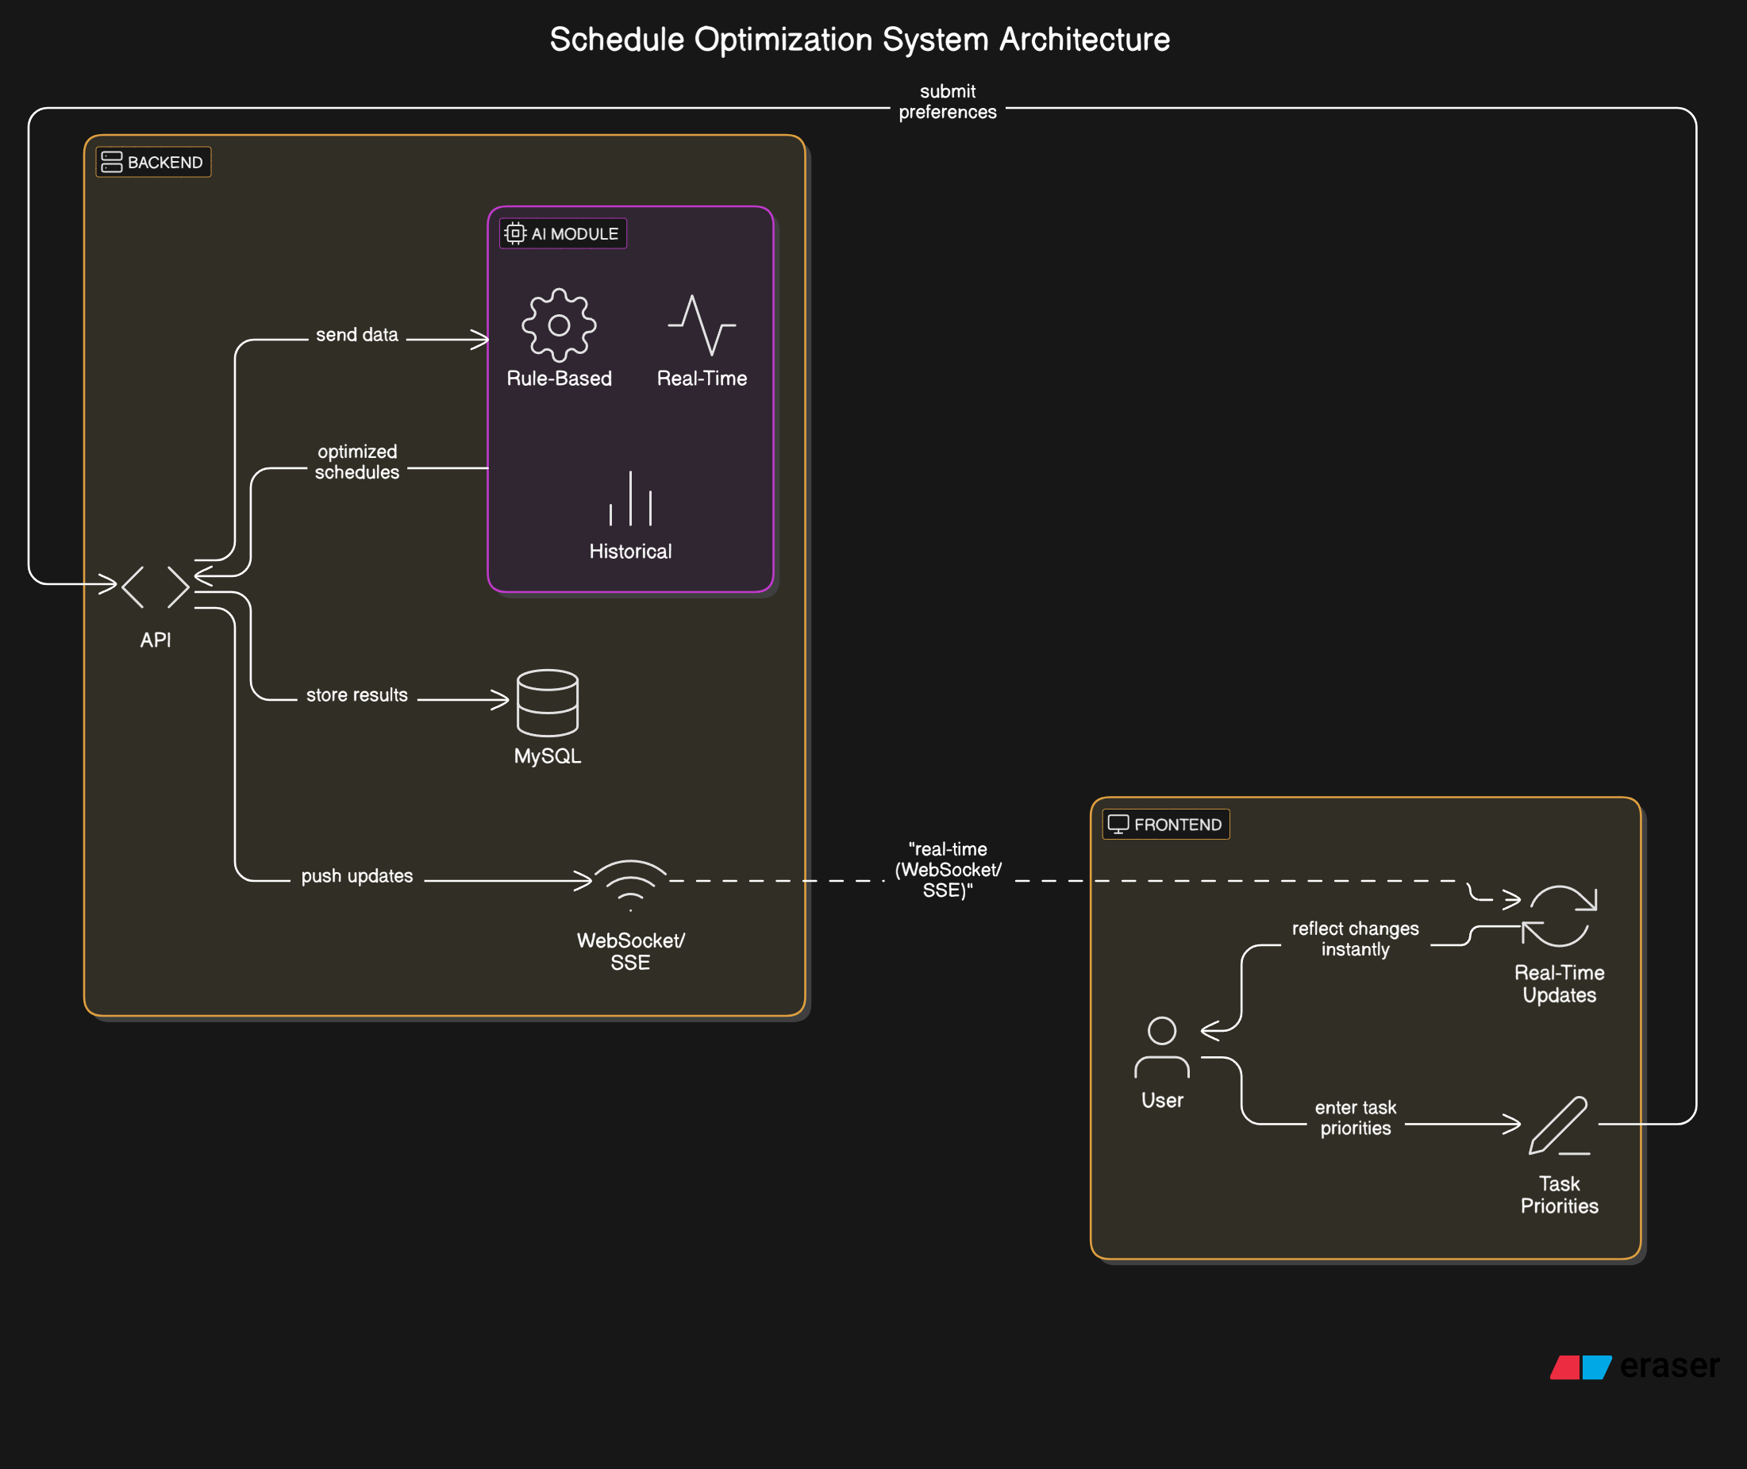
SYSTEM ARCHITECTURE

Slide 7
IMPLEMENTATION
Phase 1: Requirement gathering & system design Phase 2: Develop frontend & backend components Phase 3: Integrate AI module for scheduling Phase 4: Test full system and fix issues Phase 5: Deployment & user onboarding

Slide 8
Challenges & Mitigations
Challenge 1: Data Privacy
Mitigation: Secure authentication, encryption, GDPR compliance
Challenge 2: AI Accuracy
Mitigation: Continuous feedback loop & retraining models
Challenge 3: Tech Integration
Mitigation: Modular architecture & thorough system testing

Slide 9
Future Enhancements
Mobile App (iOS & Android)
Voice Assistant Integration (e.g., Google Assistant)
Advanced Productivity Analytics & Daily Reports

Slide 10
THANK YOU!

