Slide 1
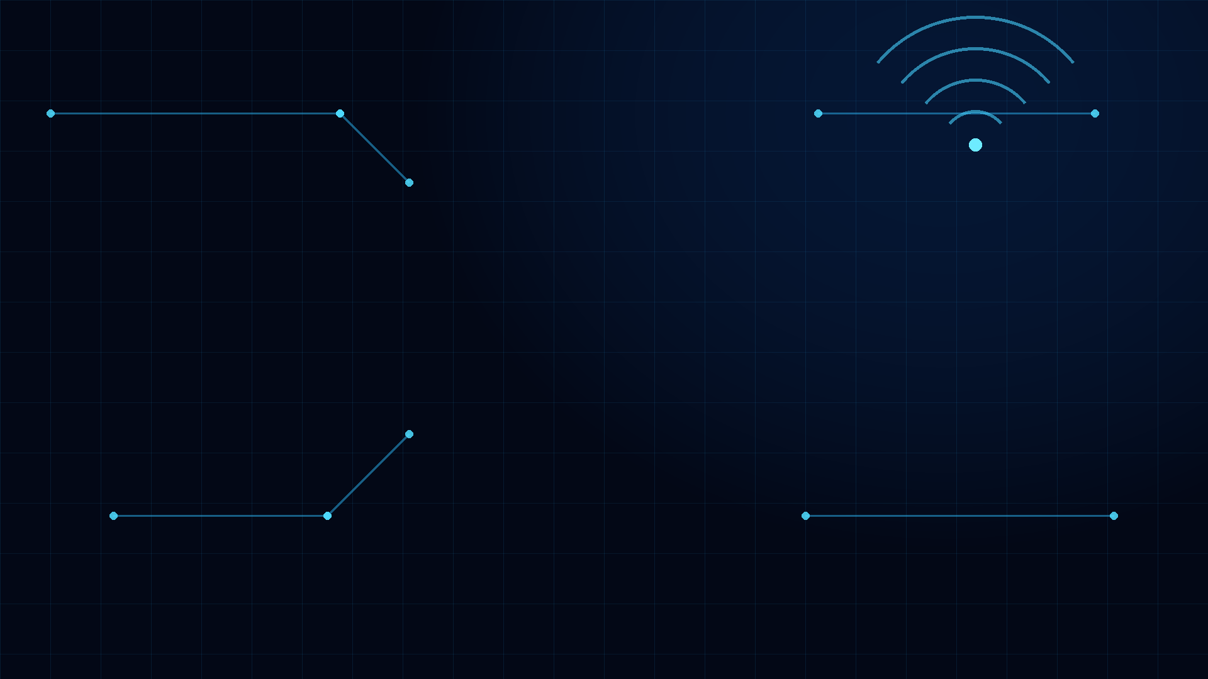

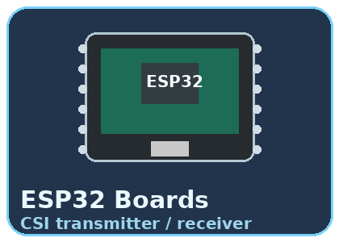
WiFi-CSI Based Human Activity
and Fall Detection
Project Guide
Batch - 8
Mrs. K. Lakshmi
Assistant Professor
B. BHUVAN - 24P81A0404
G. SUDHEER - 24P81A0420
K. SHIVAMANI - 24P81A0427
M. RAKESH - 24P81A0436

Slide 2
Introduction
• WiFi signals travel through a room and are affected when a person moves through the signal path.
• Channel State Information (CSI) records changes in the WiFi signal between a transmitter and receiver.
• Different activities such as walking, sitting and falling can produce different CSI patterns.
• The system uses these changes to recognize human activity.
• The main idea is to detect activity without using cameras or wearable devices.

Slide 3
Objective of the Project
• To develop a contactless method for detecting human activity using WiFi signals.
• To capture CSI data using ESP32 boards.
• To process the collected CSI data and extract useful features.
• To use machine learning algorithms for activity classification.
• To provide a simple approach for fall detection without a camera.

Slide 4
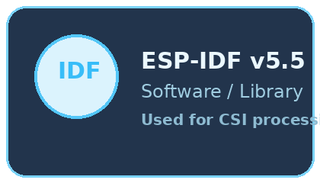
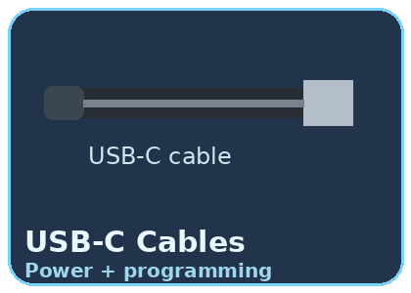


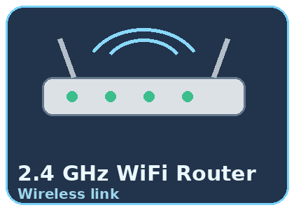
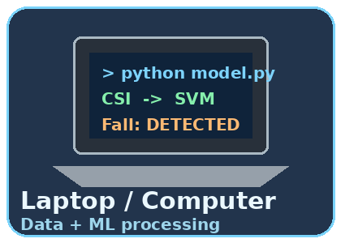
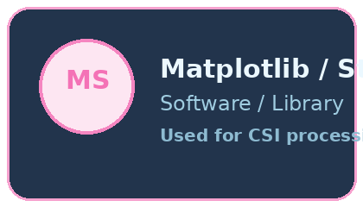
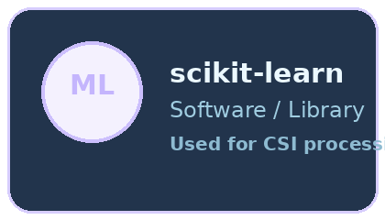
Apparatus and Components
SYSTEM HARDWARE + SOFTWARE
Hardware
Software
• ESP32 board (Reciever)
• USB-C cables
• 2.4 GHz WiFi router
• Laptop / computer
• ESP-IDF v5.5
• Python
• Library packages:
pandas, NumPy and SciPy
• Streamlit (for Dashboard)

Slide 5
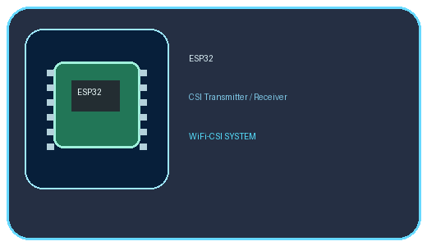
System Block Diagram
Human
Activity
Machine Learning
Classifier
→
WiFi Signal
Change
→
ESP32 CSI
Receiver
→
Signal
Processing
→
→
Activity Output
Empty / Walking / Falling / Bending / Sitting /Standing / Person /Lying
TX ESP32 → WiFi Router → RX ESP32 → Laptop

Slide 6
Working Methodology
• Data Acquisition - ESP32 receives WiFi packets and captures CSI.
• Data Logging - CSI data is recorded and stored as CSV files.
• Signal Processing - Raw data is cleaned and normalized.
• Feature Extraction - Statistical features are calculated from CSI.
• Classification - Features are given to SVM and Random Forest models.
• Activity Detection - The trained model gives the activity label.
1
2
3
4
5
6

Slide 7
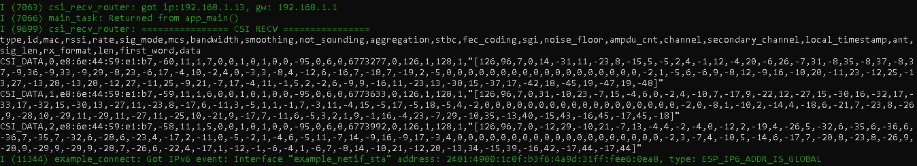
OUTPUT:
CHANNEL STATE INFORMATION (CSI) DATA:

Slide 8
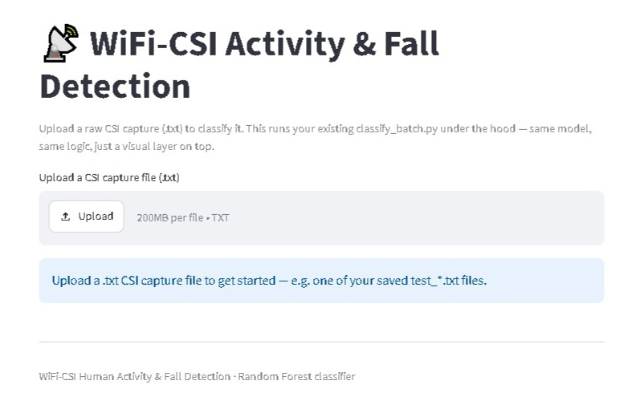
STREAM-LIT DASHBOARD:

Slide 9
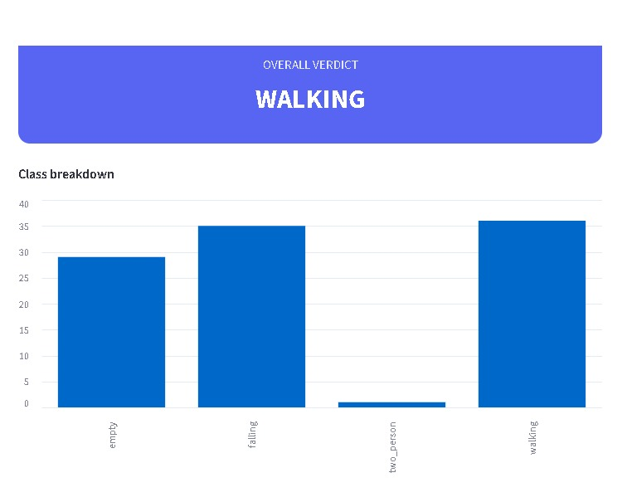
OUTPUT CLASSIFIER:
→

Slide 10
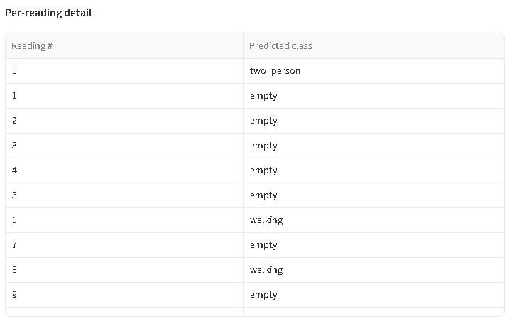

Slide 11
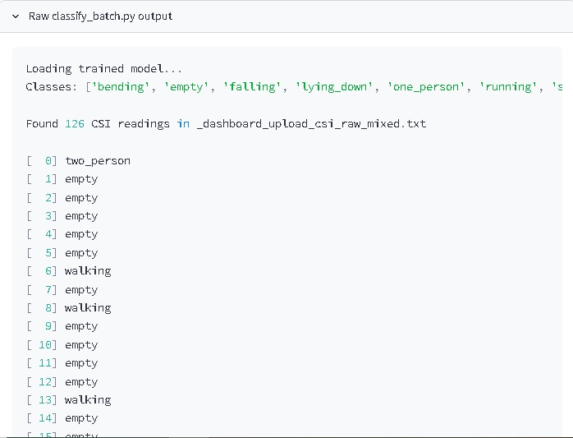

Slide 12
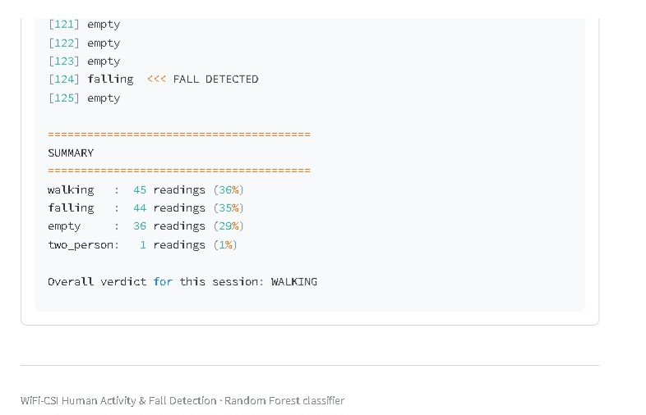

Slide 13
Advantages
• No camera is required.
• No wearable device is required.
• Provides privacy compared with camera-based monitoring.
• Can work without depending on room lighting.
• Uses low-cost ESP32 hardware.
• Can be developed using existing WiFi infrastructure.
• Suitable for continuous activity monitoring.

Slide 14
Applications
• Fall detection for elderly people living alone.
• Human presence detection in smart homes.
• Activity monitoring in healthcare facilities.
• Occupancy and intrusion detection.
• Emergency alerts after detecting a fall.
• Contactless monitoring in places where cameras are not preferred.

Slide 15
Future Scope
• Use deep learning models such as CNN and LSTM.
• Add more activities such as sitting and standing.
• Send fall alerts to a mobile phone or caregiver.
• Run the model on an edge device for standalone operation.
• Use multiple ESP32 pairs for multi-room monitoring.
• Collect a larger dataset from different people and environments.

Slide 16
Conclusion
• ESP32 is used to capture CSI information.
• Signal processing is used to prepare the collected data.
• Machine learning is used for activity classification.
• The approach avoids cameras and wearable sensors.
The project presents a simple contactless approach for
human activity and fall detection using WiFi-CSI.

