Slide 1

VisIt for the Mantid Project
Owen Arnold (Tessella PLC)
Michael Reuter (ORNL NSSD)
February 28, 2011

Slide 2
Overview of Mantid
The Mantid project provides a platform that supports high-performance computing on neutron and muon data. The framework provides a set of common services, algorithms and data objects that are:
Instrument or technique independent.
Supported on multiple target platforms (Windows, Linux, Mac OS X).
Easily extensible by Instruments Scientists/Users.
Open source and freely redistributable to visiting scientists.
Provides functionalities for Scripting, Visualization, Data transformation, Implementing Algorithms, Virtual Instrument Geometry.

Slide 3
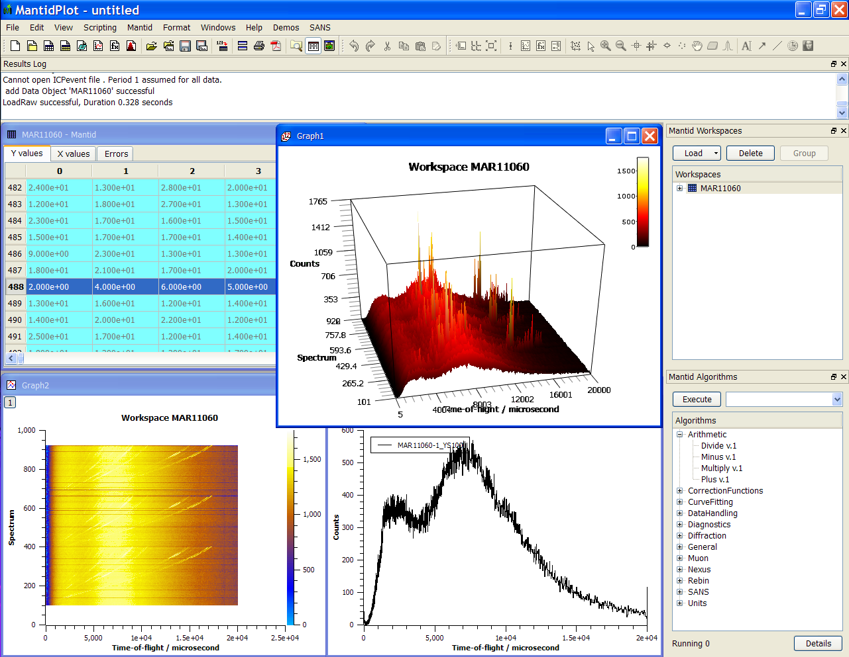
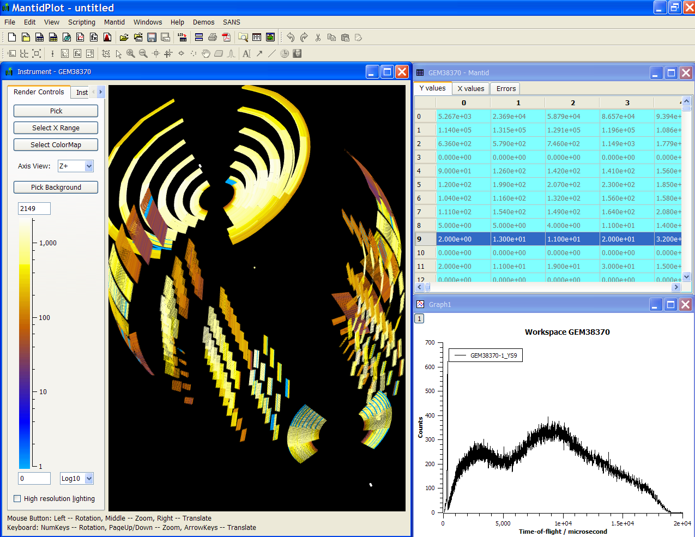
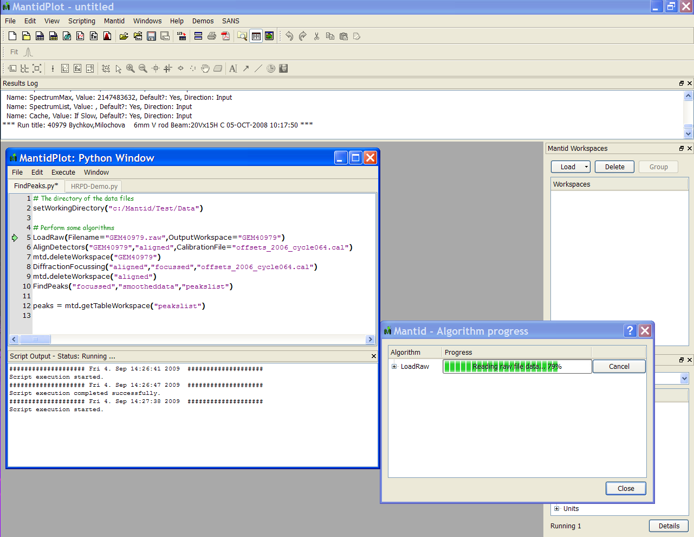
Mantid in Action

Slide 4
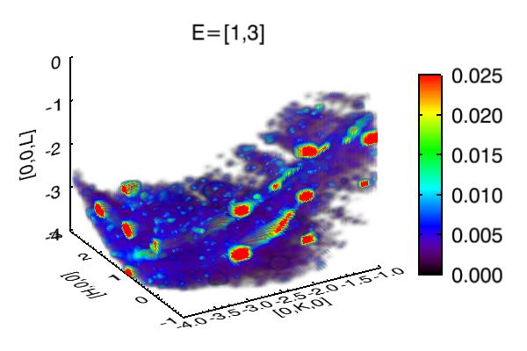
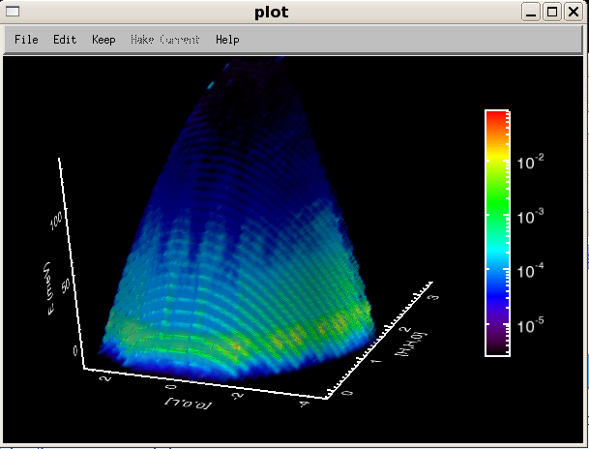
4D Visualization
(E, h, k, l) or (E, Qx, Qy, Qz)
View any 3 and 4th is “time”
No a priori knowledge of which combination to view

Slide 5
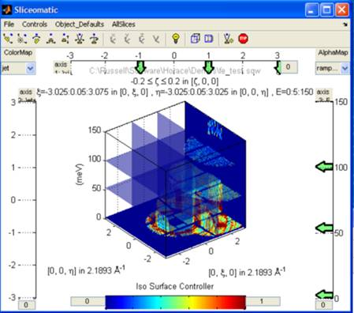
Visualizing Reduced Dimensions
Use cuts and slices to see interesting parts of data
Use multiple cuts to see data progression in different directions
Cuts/slices with width important to deal with resolution
View three orthogonal cuts simultaneously (with control) through time (ThreeSlice unrolled)

Slide 6
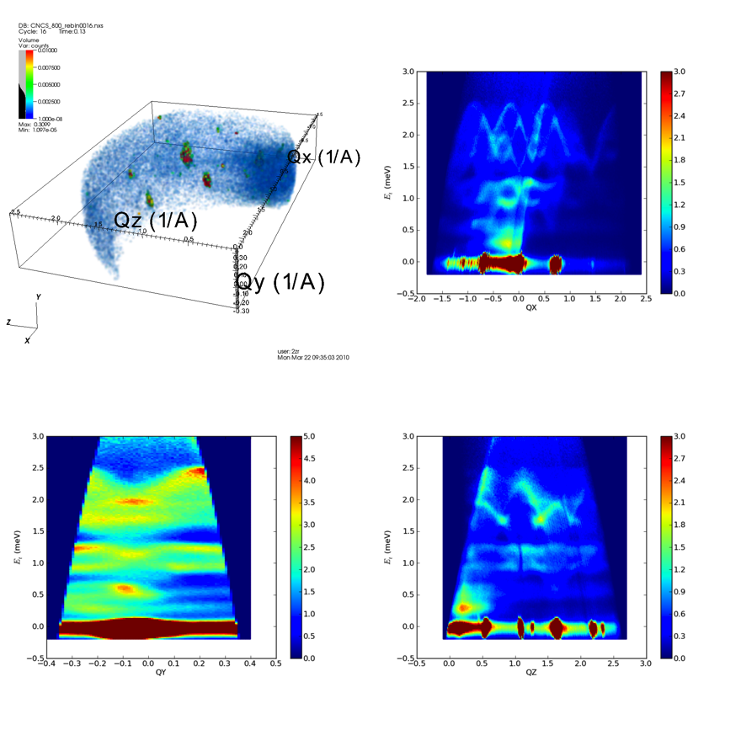
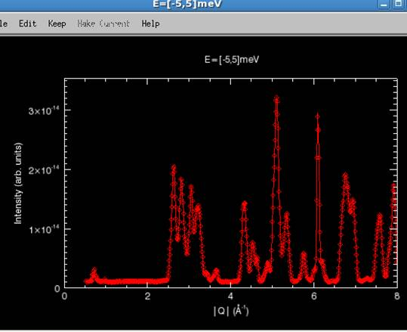
Reducing Dimensionality
Making cuts, slices or projections
Reduce to 3D, 2D or 1D
One of the axes can be “time”

Slide 7
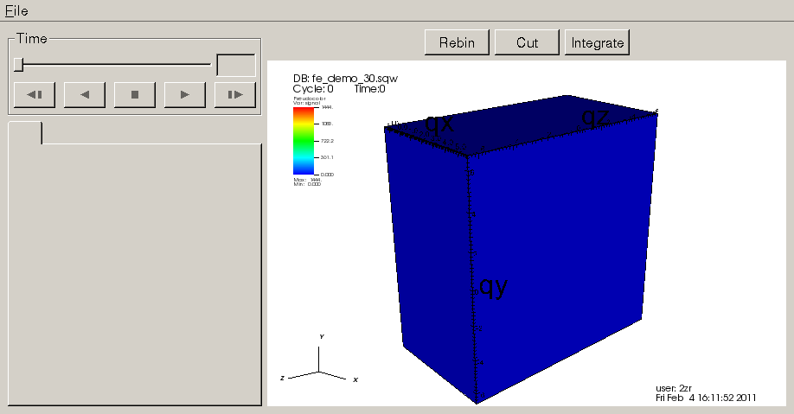
VisIt in Mantid
Provide scaled down version of VisIt
Expose certain operators and plots
Use our own plugins as well
Lean on certain bits of VisIt (VCR/TimeSlider, Plugin GUIs)

Slide 8
Mantid Rebinning
Types
Centre point
Parallelepiped
Adaptive
Exposing more detail
Merges boundaries between operators and databases
Original VisIt metadata may not apply

Slide 9
Standard Pipeline
Source/Db
vtkDataSet
Operator
vtkDataSet
Operator

Slide 10
Modified Pipeline for Rebinning
Source/Db
Arguments: Metadata
Returns: vtkDataSet
vtkDataSet + Metadata
Mantid Rebinning Libraries
Operator
vtkDataSet + Metadata
Operator

Slide 11
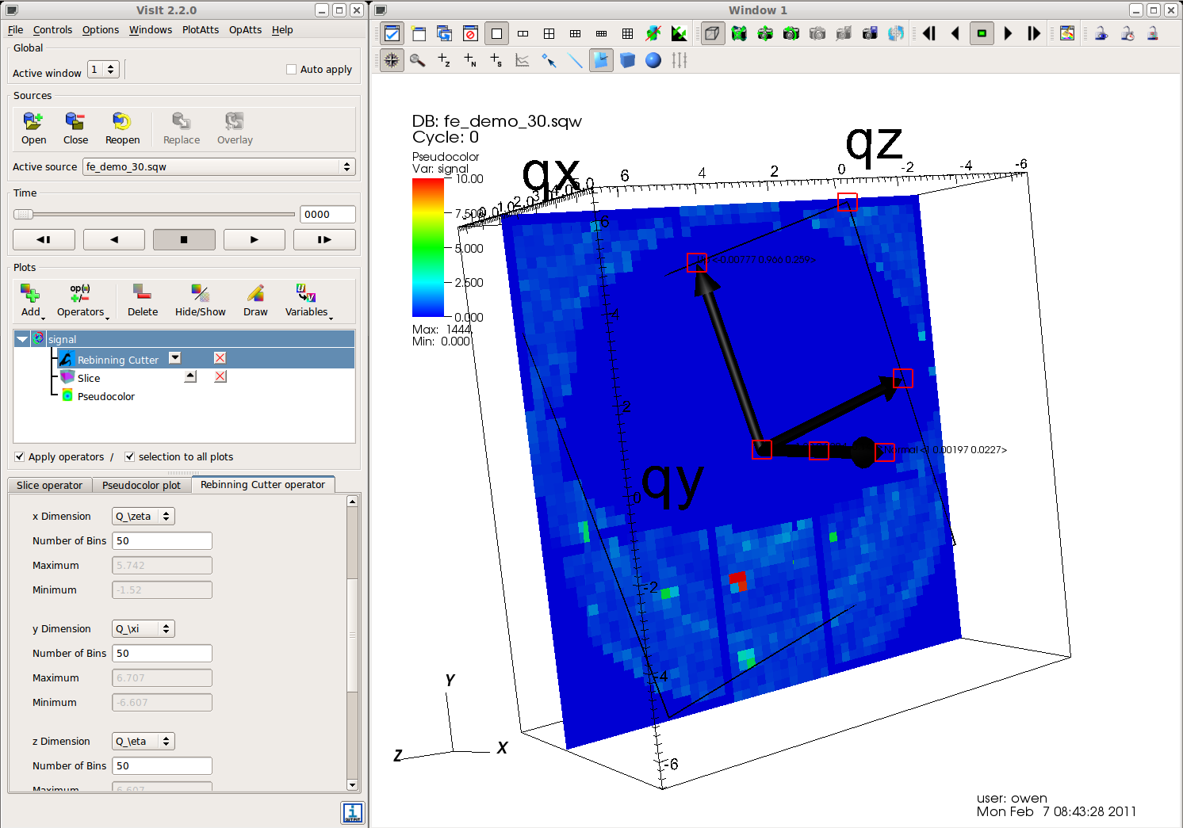
Progress

Slide 12
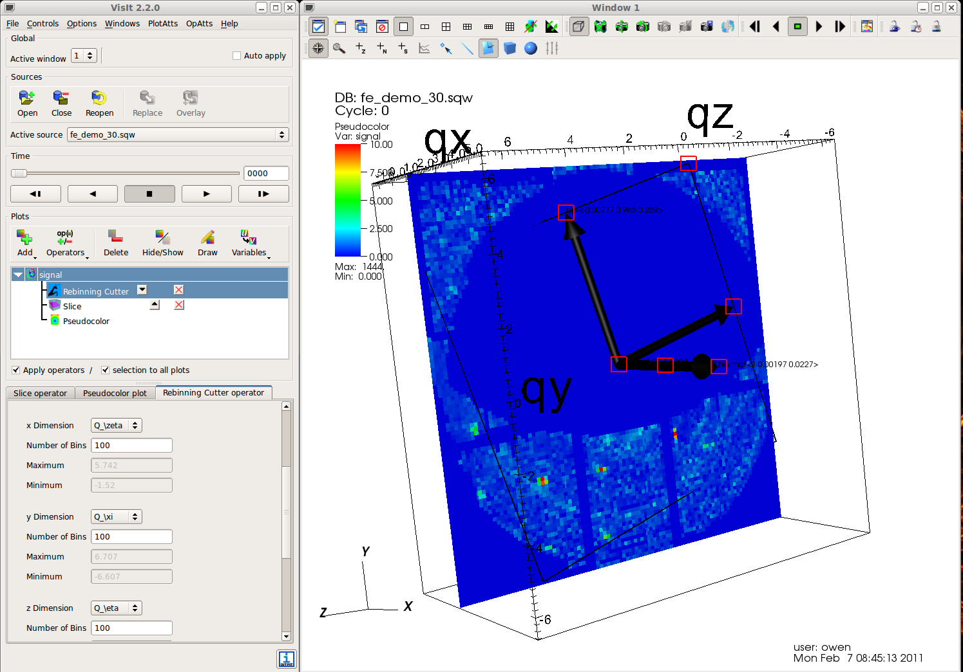
Progress

Slide 13
VisIt “Enhancements”
Pipeline branching in UI
Labeling and axes transformations in operators (rotated by arbitrary degrees and non-orthogonal)
Allow filters to publish updated time information
Improvements to box/plane interactors to make easier to use.
Interaction with File loading/Databases to provide input parameters
Exposure of extra information to VisitViewer
2D plots from 1D Query over Time
PluginVsInstall.cmake issue with CMAKE_CXX_COMPILER etc.
Documentation

