Slide 1
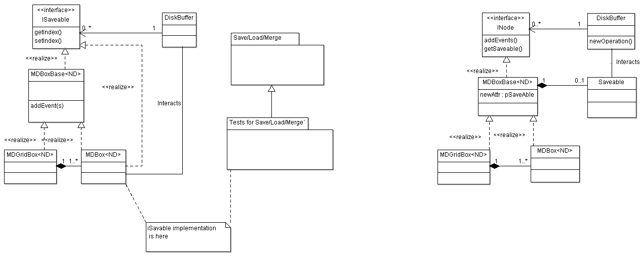
MD Box Modifications
Purpose: Allow file based workspaces to work properly
Old MD box structure
Target MD box structure

Slide 2
MD Box File format Modifications
Purpose: Decrease Error propagation, file versioning
SaveMD
Common code:
LoadMD
MDBoxFlatStructure
MDBox<nd,MDE>
std::vector<double> boxExtent
double r_min
MergeMD
2) Problem with float event coordinates.
Horace solution looks very complex for current desighn.

Slide 3
MD Box Chain Modifications?
Purpose: Multithreading, Speed
MDGridBox
MDGridBox
MDBox
MDBox
MDGridBox
MDBox
MDBox

