Slide 1
Digging Into ScriptRepository
Not so deep – it may be dangerous
Gesner Passos

Slide 2
Black Box Views
Download Service
Script
Repository
View
Clone
Git - RO
Files + Info(json)
Script Repository
Upload
Service
Files + Metadata
Clone
Git - RW

Slide 3
Download Service
Jenkins Job at is_sync_scripts_repo
Triggered at every push on github: scriptrepository
Pull Changes on cloned repository: link
Execute the script: scriptrepositoryparser.py
The parser: iterate over all the entries inside the repository to create the repository.json file:
Path
Author
Description
PubDate
All these files may be downloaded directly

Slide 4
Upload Service
Configured as a ModPython Publisher
Served by: payload.py at upload.mantidproject.org
Provides 2 service
publish_debug: for test purposes
publish
Is configured to receive a POST (as a form) with the following fields:
Author Email
Comment
Path File
It will create a commit, and push to the repository and returns a json file with key information.

Slide 5
ScriptRepository inside Mantid
Knows NOTHING about GIT
Interaction only with DownloadService and UploadService.
Actions:
Download: directly composing the downloadservice url + the relative path (ScriptRepository property)
Upload: fill an HTMLForm and send to the URL:
upload.mantidproject.org/scriptrepository/payload/publish
Delete entries: requested – Mantid2.6

Slide 6
“Versioning” Algorithm
Local Script Repo
RemoteOnly ➔ Only inside Repository.json
Repository.json
LocalOnly ➔ Only inside File
PubDate
Author
Description
Up2Date ➔ PubDate , DownloadedDate==Modified Date
Local.json
LocalChanged ➔Modified Date > DownloadedDate
AutoUpdate
PubDate
DownloadedDate
RemoteChanged ➔ PubDate > Local::PubDate
BothChanged ➔ Local && Remote Changed
File
Modified Date
The states define the available actions:
donwload or upload

Slide 7
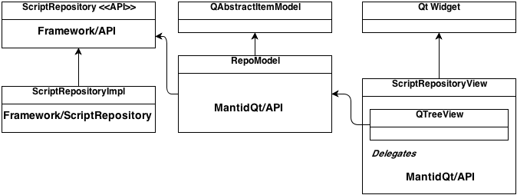
ScriptRepository into Mantid Code

