Slide 1

What is Sassena?
“Sassena is a highly scalable parallelized software for calculating neutron and xray scattering intensities from all-atomic molecular dynamics simulations”
http://www.sassena.org
Reference: B. Lindner et al. Comp. Phys. Comm. 183 (7); pp 1491-1501 (2012)
Input:
Molecular dynamics trajectory (particle coordinates)
Options file (XML)
_{simul}
Output: (in HDF5 format)
I_{inc}(Q,t), I_{coh}(Q,t)
S(Q)
Goals:
Load Sassena output into Mantid
I_{simul} (Q,t) → S_{simul} (Q,E)
Analyze S_{simul}(Q,E), compare to S_{exper}(Q,E)

Slide 2
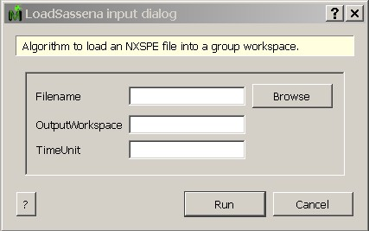
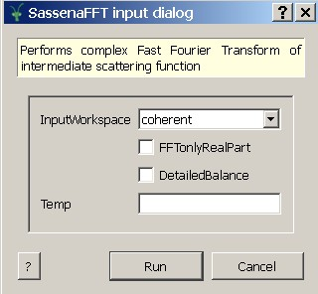
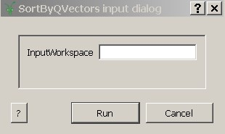
Algorithms in Mantid
LoadSassena
SassenaFFT
SortByQvectors

Slide 3
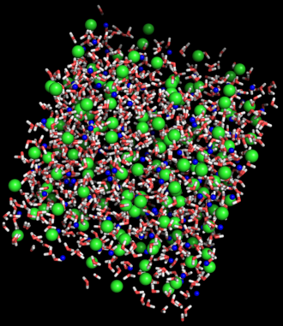
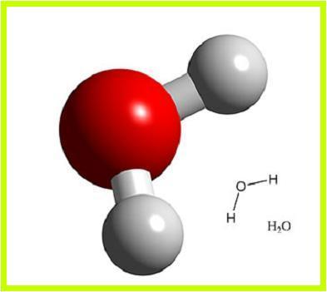
Example
Aqueous LiCl: comparison between neutron scattering experiment and MD simulation
Python Script:
Load Sassena outputs: coherent and incoherent I(Q,t)
Add and Fourier transform → S_{simul}(Q,E)
Rebin in Q and E to match experimental S_{exper}(Q,E) binning
Fit S_{simul}(Q,E) to S_{exper}(Q,E) via
Aplication:
Find the dipole moment of the model water molecule that optimizes the fit between S_{simul}(Q,E) and S_{exper}(Q,E).
Hq
-2∙Hq
Hq

