Slide 1
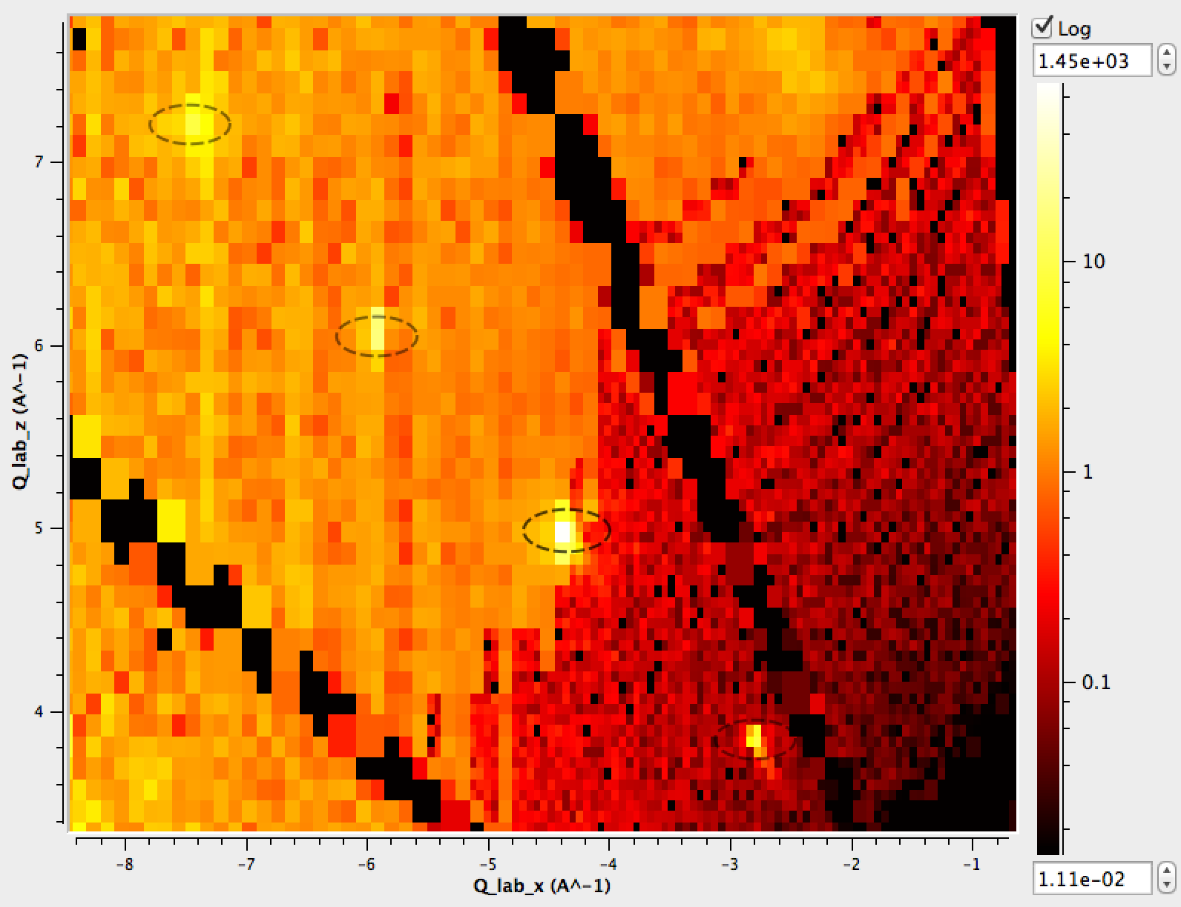
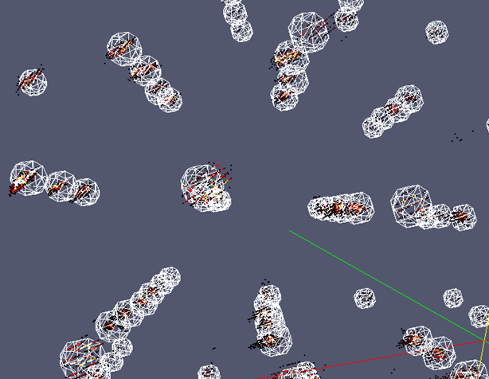
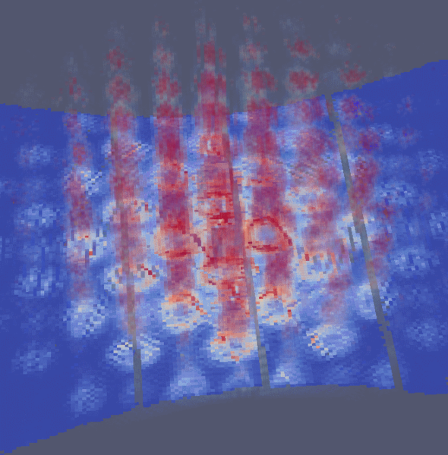
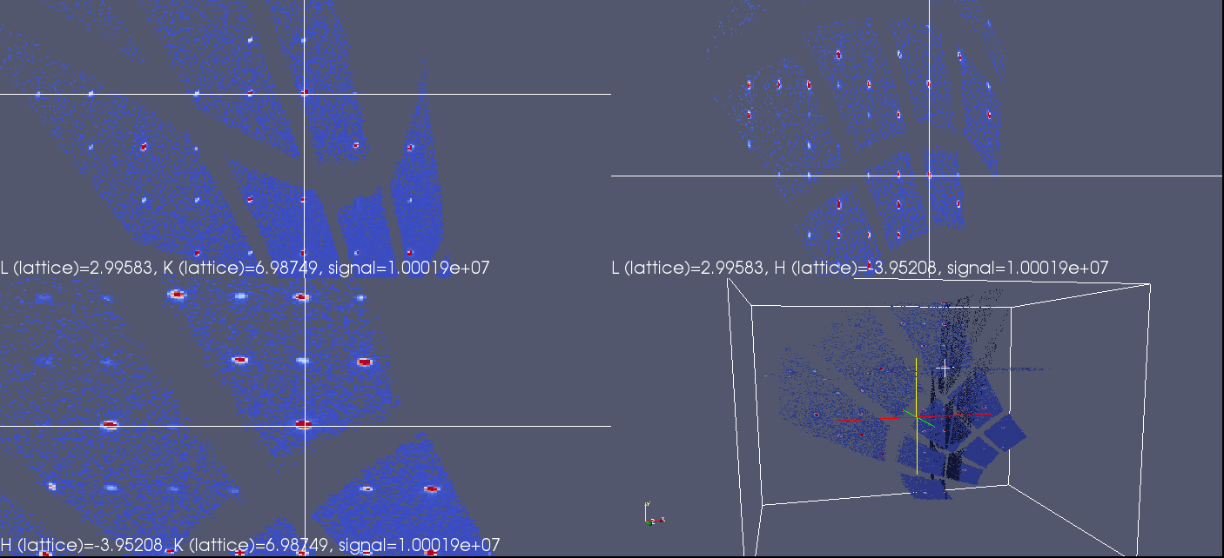
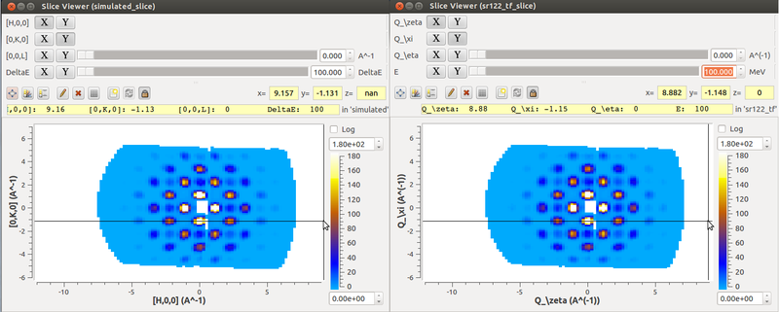
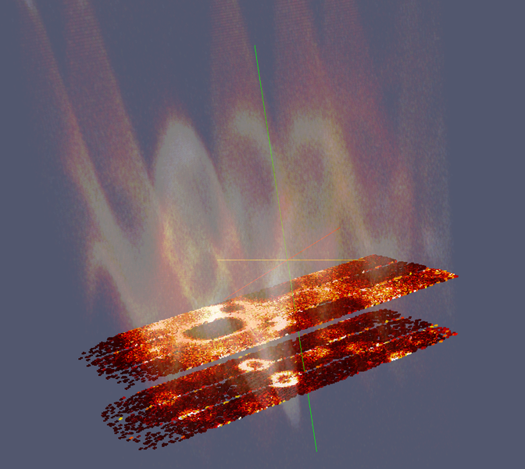
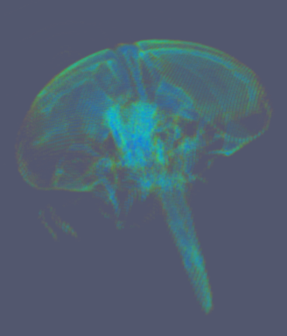
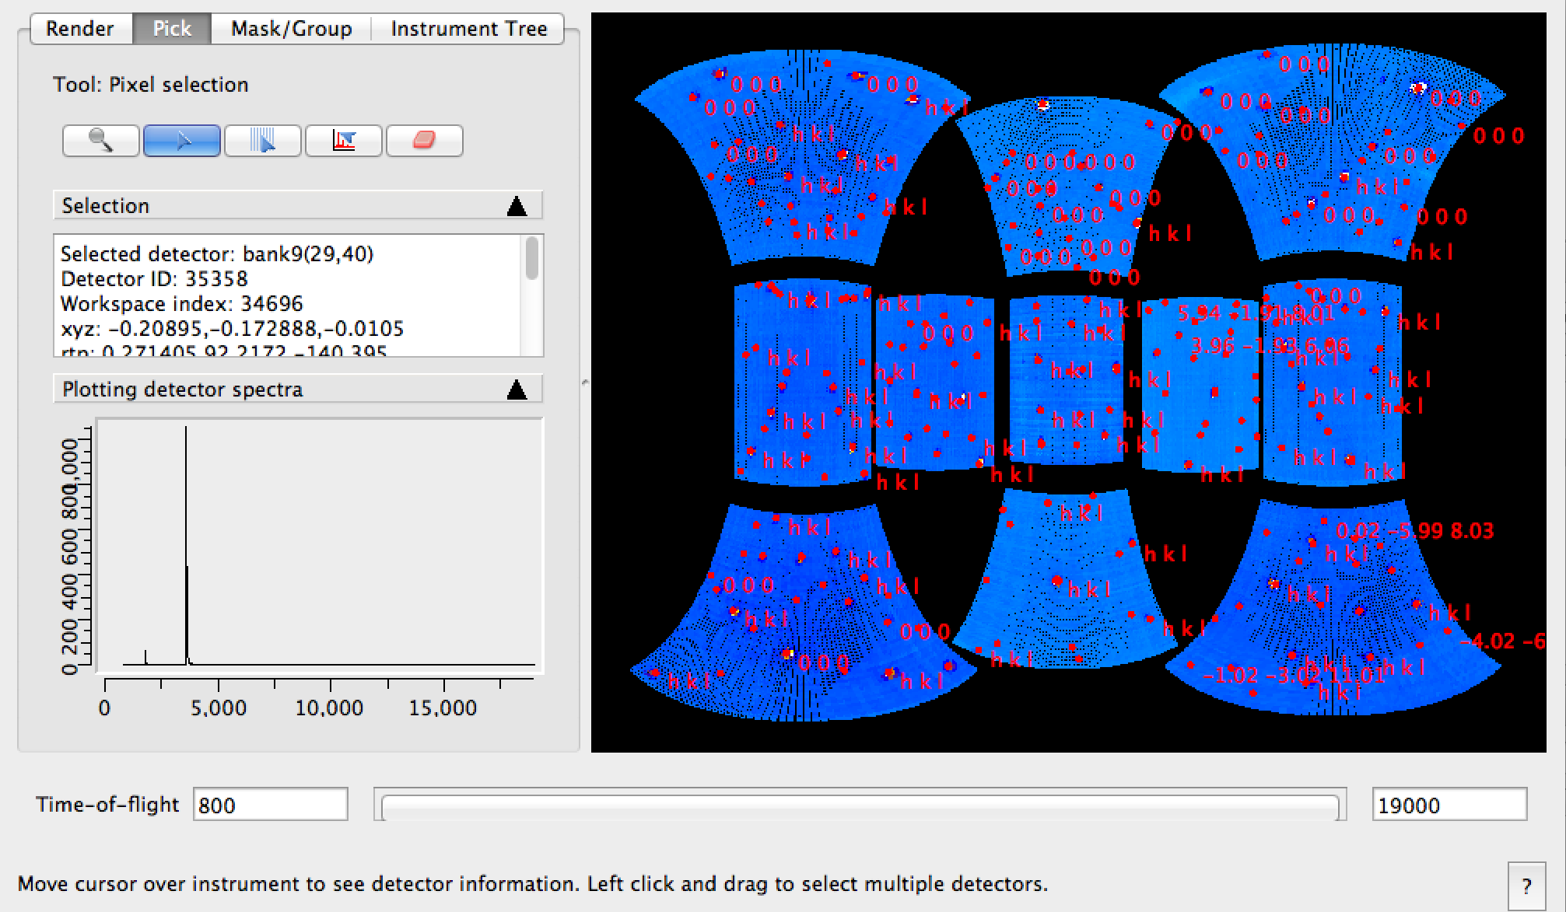
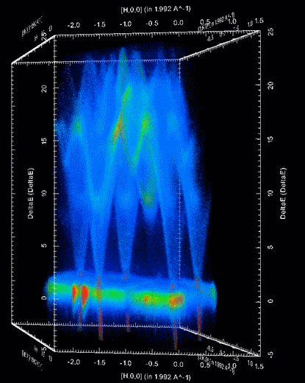




Mantid/VATES: Software for advanced visualisation and quantification of neutron scattering data
Owen Arnold¹, Michael Reuter³, Alex Buts², Andrei Savici³, Martyn Gigg¹, Janik Zikovsky³, Dennis Mikkelson³, Ruth Mikkelson³,
Vickie Lynch³, Roman Tolchenov¹, Peter Peterson³, Stuart Campbell³, Toby Perring², Nick Draper¹
¹ Tessella, Abingdon, Oxfordshire, UK
² STFC Rutherford Appleton Laboratory, Oxfordshire, UK
³ Oak Ridge National Laboratory, Oak Ridge, Tennessee, USA
Background Increasingly, to build a full understanding of the materials of interest to solid state physics, chemistry and materials research, requires the complete mapping of data in an n-dimensional manifold. The VATES project (Visualisation and Analysis Toolkit ExensionS) delivers advanced tools for visualisation and analysis of large neutron scattering datasets. The project is an international collaboration between ISIS at RAL and the SNS at Oak Ridge. Frameworks The VATES project has been developed in parallel to the Mantid Framework. Mantid is an extensible framework for neutron and muon data reduction and analysis¹. The Mantid framework is mature and deployed on approximately 40 instruments at 3 facilities. For n-dimensional visualisation, the VATES project uses ParaView², an advanced VTK based visualisation engine. In brief, the VATES project binds Mantid to ParaView via the introduction of multidimensional data structures and algorithms. In addition, we utilise ParaView’s plugin mechanism to provide customised tools for neutron scattering. We also deliver two-way interaction between ParaView and Mantid so that users can visually drive the data reduction and analysis process. Interactive visualisation, and indeed analysis in general, of large, n-dimensional, sparse datasets provided a considerable challenge. This has required engineering and innovations on both the Mantid and ParaView sides of VATES. Single Crystal Diffraction A key hurdle is the ability to identify peaks, which we can do automatically. We use a hierarchical, recursive data structure, to store our n-dimensional data, which is particularly effective, as it gives higher resolution in the regions of the Bragg peaks at an overall low memory cost. UB matrix finding and optimisation functions are now well established. We have adapted, and built upon concepts from the ISAW³ framework using specialist knowledge from that team. Work in this area is on-going, for example, we have recently extended the workflow options to include elliptical peak integration and sample placement optimisation. Almost all aspects of this workflow have been developed as part of the VATES project. The workflow is very flexible, with options for manual intervention, visualisation of algorithmic results, as well as a range of alternative functions should the default not be suitable. We have even started running multi-threaded algorithms on the fly as part of the interactive Slice Viewer modes to give very fast 2D slices through single crystal data. Putting VATES to the test; our users challenged us to accurately determine the lattice parameters of a single crystal sample analyzed on SXD at ISIS. Just a few lines of code are required to complete the full analysis (see below). A publication involving ISIS used these features for all the data processing⁴. Detector-space peak picking and visualisation tools. NaCl sample measured on SXD. Indexed peaks over a flattened spherical projection of SXD. | The toolset is common to both the SNS and ISIS. Results of analysis TOPAZ, WISH and SXD data form part of our automated test suite and are scheduled for execution several times a day. Inelastic Workflows The inelastic workflows have hinged on the ability to represent n-dimensional data. The inelastic analysis workflow begins by taking raw data, S(φ, TOF) and converting it into S(φ, E) using a standard methodology implemented in the Mantid code base. Once the inelastic data is reduced to S(φ, E), it is necessary to convert the data to other coordinates for analysis. Typical examples are S(Q, E), S(Q, E) or S(H, K, L, E). The VATES project provides a single conversion function that can handle these transformations as well as providing the capability for other multidimensional transformations. Transformations along different viewing axes are easily handled by this function. In a typical workflow, the converted data is placed on a regular grid for further analysis. This binning capability is again provided by the VATES project and allows for both axis-aligned and non-axis aligned binning. The binning capability is used to produce the desired cuts (1D) and slices (2D) from the data. Visualisation for cuts and slices are provided by the Slice Viewer from the VATES project. The Slice Viewer allows for easy exploration of the data looking for interesting cuts and/or slices for further analysis. The VATES Simple Interface (VSI) extends this capability to 3D and 4D views of the data. The VSI can be used to browse the data in higher dimensionality, but provides a mechanism for pulling up interesting views in the Slice Viewer for more detailed study. The cuts and slices can then be fit to the various physical models to extract analytical values for the phenomenon under study. | Simulation and Fitting Slices from simulation of MERLIN instrument resolution convolved with a Strontrium122 foreground model using Mantid (left) & TobyFit (right). The horizontal line shows the expected alignment of the peaks given that the sample itself was misaligned. Future From the outset, we planned to fully roll VATES into the Mantid project when it was suitably mature, in order to take advantage of the shared maintenance effort. Since 2012, we have been shipping Mantid and VATES in a single package. Increasingly, we have seen innovation intended for the VATES project filtering into the mainstream Mantid project. Our current long-term objectives include developing the downstream simulation and fitting features. Equally as important, is aiding our users through the process of building their analysis workflows using the new tools, and extending the tools on both the visualisation and analysis side where needed. In the medium-term we will extend the range of our scriptability, and implement a HORACE style syntax for high-level control. Both Mantid and VATES are being actively developed. Frequent meetings with instrument scientists continue to provide a steady stream of additional requirements and challenges. Continuous application of specialist knowledge and development effort from ISIS, the SNS and Tessella will be used to meet these challenges. Left shows slices through Spin Waves in Gd measured on SEQUOIA. Right shows VSI volumetric plot of a fly head. References [1] www.mantidroject.org [2] www.paraview.org [3] Worlton, T. G., Bouzek, C., Chatterjee, A., Hammonds, J.P., Mikkelson, D.J., Mikkelson, R.L., Miller, M., Peterson, P.F. and Serum B. (2004) New Software for Neutron Scattering Data Visualization. Neutron News 15(3), 14-15. [4] O. Young, A. R. Wildes, P. Manuel, et al. (2013). Highly frustrated magnetism in SrHo 2O 4: Coexistence of two types of short-range orders. Advance online publication. http://arxiv.org/abs/1306.1762 [5] horace.isis.rl.ac.uk [6] www.ncnr.nist.gov/dave [7] tobyfilt.isis.rl.ac.uk
Our work thus far has been based on TobyFit⁷, which is a program for simulation and least squared fitting of single crystal neutron diffraction data.
The quantification aspects of the Mantid/VATES framework allow both simulation and fitting of multi-dimensional scattering data. The framework allows resolution, foreground & background models to be completely customized to those required by the type of experiment that the fit is aiming to reproduce.
Left: Slice through an multi-dimensional workspace in Q-lab. Algorithmic output fed into visualisation to show spherically integrated regions. Right: 3D representation of integration regions with Bragg peaks in Qlab. Both from cublic NaCl on SXD.
Simulation of MERLIN instrument resolution convolved with a Strontrium122 foreground model using Mantid. Visualised using our ParaView plugins combining volumentric plot with a 2D projection.
Orthogonal HKL visualisation of Triphylite Crystal analyzed on TOPAZ. Visualisation using a 3-slice mode on the VATES Simple Interface.
Combination of n-dimensional across many runs leads to massive data volumes, so both algorithm performance, and data compression issues have been critical.
We have built upon the experience gained from HORACE⁵ and DAVE⁶ in this area of VATES.
A non-orthogonal 3D projection of Spin Waves in Gd as measured on SEQUOIA.

