Slide 1
Future of MD workspaces
Andrei Savici (ORNL)

Slide 2
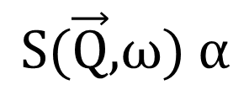
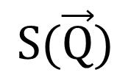
What do we want?
Inelastic
$$\text{S}\text{(}\vec{\text{Q}}\text{,}\text{ω}\text{) }\text{α}$$
Diffraction
$$\text{S}\text{(}\vec{\text{Q}}\text{)}$$

Slide 3
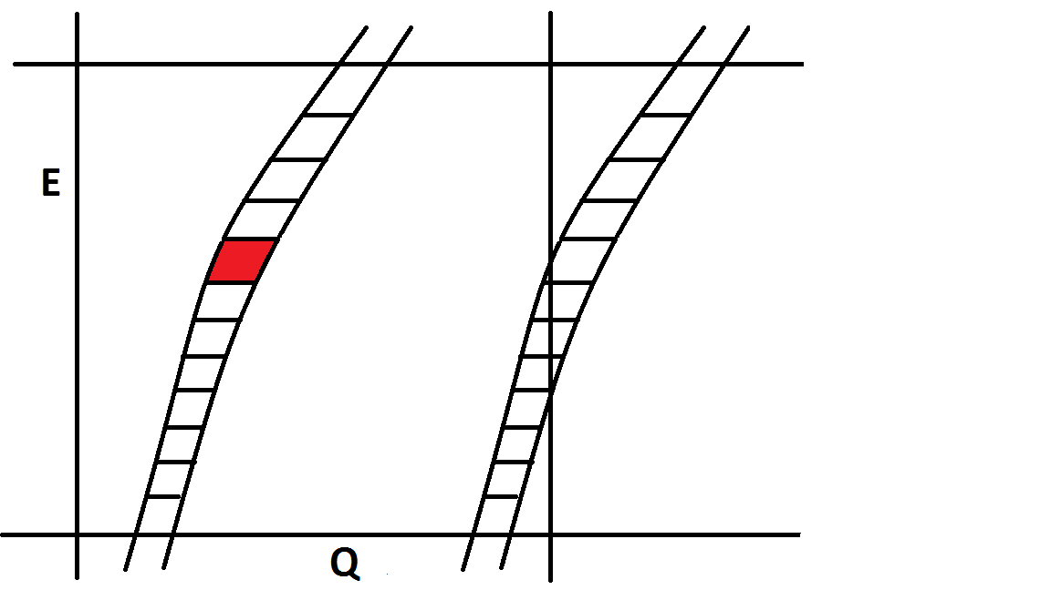
Mslice/Horace

Slide 4
Mslice/Horace
Problems:
Assumes all detectors have the same solid angle
Assumes same flux for all trajectories
Relies on energy bins being small
For inelastic scattering, most energy bins are 0
Weighted runs
Implemented in Mslice only for powder and single crystal, single orientation, not implemented in Horace/Mantid

Slide 5
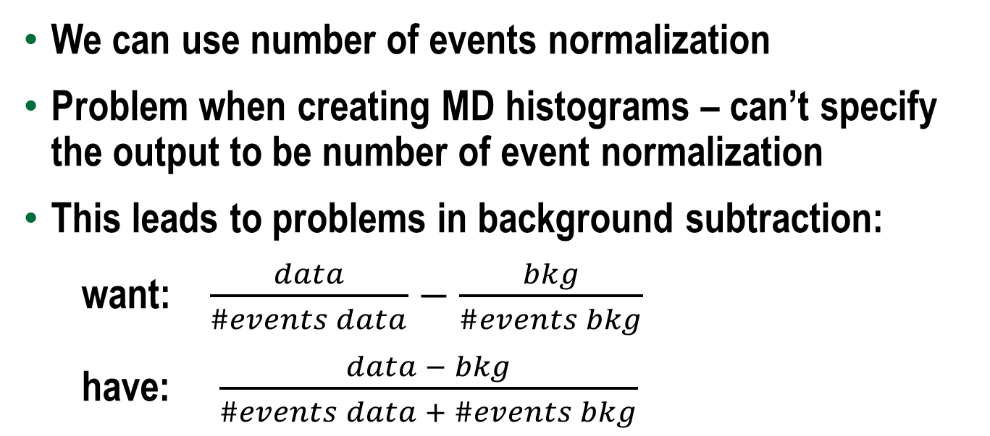
Mantid implementation
We can use number of events normalization
Problem when creating MD histograms – can’t specify the output to be number of event normalization
This leads to problems in background subtraction:
want: $\frac{data}{\#events data}−$ $\frac{bkg}{\#events bkg}$
have: $\frac{data − bkg}{\#events data + \#events bkg}$

Slide 6
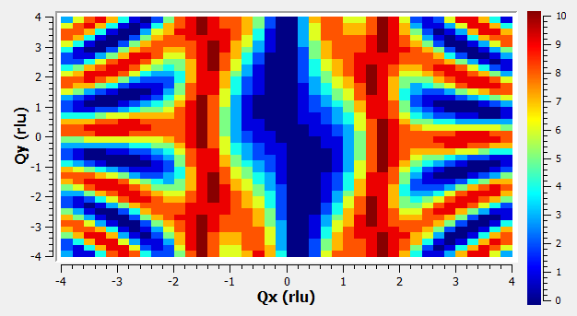
Mantid MDEventWorkspace
Physics

Slide 7
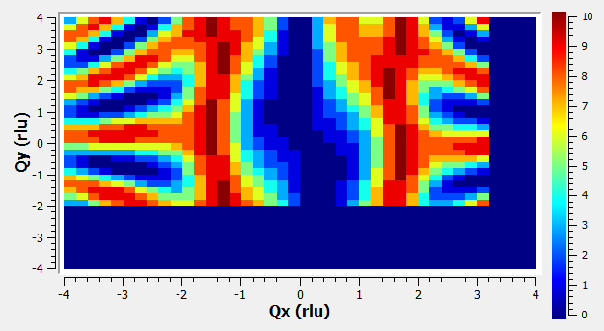
Mantid MDEventWorkspace
Measurement1

Slide 8
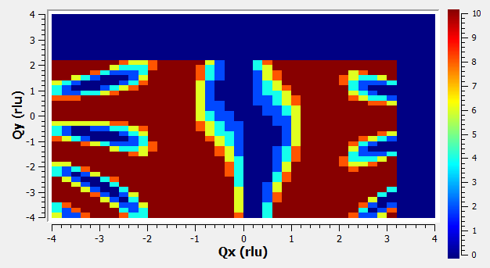
Mantid MDEventWorkspace
Measurement2 (twice as long)

Slide 9
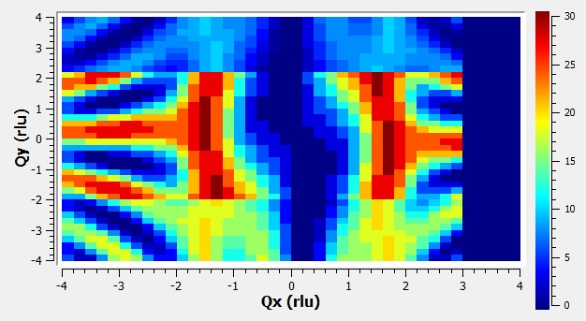
Mantid MDEventWorkspace
Measurement1+Measurement2

Slide 10
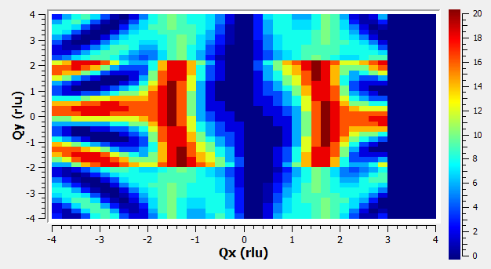
Mantid MDEventWorkspace
Measurement1+0.5Measurement2

Slide 11
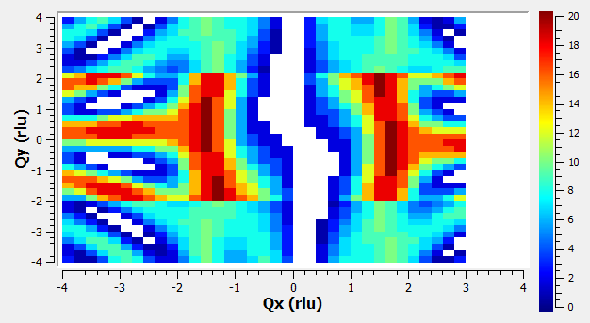
Mantid MDEventWorkspace
Zero – no events or cannot measure?

Slide 12
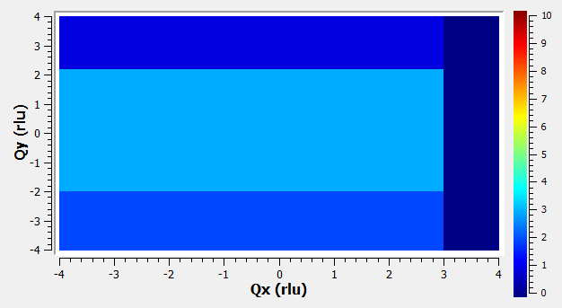
Mantid MDEventWorkspace
Weight
1
3
0
2

Slide 13
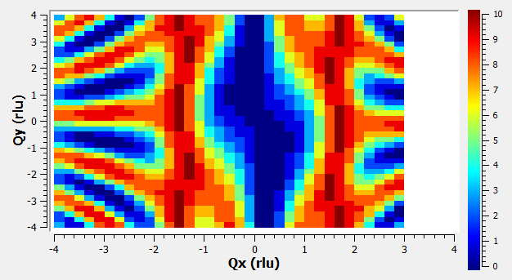
Mantid MDEventWorkspace
(Measurement1+Measurement2)/Weight
0
NAN

Slide 14
Weight problems
For inelastic: carry around a lot of zeroes
For diffraction: fake vanadium data for every orientation, scaled to incident flux (to be proven)
Both are memory intensive

Slide 15
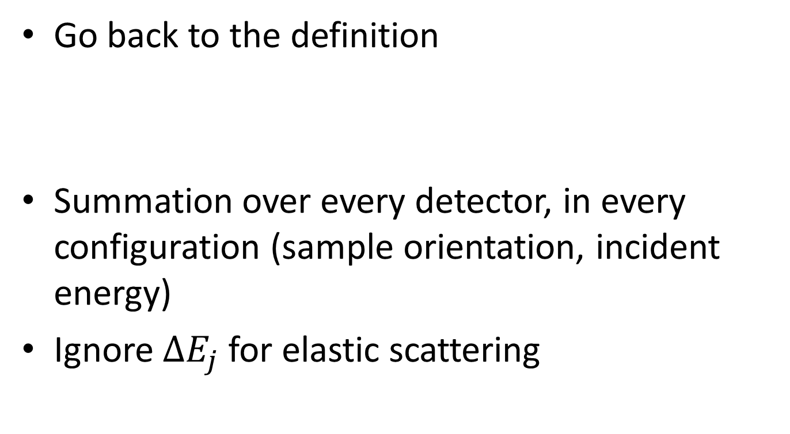
Weights, the correct way
Go back to the definition
Summation over every detector, in every configuration (sample orientation, incident energy)
Ignore $∆E_{j}$ for elastic scattering
Weight

Slide 16
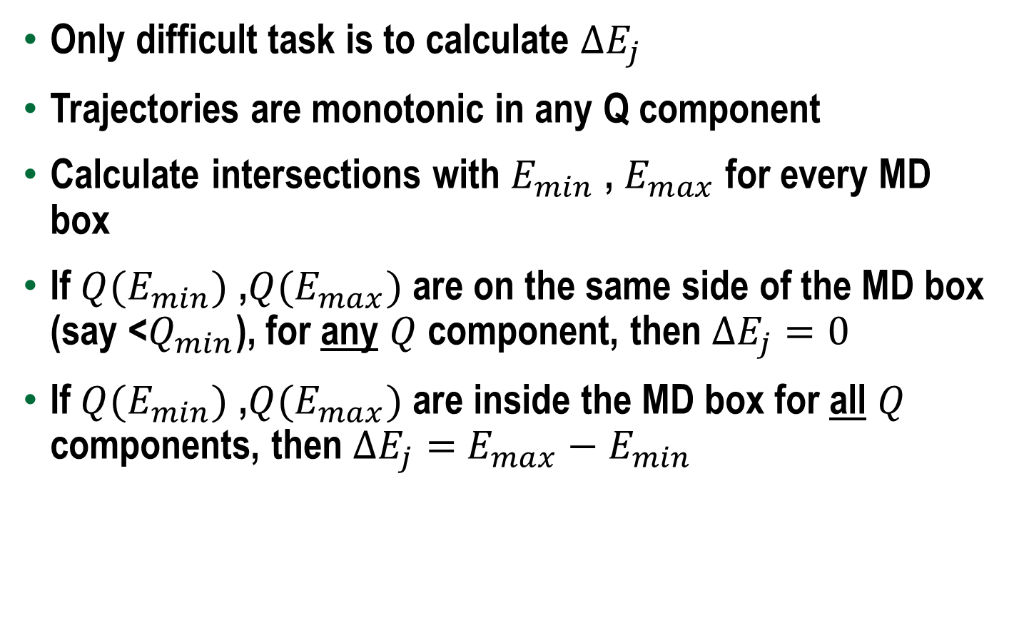
Direct inelastic
Only difficult task is to calculate $∆E_{j}$
Trajectories are monotonic in any Q component
Calculate intersections with $E_{min}$ , $E_{max}$ for every MD box
If ${Q(E}_{min})$ ,${Q(E}_{max})$ are on the same side of the MD box (say <$Q_{min}$), for any $Q$ component, then $∆E_{j}=0$
If ${Q(E}_{min})$ ,${Q(E}_{max})$ are inside the MD box for all $Q$ components, then $∆E_{j}=$ $E_{max}−E_{min}$

Slide 17
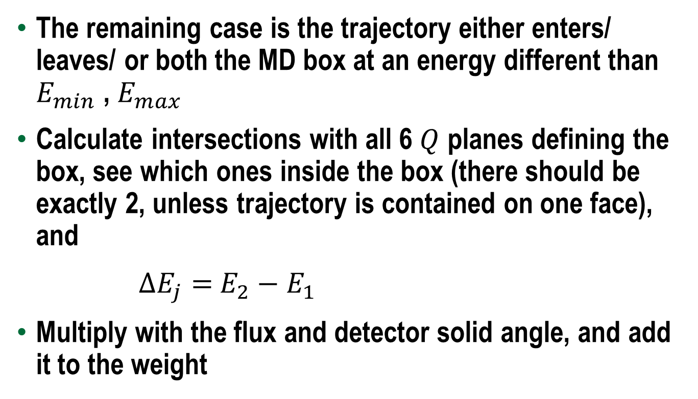
Direct inelastic
The remaining case is the trajectory either enters/ leaves/ or both the MD box at an energy different than $E_{min}$ , $E_{max}$
Calculate intersections with all 6 $Q$ planes defining the box, see which ones inside the box (there should be exactly 2, unless trajectory is contained on one face), and
$∆E_{j}=$ $E_{2}−E_{1}$
Multiply with the flux and detector solid angle, and add it to the weight

Slide 18
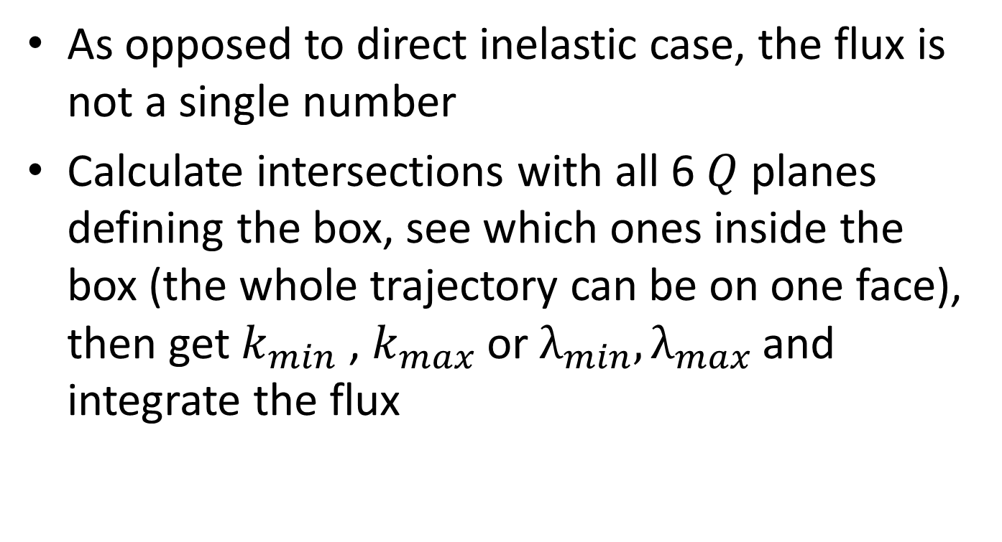
Diffraction
As opposed to direct inelastic case, the flux is not a single number
Calculate intersections with all 6 $Q$ planes defining the box, see which ones inside the box (the whole trajectory can be on one face), then get $k_{min}$ , $k_{max}$ or $λ_{min}, λ_{max }$and integrate the flux

Slide 19
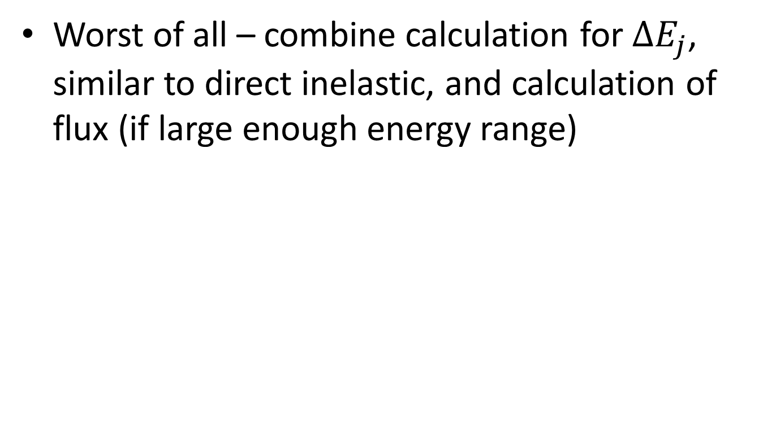
Indirect inelastic
Worst of all – combine calculation for $∆E_{j}$, similar to direct inelastic, and calculation of flux (if large enough energy range)

Slide 20
Advantages of this approach
Right thing to do
Less memory
Histogram representation will forget about any normalization – subtracting background is now natural
More computation power needed, but can be parallelized
Note: vanadium integration for SC is just one spectrum

Slide 21
Next steps
Check if the SC multiple fake vanadium approach works
Detailed design document
Check calculations for Direct Inelastic compared to Mslice/Horace
Check Single Crystal diffraction approach
Think about detector efficiency (does it enter into the weight or into #of counts)
Think if this approach is correct for structure factor or for scattering cross section
Dynamic binning using weight, not number of events

