Slide 1
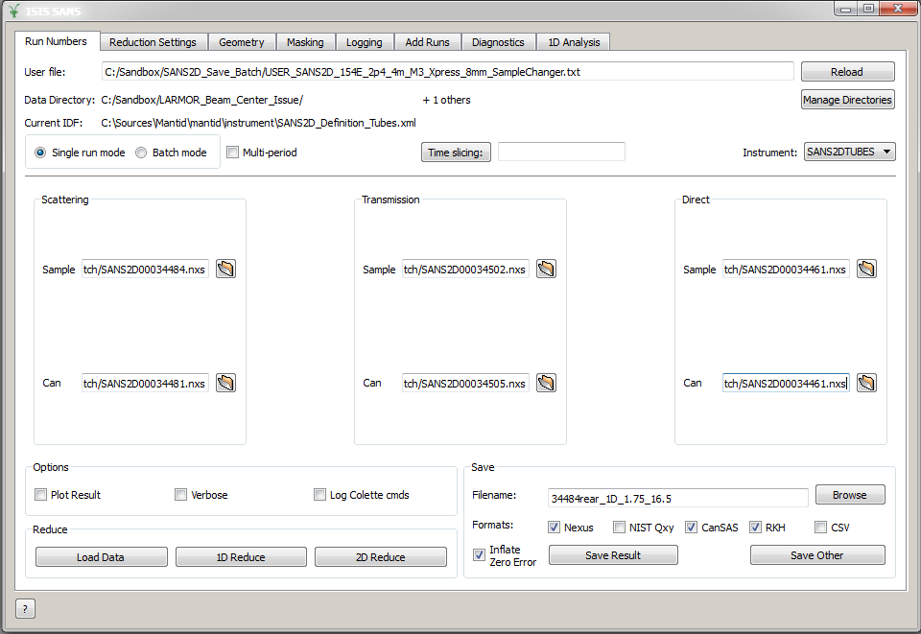
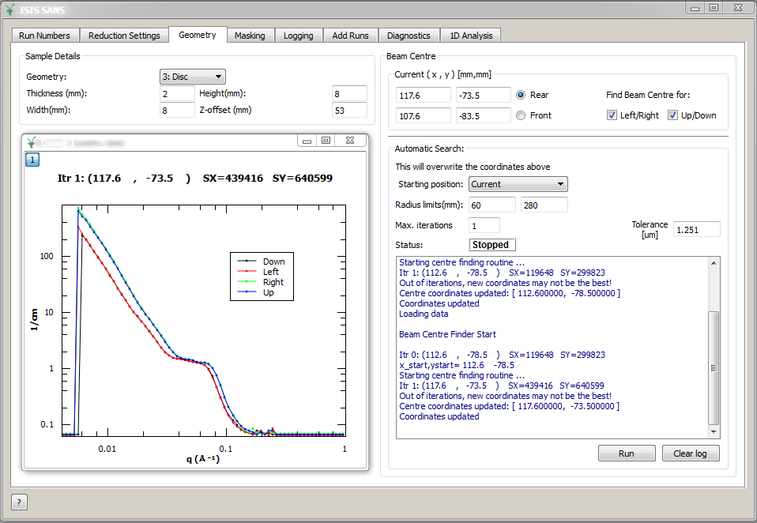
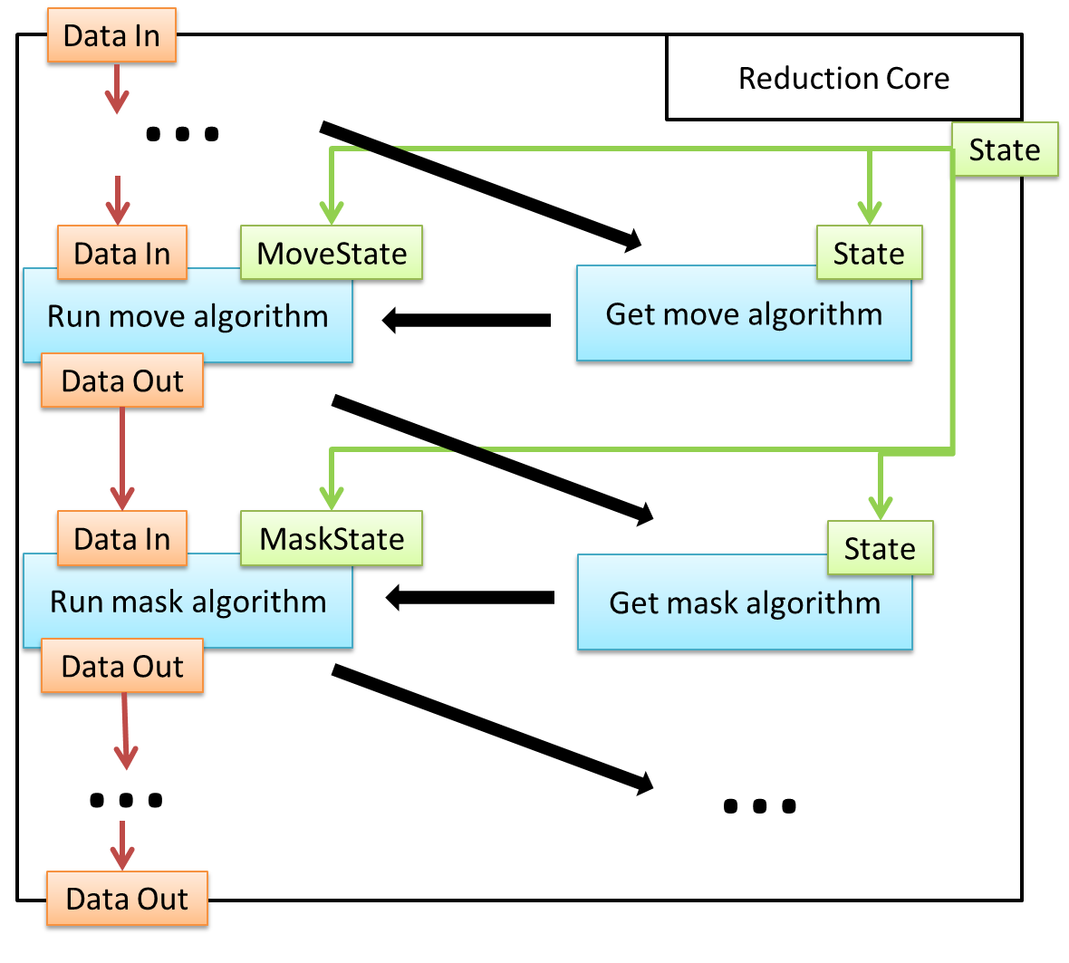
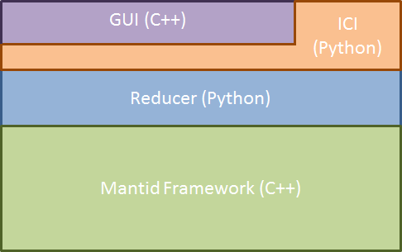
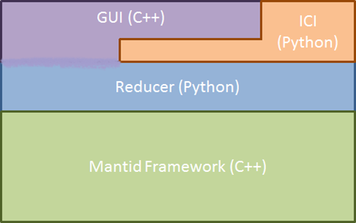
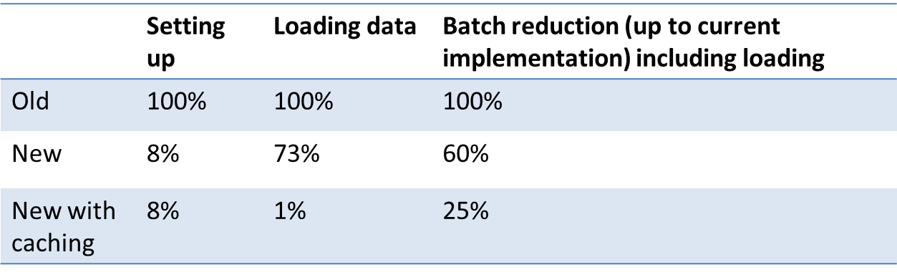





ISIS SANS Data Reduction 2.0
Anton Piccardo-Selg², Martyn Gigg², Nick Draper², Owen Arnold², Stephen King¹
¹ ISIS Pulsed Neutron and Muon Source, Rutherford Appleton Laboratory, Science & Technology Facilities Council – STFC, Harwell Oxford, OX11 0QX, UK
² Tessella, Abingdon, Oxfordshire, OX14 3YS, UK
Background SANS State |  | Workflow Algorithm Approach Data-driven algorithm selection Progress Performance
The Mantid Project’s software framework provides general support for visualisation and data reduction of neutron scattering and muon spin measurements. For several scientific areas, such as Small Angle Neutron Scattering (SANS), simple and efficient custom interfaces with tailored data reduction frameworks have been provided to allow users to analyse their data.
Workflow algorithms orchestrate a set of highly performant child algorithms (normally C++) and have been a standard way of implementing reduction chains and their sub-components in Mantid for a while now.
In the ISIS SANS 2.0 case they allow for:
easy mapping of legacy code to a set of adequate workflow algorithms.
one sub-state per algorithm approach. This enables the extension and modification of particular algorithm implementations and settings without interfering with the rest of the framework.
using established testing procedures in Mantid.
leveraging Mantid’s auto-generated documentation.
The customised reduction framework for ISIS SANS consists of:
a reduction backend which orchestrates the reduction and handles the reduction settings.
a user interface which provides access to single and batch reductions as well as diagnostic tools.
a Python interface to allow for a scriptable operation of the single or batch reductions.
convenience features such as a beam centre finder, adding content of SANS files, etc.
SANSState
ReductionCore
Each sub-state maps to exactly one workflow algorithm. This means that swapping the implementation of a workflow algorithm is a low-risk procedure. This approach also avoids the legacy code’s issue of having multiple, entirely unrelated entities of the reduction framework which configure and consume the same setting.
data: StateData
mask: StateMask
move: StateMove
slice : StateSlice
loader: SANSLoad
masker: SANSMask
mover: SANSMove
slicer : SANSSlice
…
…
The current user interface allows for single mode and batch reductions (above) and offers access to a range of custom tooling such as the Beam Centre Finder (right)
While the workflow algorithms allow us to create clearly defined units of work, we need them to be highly configurable in order to accommodate a range of currently supported instruments and potentially other facilities and instruments in the future. The user-specified data drives the creation of the adequate state object which fully determines the reduction configuration. This allows for adding functionality without having to change the core algorithm of the reduction.
Increased data volumes and demanding feature upgrades have revealed the limitations of the current approach. Some of the limitations are:
deep coupling between logic and GUI and very little separation of concerns.
virtually no unit tests (the deep coupling makes this very hard).
reduction settings are stored non-centrally and are mutable. Hard to know what the current state is (>100 settings). This leads to unnecessary data reloads.
integrating new facilities is hard due to the high coupling to facility-specific solutions.
little code documentation which makes maintainability difficult.
The original design saw for a clear separation of responsibilities (left) where the ISIS Command Interface (ICI) decoupled the reducer framework from the user interface. After many generations of developers the actual design has become highly coupled (right).
ISIS SANS instrument scientists have recently asked us to deliver a new data reduction framework which is more scalable, robust, and solves the performance issues of the current approach. In addition, they require a solution which allows other facilities to incorporate their custom data reduction easily into the same framework and interface.
The framework’s biggest bottleneck in terms of robustness and maintainability is the way it treats the reduction configuration. This can be solved by using a simple state object (SANSState) which stores the reduction-relevant information centrally and is immutable. The SANState approach is the corner stone of new design and has allowed us to significantly improve flexibility, robustness and performance.
Porting of the legacy reduction code is well under way and a large part of the old framework has already been translated and tested. Code optimisation is a priority and has been applied where possible.
The main performance gains are to be expected from caching already existing results and data. The lack of such caching is causing large performance overheads in the old reduction framework. So far, data reload has been cached. A further improvement is expected from caching reductions of background measurements.
self-validating
immutable
typed
serializable
easy to reason about
modular (sub-states for units of work)
Performance comparison of the old and new reduction framework. The test was performed using event-mode data up to and including the masking step. Note that the results are referenced to the legacy framework which is normalized to 100% of the time for a particular task. The third row made use of the caching feature.
StateMask
SANSState
- phi_min : float
- phi_max: float
- mask_files: list<string>
- mask: StateMask
- data: StateData
- move: StateMove
…
…
+ validate()
Summary of benefits:
Increased performance (caching; avoiding early conversion to histogram mode).
Reduced cost of maintenance (single responsibility design; modular approach).
Reduced development cost for additional features (self-consistent state-algorithm design).
High testability and reliability (workflow algorithms).
Removes black-box behaviour (clear documentation through workflow algorithms).
Possible adoption of other facilities (data-driven algorithm and configuration selection).
+ validate()
+ serialize()
…
+ serialize()
The state creation is handled via the builder pattern which allows us to have specialized directors that interface to the GUI and the Python interface. This approach allows for the simple integration of new configuration sources of other facilities (e.g. alternative GUI or configuration files).
The SANS State is made up of sub-states which contain information that can be easily converted into passive data structures.

