Slide 1

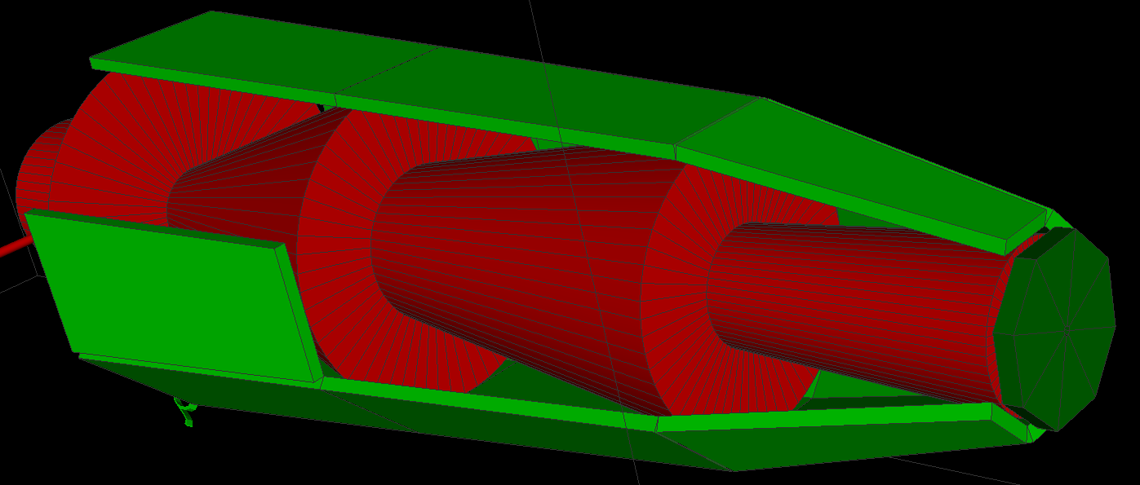
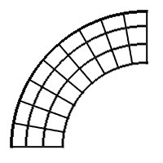
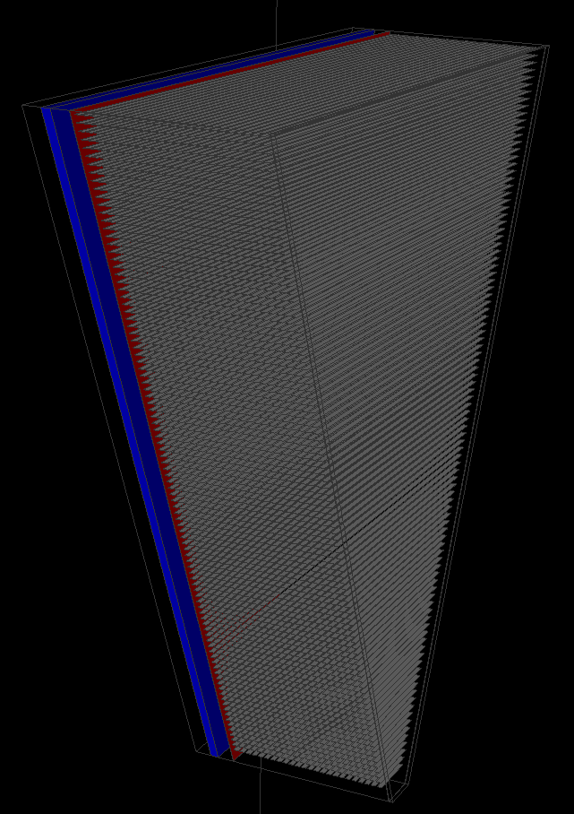
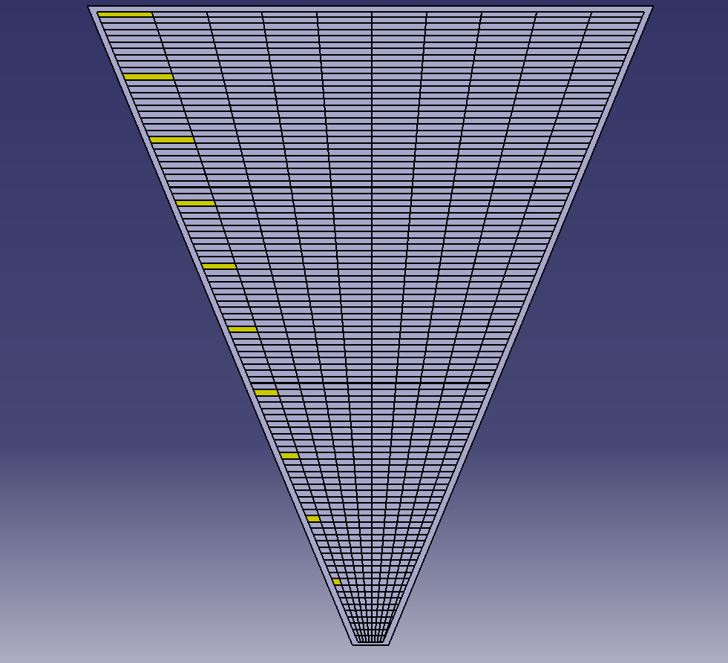
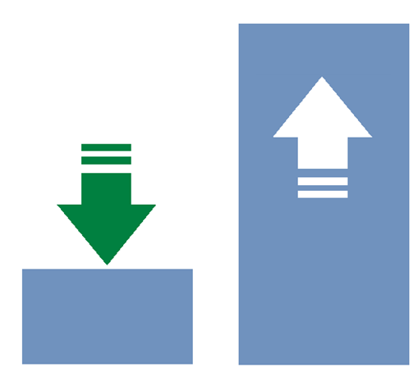
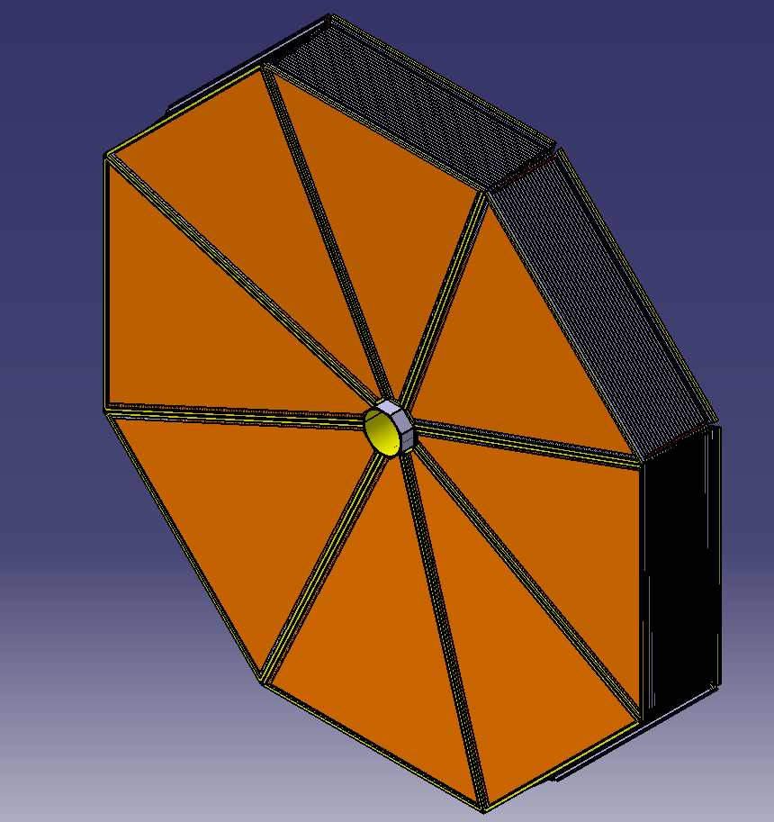
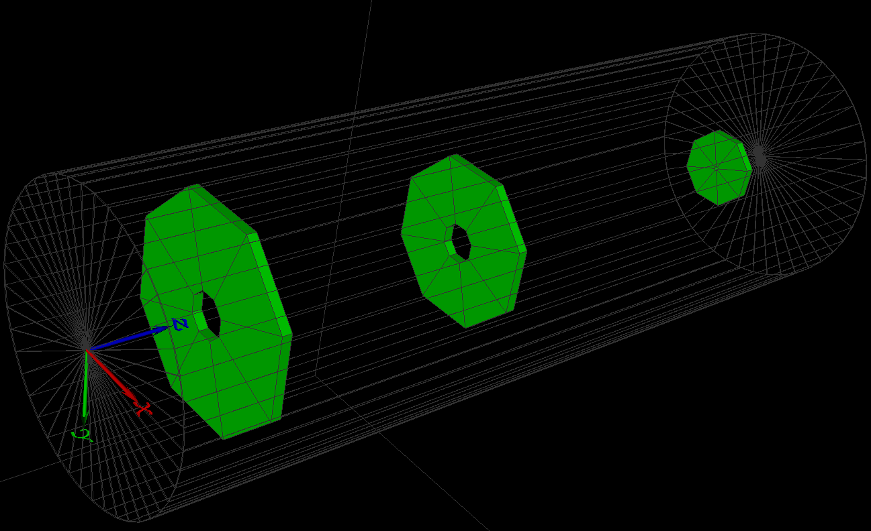
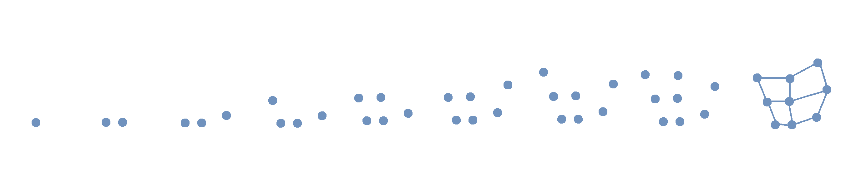

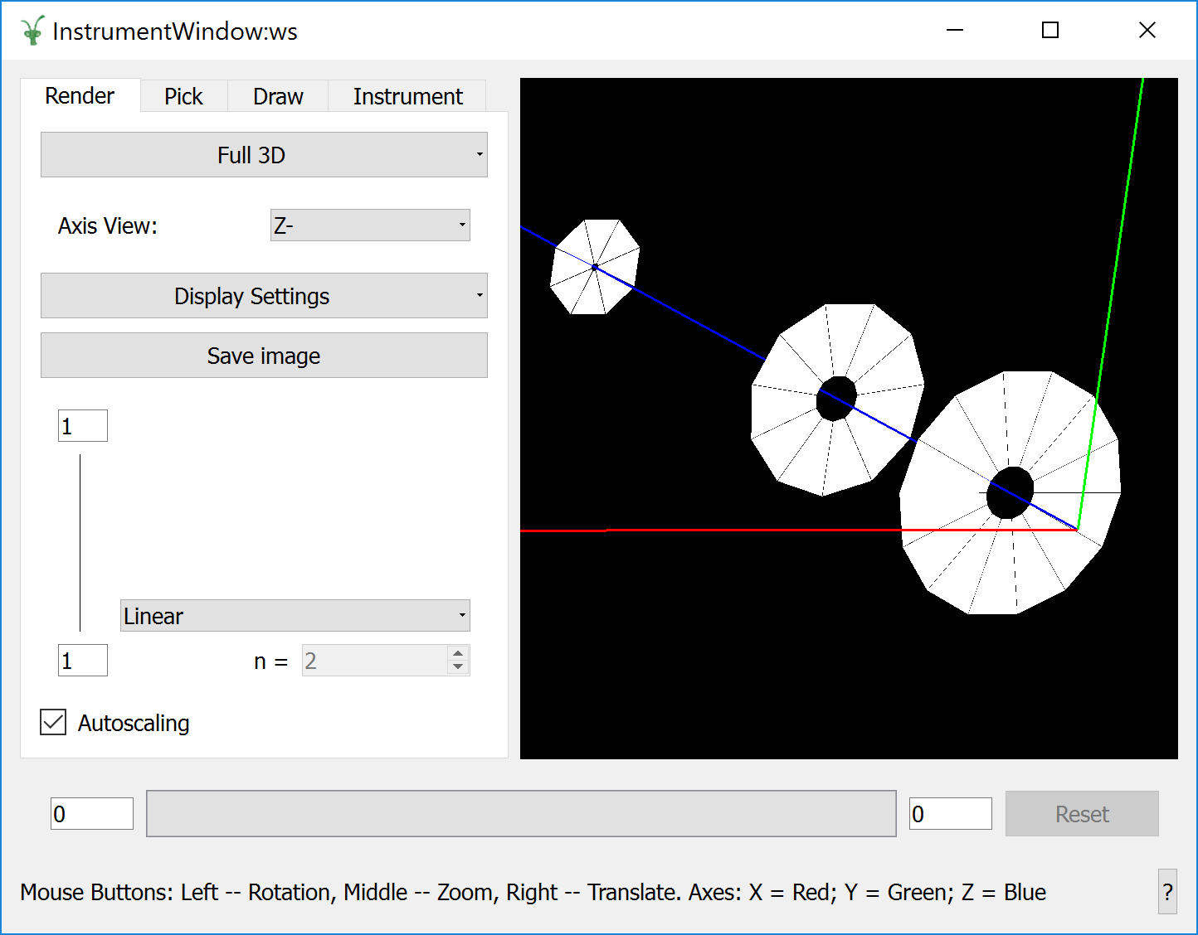
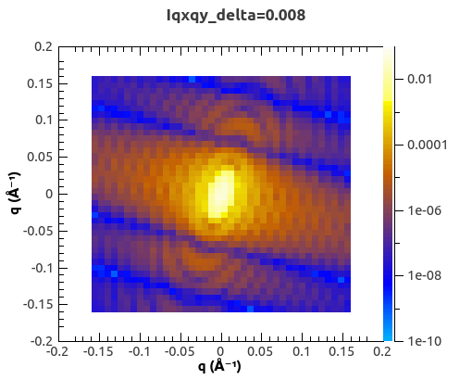
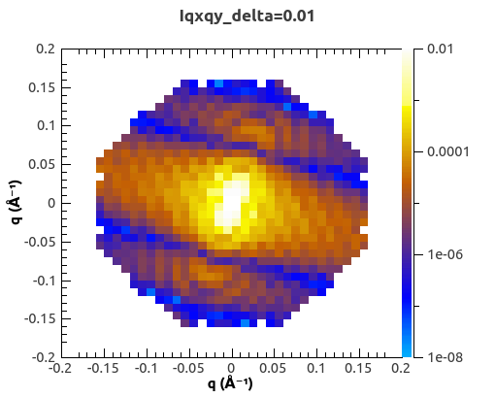
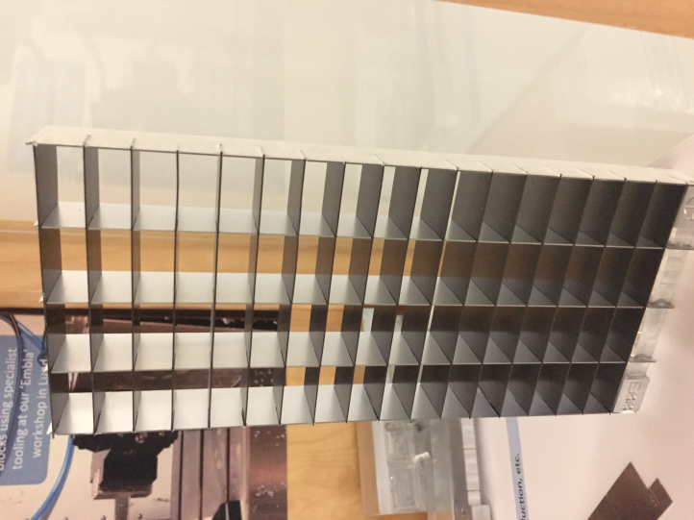
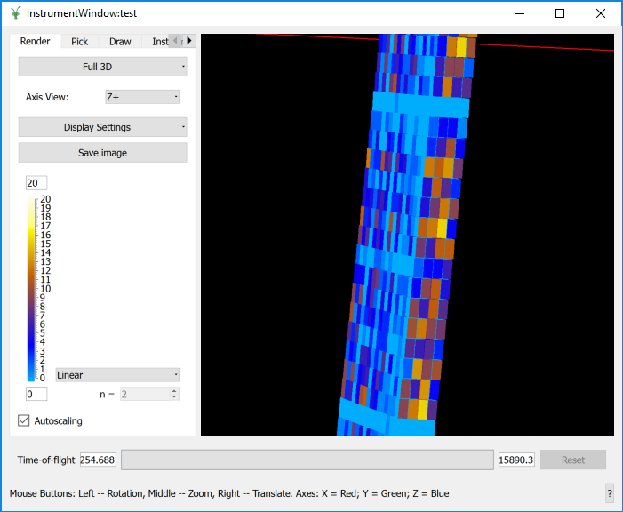
Data Reduction and Simulation for Novel
Detector Geometries in Mantid
Lamar Moore. Owen Arnold, Kelly Kanaki, Torben Nielson, John Taylor and Michael Hart
Introduction
The LOKI Challenge
The Mantid framework is the chosen platform for data reduction and instrument visualization of neutronic data for the ESS. Mantid abstracts geometry from the data itself which is a very useful feature. Geometry in Mantid is defined using
an xml format known as instrument definition files (IDFs) which provide a reusable method of storing instrument geometry independently of neutron data. Recent ESS designs and proposals for new types of instrument geometries have exposed a few core deficiencies in the way Mantid handles irregular geometries and depth. The LOKI instrument and Multi-Grid detector presented the most significant challenges as far as geometrical complexity to date.
The LOKI instrument, for boadband Small Angle Neutron Scattering experiments presented a major challenge for the current instrument visualization tool in Mantid which was unable to cope with the anticipated complexity of geometry presented by this instrument:
Results
A compact, mathematical approach was used to solve the performance issues related to the LOKI Geometry. This method allowed for the definition of geometrically regular yet topologically irregular grids. This new type is called the StructuredDetector.
The proposed physical design of LOKI is as follows:
Each detector panel contains
~500-1000 individual detectors.
Each detector is uniquely shaped.
There will be at most 8 sectors per detector bank.
With a maximum of 3 detector banks this means ~2700 total detectors.
StructuredDetector defined using regular array of vertices. Stride width and height are also provided to determine vertex winding order.
Individual detectors no longer needed to be defined in the file. They are dynamically constructed in memory.
File sizes reduced from 8MB to a few KB for the full LOKI definition resulting in much faster load times.
File load times reduced to ~2 seconds down from minutes for Structured Detector and legacy definition of LOKI.
8 MB
2 Secs
Initial tests with Mantid used naïve implementations of the IDF where each anode unit was defined separately. This resulted in numerous issues:
The resulting file contained >200,000 lines of XML for a single detector bank which made it impossible to read or write by hand.
Inefficient handling of irregular detector shapes in Mantid resulted in extremely slow load times on the order of minutes.
Once loaded, the instrument interface was extremely sluggish and impractical for further testing of the data reduction workflow.
73 KB
5 Mins
File Size
Load Speed
Vertex Winding Order
Several core improvements were made to Mantid which resulted in much faster handling of irregular geometries.
General improvements to the parsing of XML files including explicit handling of irregular geometries.
Introduced a hexahedral primitive instead of the pre-existing expensive triangulation for unknown irregular shapes.
Hexahedral primitves are rendered using OpenGL quads which complemented the vertex storage mode. Drawing effort reduced by a factor of 2.
The above performance issues raised questions about the suitability of the Mantid framework as a visualization tool. In order for Mantid to cope with such complex geometries, core improvements were required in order to more efficiently handle the definition of IDFs and memory representations of these virtual instruments.
Progress and Future Work
The detector group at the ESS are currently using the output of MCSTAS simulations to test the data reduction workflow in Mantid for the LOKI instrument.
Further work to improve compatibility between Mantid and MCSTAS must be undertaken in order to facilitate bi-directional geometry exports and explicit handling of irregular geometries.
References
The Multi-Grid Detector
[1] https://europeanspallationsource.se/data-management-and- software
[2] O. Arnold, et al., Mantid—Data analysis and visualization package for neutron scattering and μSR experiments, Nuclear Instruments and Methods in Physics Research Section A, Volume 764, 11 November 2014, Pages 156-166
[3] J. Birch, et al., In-beam test of the Boron-10 Multi-Grid neutron detector at the IN6 time-of-flight spectrometer at the ILL. Journal of Physics , Volume 528, 1.
[4] K. Lefmann and K. Nielsen, "McStas, a General Software Package for Neutron Ray-tracing Simulations", Neutron News 10, 20, (1999)
The Multi-Grid detector is a novel detector concept for time-of-flight (TOF) detection of thermal neutrons. The grid design facilitates 3-D detection of neutrons with the accuracy required for TOF experiments. Early attempts
at defining the geometry produce an inefficient scheme where each grid unit must be defined as a closed cube shape. Future efforts would move towards the creation of a detector type with a depth attribute. This would necessitate the inclusion of 2D data slices through the instrument view which is not currently supported.

