Slide 1
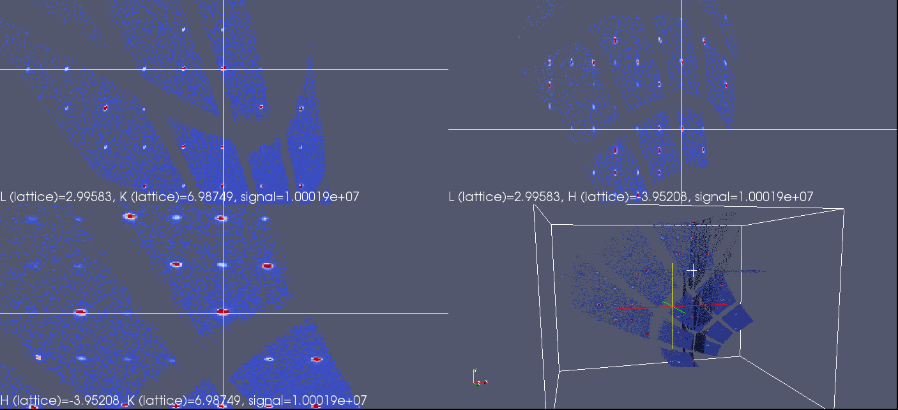
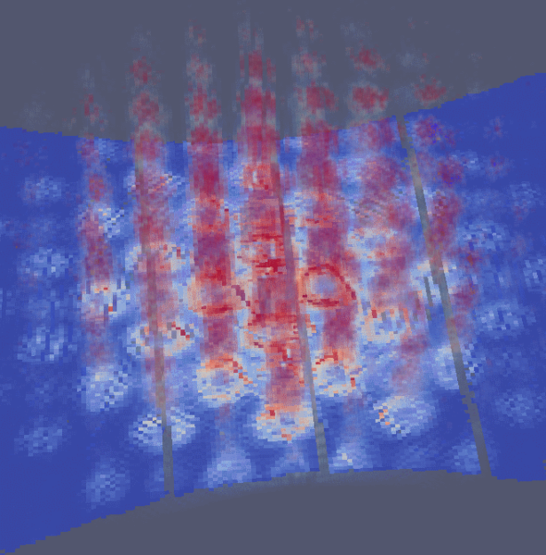
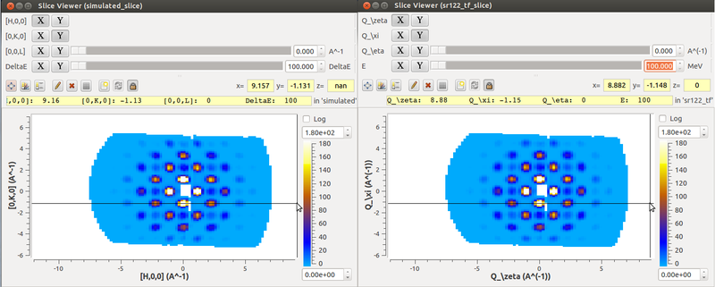
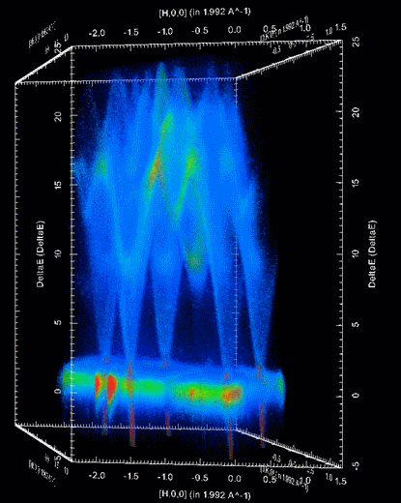
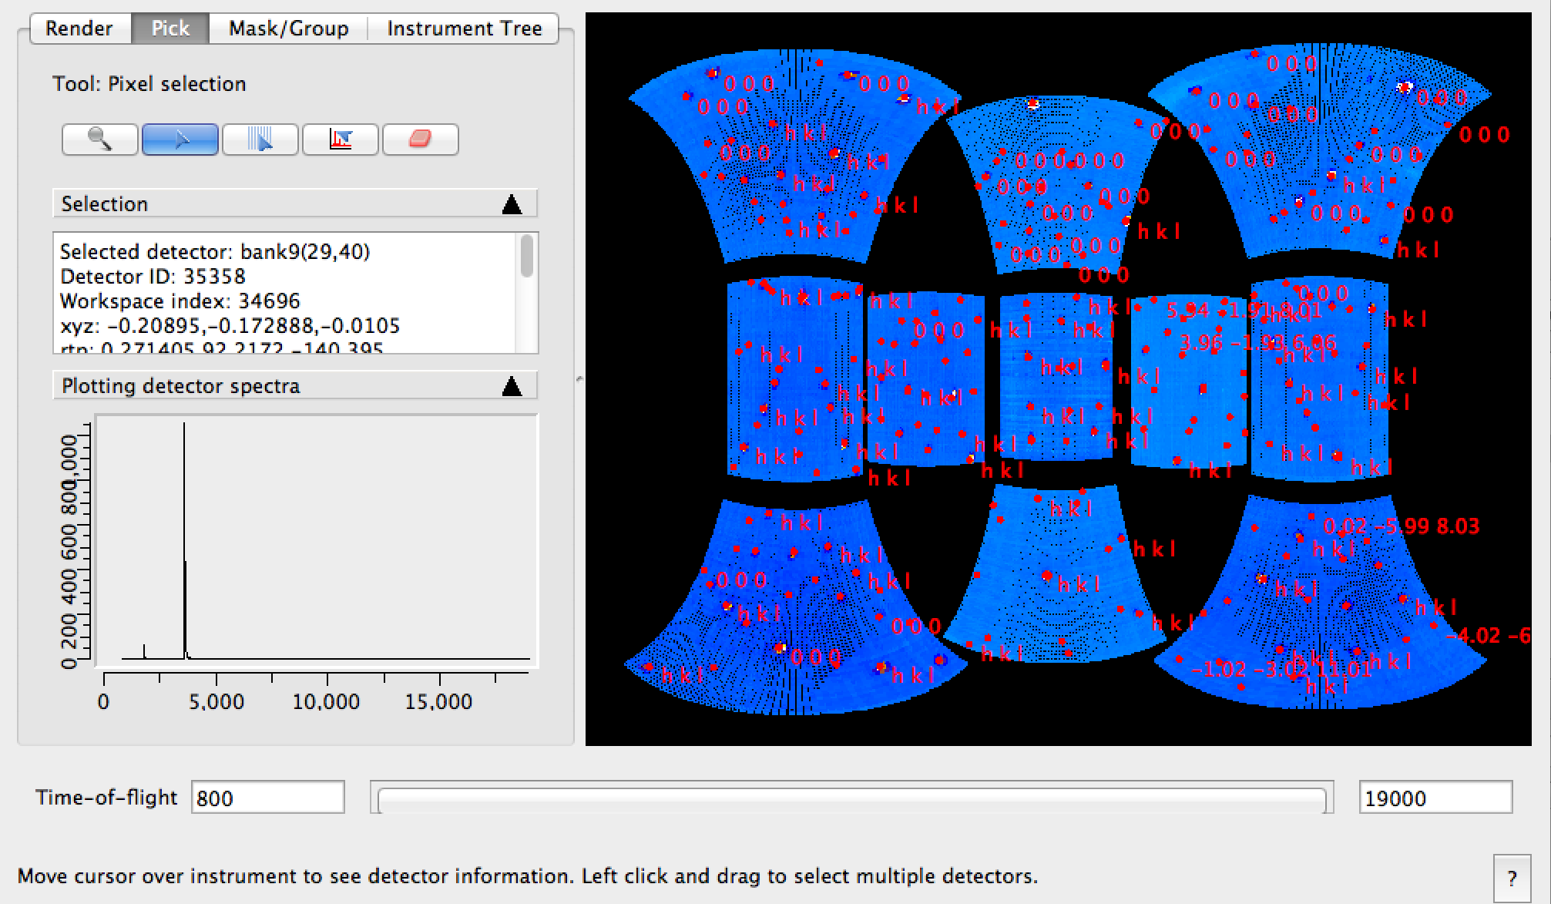
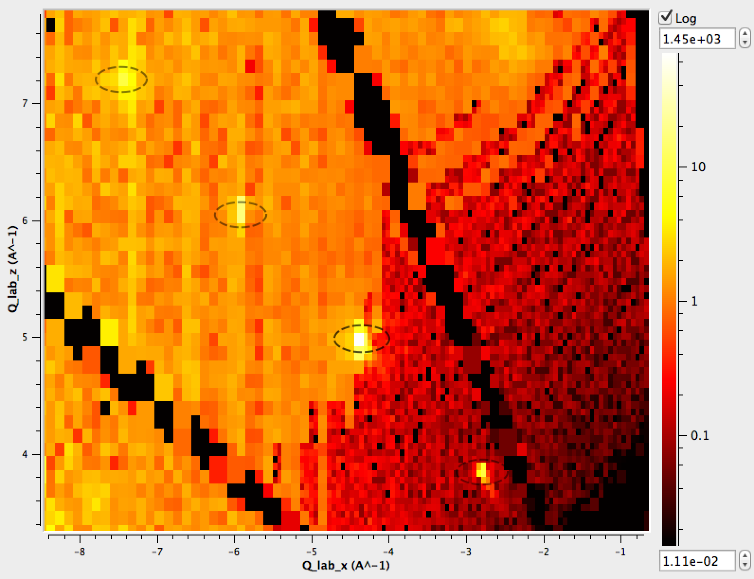
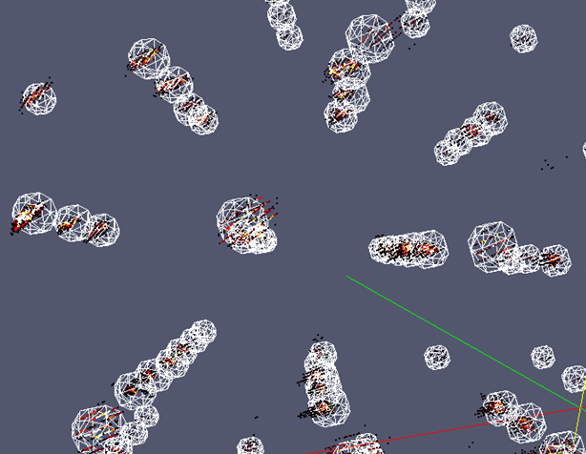




The Mantid Model VATES: Software for advanced visualization and quantification of neutron scattering data
Owen Arnold
Tessella, 26 The Quadrant, Abindon Science Park, Abingdon, Oxfordshire, OX14 3YS
Background Increasingly, to build a full understanding of the materials of interest to solid state physics, chemistry and materials research, requires the complete mapping of data in an n-dimensional manifold. The Vates project delivers advanced tools for visualisation and analysis of large neutron scattering datasets. The project is an international collaboration between ISIS at RAL and the SNS at Oakridge. Frameworks The Vates project has been developed in parallel to the Mantid Framework. Mantid is an extensible framework for neutron and muon data reduction and analysis¹. The mantid framework is mature and deployed on approximately [40] instruments at [3] facililities. For n-dimensional visualisation, the Vates project uses ParaView², an advanced VTK based visualisation engine. In brief, the Vates project binds Mantid to ParaView via the introduction of multidimensional data structures and algorithms. In addition, we utilise ParaView’s plugin mechanism to provide customised tools for neutron scattering. We also deliver two-way interaction between ParaView and Mantid so that users can visually drive the data reduction and analysis process. The Vates Simple Interface, is our customised front-end to the n-dimensional ParaView tools. It provides a minimalistic user interface, with key tools and representations ready at hand. The Slice Viewer provides very fast 2D projections through the n-dimensional data. We’ve equipped it with a suite of tools for working with 2D projections through n-dimensional data. Single Crystal Diffraction Strong involvement by both the SNS and ISIS on single crystal diffraction has driven the development of a entire suite of workflows, algorithms, and scripts. Putting Vates to the test; our users challenged us to accurately determine the lattice parameters of a single crystal sample analyzed on SXD at ISIS. Just a few lines of code are required to complete the full analysis. Detector-space peak picking and visualization tools. NaCl measured on SXD. Indexed peaks over a flattened spherical projection of SXD. Left: Slice through an multi-dimentional workspace in Q-lab. Algorithmic output fed into visualization to show spherically integrated regions. Right: 3D representation of integration regions with Bragg peaks in Qlab. Both from NaCL on SXD. | The toolset is common to both the SNS and ISIS. Results of analysis TOPAZ data from part of our automated test suite. Orthogonal HKL visualization of Triphylite Crystal analyzed on TOPAZ. Visualation using a 3-slice mode on the Vates Simple Interface. Direct Inelastic The inelastic workflows have hinged on the ability to represent n-dimensional data. Combination of n-dimensional across many runs leads to massive data volumes, so both algorithm performance, and data compression issues have been critical. We have spent several years collaborating with Kitware, to generalize their 3D visualisation tools. Three (plus) dimensional data can now be properly represented in our visualization tools A non-orthogonal 3D projection of Spin Waves in Gd as measured on SEQUOIA. | Simulation and Fitting Simulation of MERLIN instrument resolution convolved with a Strontrium122 foreground model using Mantid. Visualised using our ParaView plugins combining volumentric plot with a 2D projection. Slices from simulation of MERLIN instrument resolution convolved with a Strontrium122 foreground model using Mantid(left) & TobyFit(right). The horizontal line shows the expected alignment of the peaks given that the sample itself was misaligned. Future Work The Vates project started out in 2010 as an independent entity, utilising the core Mantid-Framework. From the outset, we planned to fully roll Vates into the Mantid project when it was suitably mature in order to take advantage of the shared maintenance effort. Since 2012, we have been shipping Mantid and Vates in a single package. Increasingly, we have seen innovation intended for the VATES project filtering into the mainstream Mantid project. Our current long term objective are to develop the downstream simulation and fitting features. Equally as important, is aiding our users through the process of building their analysis workflows using the new tools, and extending the tools on both the visualisation and analysis side where needed. Both Mantid and Vates are being actively developed. Frequent meetings with instrument scientists continue to provide a steady stream of additional requirements and challenges. Continuous specialist knowledge and development effort from ISIS, the SNS and Tessella will be used to meet these challenges. References [1] www.mantidroject.org [2] www.paraview.org [3] O. Young, A. R. Wildes, P. Manuel, et al. (2013). Highly frustrated magnetism in SrHo 2O 4: Coexistence of two types of short-range orders. Advance online publication. http://arxiv.org/abs/1306.1762 [4] tobyfilt.isis.rl.ac.uk
Our work thus far has been based on TobyFit⁴, which is program for simulation and least squared fitting of single crystal neutron diffraction data. Our framework allows the flexible addition of foreground and background models.

