Slide 1
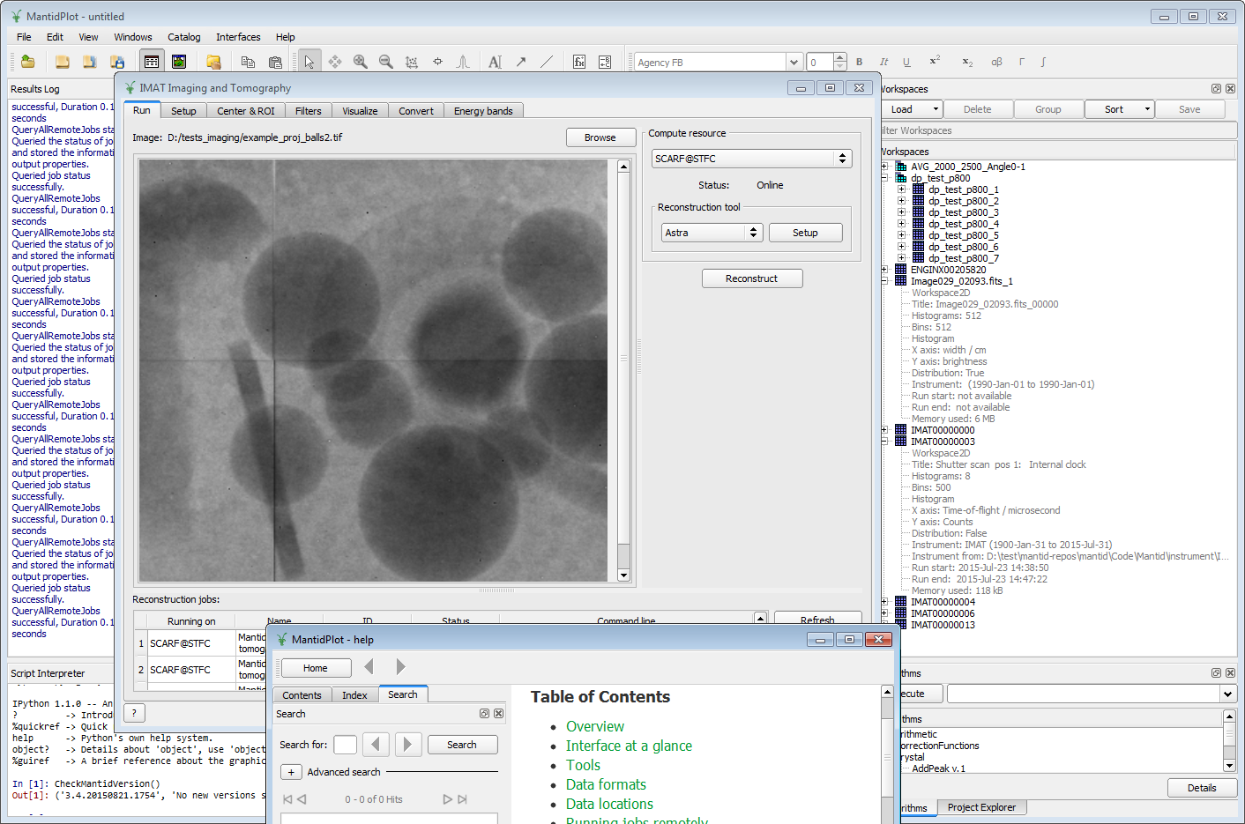
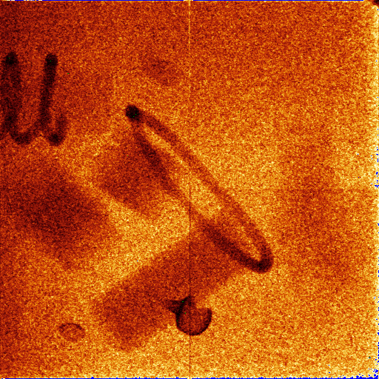
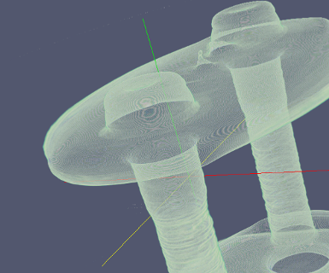
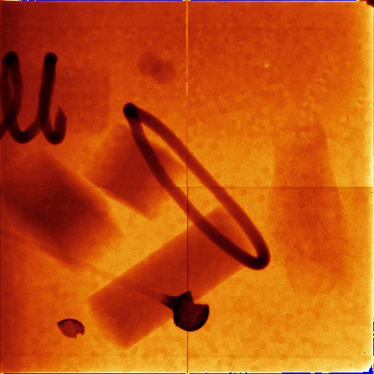
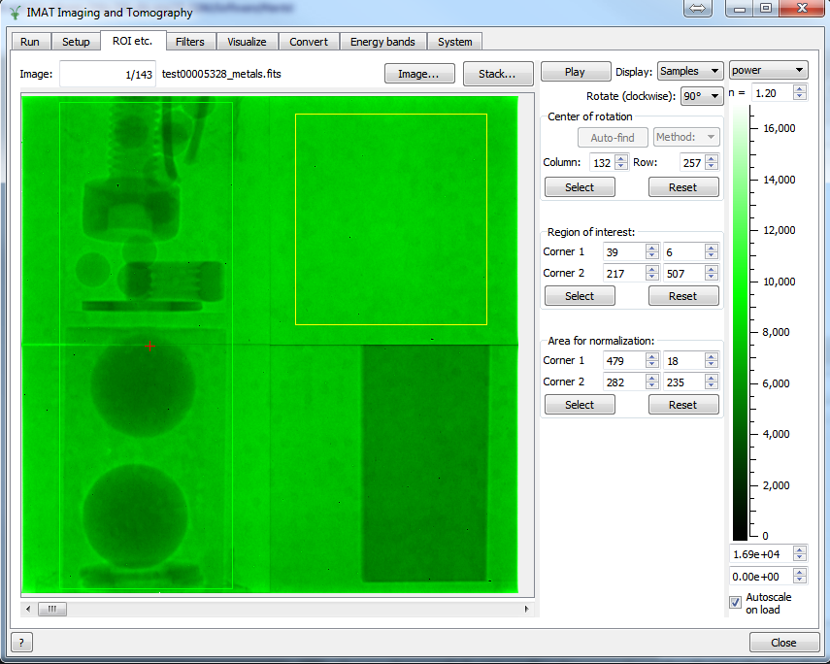
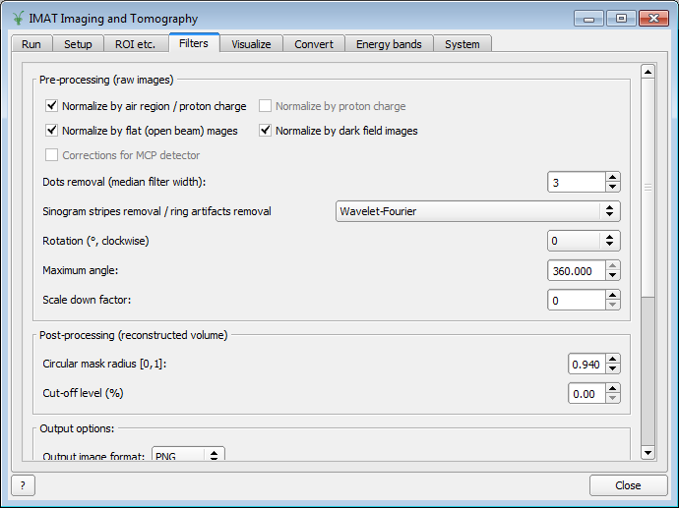
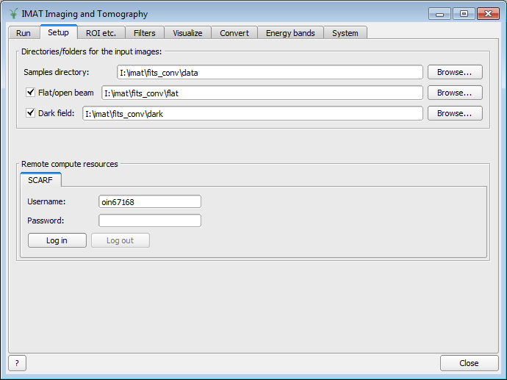
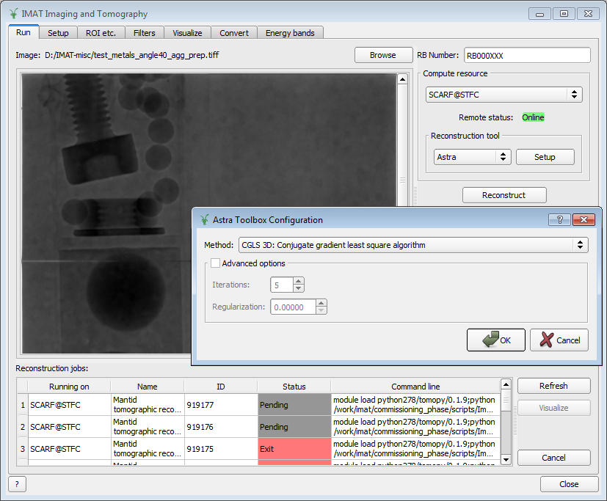





Neutron imaging data processing using the Mantid framework
Nicholas Draper², Federico Montesino Pouzols¹, Dimitar Tasev¹, Sri Nagella³, Erica Yang³, Ahmed Sajid³, John Hill¹, Genoveva Burca¹, Triestino Minniti^{1,4}, Winfried Kockelmann¹,
¹ ISIS Pulsed Neutron and Muon Source, Rutherford Appleton Laboratory, Science & Technology Facilities Council – STFC, Harwell Oxford, OX11 0QX, UK
² Tessella Ltd, Abingdon, Oxfordshire, OX14 3YS, UK
³ Scientific Computing Department, Science & Technology Facilities Council - STFC, Harwell Oxford, OX11 0QX, UK
⁴ CNR-IPCF, Viale Ferdinando Stagno D’Alcontres, n. 37 – 98158, Messina, Italy
Background Interest in neutron imaging in general and energy resolved neutron imaging in particular has been growing in recent years. Several imaging instruments are currently in different stages of planning, construction, commissioning and operation at pulsed neutron sources around the world, such as IMAT¹ at ISIS (UK), ODIN at ESS (Nordic countries), RADEN at J-PARC (Japan), and VENUS at SNS (USA). IMAT (Imaging and Materials Science & Engineering) is undergoing commissioning in 2016 and provides neutron radiography (2D), neutron tomography (3D), energy resolved (fourth dimension) and energy-dispersive neutron imaging. IMAT offers unique time-of-flight diffraction techniques by capitalising on latest image reconstruction procedures and event mode data collection schemes. These features impose several software requirements for data reduction and analysis that differ substantially from other neutron techniques. Frameworks The Mantid software project² provides an extensible framework that supports high-performance computing for data manipulation, analysis and visualisation of scientific data³. Mantid includes several so-called custom interfaces specialized for different scientific areas.. A Mantid custom graphical user interface integrates reconstruction and visualisation capabilities for neutron imaging. This interface gives access to new features of Mantid to load images and stacks of images into standard Mantid data structures and process imaging data. It also provides access to third party software such as packages for tomography reconstruction that support different 3D image reconstruction approaches. Mantid has the capability to run image reconstruction jobs either locally or in compute clusters and supercomputing facilities thereby enabling quick evaluation and refinement of the reconstruction pipeline. Compute resources Within ISIS, the SCARF and Emerald clusters, administered by the Scientific Computing Department at STFC, will allow rapid refinements during the imaging experiments. A key hurdle is the ability to take full advantage of available computing resources. Different facilities frequently choose different job scheduling tools, interfaces and hardware for their computing resources. For example the SCARF cluster at ISIS uses Platform LSF, while the clusters at the SNS use MOAB. The Mantid framework provides the middleware required to control jobs in different computing facilities handling the different job schedulers and/or web service interfaces. The Mantid framework itself can be used through its scripting interface via a web service API. This addresses challenges that arise at different facilities, such as different authentication methods, job schedulers, and location of compute resources. It also enables users to take full advantage of CPU and GPGPU clusters. | Tomography: reconstruction tools The imaging interface being integrated in Mantid supports third party software for 3D image tomographic reconstruction. A number of tools are currently supported and/or being trialed: TomoPy⁴, Astra Tomography Toolbox⁵, and Octopus⁶, and in the future the reconstruction pipeline software Savu⁷ developed by the Diamond light source, and the tool MuhRec⁸ developed by Paul Scherrer Institut. Different reconstruction approaches are thus supported, namely filtered back projection and iterative methods such as simultaneous iterative reconstruction technique, but also variants of these developed in different tools. Mantid also integrates multidimensional visualisation tools that leverage on the VSI (Vates simple interface) and ParaView⁹, providing powerful tools to visualise the ≥4 dimensional data that can result from imaging at a time of flight spallation source. | Pre-/post-processing and visualization Future Mantid and its imaging features are being actively developed. Long-term objectives include dealing with the multiple challenges posed by the complex datasets with three or more dimensions produced by energy-dependent tomography experiments: data volumes, better tailored pre-/post-processing, ease of analysis, etc. Equally important is aiding our users through the process of building their analysis workflows using the new features, and extending the tools on both the visualisation and manipulation and analysis sides where needed. References [1] W. Kockelmann, S.Y. Zhang, J.F. Kelleher, J. B. Nightingale, G. Burca,, J.A. James, (2013). IMAT – A New Imaging and Diffraction Instrument at ISIS, Physics Procedia, 43: 100-110 . [2] www.mantidproject.org [3] O. Arnold, et al., (2014). Mantid—Data analysis and visualization package for neutron scattering and μSR experiments, Nuclear Instruments and Methods in Physics Research Section A, 764(11): 156-166. [4] Gürsoy D, De Carlo F, Xiao X, and Jacobsen C, (2014). TomoPy: a framework for the analysis of synchrotron tomographic data. Journal of Synchrotron Radiation, 21(5):1188–1193. [5] W. van Aarle, W J. Palenstijn, J. De Beenhouwer, T. Altantzis, S. Bals, K. J. Batenburg, and J. Sijbers, (2015). The ASTRA Toolbox, a platform for advanced algorithm development in electron tomography, Ultramicroscopy, 157: 35–47. [6] octopusimaging.eu [7] R. C. Atwood, A. J. Bodey, S. W. T. Price, M. Basham, M. Drakopoulos, (2015). A high-throughput system for high-quality tomographic reconstruction of large datasets at Diamond Light Source, Philosophical Transactions A, 373(2043): 20140398. https://github.com/DiamondLightSource/Savu [8] http://imagingscience.ch/muhrechome/index.html [9] www.paraview.org
The new imaging features of Mantid are being tested with simulated and sample images. Mantid provides a harmonised and simple interface to different, heterogeneous tomographic reconstruction tools and methods and tools which provide a varying degree of support for image pre-processing tasks.
Mantid is being extended with support for several input/output formats and additional parameterization and pre-/post-processing functionality. Several pre-processing tasks that are essential for effective tomographic reconstruction are being integrated, considering different forms of image normalization, filtering and selection of regions of interest.
Mantid imaging interface integrated in the general Mantid graphical user interface with functionality for general manipulation and analysis of neutron data. Support is being added for different data formats (NeXus NXtomo, FITS, TIFF, PNG, etc.) and variants of them, as well as extensions currently being defined for more specific processing of imaging data from IMAT.
Example image (top: single energy band, bottom: average across multiple energy bands) taken for testing purposes with the IMAT MCP detector, on a test beamline at ISIS.
SCREENSHOT NEEDS UPDATE,
BUT APPROX SOMETHING LIKE THIS
Configuration of different filters or pre- and post-processing steps for tomographic reconstruction jobs. This includes different forms of normalization, simple transformations like masks and scale factors, and other filters to enhance reconstruction outputs.
Section of the imaging interface for selection of different image parameters, including center of rotation, regions of interest, normalization region (white beam).
Remote compute resource settings in the imaging interface of Mantid, including parameters and user credentials for remote execution of reconstruction jobs on a HPC platform.
Simplified system architecture of the project ULTRA2 (Ultra High-throughput HPC Platform for Scientific Applications). IMAT instrument will benefit from the high performance computing services provided by this platform. This project, led by the Scientific Computing Department at STFC, aims at providing secure and efficient high performance computing and data services to support operations at ISIS and the Diamond Light Source.
Interface for the submission and control of remote reconstruction jobs. Multiple jobs can be submitted simultaneously, using common and specific parameters, and taking full advantage of the compute resources available on site for rapid in-experiment analysis and also off-site data analysis.

