Slide 1
New MD normalization update
Use TOPAZ single crystal diffraction data (looking at diffuse scattering)
Use vanadium in different “orientations”
Very memory intensive (each vanadium orientation is ~ 21 GB)

Slide 2
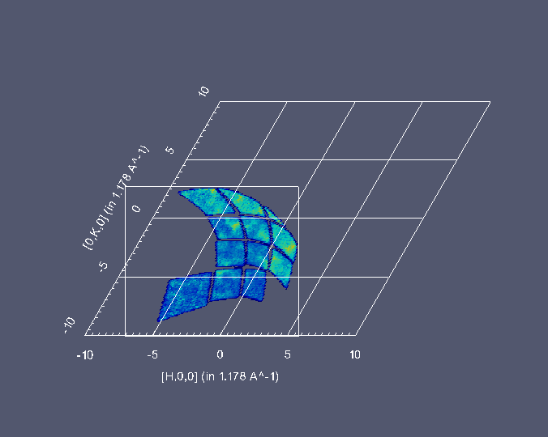
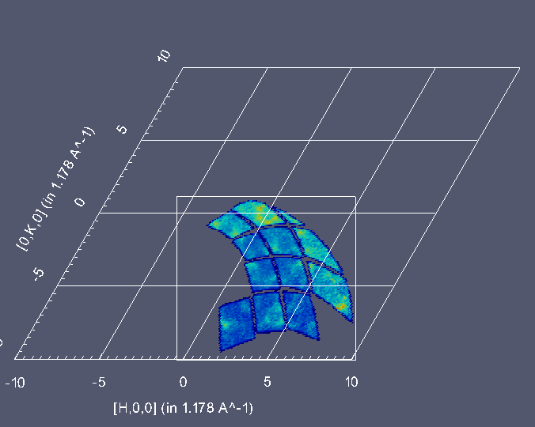
Data

Slide 3
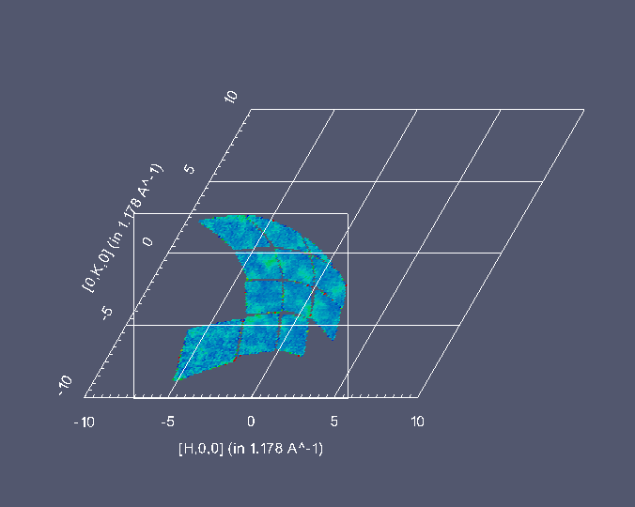
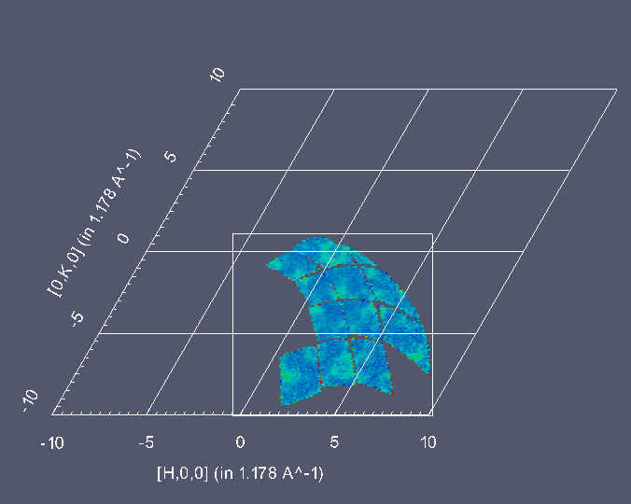
Normalized runs

Slide 4
Normalize then add (l=-3.5)

Slide 5
Normalize then add (l=-4)

Slide 6
Normalize then add (l=-4.5)

Slide 7
Symmetry + Correct normalization (l=-2.5)

Slide 8
Symmetry + Correct normalization (l=-3.5)

Slide 9
Symmetry + Correct normalization (l=-4.5)

Slide 10
Symmetry + Correct normalization (l=4.5)

