Slide 1
New Advanced GUI for Reflectometry at ISIS
Simple, intuitive interface requiring minimal user interaction
Once setting have been chosen, GUI is in ‘autoreduce’ mode and can be minimised
Reduced data should appear as workspaces in MantidPlot for inspection, fitting etc (naming could be set to either run title or naming convention or both – e.g. in a group workspace)
Reduced data should also be automatically saved to a specified location in a specified format.
Simple tab for eventmode filtering
Should generate reduction script for all data (to be used for later re-processing)
GUI could/should be used in conjunction with the web-based ‘autoreduce’

Slide 2
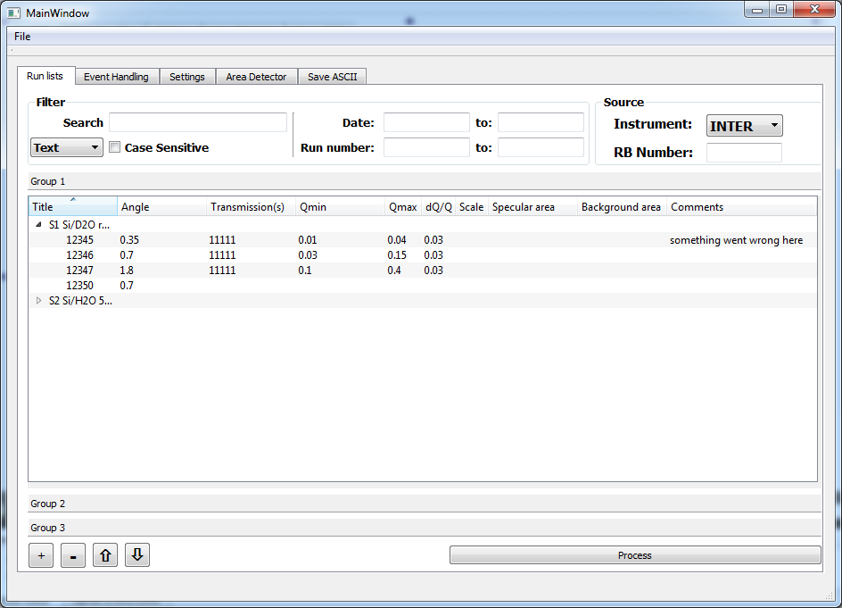
Filtering for finding runs and for specifying which data range should autoreduce.
Tree view, containing individual runs for a given sample.
Main branch is labelled with sample/run title.
Two or three ‘Pages’ in case one experiment has groups of runs with different ‘settings’.
The first ‘Page’ should be automatically populated (autoreduce?). Then, drag and drop into other pages for re-processing with different ‘settings’

Slide 3
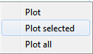
Context menu for plotting, moving to other page etc.
Parameters such as q-ranges, resolution, scaling, transmission run(s) can be edited (changed from defaults) in-line here.
Adding, removing and re-ordering of runs to be processed
Processing individual rows

Slide 4
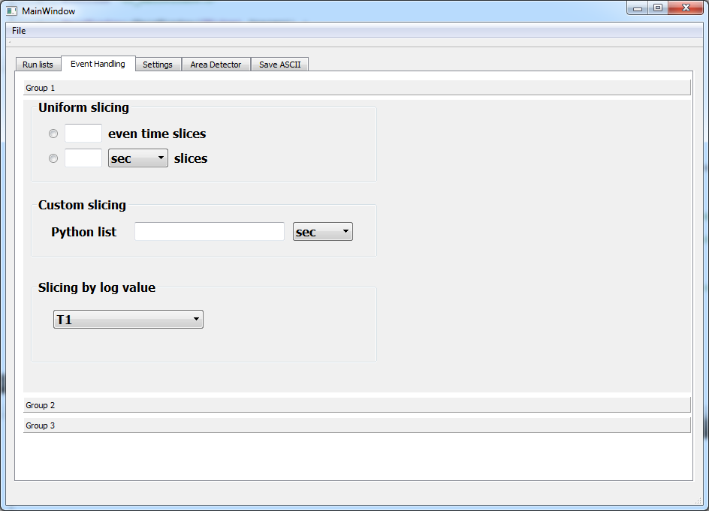
Event mode filtering setting for each ‘page’ (set of runs).

Slide 5
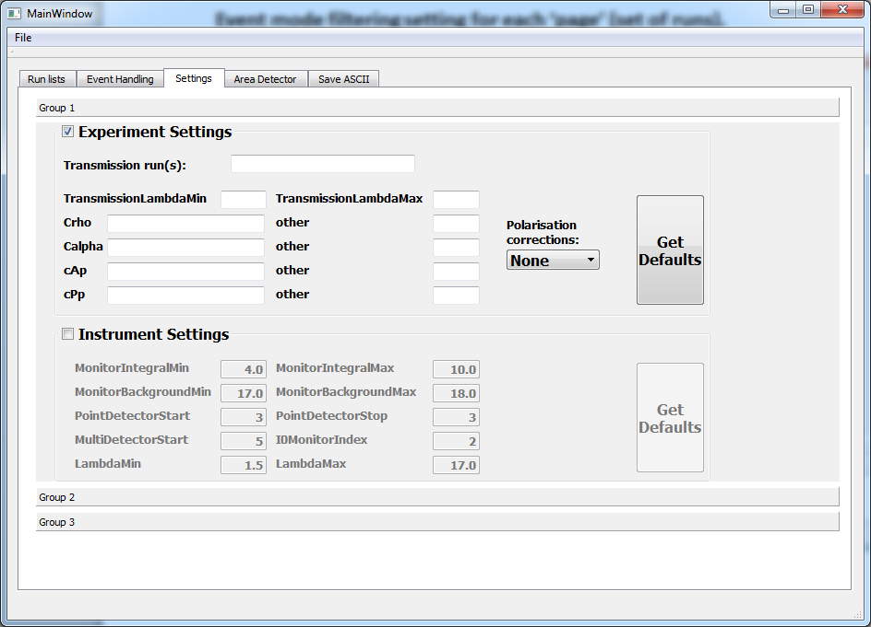
Settings for each ‘page’ (set of runs). Will be pre-populated from IDF/paramter file of selected instrument.

Slide 6
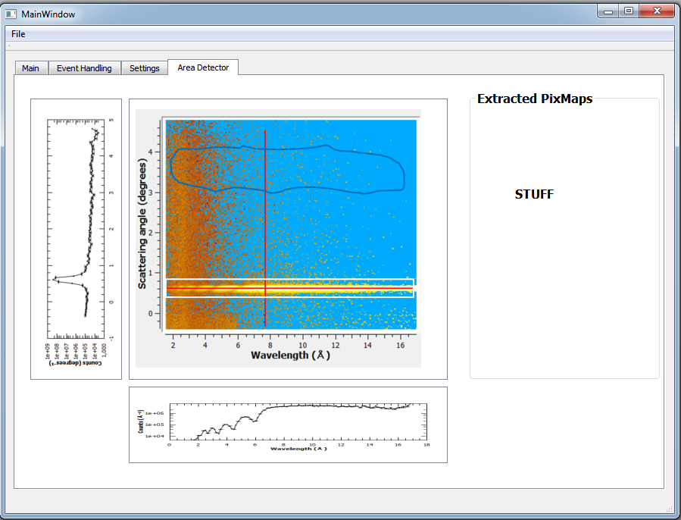
This can be a tab similar to the ‘SliceViewer’, but with improved functionality (irregular pixel ranges, editable cut graphs etc.)
Lots of edit buttons
Background:
Specular:
Flood file:
Mask file:
fully customisable graphs

Slide 7
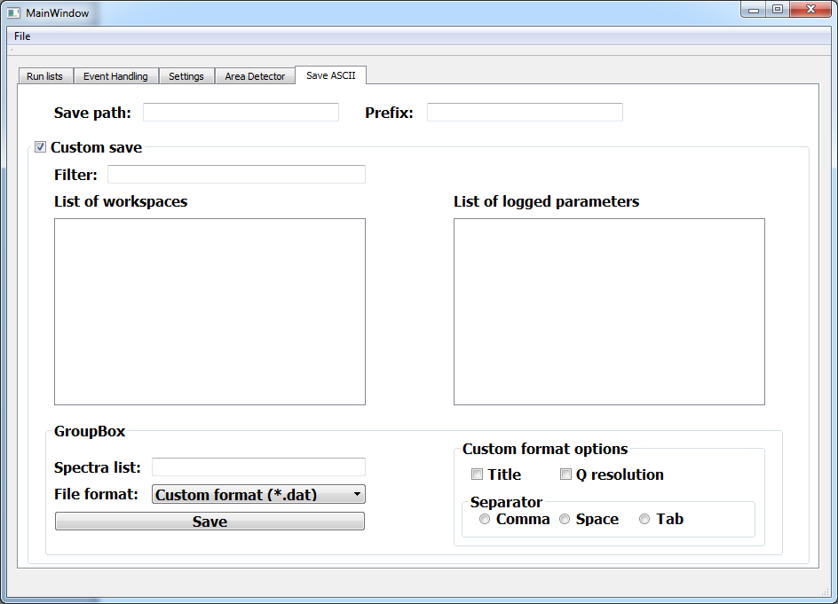
Saving should also happen automatically, at the end of the processing chain, into the specified directory. Separate saving with custom options should also be possible, just as it works now in the Reflectometry GUI.

